Slide 1


Selection – if statements
Produced
by:
Ms. Mairead Meagher,
Ms. Siobhán Roche.
Department of Computing and Mathematics
http://www.setu.ie/
7.0

Slide 2
Upcoming
Conditional statements;
Recap
Examples

Slide 3

Conditionals – the if statement

Slide 4
Making choices in everyday life
If I have an assignment to complete, then I shall work on my assignment
Have I work to do?
Just Do it!
Yes

Slide 5
Conditional Statement Syntax (1)
if(condition1…perform some test)
{
Do these statements if the test gave a true result
}

Slide 6
Making a choice in the ticket machine (1)
public void insertMoney(int amount)
{
if(amount > 0) {
balance = balance + amount;
}
}
the conditional statement avoids an inappropriate action

Slide 7
Making choices in everyday life (2)
If I have an assignment to complete, then I shall work on my assignment
Otherwise I will go to the Gym
Have I work to do?
Just Do it!
Yes
No
Go to Gym

Slide 8
Conditional Statement Syntax (2)
boolean condition to be tested
‘if’ keyword
actions if condition is true
if(condition1…perform some test) {
Do these statements if the test gave a true result
}
else {
Do these statements if the test gave a false result
}
actions if condition is false
‘else’ keyword

Slide 9
Making a choice in the ticket machine (2)
public void insertMoney(int amount)
{
if(amount > 0) {
balance = balance + amount;
}
else {
System.out.printf( "Use a positive amount: %d%n", amount);
}
}
the conditional statement avoids an inappropriate action

Slide 10
Making choices in everyday life (3)
If I have an assignment to complete, then I shall work on my assignment
Otherwise if I am a member of a gym, go to the gym
Otherwise I will go for a run
Have I work to do?
Just Do it!
Yes
No
Am I a member of a gym?
Go to the gym
Yes
No
Go for a run

Slide 11
Conditional Statement Syntax (3)
if(condition1…perform some test)
{
Do these statements if condition1 gave a true result
}
else if(condition2…perform some test)
{
Do these statements if condition1 gave a false result and condition2 gave a true result
}
else
{
Do these statements if both condition1 and
condition2 gave a false result
}
Notes:
You can half multiple ocurences of “else if”

Slide 12
Making a choice in the ticket machine (3)
public void specialOffer(int amount)
{
if(amount >100) {
balance = balance + 50;
}
else if (amount > 50){
balance = balance + 25;
}
else amount = amount + 5;
}
Note that if any condition is true, the associated statements are executed AND the if statement is finished.

Slide 13
Boolean conditions
A boolean condition is an expression that evaluates to either true or false e.g.
price < 50
An if statement evaluates a boolean condition and its result will determine which portion of the if statement is executed.

Slide 14
Boolean conditions
// Do these statements before.
if (boolean condition)
{
// Perform this clause if the
// condition is true.
}
// Do these statements after.

Slide 15
Java Relational Operators
Operator | Use | Returns true if…
> | op1 > op2 | op1 is greater than op2
>= | op1 >= op2 | op1 is greater than or equal to op2
< | op1 < op2 | op1 is less than to op2
<= | op1 <= op2 | op1 is less than or equal to op2
== | op1 == op2 | op1 and op2 are equal
!= | op1 != op2 | op1 and op2 are not equal
BEWARE = is an assignment operator.
It doesn’t test for equality. Use == to test for equality in primitive types
Source: http://www.freejavaguide.com/relational_operators.htm

Slide 16
Some notes on the if statement
An if statement IS a statement; it is only executed once.
When your if statement only has one statement inside it, you do not need to use the curly braces.
For example, both of these are the same:
if (price < 50)
{
price = 50;
}
if (price < 50)
price = 50;
Notes:
But I would advise to use use them to avoid errors when updating programs later.

Slide 17
Some notes on the if statement
The semi-colon (;) is a statement terminator.
if (price < 50)
{
rect(0, 0, 50, 100) ;
}
No semi-colon needed here
No semi-colon needed here
Semi-colon IS needed here
Notes:
Why?
A simple statement ends in a semi colon
A compound statement is a collection of statement surround by curly braces
An if statement is the if keyword followed by a condition in brackets followed by compound statement

Slide 18
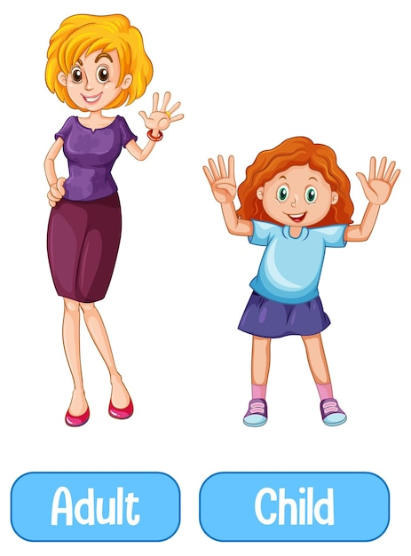
Conditional Example 1– Child or Adult?
Functionality:
Anyone less than 19 is a child and everyone else is an adult
age < 19 - child
Otherwise adult

Slide 19
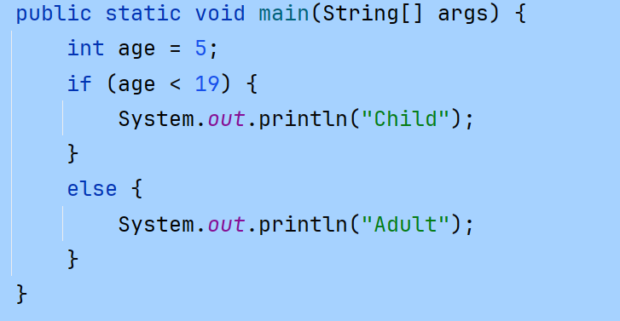


Conditional Example 1 - code
Notes:
QUESTION: Replace the x value in the rect() function call with a statement that calculates the width of the rectangle to draw
//Reas, C. & Fry, B. (2014) Processing – A Programming Handbook for Visual Designers and Artists, 2nd Edition, MIT Press, London.
void setup() {
size(100, 100);
noStroke();
fill(0);
}
void draw() {
background(204);
if (mouseX < 50) {
rect(0, 0, 50, 100); // Left
} else {
rect(50, 0, 50, 100); // Right
}
}

Slide 20
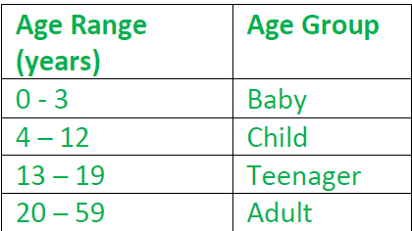

Conditional Example 2 – Introduce more age groups
Functionality:
If the age is
< 4 Baby
< 13- Child
< 19 – Teenager
Otherwise Adult

Slide 21
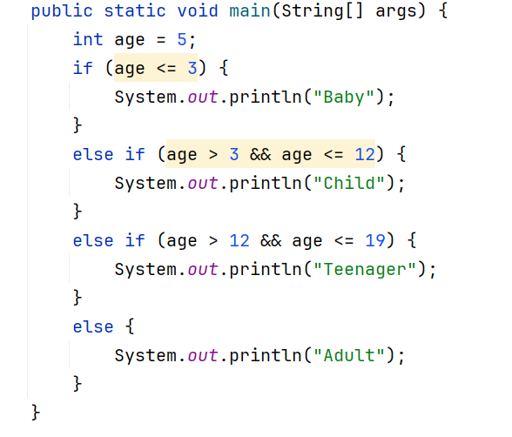
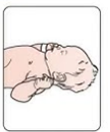

Conditional Example 2 - code

Slide 22
Conditional Example 2 – different values
What happens when the value of age changes to:
2
5
14
21

Slide 23
Simple Boolean Conditions
if (age < 19)
if (age < 4)
else if (age < 13)
else if (age < 20)
else
else

Slide 24
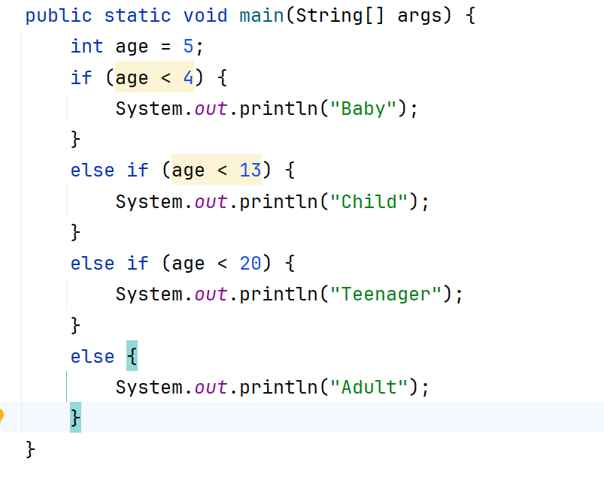
Conditional Example 2 - better code
Remember when a condition is true, once the stmt is executed, the if stmt is terminated

Slide 25

Questions?

