Slide 1

Gym App V1
New App (with Validation)
Produced
by:
Dr. Siobhán Drohan,
Ms. Mairead Meagher,
Ms. Siobhán Roche.
Department of Computing and Mathematics
http://www.setu.ie/

Slide 2

Gym App
Version 1.0

Slide 3
Gym App V1.0
Driver
GymMember

Slide 4
Gym App V1.0
Driver
The GymMember class stores details about a single member of a gym i.e.:
name
height
weight
membershipNumber
if they are current members or not? (i.e. have they paid their membership fee)
GymMember

Slide 5
Gym App V1.0
Driver
The Driver class:
has the main() method.
reads the gym member details from the user (via the console)
creates a new GymMember object.
prints the gym member details from the object (to the console)
GymMember

Slide 6
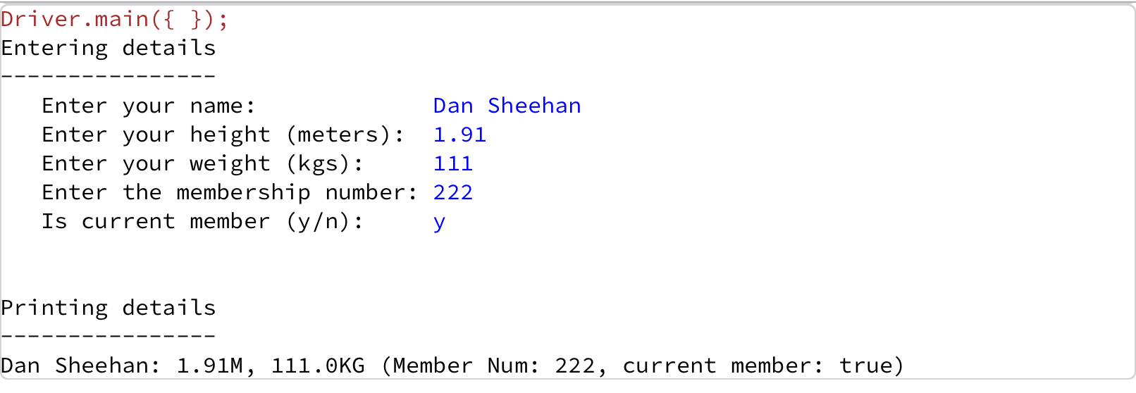
Gym App V1.0 – Sample I/O

Slide 7
Encapsulated Class:
GymMember

Slide 8
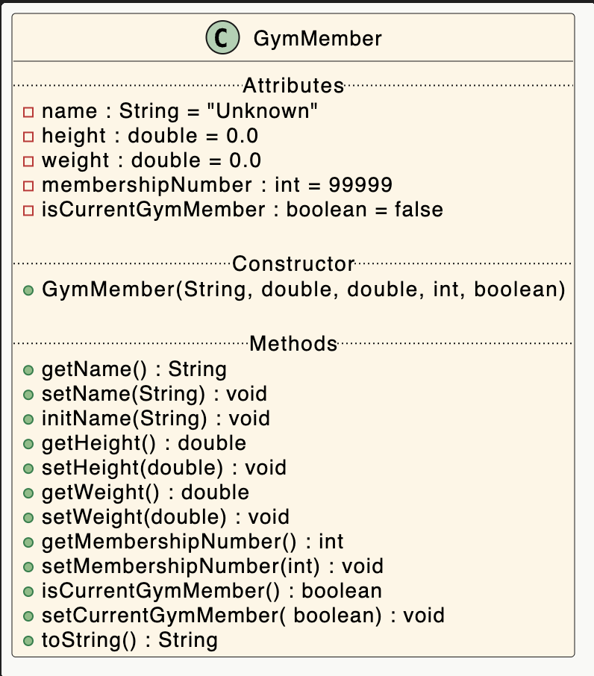
A GymMember Class…
Object Type/ Class Name
i.e. GymMember
The C icon means it is a Class.
Fields/Attributes
The green circle means it is public.
The red box means it is private.

Slide 9
A GymMember Class…Constructor
Constructor i.e. for building objects.
The green circle means it is public.
Constructors have same name as the class
Five parameters; one for each field.

Slide 10
A GymMember Class…Fields and Constructor
private String name = "Unknown"; private double height = 0.0 private double weight = 0.0; private int membershipNumber = 99999;
private boolean isCurrentGymMember = false; public GymMember(String name, double height, double weight, int membershipNumber, boolean isCurrentGymMember) { initName(name); setHeight(height); setWeight(weight); setMembershipNumber(membershipNumber); setCurrentGymMember(isCurrentGymMember); }

Slide 11
A GymMember Class…methods
Methods i.e. the behaviours of the class

Slide 12
A GymMember Class…methods
Return type
Method name

Slide 13
A GymMember Class…getters
getters
Note the different naming standard for a boolean field getter

Slide 14
Getters (Accessor Methods)
Accessor methods
return information about the state of an object
i.e. the values stored in the fields.
A ‘getter’ method
is a specific type of accessor method and typically:
contains a return statement (as the last executable statement in the method).
defines a return type.
does NOT change the object state.

Slide 15
Getters
return type
visibility modifier
method name
parameter list (empty)
public double getHeight()
{
return height;
}
return statement
start and end of method body (block)

Slide 16
A GymMember Class…getters
public String getName() { return name; } public double getHeight() { return height; } public double getWeight() { return weight; } public int getMembershipNumber() { return membershipNumber; } public boolean isCurrentGymMember() { return isCurrentGymMember; }

Slide 17
A GymMember Class…setters
setters

Slide 18
Setters (Mutator methods)
Mutator methods
change (i.e. mutate!) an object’s state.
A ‘setter’ method
is a specific type of mutator method and typically:
contains an assignment statement
takes in a parameter
changes the object state.

Slide 19
Setters – without validation
return type
visibility modifier
method name
parameter
public void setHeight(double height)
{
this.height = height;
}
Instance field
being mutated
assignment
statement
Value passed
as a parameter

Slide 20
Setters – with validation
return type
visibility modifier
method name
parameter
public void setHeight(double height)
{
if ((height >= 0) && (height <= 3.0)){
this.height = height;
}
Validation of value
passed as a
parameter
Instance field
being mutated
Value passed
as a parameter

Slide 21
A GymMember Class…special case for Strings in Constructor
public void initName(String name) { if (name != null){ if (name.length() > 30) this.name = name.substring(0,30); else this.name = name; } }
This is used in the constructor instead of the setter (setName()). This is because we assume that the name is somewhat correct (just too long)
We will always used this technique for Strings

Slide 22
A GymMember Class…setters
public void setName(String name) { if (name != null){ if (name.length() <= 30) this.name = name; } }

Slide 23
A GymMember Class…setters
public void setHeight(double height) { if ((height >= 0) && (height <= 3.0)) { this.height = height; } }
public void setWeight(double weight) { if ((weight >= 0) && (weight <= 500)) { this.weight = weight; } }

Slide 24
A GymMember Class…setters
public void setMembershipNumber(int membershipNumber) { if ((membershipNumber > 0) && (membershipNumber < 99999)) { this.membershipNumber = membershipNumber; } }
public void setCurrentGymMember(boolean currentGymMember) { isCurrentGymMember = currentGymMember; }

Slide 25
Getters/Setters
For each instance field in a class, you are normally asked to write:
A getter
Return statement
A setter
Assignment statement

Slide 26
A GymMember Class…toString
toString():
Builds and returns a String containing a user-friendly representation of the object state.

Slide 27

A GymMember Class…toString
@Override public String toString() { return name + ": " +
height + "M, " +
weight + "KG (Member Num: " +
membershipNumber + ", current member: " + isCurrentGymMember + ")"; }
Sample Console Output :
Sample Console Output if we don’t have a toString written for GymMember:

Slide 28
toString()
This is a useful method and you will write a toString() method for most of your classes.
When you print an object, Java automatically calls the toString() method e.g.
GymMember gymMember = new GymMember();
//both of these lines of code do the same thing
System.out.println(gymMember);
System.out.println(gymMember.toString());

Slide 29
Encapsulationrecap
GymMember

Slide 30
Encapsulation in Java – steps 1-3
Encapsulation Step | Approach in Java
1. Wrap the data (fields) and code acting on the data (methods) together as single unit. | public class ClassName { Fields Constructors Methods }
2. Hide the fields from other classes. | Declare the fields of a class as private.
3. Access the fields only through the methods of their current class. | Provide public setter and getter methods to modify and view the fields values.
http://www.tutorialspoint.com/java/java_encapsulation.htm

Slide 31
A GymMember Class… An Encapsulated Class
1. GymMember class wraps the data (fields) and code acting on the data (methods) together as single unit.

Slide 32
A GymMember Class… An Encapsulated Class
1. GymMember class wraps the data (fields) and code acting on the data (methods) together as single unit.
2. Fields are hidden from other classes.

Slide 33
A GymMember Class… An Encapsulated Class
1. GymMember class wraps the data (fields) and code acting on the data (methods) together as single unit.
2. Fields are hidden from other classes.
3. Access the fields only through the methods of Product (e.g. getter and setter methods).

Slide 34
User I/O
Driver

Slide 35
Using the GymMember Class
1
private GymMember gymMember;
gymMember
Declaring an object gymMember, of type GymMember.
null

Slide 36
Using the GymMember Class
1
private GymMember gymMember;
gymMember
Declaring an object gymMember, of type GymMember.
2
gymMember = new GymMember(“Joe Soap”, 1.8, 175, 12001, true);
gymMember
name
“Joe Soap”
Calls the GymMember constructor to build the gymMember object in memory.
height
1.8
weight
175
membershipNumber
12001
isCurrentGymMember
true

Slide 37
Multiple GymMember objects
private GymMember gymMember = new GymMember(“Joe Soap”, 1.8, 175, 12001, true);
gymMember
gymMember
name
“Joe Soap”
height
1.8
weight
175
membershipNumber
12001
isCurrentGymMember
true

Slide 38
Multiple GymMember objects
private GymMember gymMember = new GymMember(“Joe Soap”, 1.8, 175, 12001, true);
private GymMember gymMember2 = new GymMember(“Mary Lee”, 1.5, 125, 12002, false);
gymMember
gymMember2
gymMember
gymMember2
name
“Joe Soap”
name
“Mary Lee”
height
1.8
height
1.5
weight
175
weight
125
membershipNumber
12001
membershipNumber
12002
isCurrentGymMember
true
isCurrentGymMember
false

Slide 39
import java.util.Scanner; public class Driver { private Scanner input = new Scanner(System.in); private GymMember gymMember; public static void main(String[] arg) { new Driver(); } public Driver() { addGymMember(); printGymMember(); }
// addGymMember () code
// printGymMember() code
}
Driver Class

Slide 40
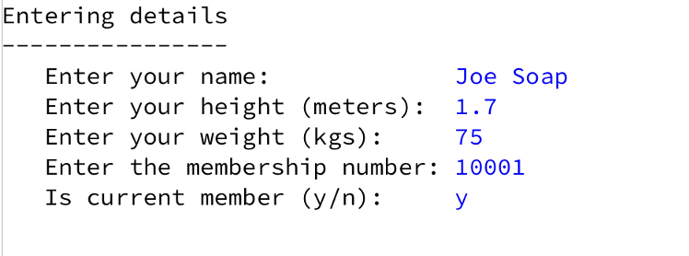
private void addGymMember() { //obtaining the data from the user System.out.println("Entering details"); System.out.println("----------------"); System.out.print(" Enter your name: "); String name = input.nextLine(); System.out.print(" Enter your height (meters): "); double height = input.nextDouble(); System.out.print(" Enter your weight (kgs): "); double weight = input.nextDouble(); System.out.print(" Enter the membership number: "); int membershipNumber = input.nextInt(); System.out.print(" Is current member (y/n): "); char isCurrentMemberChar = input.next().charAt(0); boolean isCurrentMember = false; if ((isCurrentMemberChar == 'Y') || (isCurrentMemberChar == 'y')) { isCurrentMember = true; } gymMember = new GymMember(name, height, weight, membershipNumber, isCurrentMember); }
Driver Class

Slide 41
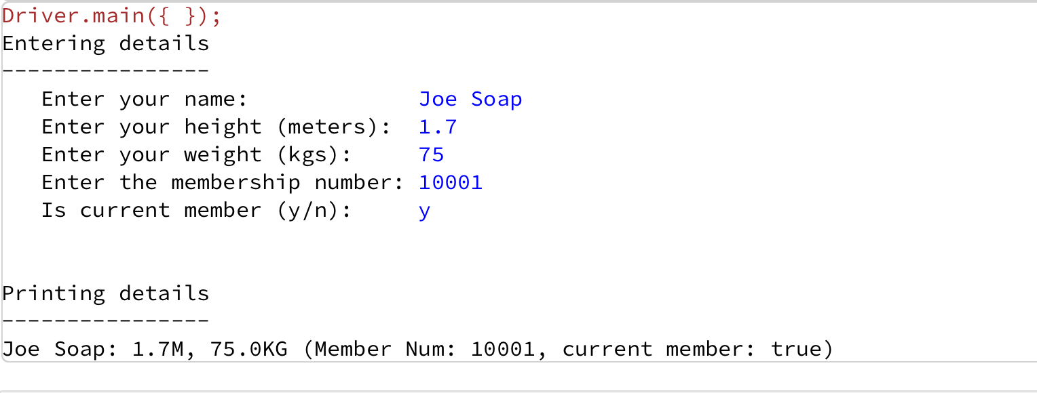
private void printGymMember() { //printing out the data to the user System.out.println("\n\nPrinting details"); System.out.println("----------------"); System.out.println(gymMember); }
Driver Class

Slide 42

Questions?

