Slide 1

Using Methods
More on writing methods
Produced
by:
Dr. Siobhán Drohan
Mr. Colm Dunphy
Ms Mairead Meagher
Ms Siobhan Roche
Department of Computing and Mathematics
setu.ie

Slide 2
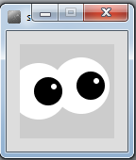
Topics list
RECAP: Method Terminology:
Method examples – return values
Celcius / Farenheit Converter.
Cubed
Product
Overloading methods.
Recursion.

Slide 3
Simple Methods
A method is a named block of code, that can be invoked later
Method named
Public void printHello () {
System.out.println("Hello!");
}

Slide 4
Method terminology
Method signature / header
void printHello()
{
System.out.println(“Hello”);
}
Method body

Slide 5
Method signature
Return type
Method name
Parameter list
void printHello()

Slide 6
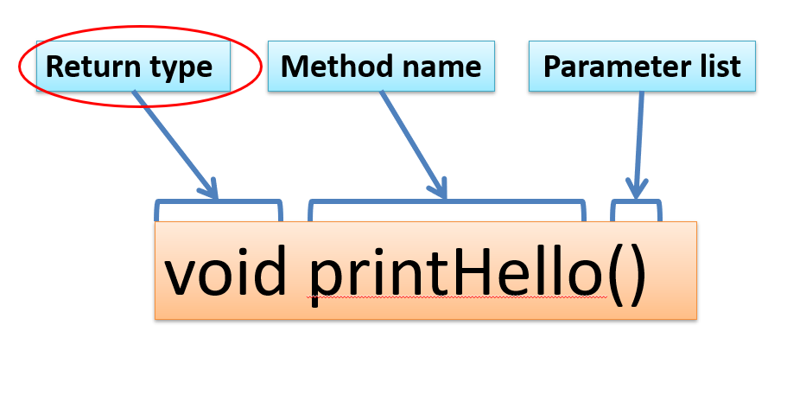
Return Type
Methods can return information.
The void keyword just before the method name means that nothing is returned from the method.
When a data type (e.g. int) appears before the method name, this means that something is returned from the method.
Within the body of the method, you use the return statement to return the value.
int timesTwo(int number)
{
number = number * 2;
return number;
}

Slide 7
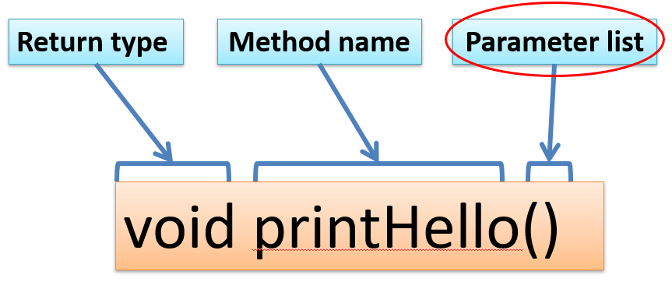
Parameter list
Methods take in data via their parameters.
Methods do not have to pass parameters
A parameter is a variable declaration –
it has a type (e.g. int) and a name (e.g. num).
If a method needs additional information to execute, we provide a parameter, so that the information can be passed into it.
Methods can have any number of parameters
int timesTwo(int number)
{
number = number * 2;
return number;
}

Slide 8
Topics list
RECAP: Method Terminology:
Method examples – return values
Celcius / Farenheit Converter.
Cubed
Product
Overloading methods.
Recursion.

Slide 9
Return a double
Now we consider an example where the method does return a value (which could be any data type) but in this next example it returns a double

Slide 10
Example – Farenheit to Celsius
double celsius = farenheitToCelsius (451.0);
System.out.println("Celsius value is: " + celsius);
Farenheit value is hardcoded as a literal.
232.77779
Celsius value is: 232.77779
Return type
double farenheitToCelsius (double farenheit)
{
double result = (farenheit - 32.0) * (5.0/9.0);
return result;
}
451.0
232.77779
451.0
Source: Reas & Fry (2014)

Slide 11
Example – Updated
double farenheitToCelsius (double farenheit)
{
double result = (farenheit - 32.0) * (5.0/9.0);
return result;
}
both methods are exactly the same
double farenheitToCelsius (double farenheit)
{
return (farenheit - 32.0) * (5.0/9.0);
}
Source: Reas & Fry (2014)

Slide 12
Topics list
RECAP: Method Terminology:
Method examples – return values
Celcius / Farenheit Converter.
Cubed
Product
Overloading methods.
Recursion.

Slide 13
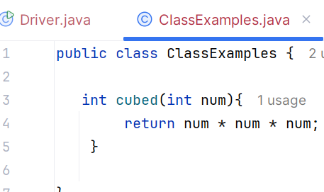
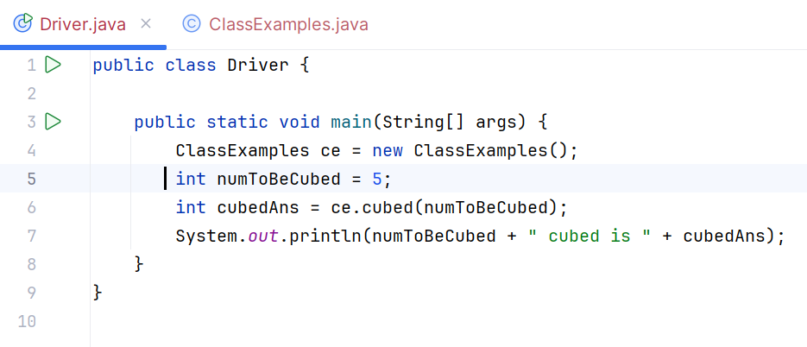
Example: Cubed
5
5
5
5
125
Return type
Notes:
// Cubed
void setup ()
{
size(1024,768);
textSize(40);
fill(0,0,255);
}
void draw()
{
int number = 5;
text (number + " cubed is " + cubed(number), 100,100 );
}
int cubed (int num)
{
return num * num * num ;
}

Slide 14
Topics list
RECAP: Method Terminology:
Method examples – return values
Celcius / Farenheit Converter.
Cubed
Product
Overloading methods.
Recursion.

Slide 15
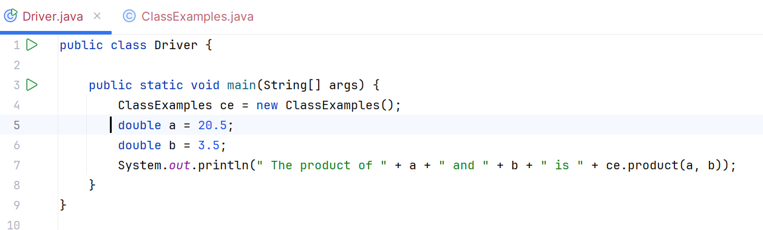
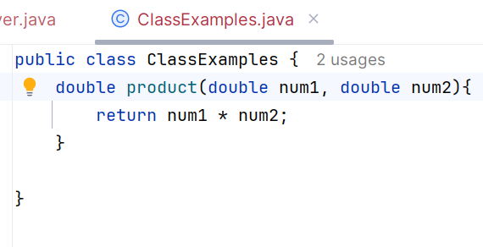
Example: Product
Return type
Notes:
// Cubed
void setup ()
{
size(1024,768);
textSize(40);
fill(0,0,255);
}
void draw()
{
int number = 5;
text (number + " cubed is " + cubed(5), 100,100 );
}
int cubed (int num)
{
return num * num * num ;
}

Slide 16

Questions?

