Slide 1

Introduction to JVM
Java Virtual Machine and the main method
Produced
by:
Dr. Siobhán Drohan,
Ms. Mairead Meagher,
Ms. Siobhán Roche.
Department of Computing and Mathematics
http://www.setu.ie/

Slide 2
Topics list
Files in Java.
Java Virtual Machine (JVM).
main() method.

Slide 3
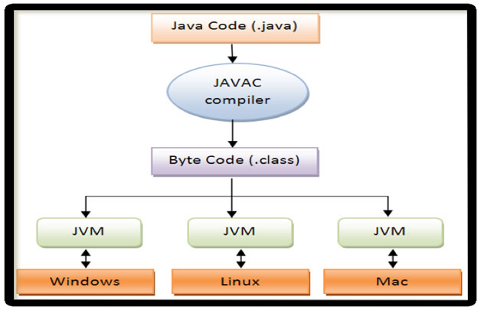
Files in Java
Java code is written in .java file.
code contains one or more Java language constructs e.g. Classes, Methods, Variable, Objects etc.
Compiling this code generates a .class file
A .class file
“byte code”
the input to Java Virtual Machine (JVM)
The JVM (for a specific platform)
reads this byte code
interprets it as machine code instructions (for that platform)
and executes the program (on that platform)
http://viralpatel.net/blogs/java-virtual-machine-an-inside-story/

Slide 4
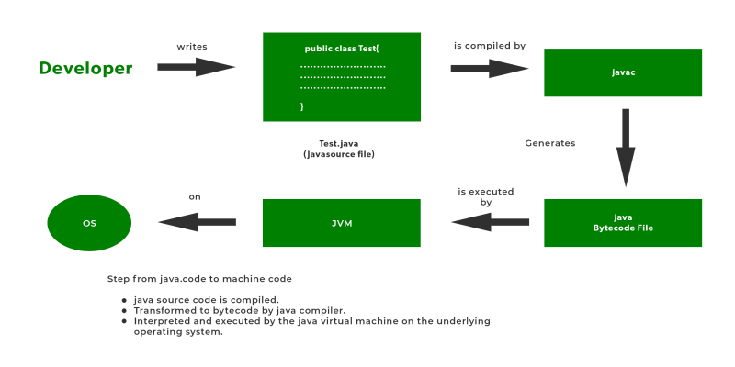
Development Process
https://dev.to/leetcode/what-happens-when-we-run-a-java-code-1p8i

Slide 5
Topics list
Files in Java.
Java Virtual Machine (JVM).
main() method.

Slide 6
Java Virtual Machine (JVM)
Java Virtual Machine (JVM)
is a “virtual” computer that resides in the “real” computer as a software process.
E.g. JVM for windows, for OSX, Linux etc.
The JVM gives Java the flexibility of platform independence.
The .class files can be run on any OS, once a JVM has been installed
(NB: JVM is installed when you install the JDK).
http://viralpatel.net/blogs/java-virtual-machine-an-inside-story/

Slide 7






Java Virtual Machine (JVM)
Windows
JVM
Linux
JVM
Source code
.java
Java
Compiler
Byte code
.class
Apple
JVM
Platform Specific JVMs

Slide 8
Topics list
Files in Java.
Java Virtual Machine (JVM).
main() method.

Slide 9
main() method
When you want to run a java project, the Java Virtual Machine (JVM) invokes the main() method in the project.
For the JVM to recognise it, the main() method must have a specific method signature.
public static void main(String[] args) {
... }

Slide 10
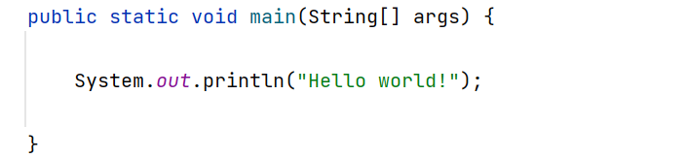
main() method - signature
“main” must exist
“main” must be public
“main” must be static (class method)
“main” must have a String array parameter
Only “main” can be invoked automatically.

Slide 11
The main() method typically…
public static void main(String[] args)
{
Driver driver= new Driver();
driver.runMenu();
}
Creates an object
Calls the first method

Slide 12

Questions?

