Slide 1


Objects First with JAVA
A Practical Introduction using BlueJ
DAVID J. BARNES • MICHAEL KÖLLING
Produced
by:
Ms. Mairead Meagher,
Ms. Siobhán Roche.
Department of Computing and Mathematics
http://www.setu.ie/

Slide 2
Course Contents
Introduction to object-oriented programming…
…with a strong software engineering foundation…
…aimed at producing and maintaining large, high-quality software systems.

Slide 3
Terminology
inheritance
responsibility-driven design
encapsulation
iterator
overriding
coupling
abstraction
cohesion
interface
javadoc
class
collection class
mutator
lambda
stream
instance
polymorphic method call

Slide 4
Goals
Sound knowledge of programming principles
Sound knowledge of object-orientation
Able to implement a small software system in Java

Slide 5
Book
David J. Barnes & Michael Kölling Objects First with Java A Practical Introduction using BlueJ 7th edition, Pearson Education, 2025

Slide 6
Overview
Objects and classes
Understanding class definitions
Object interaction
Grouping objects
Functional programming style
More sophisticated behavior - libraries
Designing classes
Teamwork

Slide 7
Overview
Data-oriented classes
A brief history of Java
Handling errors
Designing applications

Slide 8
Classes and objects
Fundamental to much of the early parts of this course.
Class: category or type of ‘thing’. Like a template or blueprint.
Object: belongs to a particular class and has individual characteristics.
Explore through BlueJ …

Slide 9
Fundamental concepts
object
class
method
parameter
data type
It is vital to understand these concepts as soon as possible.

Slide 10
Classes and Objects
A class
represents all similar objects of a kind (example: “car”)
objects
represent ‘things’ from the real world, or from some problem domain;
example: “that red car in the parking lot”.

Slide 11
Methods and Parameters
Objects have operations which can be invoked (Java calls them methods).
Methods may have parameters to receive additional information needed to execute.
Parameters introduce variation into the effect of method calls.

Slide 12
Other observations
Many distinct instances can be created from a single class.
An object has attributes: values stored in fields.
The class defines what fields an object has, but each object stores its own set of values (the state of the object).

Slide 13
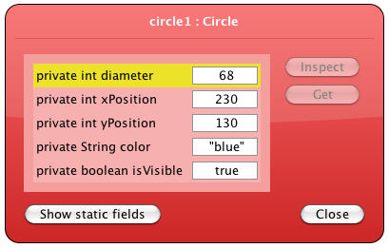
State

Slide 14
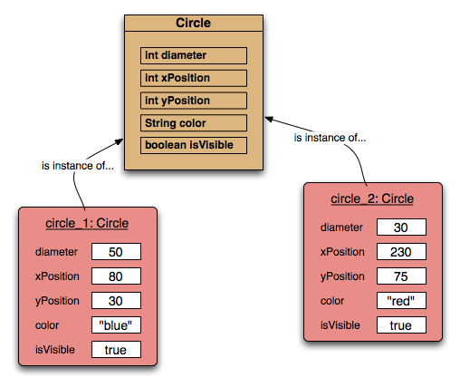
Two Circle objects

Slide 15
Source code
Each class has source code associated with it that defines its details (attributes and methods).
The source code is written to obey the rules of a particular programming language.

Slide 16
Return values
All the methods in the figures project have void return types; but …
… methods may return a result via a return value.
Such methods have a non-void return type.
More on this later..

Slide 17
Review
Classes model concepts.
Source code realises those concepts.
Source code defines
What objects can do (methods).
What data they store (attributes).
Objects come into existence with pre-defined attribute values.
The methods determine what objects do with their data.

Slide 18
Review
When a method is called an object:
Alters its state, and/or
Uses its data to decide what to do.
Some methods take parameters that affect their actions.
Methods without parameters typically use their state to decide what to do.
Some methods return a value.

Slide 19
Review
Most programs contain multiple classes.
At runtime, objects interact with each other to realize the overall purpose of the program.

Slide 20

Questions?

