Slide 1


Variables, Data Types & Arithmetic Operators
Produced
by:
Ms. Mairead Meagher,
Ms. Siobhán Roche.
Department of Computing and Mathematics
http://www.setu.ie/
7.0

Slide 2
Topics list
Variables.
Data Types.
Java’s Primitive Data Types
Whole numbers.
Decimal numbers.
Others.
Arithmetic operators.

Slide 3
Variables
In Programming, variables:
are created (defined) in your programs.
are used to store data (whose value can change over time).
have a data type.
have a name.
are a VERY important programming concept.

Slide 4
Variable names…
Are case-sensitive.
Begin with either:
a letter (preferable),
the dollar sign "$", or
the underscore character "_".
Can contain letters, digits, dollar signs, or underscore characters.
Can be any length you choose.
Must not be a keyword or reserved word e.g. int, while, etc.
Cannot contain white spaces.
https://docs.oracle.com/javase/tutorial/java/nutsandbolts/variables.html
Notes:
We will name our variables beginning with a letter and typically containing only letters (no special characters).
CamelCase for variables and function names that have multiple words. We capitalize each word except the first

Slide 5
Variable names should be carefully chosen
Use full words instead of cryptic abbreviations e.g.
variables named speed and gear are much more intuitive than abbreviated versions, such as s and g.
If the name consists of:
only one word,
spell that word in all lowercase letters e.g. ratio.
more than one word,
capitalise the first letter of each subsequent word e.g. gearRatio and currentGear.
This is called camelCase
https://docs.oracle.com/javase/tutorial/java/nutsandbolts/variables.html

Slide 6
Kinds of variables so far
Fields are one sort of variable.
They store values through the life of an object.
They are accessible throughout the class.
Parameters are another sort of variable:
They receive values from outside the method.
They help a method complete its task.
Each call to the method receives a fresh set of values.
Parameter values are short lived.

Slide 7
Topics list
Variables.
Data Types.
Java’s Primitive Data Types
Whole numbers.
Decimal numbers.
Others.
Arithmetic operators.

Slide 8
Data Types
In Java, when we define a variable, we have to give it a data type.
The data type defines the kinds of values (data) that can be stored in the variable e.g.
- 456
2
45.7897
I Love Programming
S
true
The data type also determines the operations that may be performed on it.
Notes:
Operations…e.g. I cannot divide “I Love Programming” by ‘S’.
E.g. Mathematical operations are only available on numeric types.
E.g. I cannot add ‘S’ to true.

Slide 9
Data Types
Java uses two kinds of data types:
Primitive types
Object types
We are only looking at Primitive types now; we will cover Object types later in the module.

Slide 10
Topics list
Variables.
Data Types.
Java’s Primitive Data Types
Whole numbers.
Decimal numbers.
Others.
Arithmetic operators.

Slide 11
Java’s Primitive Data Types
Java programming language supports eight primitive data types.
A primitive type is predefined by the language and is named by a reserved keyword.
A primitive type is highlighted red when it is typed into the PDE e.g.
int numberOfItems;
boolean isAlive
float sizeOfSquare;

Slide 12
Topics list
Variables.
2. Data Types.
3. Java’s Primitive Data Types
Whole numbers.
Decimal numbers.
Others.
4. Arithmetic operators.

Slide 13
Java’s Primitive Data Types (whole numbers)
Type | Byte-size | Minimum value (inclusive) | Maximum value (inclusive) | Typical Use
byte | 8-bit | -128 | 127 | Useful in applications where memory savings apply.
short | 16-bit | -32,768 | 32,767
int | 32-bit | -2,147,483,648 | 2,147,483,647 | Default choice.
long | 64-bit | -9,223,372,036,854,775,808 | 9,223,372,036,854,775,807 | Used when you need a data type with a range of values larger than that provided by int.
Notes:
I usually show them how the minimum and max values for byte are calculated e.g.
8-bit is 2 to the power of 8 = 256
To spread this value over the negative/positive number range, divide by two = 128. so -128 range up to +127, with 0 being on the “positive size”.
Then they can always work out the min/max values for the other whole numbers.

Slide 14
TO HERE – add from 24 data types®

Slide 15
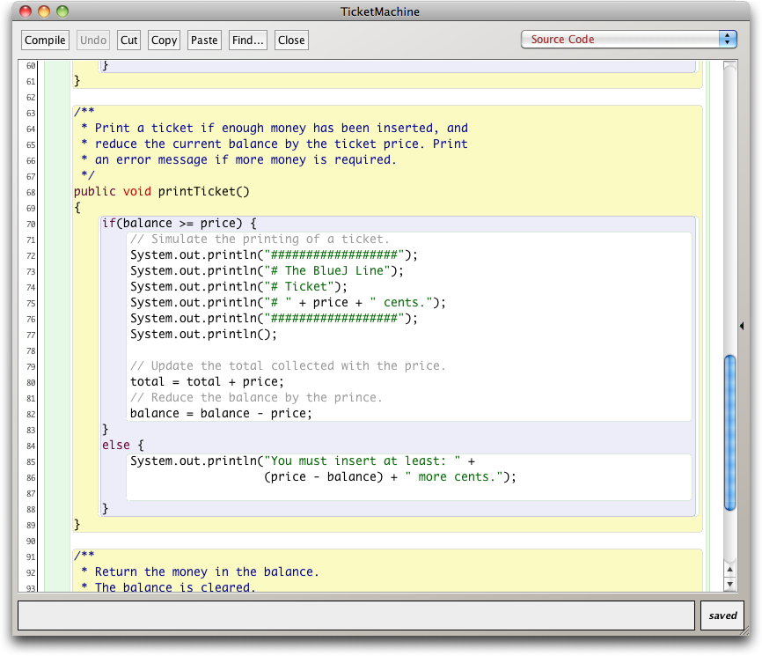
Scope highlighting

Slide 16
Scope and lifetime
Each block defines a new scope.
Class, method and statement.
Scopes may be nested:
statement block inside another block inside a method body inside a class body.
Scope is static (textual).
Lifetime is dynamic (runtime).

Slide 17
To think about
How could we write a method to ‘refund’ an excess balance?
We need to return the value in balance.
We need to set the balance to zero.
How can we do the first without losing the value in balance?
Notes:
write method in BlueJ;
first: do it wrong

Slide 18
Unsuccessful attempt
public int refundBalance()
{
// Return the amount left.
return balance;
// Clear the balance.
balance = 0;
}
It looks logical, but the language does not allow it.
A method will terminate immediately after executing a return statement!

Slide 19
Local variables
Methods can define their own, local variables:
Short lived, like parameters.
The method sets their values – unlike parameters, they do not receive external values.
Used for ‘temporary’ calculation and storage.
They exist only as long as the method is being executed.
They are only accessible from within the method.
They are defined within a particular scope.

Slide 20
Local variables
public int refundBalance()
{
int amountToRefund;
amountToRefund = balance;
balance = 0;
return amountToRefund;
}
A local variable
No visibility
modifier

Slide 21
Scope and lifetime
The scope of a field is its whole class.
The lifetime of a field is the lifetime of its containing object.
The scope of a local variable is the block in which it is declared.
The lifetime of a local variable is the time of execution of the block in which it is declared.

Slide 22

Questions?

