Slide 1

ShopV2.2
Improving Product(with Validation)
Produced
by:
Dr. Siobhán Drohan,
Ms. Mairead Meagher,
Ms. Siobhán Roche.
Department of Computing and Mathematics
http://www.setu.ie/

Slide 2
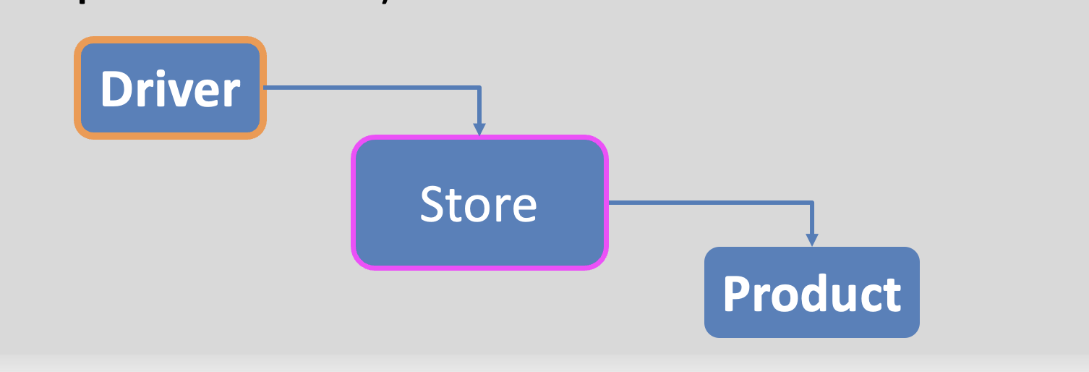
Recap: Shop V2.1 - Product
The Product class stores details about a product:
name
code
unit cost
in the current product line or not?

Slide 3
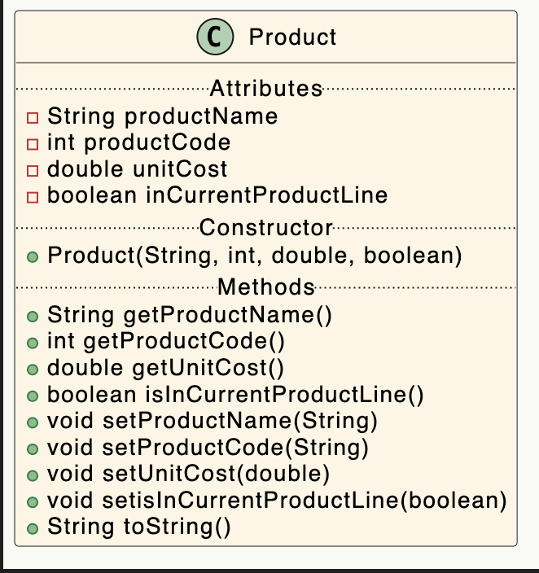
The Product Class…

Slide 4
A Product Class… constructor
Constructor i.e. for building objects.
The green circle means it is public.
Constructors have same name as the class
Four parameters; one for each field.

Slide 5
A Product Class… fields and constructor
public class Product { private String productName; private int productCode; private double unitCost; private boolean inCurrentProductLine; public Product (String productName, int productCode, double unitCost, boolean inCurrentProductLine){
this.productName = productName; this.productCode = productCode; this.unitCost = unitCost; this.inCurrentProductLine = inCurrentProductLine; }

Slide 6
A Product Class… methods
The green circle means it is public.
Methods i.e. the behaviours of the class

Slide 7
Getters
return type
visibility modifier
method name
parameter list (empty)
public double getUnitCost()
{
return unitCost;
}
return statement
start and end of method body (block)

Slide 8
A Product Class…getters
public String getProductName(){ return productName; } public double getUnitCost(){ return unitCost; } public int getProductCode() { return productCode; } public boolean isInCurrentProductLine() { return inCurrentProductLine; }

Slide 9
A Product Class…setters
setters

Slide 10
Setters
return type
visibility modifier
method name
parameter
public void setUnitCost(double unitCost)
{
this.unitCost = unitCost;
}
field being mutated
assignment
statement
Value passed
as a parameter

Slide 11
A Product Class…setters
public void setProductCode(int productCode) { this.productCode = productCode; } public void setProductName(String productName) { this.productName = productName; } public void setUnitCost(double unitCost) { this.unitCost = unitCost; } public void setInCurrentProductLine(boolean inCurrentProductLine) { this.inCurrentProductLine = inCurrentProductLine; }

Slide 12
Getters/Setters
For each instance field in a class, you are normally asked to write:
A getter
Return statement
A setter
Assignment statement

Slide 13
A Product Class…toString
toString():
Builds and returns a String containing a user-friendly representation of the object state.

Slide 14
A Product Class…
public String toString() { return "Product description: " + productName + ", product code: " + productCode + ", unit cost: " + unitCost + ", currently in product line: " + inCurrentProductLine; }
Sample Console Output if we printed a Product Object:
Product description: 24 Inch TV, product code: 23432, unit cost: 399.99, currently in product line: true

Slide 15
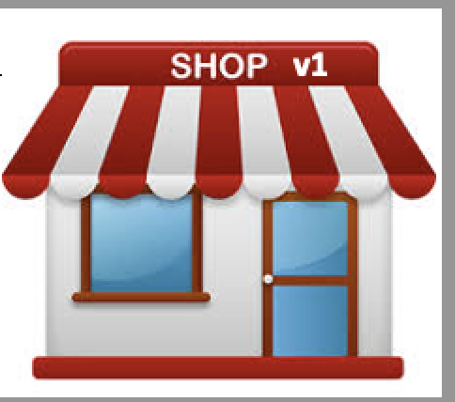
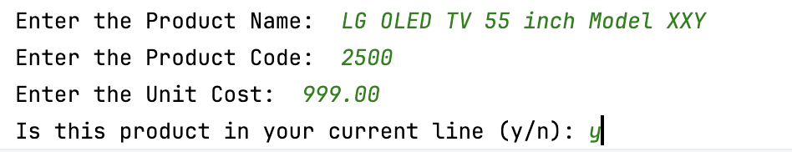
Shop V2.1 – Sample I/O
Entering a product:

Slide 16
Shop V2.1
1. Invites the user to enter the details of a product
2. Prints the details about that product to the console
Limitations:
Currently no benefit from all the infrastructure
No extra checks on the data.
We could do more checking on the data coming in (from keyboard) in case there are obvious errors.

Slide 17
No Validation
The purpose of this app is to read in a product, and later perform calculations on it, adding it to collections, updating it etc.
You could, for either the add or the update, enter preposterous values for any of the fields and at the moment we simply accept them

Slide 18
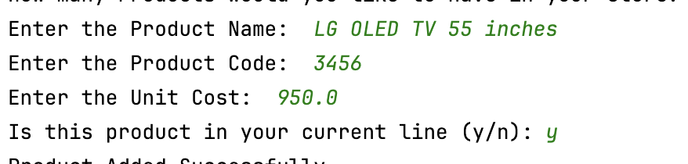
No Validation
Clearly we need to put some restrictions in place for each field e.g. :
min and max permitted values
default value if the min and max are breached
Strings have a max length

Slide 19
Introducing Validation – Shop 2.2
Implement validations for fields in Products

Slide 20
Validation Rules for fields in the Product class
Field Name | Field type | Rules for valid values | Default Value | Note
productName | String | Length of string <= 20 | In constructor, if the productName is longer than 20 characters, the string should be truncated to 20 | This is an outlier – for other types the default is not at all related to the invalid input.
productCode | int | Valid values are between 1000 and 9999 (inclusive) | 9999 | This is a nice way of ensuring 4 digits
unitCost | double | Non-negative (>=0) | 0
inCurrentProductionLine | boolean | No validation required | false | You should never need validation on Booleans.

Slide 21
Implementing Validation Rules
Default Values

Slide 22
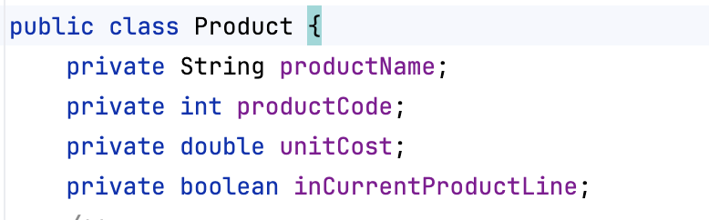
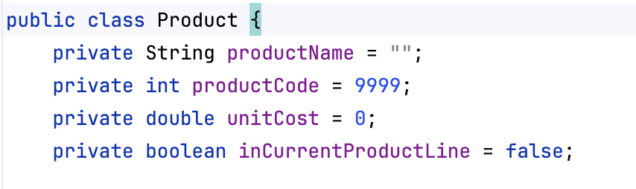
Validation Rules – implementing default values
Field Name | Default Value
productName | In constructor, if the productName is longer than 20 characters, the string should be truncated to 20
productCode | 9999
unitCost | 0
inCurrentProductionLine | false
becomes

Slide 23
Implementing Validation Rules
productCode

Slide 24
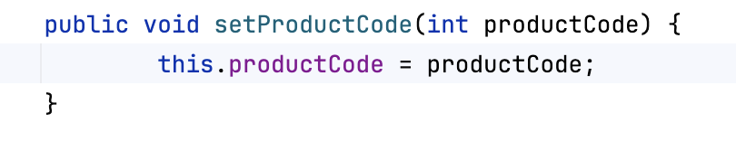
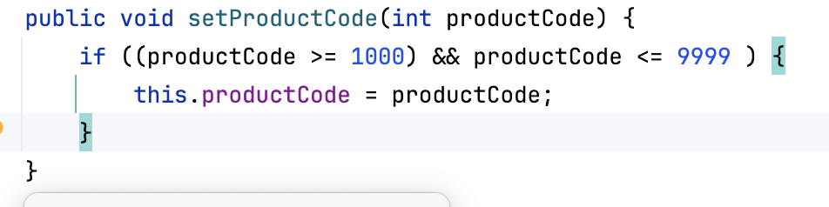
productCode – mutator changes
Field | Min Value | Max Value
productCode | Greater than or equal to 1000 | Less than or equal to 9999
becomes

Slide 25
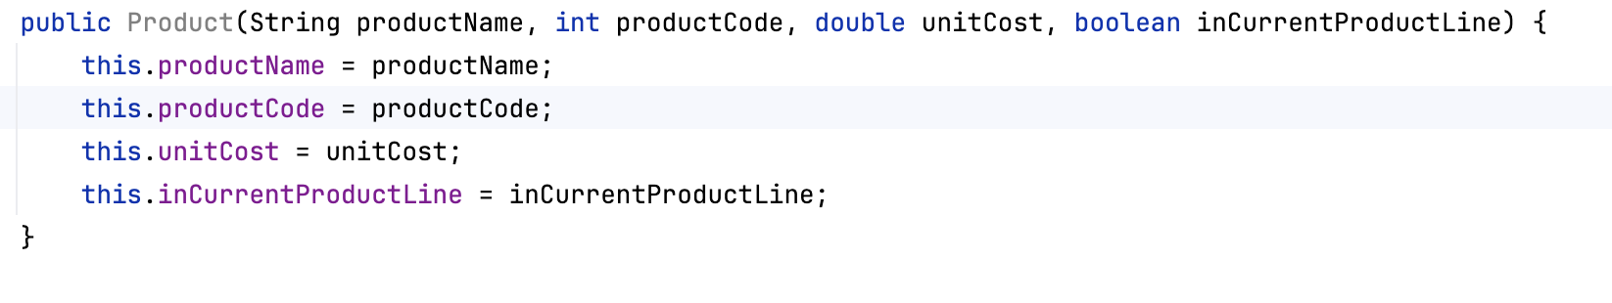
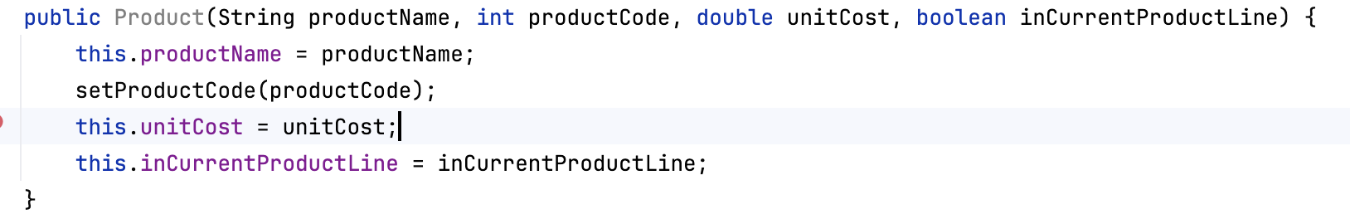
productCode – constructor changes
Field | Min Value | Max Value | Default value
productCode | Greater than or equal to 1000 | Less than or equal to 9999 | 9999
becomes

Slide 26
Implementing Validation Rules
unitCost

Slide 27
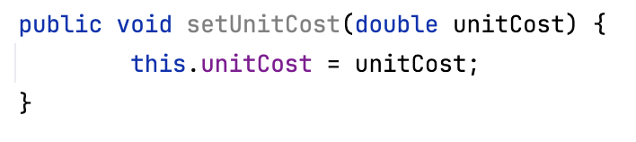
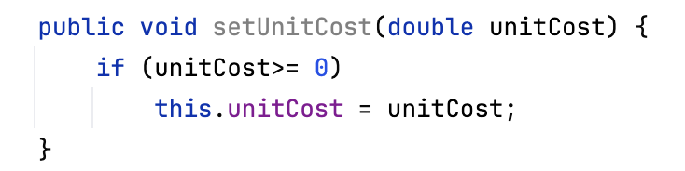
unitCost – mutator changes
Field | Validation Rule
unitCost | Non-negative (>=0)
becomes

Slide 28
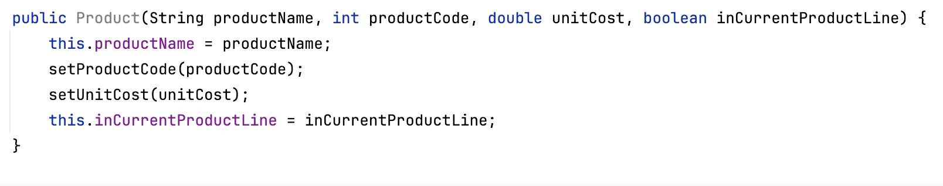
unitCost – constructor changes
Field | Validation Rule | Default
unitCost | Greater than or equal to 0 | 0
becomes

Slide 29
Implementing Validation Rules
productName

Slide 30
Implementation of validation with Strings
Strings use a different rule for default values when the validation rule is based on length of string.
Numbers, chars, etc. use a fixed default so we can use setters in the constructor (if the values are invalid, the default values remain)
If the String value we are checking is invalid, then instead of staying at a fixed default value, we (usually) truncate the input String to the correct length

Slide 31
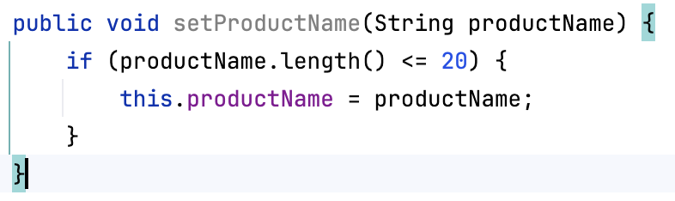
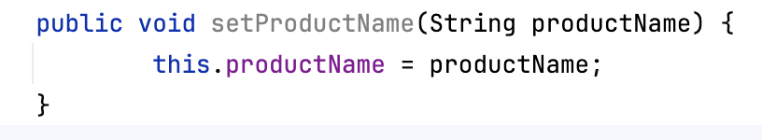
productName – mutator changes
Field | Validation Rule
productName | Length of string must be <= 20
becomes

Slide 32
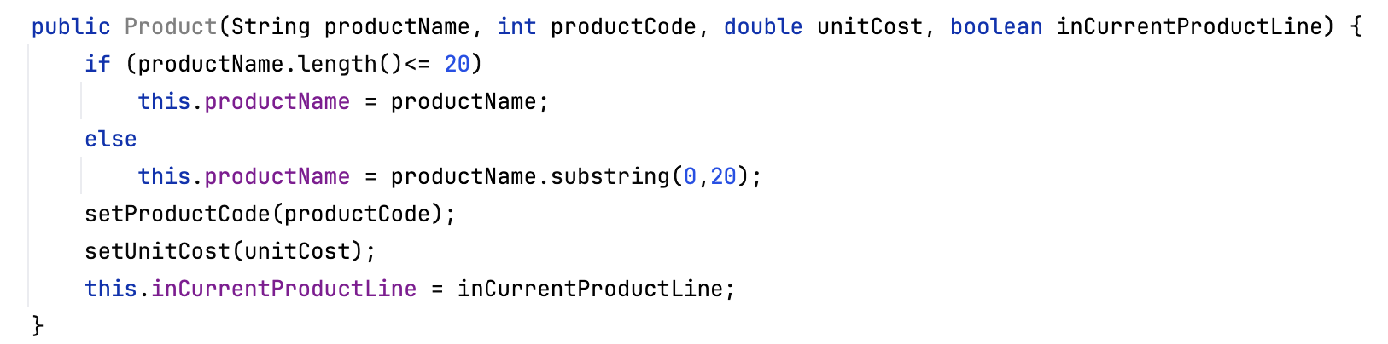
productName – constructor changes
Field | Validation Rule | Default
productName | Length of string must be <= 20 | If length of string is > 20, use first 20 chars of string
Setter not used here
becomes

Slide 33
inCurrentProductionLine
There is no validation needed for inCurrentProductionLine
This is generally the case for booleans.

Slide 34
Boundary Testing the Validation Rules
For BOTH add and update

Slide 35
What is Boundary Testing?
Boundary Testing is when you input test data that are:
the boundary values in your Boolean expressions.
Just above | Just at lower bound | in middle of valid range
Just below | Just at upper bound
Inputting the following values for productCode would test the ‘boundaries’ of this if statement:
[999, 1000, 2000, 9999, 10000]
tests

Slide 36
Example Boundary Test for productCode
Just-Below Upper Boundary Test:
default values are correctly used when adding and updating.
Add a new Product with the value of
999
for productCode
The default value of 9999 should be stored

Slide 37
Example Boundary Test
Add a new Product with the value of
1000
for productCode
Just-Inside Lower Boundary Test:
values are accepted for both add and update
The value of 1000 should be accepted and stored

Slide 38
Example Boundary Test
Add a new Product with the value of
2000
for productCode
Inside range Boundary Test:
values are accepted for both add and update
The value of 2000 should be accepted and stored

Slide 39
Example Boundary Test
Add a new Product with the value of
9999
for productCode
Just-Below Upper range Boundary Test:
values are accepted for both add and update
The value of 9999 should be accepted and stored

Slide 40
Example Boundary Test
Add a new / updated a currentProduct with the value of
10000
for productCode
Just-Above Upper range Boundary Test:
values are not accepted for either add or update
For adding (constructor), 9999 (default) should be stored,
For update (setter) the previous value should remain unchanged.

Slide 41
The rest of the fields
The checking of the other fields are left as an exercise.
Note that later, once you are familiar with the way to test these boundaries, we will use JUnit to help automate the running (and re-running) of these checks.

Slide 42

Questions?

