Slide 1

Menu Driven Apps
Loops, menus and the switch statement
Produced
by:
Ms. Maireád Meagher
Dr. Siobhán Drohan
Department of Computing and Mathematics
http://www.wit.ie/

Slide 2
Topics list
A simple menu using switch.
ShopV3.0 – adding a menu.

Slide 3
Topics list
A simple menu using switch.
ShopV3.0 – adding a menu.

Slide 4
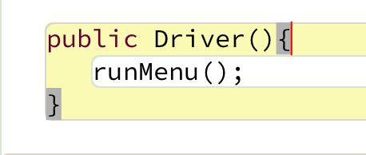
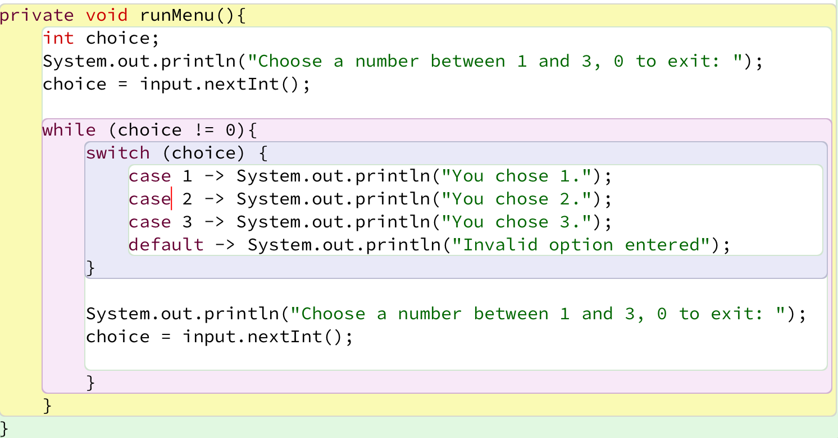
Now loop on the switch statement
Note the use of the Loop Control Variable, option.

Slide 5
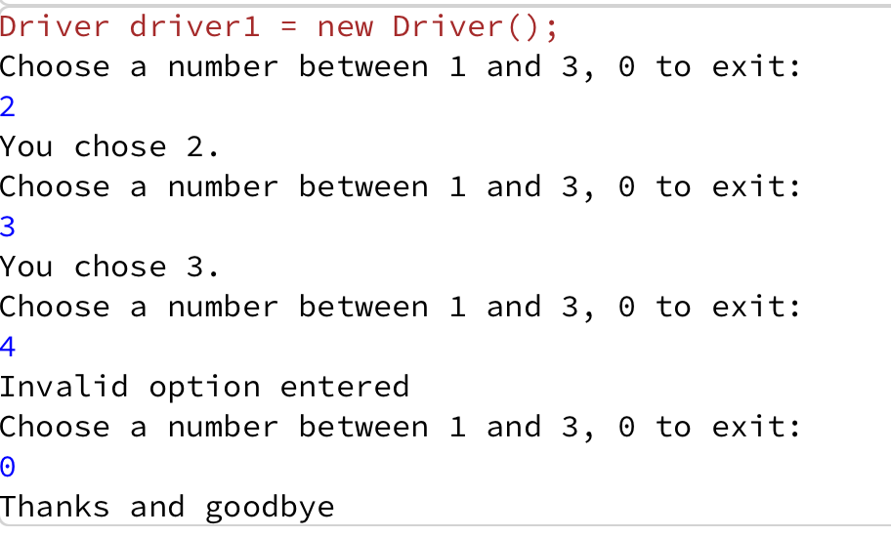
This gives the following output
Notes:
private void runMenu(){ int option = ScannerInput.readNextInt("Choose a number between 1 and 3:"); while (option != 0){ switch (option){ case 1 -> System.out.println("You chose 1"); case 2 -> System.out.println("You chose 2"); case 3 -> System.out.println("You chose 3"); default -> System.out.println("Invalid option entered: " + option); } option = ScannerInput.readNextInt("Choose a number between 1 and 3:"); } }

Slide 6
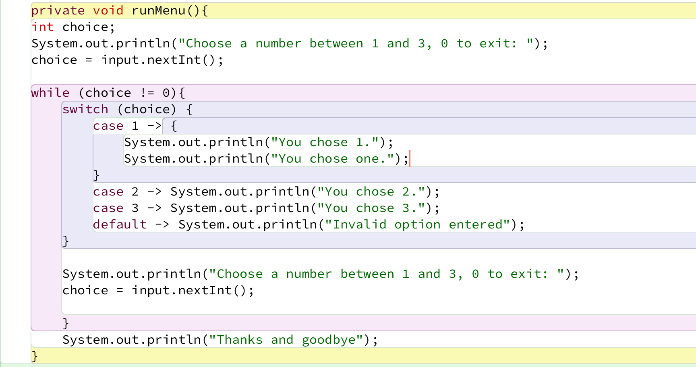
If you wanted more than one line of code associated with a case, just declare a code block:

Slide 7
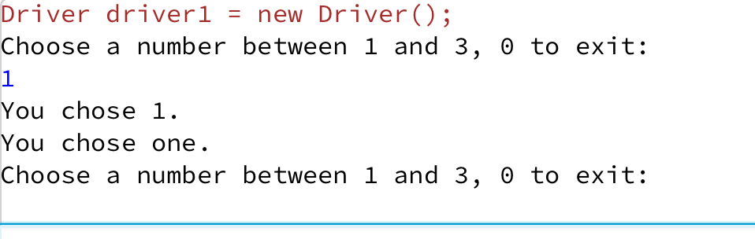
If you wanted more than one line of code associated with a case, just declare a code block:

Slide 8
Topics list
A simple menu using switch.
ShopV3.0 – adding a menu.

Slide 9
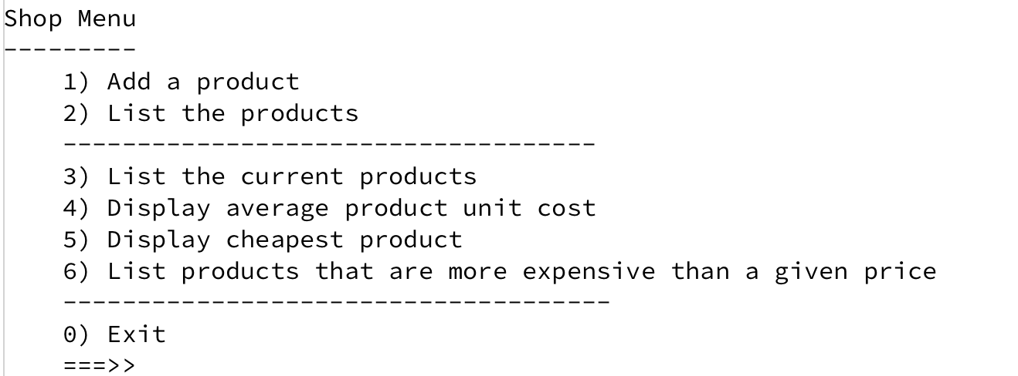
Adding a basic menu to Shop…

Slide 10
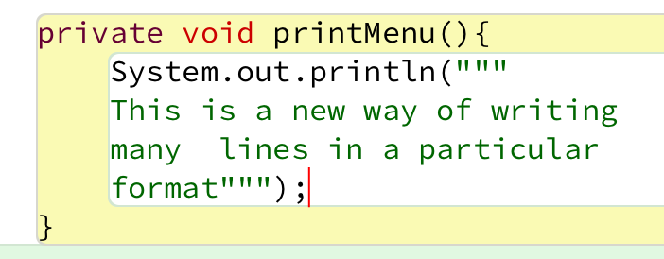
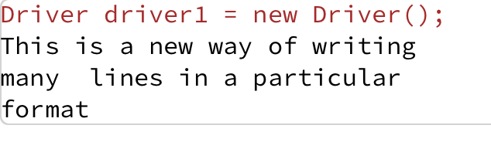
More on print
We have a new way to print to console in a formatted way
We are using Raw Strings (the triple double quotes) to format the output for the menu.

Slide 11
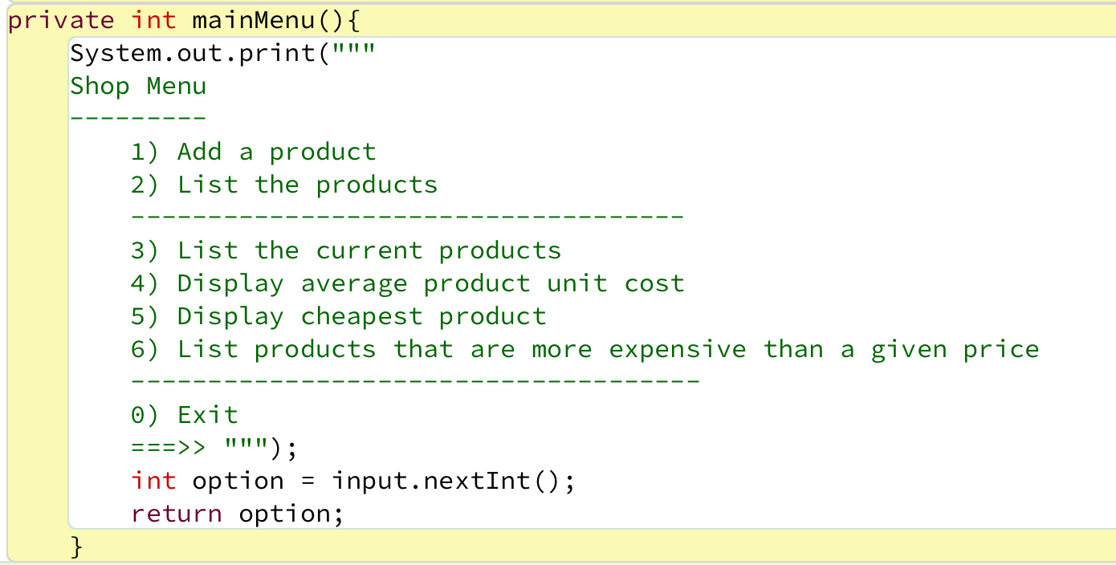
Menu to be displayed…
Driver Class

Slide 12
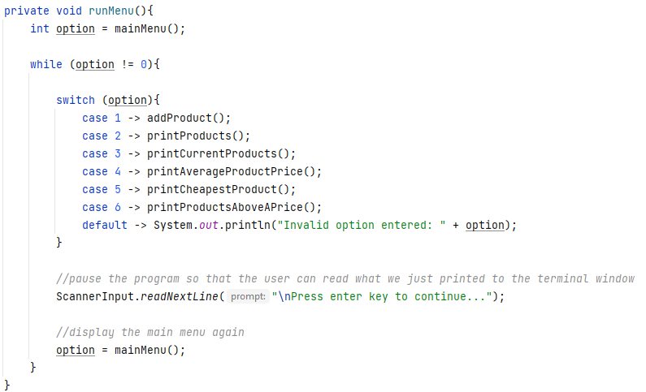
Handling the menu input…
Driver Class

Slide 13
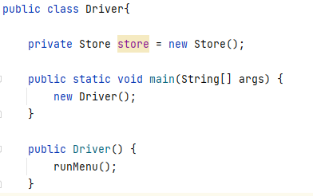
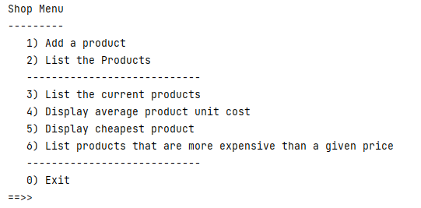
Calling the menu on startup…
Driver Class

Slide 14
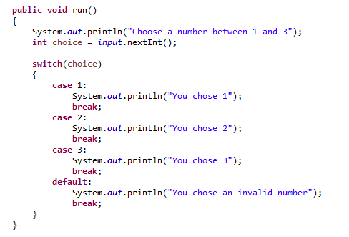
NOTE: A simple menu using the older format of the switch statement
A break statement is needed after each case, otherwise execution “falls” into the next statement regardless.

Slide 15

Questions?

