Slide 1

Why Use Separate Classes and a Driver in Java
Building clear, modular Java programs
Produced
by:
Ms Mairead Meagher
Ms Siobhan Roche
Department of Computing and Mathematics
setu.ie

Slide 2
Organising Your Code
Everything in Java is a class
Class with methods → contains logic, tasks, reusable functionality
Driver class → contains main(), runs the program
Separating them keeps responsibilities clear and code structured

Slide 3
Why Separate Them
Cleaner, modular code
Easier testing of methods
Methods can be reused in other programs
main() becomes a simple controller

Slide 4
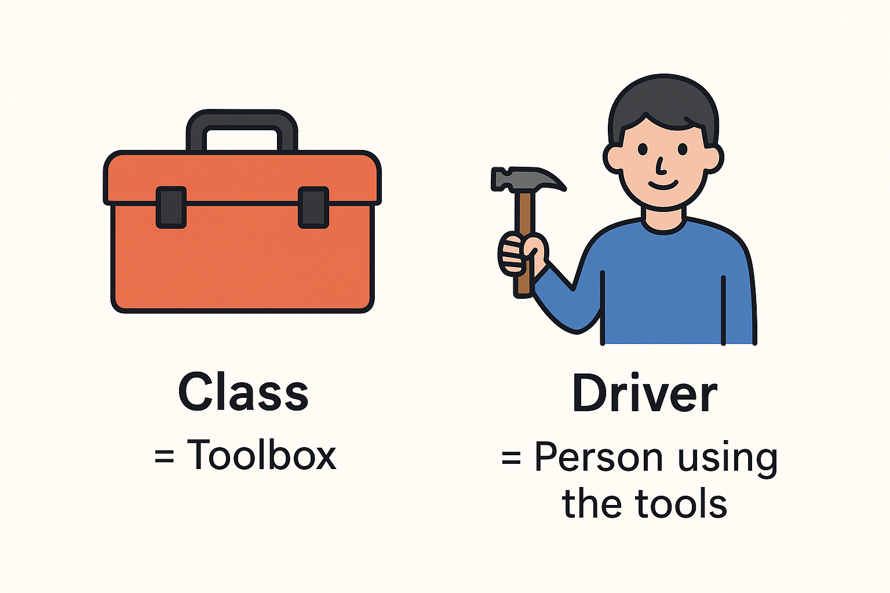
“Think of your class as the toolbox, and the Driver as the person using the tools.”
The Toolbox must exist before the person can use the tools

Slide 5


How They Interact (Code Example)
Calculator.java
-----------------
public class Calculator {
public int add(int x, int y) {
return x + y;
}
}
CalculatorDriver.java
-----------------
public class CalculatorDriver {
public static void main(String[] args) {
Calculator calc = new Calculator();
int result = calc.add(5, 3);
System.out.println("Sum = " + result);
}
}
1. Create Object
2. Invoke Method

Slide 6
Why Create an Object?
Methods belong to the class
You need an object to access those methods
Class = blueprint
Object = usable thing

Slide 7
Another way to set up Driver – calling Internal methods in Driver
public class Driver {
private Scanner input = new Scanner (System.in);
public static void main(String[] args) {
new Driver();
}
public Driver(){
//Uncomment the line with the method you want to run.
exercise1();
//exercise2();
exercise16();
}
private void exercise1() { //also written in Driver
System.out.println("Exercise 1: reads in 6 integers into an integer array and prints the values to the screen.");
int[] numbers = new int[6];
for (int i = 0; i < numbers.length ; i++) {
System.out.print("Enter value : ");
numbers[i] = input.nextInt();
}
for (int i = 0; i < numbers.length ; i++) {
System.out.println("value " + (i+1) + " is: " + numbers[i]);
}
}
1. Call Driver (private) methods in the constructor
2. Simply call the constructor in the main method.

Slide 8

Questions?

