Slide 1

Menu Driven Apps
Loops, menus and the switch statement
Produced
by:
Ms. Maireád Meagher
Dr. Siobhán Drohan
Siobhan Roche
Department of Computing and Mathematics
http://www.wit.ie/

Slide 2
Topics list
Loops
Loop Control Variables
Arrays and counter controlled loops
Arrays and sentinel based loops
Arrays and flag-based loops

Slide 3
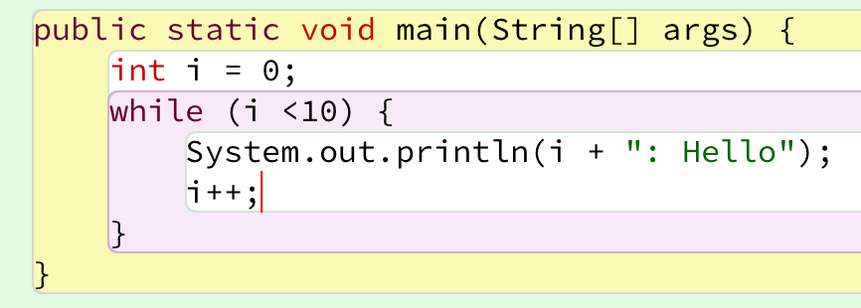
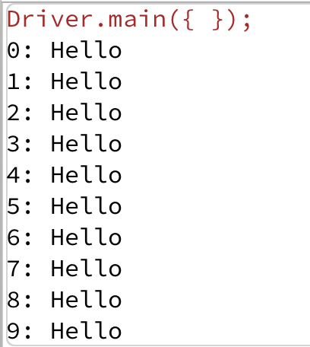
Recap - Loop Control Variable
This loop is a counter-controlled while loop
1. Initialise
2. Test i.e. boolean condition
3. Update directly before end of loop
Notes:
public class Loops { public static void main(String args[]){ new Loops(); } public Loops(){ simpleWhile(); } public void simpleWhile(){ int i = 0; while (i < 10){ System.out.println(i); i++; } } }

Slide 4
Topics list
Loops
Loop Control Variables
Arrays and counter controlled loops
Arrays and sentinel based loops
Arrays and flag-based loops
switch statement.
A simple menu using switch.
ShopV3.0 – adding a menu.

Slide 5
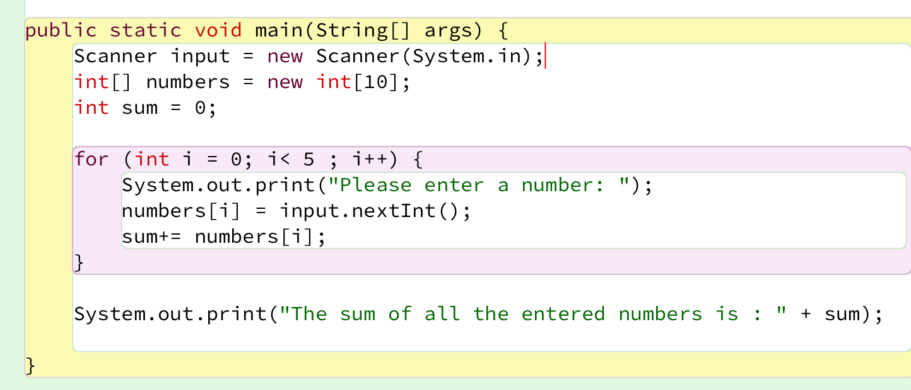
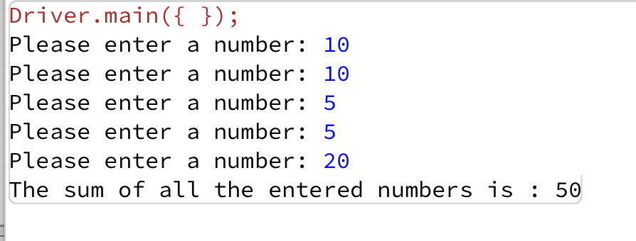
Recap - Counter-Controlled for Loop

Slide 6
Recap - Counter-Controlled Loops
Sometimes we know when we are coding, we know how many inputs we will have.
The previous slide displays an example of this.
Other times, we find out at run time how many inputs we have…an example of this is on the next slide.

Slide 7
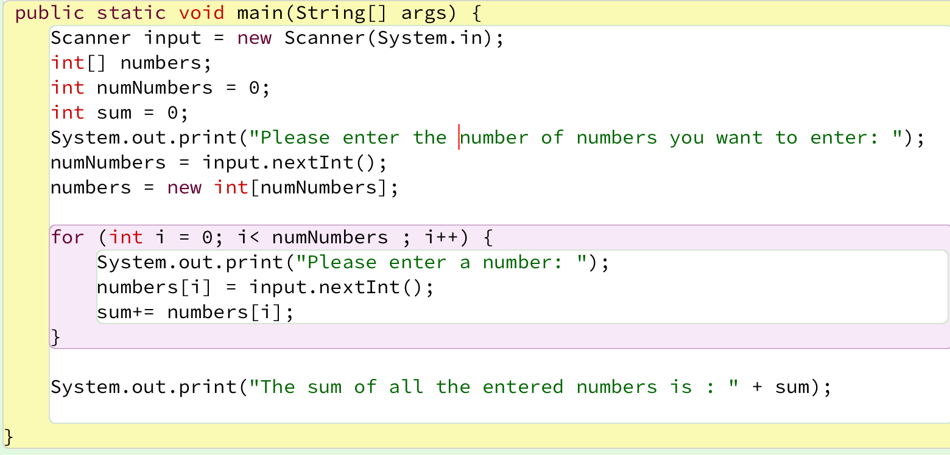
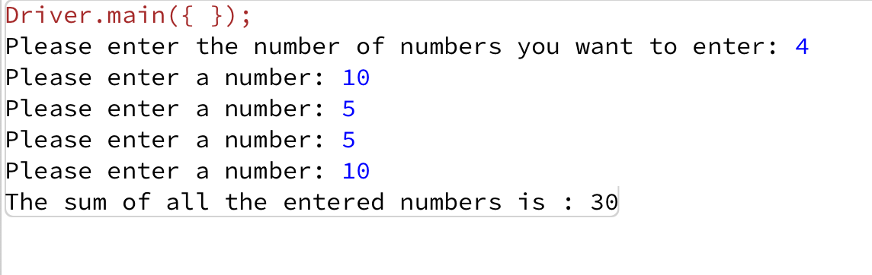
Recap - Counter-Controlled for Loop
Here, we know at run-time how many inputs we have.

Slide 8
Topics list
Loops
Loop Control Variables
Arrays and counter controlled loops
Arrays and sentinel based loops
Arrays and flag-based loops
switch statement.
A simple menu using switch.
ShopV3.0 – adding a menu.

Slide 9
Sentinel-based loops
Use this type of loop when you do not know how many inputs you will have.
The end of input is signalled by a special value.
e.g. if you are calculating the ‘average of ages of people in the room’, write a program that will continually take in ages until, say, -1 is entered. -1 would be the sentinel value.

Slide 10
Structure
Concept of Loop Control Variable is vital here.
The loop continuation is solely based on the input, so the variable containing the information is the Loop Control Variable.
Initialise the Loop Control Variable before entry into the loop.
Remember to ‘update the Loop Control Variable’ just before the end of the loop.

Slide 11
Try this exercise
Write a loop to read in and add up a set of integers. Keep going until the value ‘-1’ is inputted.
What is your Loop Control Variable?
Note: in this exercise, you do not need to store the values in an array…we will do this in a few slides time.

Slide 12
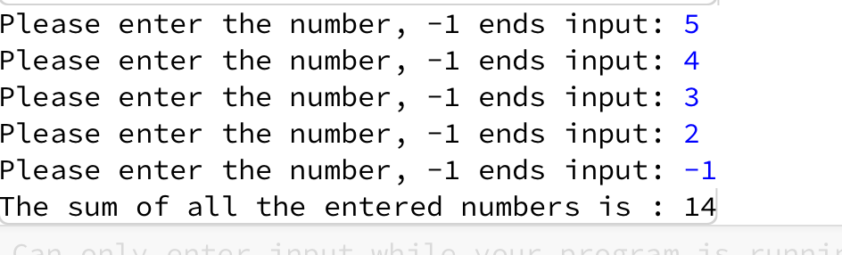
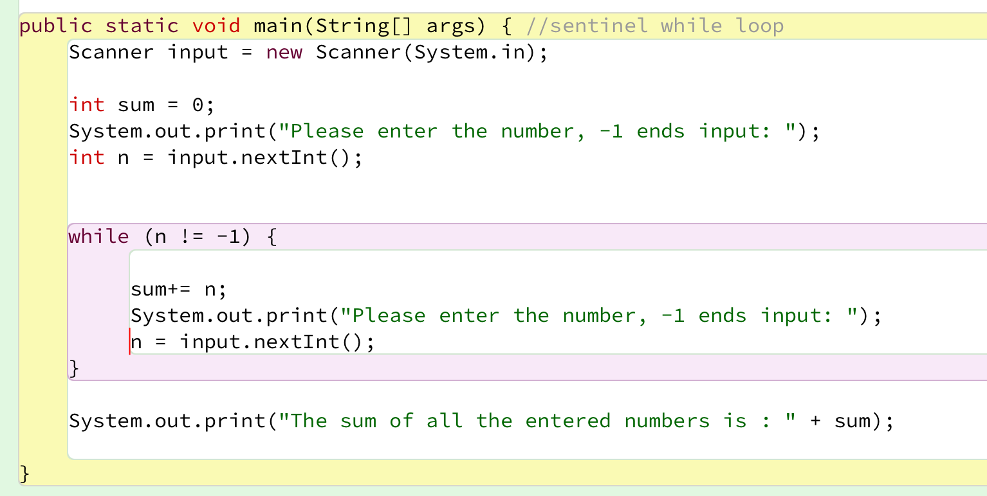
Solution
1. Initialise
2. LCV Condition
3. Update LCV directly before end of loop

Slide 13
Next step in the exercise
We need to record how many inputs have happened.
Try to change the previous solution so that you know at the end how many numbers have been inputted.
At the end, print the sum and number of inputs.

Slide 14
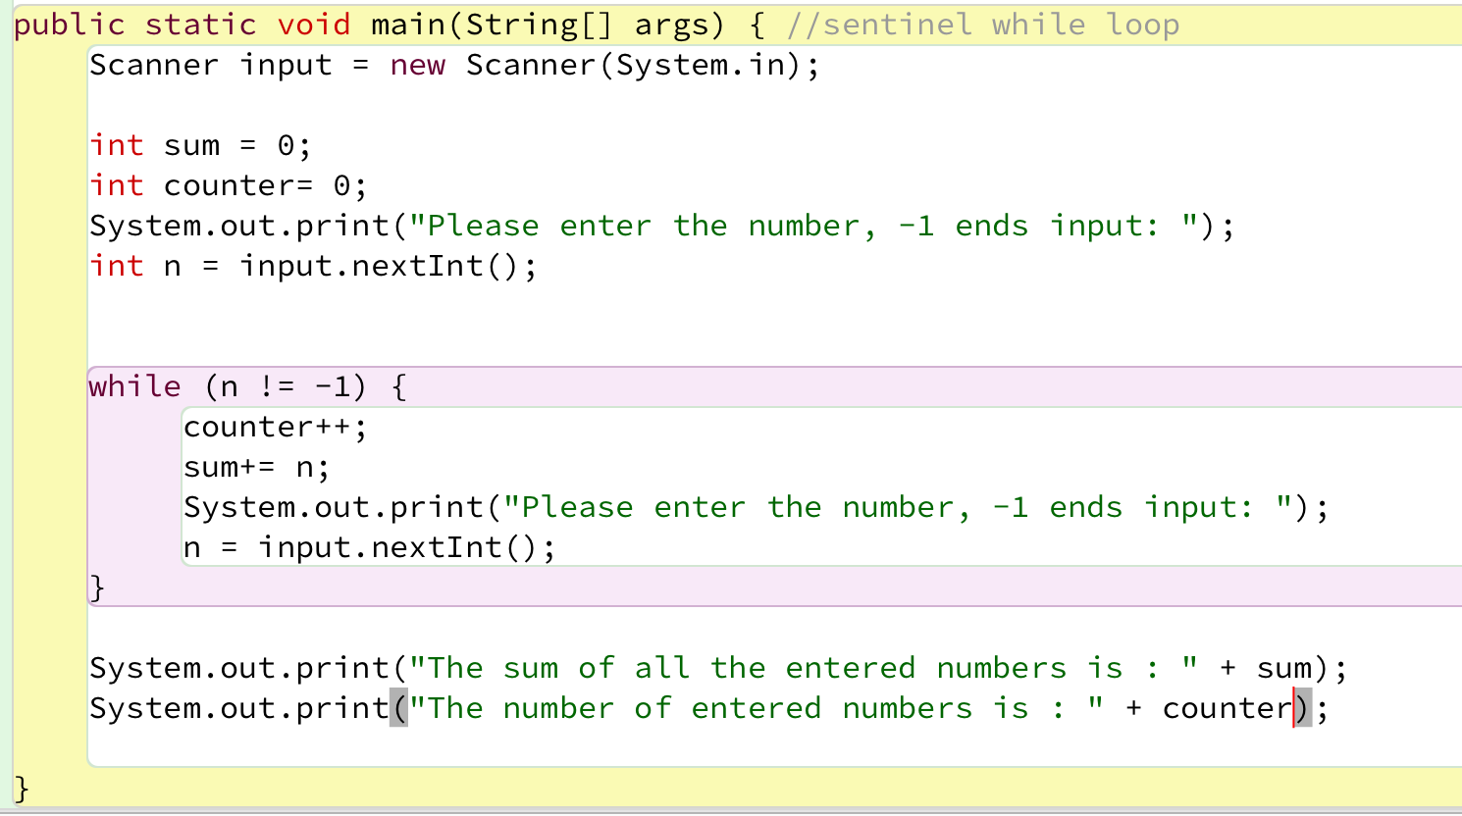
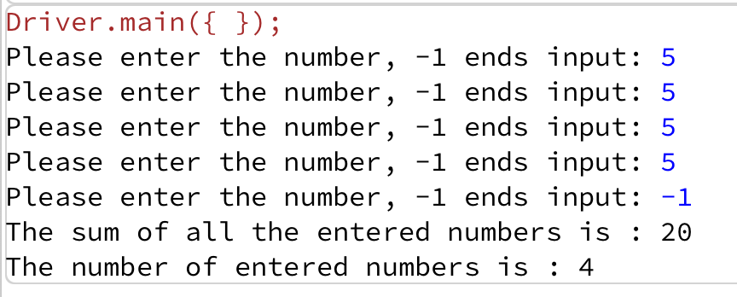
Code with number of inputs

Slide 15
Try this now - using arrays
Same structure as before, but now we want to store the input.
Re-write the code on the previous slide, but store the data in an array.
NOTE:
Assume the max number of inputs possible is 100 (i.e. size of array).
We also need to know how many inputs actually happened.

Slide 16
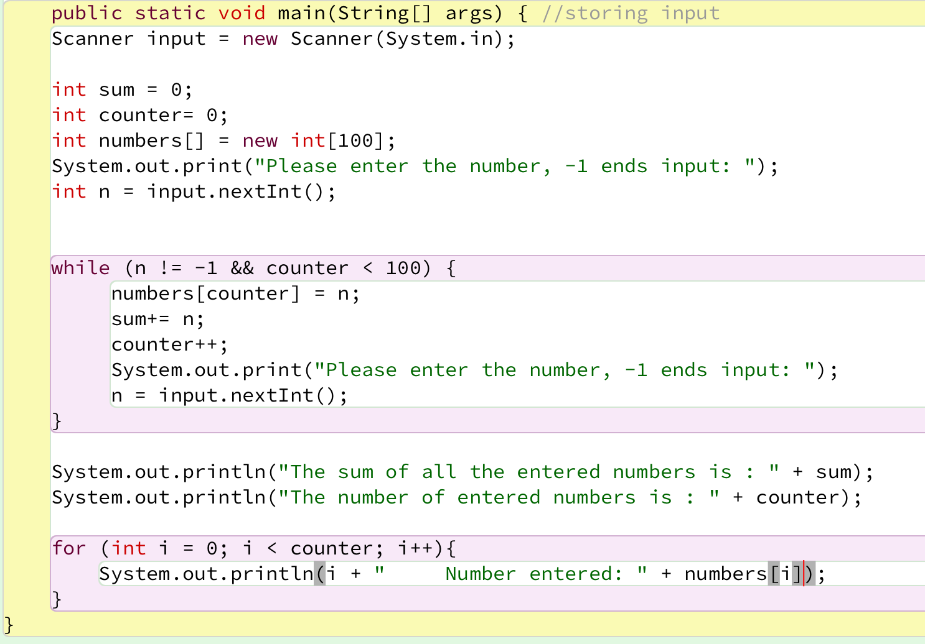
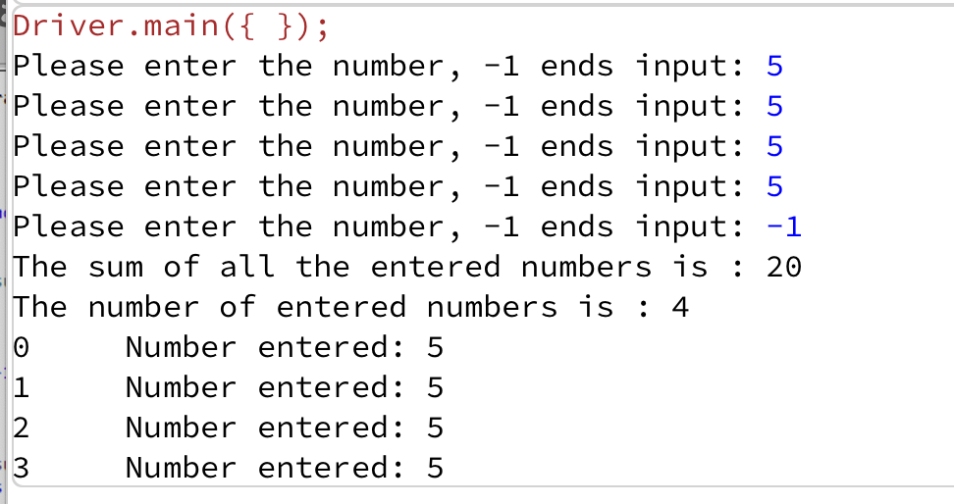
Solution – storing inputs

Slide 17
Sentinel based loops and menus
Menus
Based on repetitively giving user options
Stops when user enters a know ‘exit’ value
We will use the sentinel-based loops (with ‘exit’ value as our sentinel) when we implement a menu system

Slide 18
Topics list
Loops
Loop Control Variables
Arrays and counter controlled loops
Arrays and sentinel based loops
Arrays and flag-based loops

Slide 19
Flag-Based Loops
These are used when you want to examine a collection of data to check for a property. Once a property has been established, it cannot be ‘unestablished’.
‘Once the flag is raised, it cannot be taken down’

Slide 20
Flag-Based Loops - example
Given a populated array of numbers, cycle over the array to see if any numbers are odd.
If you find:
At least one odd number, print out to the user that there is at least one odd number.
No odd numbers, inform the user of this.

Slide 21
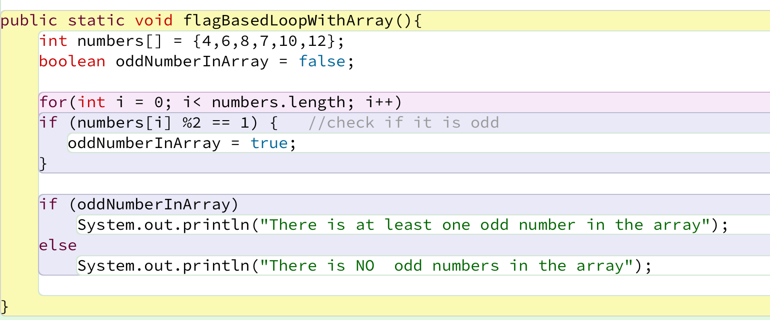
Solution: check if ‘any numbers odd’

Slide 22
What about having a flag-based loop in a method with a boolean return type?

Slide 23
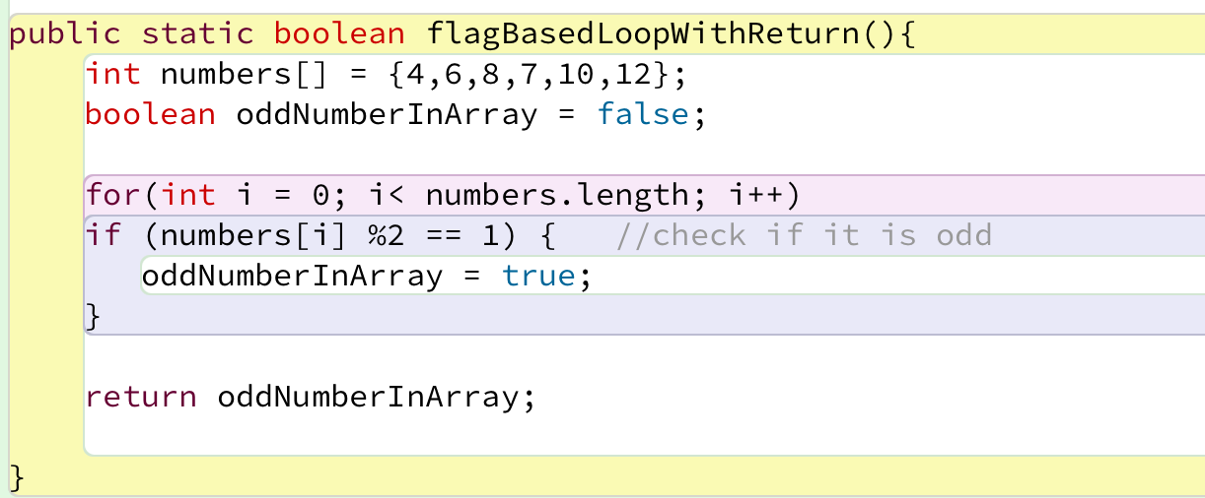
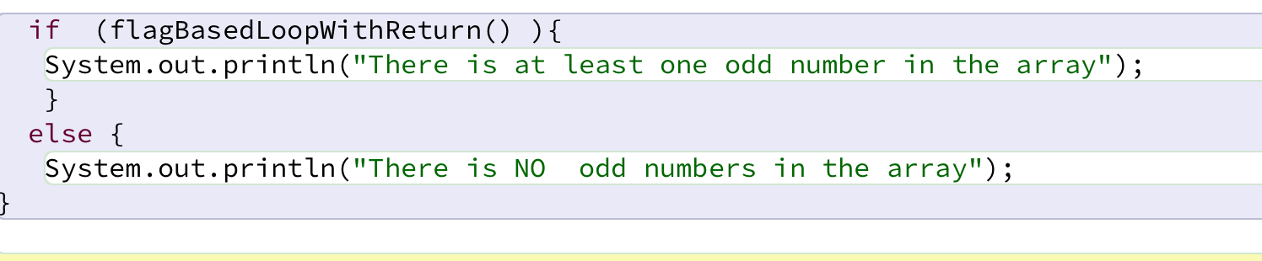
Code with boolean return type
Calling the method and handling the returned boolean

Slide 24

Questions?

