Slide 1

Switch Statement
Produced
by:
Ms. Maireád Meagher
Dr. Siobhán Drohan
Siobhan Roche
Department of Computing and Mathematics
http://www.wit.ie/

Slide 2
The switch statement
The switch statement works in exactly the same way as a set of if statements, but is more compact and readable.
The switch statement switches on a single value to one of an arbitrary number of cases.

Slide 3
The switch statement

Slide 4
The switch statement
A switch statement can have any number of case labels.
The default case is optional; if no default is given, it may happen that no case is executed.
Can switch on int, char or String.
Good Resource: https://blog.codeleak.pl/2020/05/switch-as-an-expression-in-java.html

Slide 5
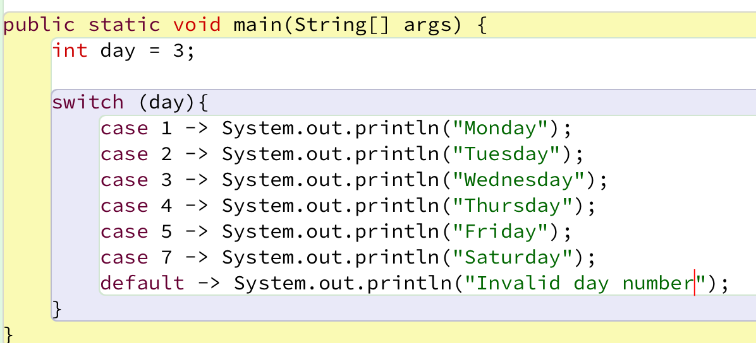
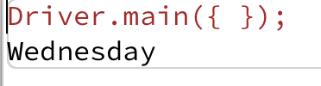
The switch statement – int example
Notes:
private static void intSwitch(){ int day = 3; switch (day){ case 1 -> System.out.println("Monday"); case 2 -> System.out.println("Tuesday"); case 3 -> System.out.println("Wednesday"); case 4 -> System.out.println("Thursday"); case 5 -> System.out.println("Friday"); case 6 -> System.out.println("Saturday"); case 7 -> System.out.println("Sunday"); default -> System.out.println("Invalid day: " + day); } }

Slide 6
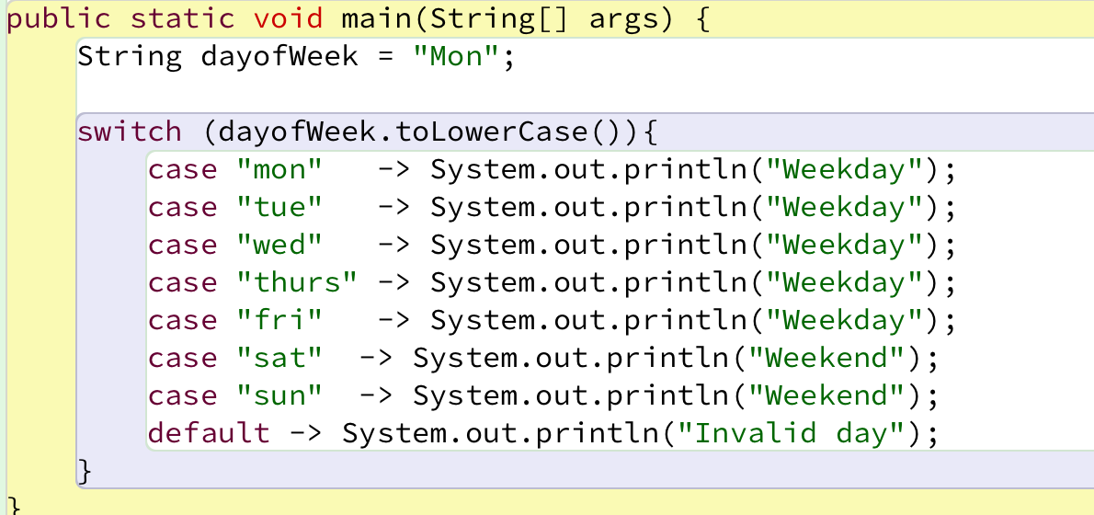
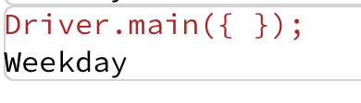
The switch statement – String example
Notes:
private static void stringSwitchLong(){ String dayOfWeek = "Mon"; switch (dayOfWeek.toLowerCase()){ case "mon" -> System.out.println("Weekday"); case "tues" -> System.out.println("Weekday"); case "wed" -> System.out.println("Weekday"); case "thurs" -> System.out.println("Weekday"); case "fri" -> System.out.println("Weekday"); case "sat" -> System.out.println("Weekend"); case "sun" -> System.out.println("Weekend"); default -> System.out.println("Invalid day: " + dayOfWeek); } }

Slide 7
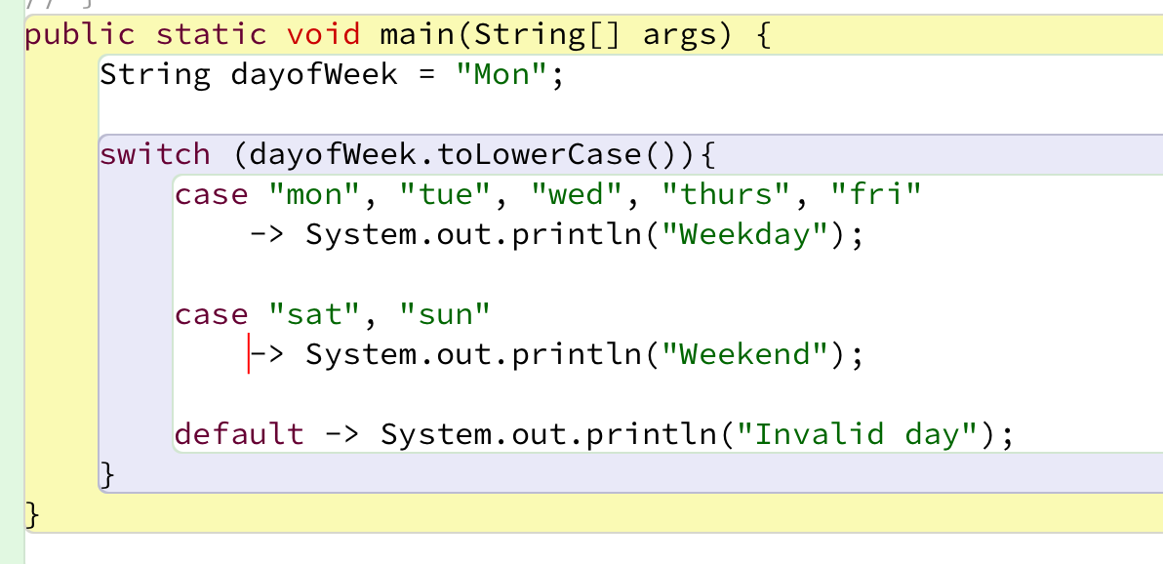
The switch statement – String example
DRY code – Don’t Repeat Yourself!
Notes:
private static void stringSwitchCondensed(){ String dayOfWeek = "Mon"; switch (dayOfWeek.toLowerCase()){ case "mon", "tues", "wed", "thurs", "fri" -> System.out.println("Weekday"); case "sat", "sun" -> System.out.println("Weekend"); default -> System.out.println("Invalid day: " + dayOfWeek); } }

Slide 8
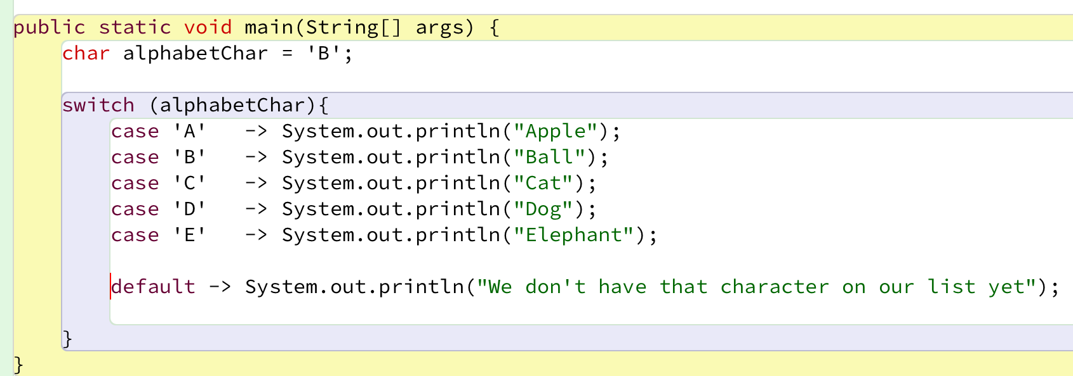
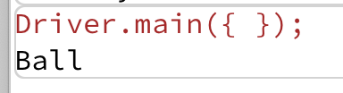
The switch statement – char example
Notes:
private static void charSwitch(){ char alphabetChar = 'B'; switch (alphabetChar){ case 'A' -> System.out.println("Apple"); case 'B' -> System.out.println("Ball"); case 'C' -> System.out.println("Cat"); case 'D' -> System.out.println("Dog"); case 'E' -> System.out.println("Elephant"); default -> System.out.println("Char not on our list yet: " + alphabetChar); } }

Slide 9
When is switch used?
When there is a short number of options with exact values ;
Menus are a good example of this;
We will use switch statements to, given the user choice, will invoke a particular method.

Slide 10

Questions?

