Slide 1
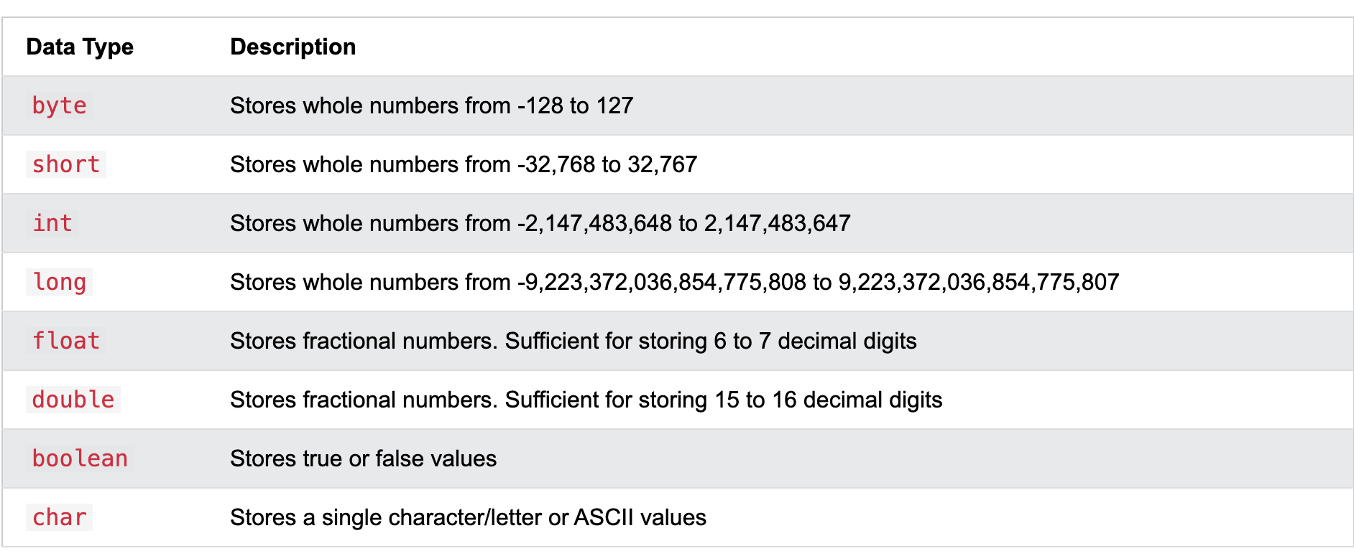
Primitive types in Java
Ref : https://www.w3schools.com/java/java_data_types.asp

