Slide 1

Iteration in Programming
while loops
Produced
by:
Dr. Siobhán Drohan,
Ms. Mairead Meagher,
Ms. Siobhán Roche.
Department of Computing and Mathematics
http://www.setu.ie/

Slide 2
Topics list
Repetition in Programming – Intro to looping
Use of loops (while loops).

Slide 3
Recap: Boolean conditions
A boolean condition is an expression that evaluates to either true or false e.g.
Boolean conditions can be used to control:
Selection i.e. if statements and
Iteration i.e. loops (we will look at these now).
price >= 0

Slide 4
Repetition in Programming
Computers are very good at repetition.
Example:
calculate pay for 1000 employees.
You should use the same calculate pay algorithm 1000 times.
You don’t write the calculate pay algorithm 1000 times; instead you include it in a loop.

Slide 5
Scenario: Checking Tickets at a Cinema
Imagine you’re working at a cinema. A group of people is coming in for a movie. Your job is to:
Check each person’s ticket as they enter.
Let them in if they have a valid ticket.
Keep a count of how many valid tickets you check.
Stop when there are no more people in the queue (or you have reached a certain number).

Slide 6
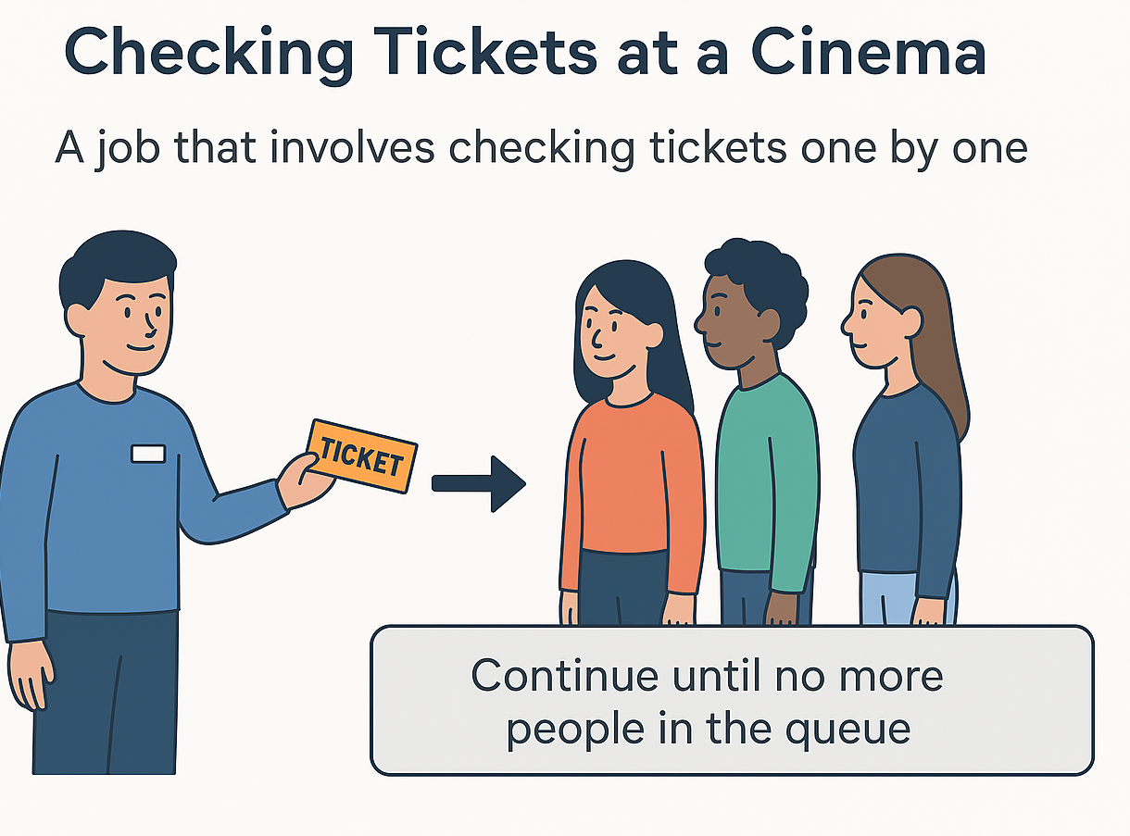
Form of loop
Real-world action | Programming equivalent
Repeating ticket checks for each person | Loop that repeats for each input
Queue of people | Data to process (e.g., list or unknown number of inputs)
Stop when no more people or reached a certain number | Loop termination condition
Counting valid tickets | Using a counter variable inside the loop

Slide 7
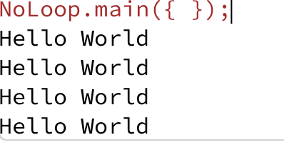
Repetition without loop
Print “Hello world” to the screen 4 times
System.out.println("Hello World");
System.out.println("Hello World");
System.out.println("Hello World");
System.out.println("Hello World");

Slide 8
Introducing loop form
Print “Hello world” to the screen 4 times
With a loop:
do this 4 times
System.out.println("Hello World");
Notes:
We add 20 because its 10 for the height of the rectangle +10 for the gap

Slide 9
Introducing loop form
Print “Hello world” to the screen 4 times
Introduce a counter
Set a counter to 1
do this while counter <= 4
increase counter by one
System.out.println("Hello World");
Notes:
We add 20 because its 10 for the height of the rectangle +10 for the gap

Slide 10
Topics list
Repetition in Programming – Intro to looping
Use of loops (while loops).

Slide 11
Loops in Programming
There are three types of loop in (Java) programming:
while loops
for loops
do while loops

Slide 12
while loop pseudo code
General form of a while loop
while keyword
boolean condition
while(loop condition) {
loop body
}
Statements to be repeated
Pseudo-code expression of the actions of a while loop
while we wish to continue, do the things in the loop body

Slide 13
Construction of while loop
Declare and initialise loop control variable (LCV)
while(boolean condition based on LCV is true)
{
“do the job to be repeated”
“update the LCV”
}
This structure should always be used
Notes:
The “update the LCV” should always update it so that the Boolean condition will eventually evaluation to false.

Slide 14
while loop Flowchart
Example 1
int i = 1;
while (i <= 4)
{
System.out.println("Hello World");
i++;
}
true
boolean
condition?
statement(s)
false

Slide 15
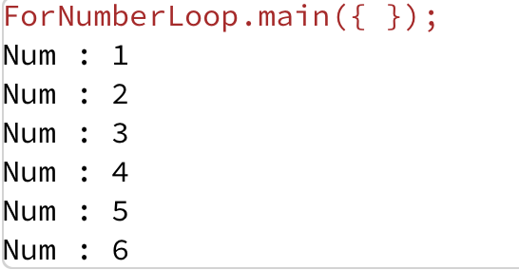
Example 2 - Loop using the counter variable
int i = 1;
while (i <= 6) {
System.out.println("Num : " + i);
i++;
}

Slide 16
Some Study Exercises
Example 1:
Change the code so that “Hello World” is printed out 10 times.
Example 2:
Change the code so that the numbers from 1 to 10 (inclusive) are printed out, one line at a time.
Change the code so that the numbers from 10 to 1 are printed out.

Slide 17

Questions?

