Slide 1

Iteration in Programming
for loops, do while loops
Produced
by:
Dr. Siobhán Drohan,
Ms. Mairead Meagher,
Ms. Siobhán Roche.
Department of Computing and Mathematics
http://www.setu.ie/

Slide 2
Loops
There are three types of loop in programming:
while loops:
Counter controlled (n times) - covered in previous talk
Sentinel based (covered later in the course)
Flag based (covered later in the course)
for loops (this slide deck)
do While loops (this slide deck)

Slide 3
Topics
For loops
2. Comparison of while and for loops
3. do while loops (this slide deck)
4. Comparison of while and do while

Slide 4
For loop pseudo-code
General form of a for loop
for(initialization; boolean condition; post-body action)
{
statements to be repeated
}

Slide 5
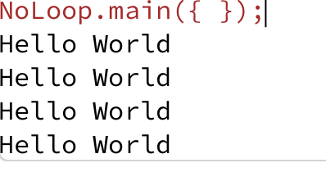
Recap: Loop Example
This was a slide from the previous talk. We used a while loop to repeatedly print “Hello World” to the console.
int i = 1;
while (i <= 4)
{
System.out.println("Hello World");
i++;
}
Notes:
int yCoordinate = 60;
size(600, 300);
background(102);
fill(255);
noStroke();
int i = 0;
while(i < 4)
{
rect(50, yCoordinate, 500, 10);
yCoordinate += 20;
i++;
}

Slide 6
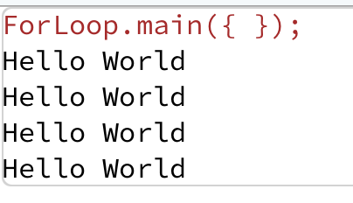
For loop – Example 1
for (int i = 1; i<=4; i++) {
System.out.println("Hello World");
}
This code does the same as the previous slide, except that we use a different loop: for
Notes:
int yCoordinate = 60;
size(600, 300);
background(102);
fill(255);
noStroke();
for(int i = 0; i < 4; i++)
{
rect(50, yCoordinate, 500, 10);
yCoordinate = yCoordinate + 20;
}

Slide 7
For loop syntax
for(initialization; boolean condition; post-body action)
{
statements to be repeated
}

Slide 8
For loop syntax
for(initialization; boolean condition; post-body action)
{
statements to be repeated
}

Slide 9
For loop syntax
initialization | int i = 1; | Initialise a loop control variable (LCV) e.g. i. It can include a variable declaration.
boolean condition | i <= 4; | Is a valid boolean condition that typically tests the loop control variable (LCV).
post-body action | i++ | A change to the loop control variable (LCV). Contains an assignment statement.

Slide 10
for Loop Flowchart
boolean
condition?
true
statement(s)
update
for (int i = 1; i<=4; i++) {
System.out.println("Hello World");
}
false
Notes:
for(int i = 0; i < 4; i++)
{
rect(50, yCoordinate, 500, 10);
yCoordinate = yCoordinate + 20;
}

Slide 11
For loop: all parts are optional
for ( ; ; )
{
// statements here
}
This is an infinite loop…

Slide 12
Loops can be nested
for (int i=0; i < 4; i++){
}
for (int j=0; j < 4; j++){
println("The value of i is: " + i + " and j is: " + j);
}
The value of i is: 0 and j is: 0
The value of i is: 0 and j is: 1
The value of i is: 0 and j is: 2
The value of i is: 0 and j is: 3
The value of i is: 1 and j is: 0
The value of i is: 1 and j is: 1
The value of i is: 1 and j is: 2
The value of i is: 1 and j is: 3
The value of i is: 2 and j is: 0
The value of i is: 2 and j is: 1
The value of i is: 2 and j is: 2
The value of i is: 2 and j is: 3
The value of i is: 3 and j is: 0
The value of i is: 3 and j is: 1
The value of i is: 3 and j is: 2
The value of i is: 3 and j is: 3

Slide 13
Topics
For loops
2. Comparison of while and for loops
3. do while loops (this slide deck)
4. Comparison of while and do while

Slide 14
for versus while
for loop
Variable i is the Loop
Control Variable (LCV). It must be initialised, tested
and changed.
for(int i = 1; i <= 4; i++)
{
System.out.println(“Hello World”);
}
int i = 1 is the initialisation.
i <= 4 is the boolean
condition i.e. the test
i++ is the post-body action
i.e. the change.
while loop
int i = 1;
while(i <= 4)
{
System.out.println(“Hello World”);
i++;
}

Slide 15
Topics
For loops
2. Comparison of while and for loops
3. do while loops (this slide deck)
4. Comparison of while and do while

Slide 16
Construction of do loop
Declare and initialise loop control variable (LCV)
do {
“do the job to be repeated”
“update the LCV”
} while (boolean condition based on LCV is true);
This structure should always be used
Notes:
The “update the LCV” should always update it so that the Boolean condition will eventually evaluation to false.

Slide 17
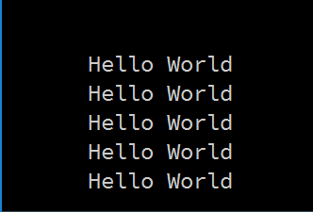
Simple do Loop
This basic do loop, produces this output.
int i = 1;
do {
System.out.println("Hello World");
i++;
} while (i <=5);

Slide 18
Topics
For loops
2. Comparison of while and for loops
3. do while loops (this slide deck)
4. Comparison of while and do while

Slide 19
Do versus While
Use a do loop when the code that may be repeated must be run at least once
Use a while loop when the code that may be repeated may never run

Slide 20

Questions?

