Slide 1

Methods – So far
Methods terminology
Produced
by:
Dr. Siobhán Drohan
Mr. Colm Dunphy
Ms Mairead Meagher
Ms Siobhan Roche
Department of Computing and Mathematics
setu.ie

Slide 2
Why do we need methods?
At times, a certain portion of code has to be used many times.
Instead of re-writing the code many times, it is better to put them into a "subroutine", and "call" this "subroutine" many time - for ease of maintenance and understanding.
Subroutine is called method (in Java) or function (in C/C++).

Slide 3
What are methods?
A method is a reusable block of code that performs a specific task.
It helps organise a program by breaking it into smaller, manageable parts.
Methods can be called whenever needed, reducing repetition and making the code easier to read and maintain.
Methods help us so we don’t have to write the same instructions over and over—they make our code cleaner, faster, and more fun!

Slide 4
Benefits of using methods?
Divide and conquer: Construct the program from simple, small pieces or components. Modularise the program into self-contained tasks.
Avoid repeating code: It is easy to copy and paste, but hard to maintain and synchronise all the copies.
Software Reuse: You can reuse the methods in other programs, by packaging them.

Slide 5
Topics list
Method terminology:
Return type
Method names
Parameter list
Notes:
Let’s look at the terminology used with methods.
Then we’ll look at handling mouse events using methods

Slide 6
Method terminology
Method signature / header
void printHello()
{
System.out.println(“Hello”);
}
Method body

Slide 7
Method signature
Return type
Method name
Parameter list
void printHello()

Slide 8
Topics list
Method terminology:
Return type
Method names
Parameter list

Slide 9
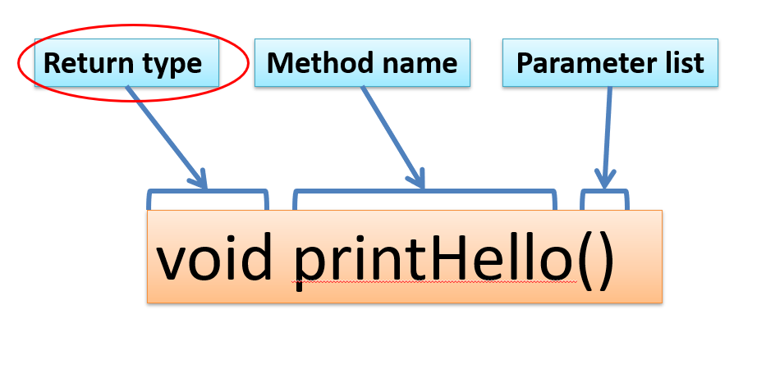
Return Type: void
Methods can return information.
The void keyword just before the method name means that nothing is returned from the method.
void is a return type and must be included in the method signature, if your method returns no information.

Slide 10
Return Type: int
When a data type (e.g. int) appears before the method name, this means that something is returned from the method.
Within the body of the method, you use the return statement to return the value.
E.g. return(1);
E.g. return(answer);

Slide 11
Return Type: int
Method header
int val = 30;
void draw()
{
int result = timesTwo(val);
System.out.println(result);
}
int timesTwo(int number)
{
number = number * 2;
return number;
}
// The red int in the method declaration
// specifies the type of data to be returned.
Method call
val is passed in becoming number
Method definition
Notes:
Draw attention to the naming of the variables in the parameter list. The actual name of the variable does not matter…the type is all java is interested in. To demonstrate this concept, val and number are used.

Slide 12
Return Types
Methods can return any type of data e.g.
boolean
byte
char
int
float
String
etc.
You can only have one return type, per method.

Slide 13
Topics list
Method terminology:
Return type
Method names
Parameter list

Slide 14
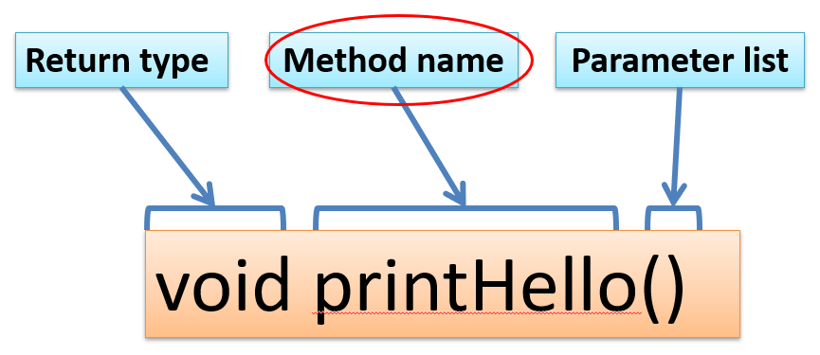
Method name
Method names should:
Use verbs (i.e. actions) to describe what the method does e.g.
calculateTax
printResults
Be mixed case with the first letter lowercase and the first letter of each internal word capitalised. i.e. camelCase

Slide 15
Topics list
Method terminology:
Return type
Method names
Parameter list

Slide 16
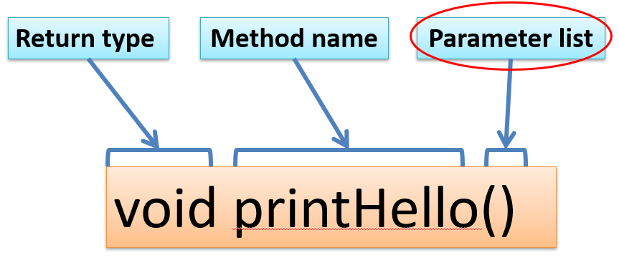
Parameter list
Methods take in data via their parameters.
Methods do not have to pass parameters e.g. setup() has no parameters.

Slide 17
Methods with NO parameters
void printFirstName()
void printFullName()
Methods do not have to pass parameters.
These methods have no parameters; note how no variable is passed in the parenthesis i.e. ().
These methods don’t need any additional information to do its tasks.
E.g. outputHello();
void outputHello(){
println(“Hello’);
}

Slide 18
Methods with Parameters
void println(String myString)
void printSum(int num1, int num2)
A parameter is a variable declaration –
it has a type (e.g. int) and a name (e.g. num1).
If a method needs additional information to execute, we provide a parameter/s, so that the information can be passed into it.
The first method, println, above has one parameter.
The second method printSum has two parameters
Methods can have any number of parameters

Slide 19

Questions?

