Slide 1

Using Methods
More on writing methods
Produced
by:
Dr. Siobhán Drohan
Mr. Colm Dunphy
Ms Mairead Meagher
Ms Siobhan Roche
Department of Computing and Mathematics
setu.ie

Slide 2
Topics list
Method examples – return values
Celcius / Farenheit Converter.
Cubed
Product
Boolean methods
Overloading methods.

Slide 3
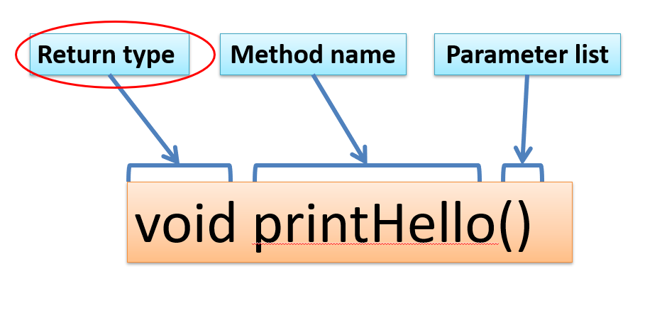
Return Type
Methods can return information.
The void keyword just before the method name means that nothing is returned from the method.
When a data type (e.g. int) appears before the method name, this means that something is returned from the method.
Within the body of the method, you use the return statement to return the value.
int timesTwo(int number)
{
number = number * 2;
return number;
}

Slide 4
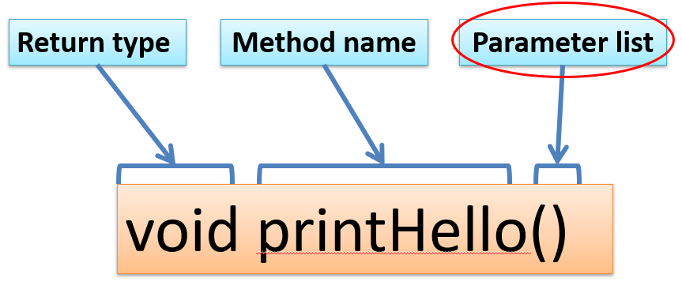
Parameter list
Methods take in data via their parameters.
Methods do not have to pass parameters
A parameter is a variable declaration –
it has a type (e.g. int) and a name (e.g. num).
If a method needs additional information to execute, we provide a parameter, so that the information can be passed into it.
Methods can have any number of parameters
int timesTwo(int number)
{
number = number * 2;
return number;
}

Slide 5
Return a double
Now we consider an example where the method does return a value (which could be any data type) but in this next example it returns a double.

Slide 6
Example 1 – Farenheit to Celsius
double celsius = farenheitToCelsius (451.0);
System.out.println("Celsius value is: " + celsius);
Farenheit value is hardcoded as a literal.
232.77779
Celsius value is: 232.77779
Return type
double farenheitToCelsius (double farenheit)
{
double result = (farenheit - 32.0) * (5.0/9.0);
return result;
}
451.0
232.77779
451.0
Source: Reas & Fry (2014)

Slide 7
Example 1 – Updated
double farenheitToCelsius (double farenheit)
{
double result = (farenheit - 32.0) * (5.0/9.0);
return result;
}
both methods are exactly the same
double farenheitToCelsius (double farenheit)
{
return (farenheit - 32.0) * (5.0/9.0);
}
Source: Reas & Fry (2014)

Slide 8
Topics list
Method examples – return values
Celcius / Farenheit Converter.
Cubed
Product
Boolean methods
Overloading methods.

Slide 9
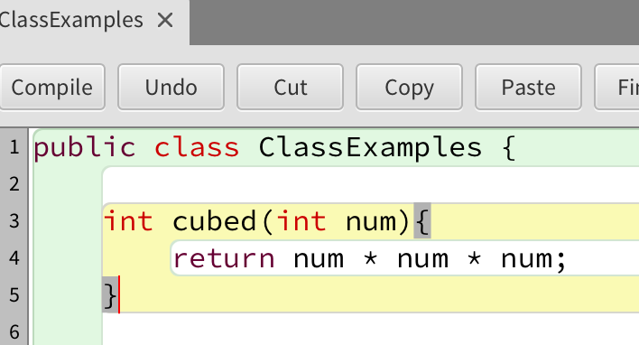
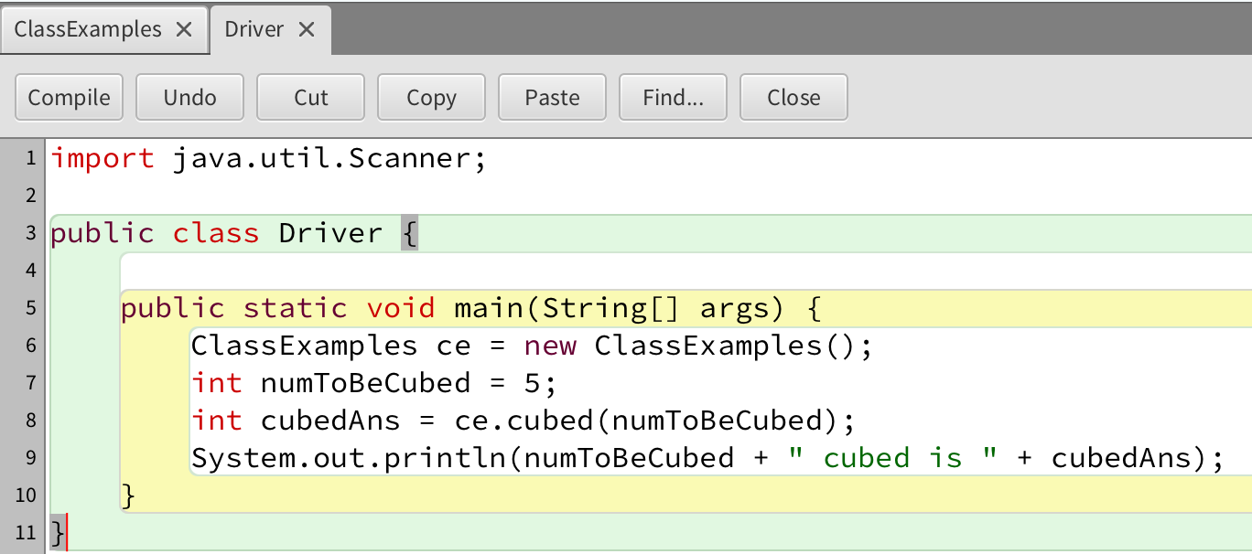
Example: Cubed
5
5
5
5
125
Return type
Notes:
// Cubed
void setup ()
{
size(1024,768);
textSize(40);
fill(0,0,255);
}
void draw()
{
int number = 5;
text (number + " cubed is " + cubed(number), 100,100 );
}
int cubed (int num)
{
return num * num * num ;
}

Slide 10
Topics list
Method examples – return values
Celcius / Farenheit Converter.
Cubed
Product
Boolean methods
Overloading methods.

Slide 11
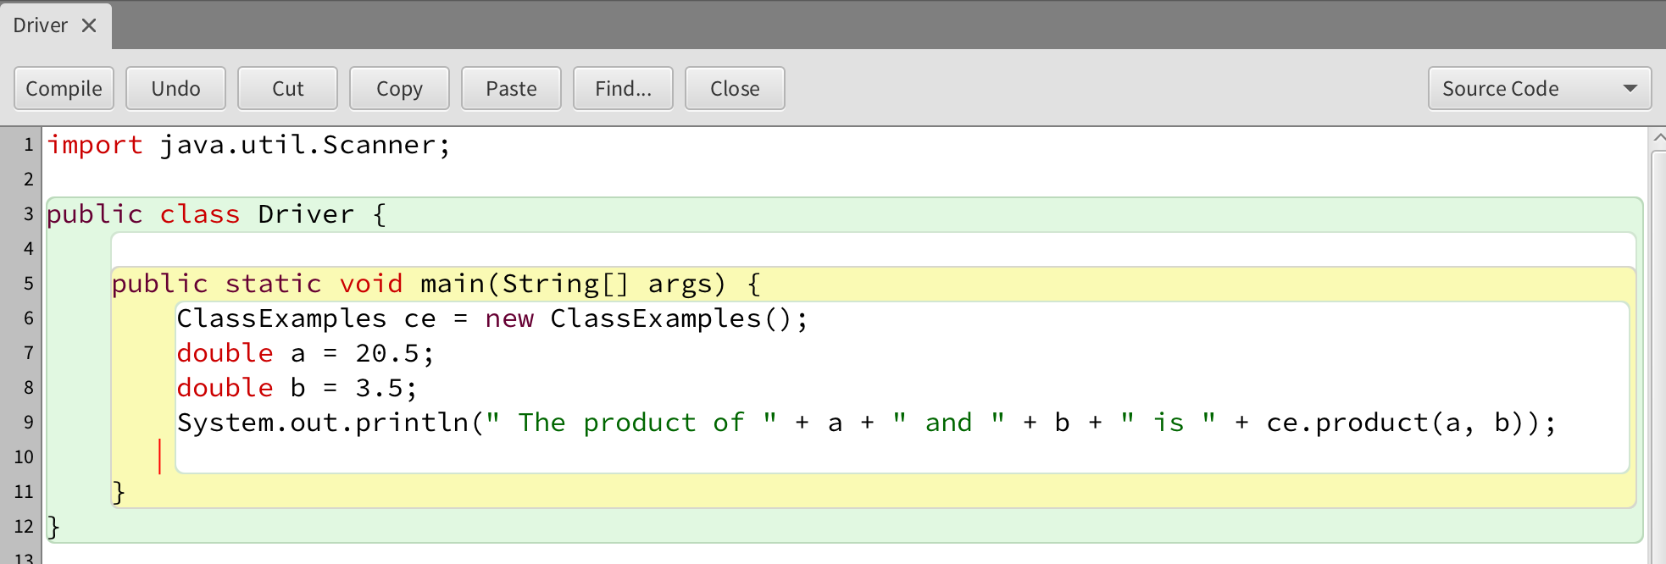
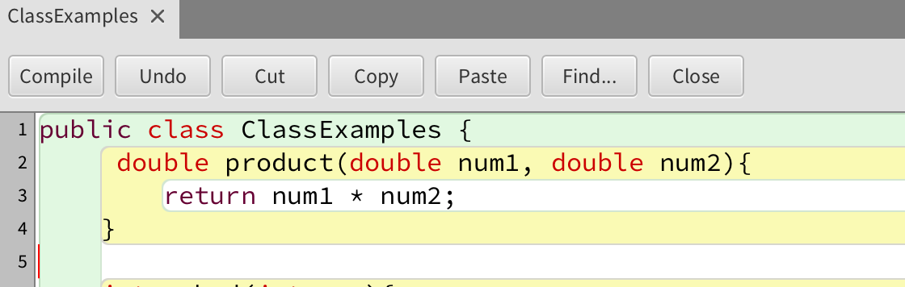
Example: Product
Return type
Notes:
// Cubed
void setup ()
{
size(1024,768);
textSize(40);
fill(0,0,255);
}
void draw()
{
int number = 5;
text (number + " cubed is " + cubed(5), 100,100 );
}
int cubed (int num)
{
return num * num * num ;
}

Slide 12
Topics list
Method examples – return values
Celcius / Farenheit Converter.
Cubed
Product
Boolean methods
Overloading methods.

Slide 13
What is a Boolean Method?
A Boolean method returns a boolean value — either true or false.
They are used to check conditions and make decisions in a program.
Examples: checking if a number is even, verifying a temperature range, or determining permissions.

Slide 14
Syntax – Defining a Boolean Method
public boolean isEven(int number) {
if (number % 2 == 0) {
return true;
}
else {
return false;
}
}
public boolean → method returns a Boolean
isEven → typically starts with is, has, or can
return true / false → gives back the Boolean result

Slide 15
public boolean isEven(int number) { if (number % 2 == 0) { return true; } else { return false; } }

Slide 16
Long Form
Short Form
public boolean isEven(int number) { if (number % 2 == 0) { return true; } else { return false; } }
public boolean isEven(int number) { return number % 2 == 0; }

Slide 17
public boolean isEven(int number) { return number % 2 == 0; }

Slide 18
Using a Boolean Method
public boolean isEven(int number) {
if (number % 2 == 0) {
return true;
}
else {
return false;
}
}
Output: Number is even
Explanation: The if statement calls the Boolean method and uses its result directly.
if (isEven(8)) {
System.out.println('Number is even’);
}
else {
System.out.println('Number is odd');
}

Slide 19
Boolean Method with Objects
Explanation:
The expression itself produces a true or false value.
You can return the expression directly without an if statement.
public boolean isAdult(int age) {
return age >= 18;
}

Slide 20
Typical Boolean Method Names
Check if number is positive → isPositive()
Check if user has access → hasAccess()
Check if list is empty → isEmpty()
Check if two values match → equals()
Tip: Boolean methods usually start with verbs like is, has, or can.

Slide 21
Why Use Boolean Methods?
✅ Make code clearer and reusable
✅ Separate checking logic from actions
✅ Work naturally with if, while, and logical operators (&&, ||, !)

Slide 22
Other Examples
Check is a number between (inclusive) a lower and upper limit
public boolean isBetween(int numToCheck, int lower, int upper) {
if (lower <= numToCheck && numCheck <= upper) {
return true;
}
else {
return false;
}
}

Slide 23
public boolean isBetween(int numToCheck, int lower, int upper) {
if (lower <= numToCheck && numCheck <= upper) {
return true;
}
else {
return false;
}
}

Slide 24
Long Form
Short Form
public boolean isBetween(int numToCheck, int lower, int upper) {
if (lower <= numToCheck && numCheck <= upper) {
return true;
}
else {
return false;
}
}
public boolean isBetween(int numToCheck, int lower, int upper) {
return(lower <= numToCheck && numCheck <= upper) ;
}

Slide 25
public boolean isBetween(int numToCheck, int lower, int upper) {
return(lower <= numToCheck && numCheck <= upper) ;
}

Slide 26
Topics list
RECAP: Method Terminology:
Method examples – return values
Celcius / Farenheit Converter.
Cubed
Product
Overloading methods.

Slide 27
Overloaded methods
Multiple methods can have the same name, once they have a different parameter list.
We could write the following:
void addNum()
void addNum (int num1, int num2)
void addNum (int num1, int num2, int num3)
void addNum (int num1, int num2, int num3, int num4)
Same Name
Different Parameter List
Source: Reas & Fry (2014)

Slide 28
Overloaded methods
Method signature | Parameter List
void addNum() | no parameter
void addNum(int num1, int num2) | int, int
void addNum(int num1, int num2, int num3) | int, int, int
void addNum(int num1, int num2, int num3, int num4) | int, int, int, int
Same method name, but different parameter list
Source: Reas & Fry (2014)

Slide 29
Overloaded methods
A program can have two or more methods with the same name, only if their parameter list is different.
When Java is checking that a parameter list is different, it is not checking the name of the variables, it is checking the data type of the variables e.g.
this is permitted as the data type is different:
void addNum ( int num1)
void addNum ( double num1)
Data types must be different for a method with the same name to be overloaded
Source: Reas & Fry (2014)

Slide 30

Overloaded methods
public class ClassExamples { void addNum(double num1, double num2){ double result = num1 + num2; System.out.println("This is double addNum " + result); }
void addNum(int num1, int num2){ int result = num1 + num2; System.out.println("This is int addNum " + result);; }
}
public class Driver { public static void main(String[] args) { ClassExamples ce = new ClassExamples(); double cel = ce.farenheitToCelsius(451); double c = 20.5; double d = 3.5; ce.addNum(c, d); } }
Q: Which addNum method is called and why?

Slide 31
Overloaded methods
When you call a method, Java matches the number and type of the arguments you passed to the method, with all the declared methods.
When a match is found, Java invokes that method e.g.
addNum (0, 4) calls void addNum (int num1, int num2)
addNum (0.0, 4.0) calls void addNum (double num1, double num2)
Source: Reas & Fry (2014)

Slide 32
Key features of Method Overloading
Multiple methods can share the same name in a class when their parameter lists are different.
Overloading is a way to increase flexibility and improve the readability of code.
Overloading does not depend on the return type of the method, two methods cannot be overloaded by just changing the return type.
It does depend on:
The number of parameters
The types of parameters
The order of parameters

Slide 33

Questions?

