Slide 1


Miscellaneous
Arithmetic Ops, Compound Assignment Stmts, Order of Eval
Produced
by:
Ms. Mairead Meagher,
Ms. Siobhán Roche.
Department of Computing and Mathematics
http://www.setu.ie/
7.0

Slide 2
Topics list
Recap on Arithmetic Operators.
Compound Assignment Statements
Order of Evaluation

Slide 3
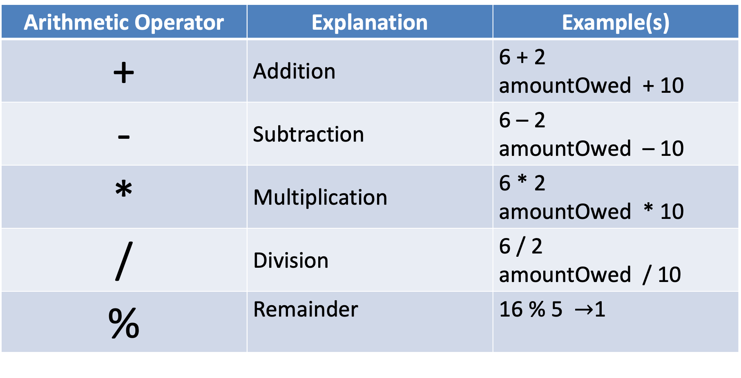
Arithmetic Operators
Arithmetic Operator | Explanation | Example(s)
+ | Addition | 6 + 2 amountOwed + 10
- | Subtraction | 6 – 2 amountOwed – 10
* | Multiplication | 6 * 2 amountOwed * 10
/ | Division | 6 / 2 amountOwed / 10
% | Remainder | 16 % 5 $→$1

Slide 4
Topics list
Recap on Arithmetic Operators.
Compound Assignment Statements
Order of Evaluation

Slide 5
Compound Assignment Statements
 | Full statement | Shortcut
Mathematical shortcuts | x = x + a; | x += a;
 | x = x - a; | x -= a;
 | x = x * a; | x *= a;
 | x = x/a; | x /=a;
Increment shortcut | x = x+1; | x++;
Decrement shortcut | x = x - 1; | x--;
Notes:
Objects First with Java
© David J. Barnes and Michael Kölling
5

Slide 6
Arithmetic Operators
These examples are straightforward uses of the arithmetic operators.
However, we typically want to do more complex calculations involving many arithmetic operators.
To do this, we need to understand the Order of Evaluation.

Slide 7
Topics list
Recap on Arithmetic Operators.
Compound Assignment Statements
Order of Evaluation

Slide 8
Order of Evaluation
Brackets ()
Multiplication (*)
Division (/)
Addition (+)
Subtraction (-)
BoMDAS
Beware My Dear Aunt Sally

Slide 9

Order of Evaluation - Quiz
What are the results of these calculations?
Q1: 3+6*5-2
Q2: 3+6*(5-2)
Q3: (3+6)*5-2
Notes:
A1: 31
A2: 21
A3: 43

Slide 10

Questions?

