Slide 1


BlueJ
Lets get started.
Produced
by:
Ms. Mairead Meagher,
Ms. Siobhán Roche.
Department of Computing and Mathematics
http://www.setu.ie/

Slide 2

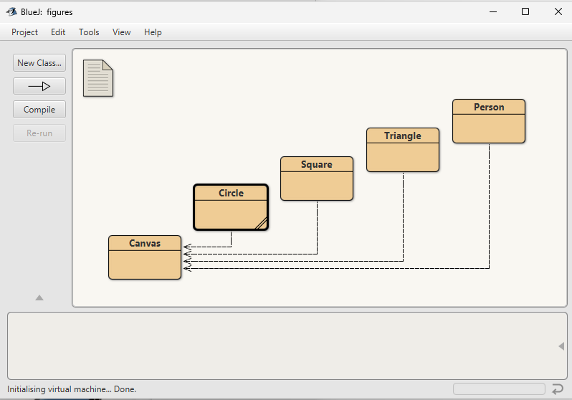
What is BlueJ?
BlueJ is a free, beginner-friendly integrated development environment (IDE) for the Java programming language, designed to teach object-oriented programming concepts.

Slide 3
Why are we using BlueJ?
Simple, non-intimidating interface
Interactive object creation
Powerful visualisation of class structure and objects
Makes complex Object-Oriented Programming (OOP) concepts easier for beginners to grasp and experiment with.

Slide 4

What is Programming?
Programming IS problem solving.
Notes:
You should ALWAYS think about how you are going to solve the programming problem BEFORE jumping in and starting to code.
Give examples of problem being solved e.g. registering students on day 1 of a college course…steps involved are broken down into individual instructions, followed in a particular order (sequence), with some instructions being made conditionally (selection) and some instructions being done repetitively (iteration). Selection could be if they have a previous qualification, do something. Repetition…maybe they have multiple phone numbers that need to be entered?

Slide 5
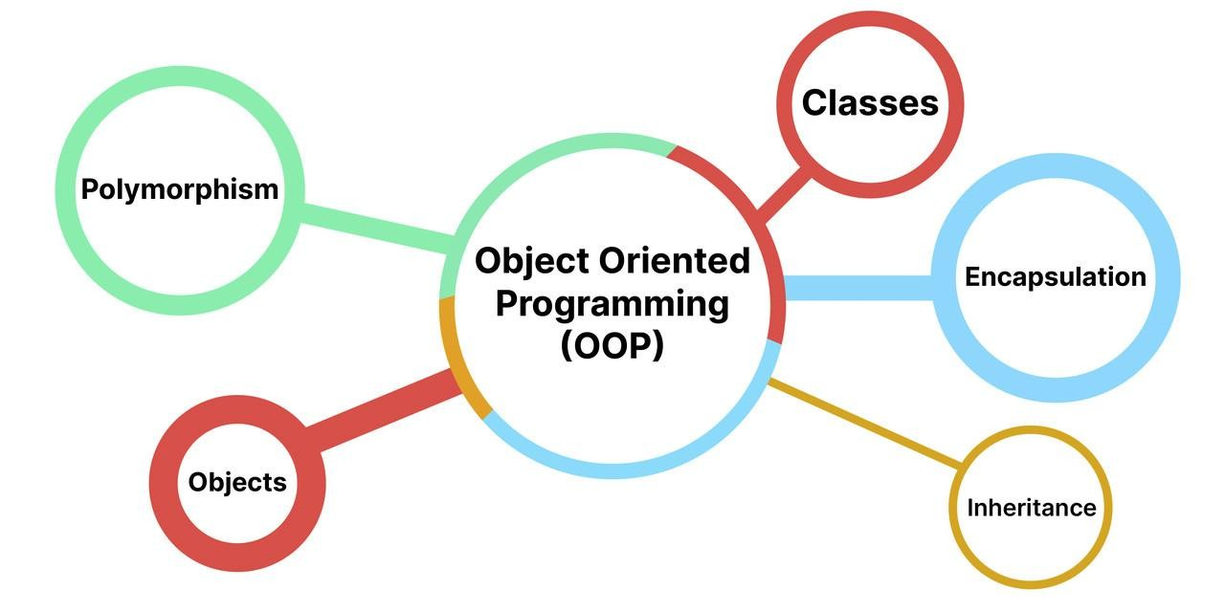
What is Object Oriented Programming (OOP)?
Object-oriented programming is based on the concept of objects.
In object-oriented programming data structures, or objects are defined, each with its own properties or attributes.
Each object can also contain its own procedures or methods

Slide 6
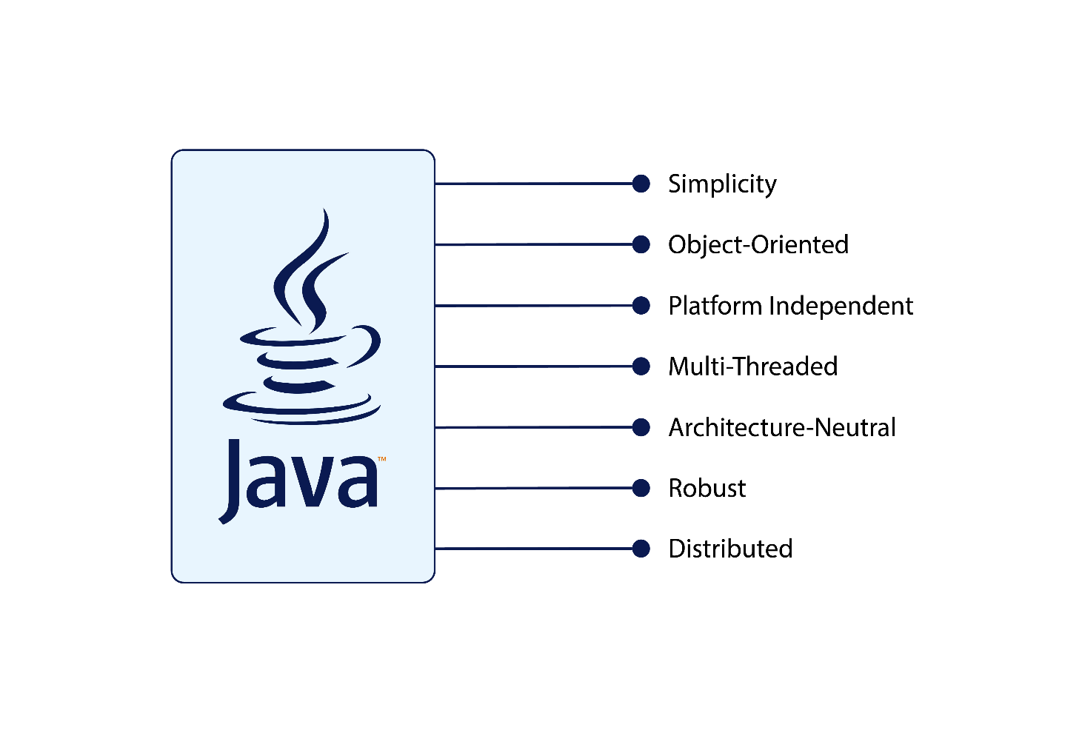
What is Java?
Java is a multiplatform, object-oriented programming language that runs on billions of devices worldwide.
It powers applications, smartphone operating systems, enterprise software, and many well-known programs.
Despite having been invented over 20 years ago, Java is currently the most popular programming language for app developers.

Slide 7
Flow of Control in a Program
Each program you write will typically have:
Sequence | Things that will be done in a particular order
Selection | Things that will be done conditionally
Iteration | Things that will be done repetitively

Slide 8
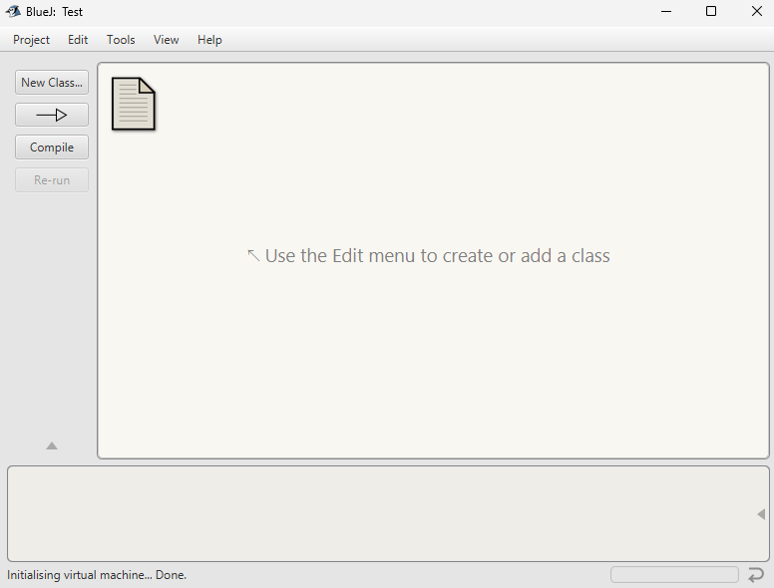
Launch BlueJ
Project Window
Toolbar
Class Diagram Area

Slide 9
Hello World
BlueJ

Slide 10
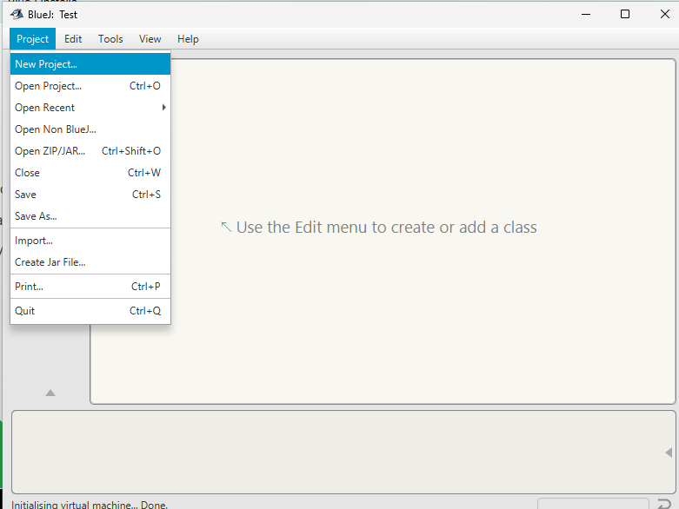
New Java Project
Click on Project -> New Project

Slide 11
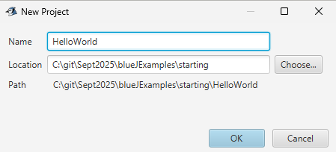
New Java Project
Give your project a name and location, press OK

Slide 12
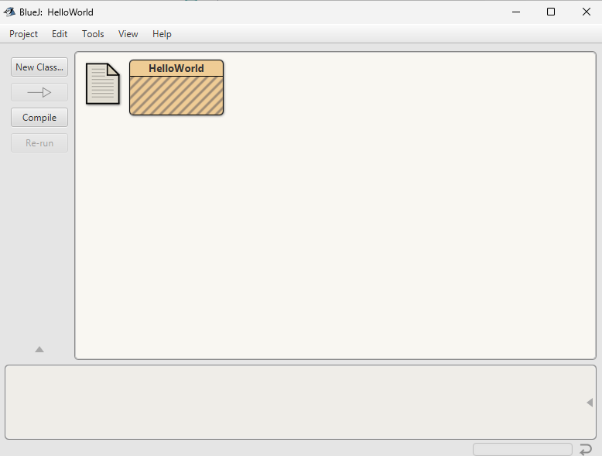
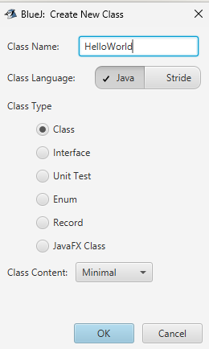
New Java Project
Click on New Class, and name it

Slide 13
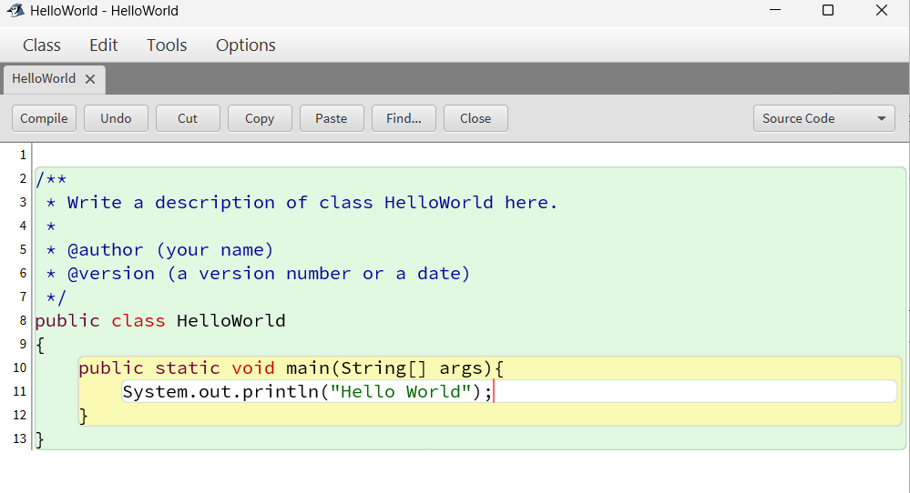
main method
Double-Click on the HelloWorld class, and add the following code
Main method

Slide 14
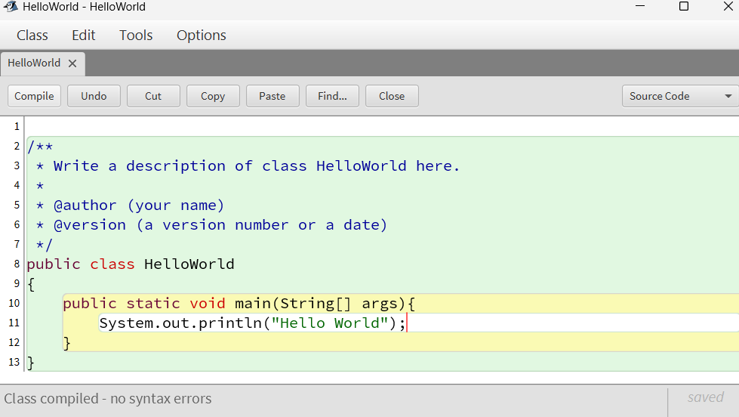
Compile
Click Compile

Slide 15
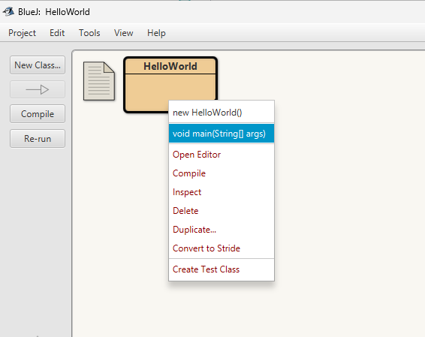
Run your Code
Right-Click on your class, and choose your main method

Slide 16
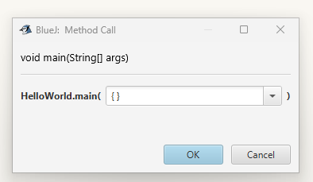
Run your Code
Click OK

Slide 17
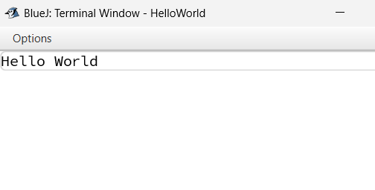
Output
You should see the following in your code window

Slide 18

Questions?

