Slide 1

Shop v2.1 – Store Add more methods
Produced
by:
Ms Siobhan Roche
Ms Mairead Meagher
Department of Computing and Mathematics
http://www.setu.ie/

Slide 2
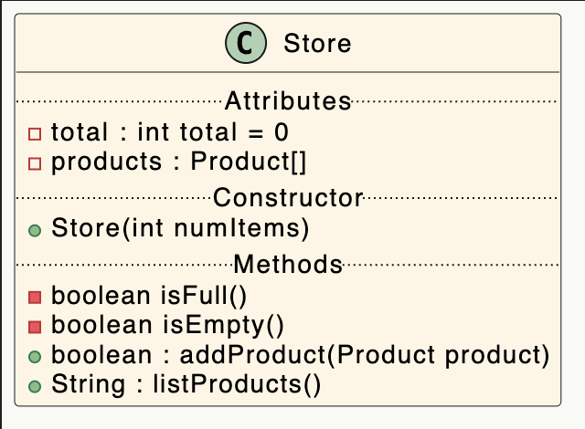
Shop V2.1 – Store Class
fields
constructor
Private methods
public methods

Slide 3
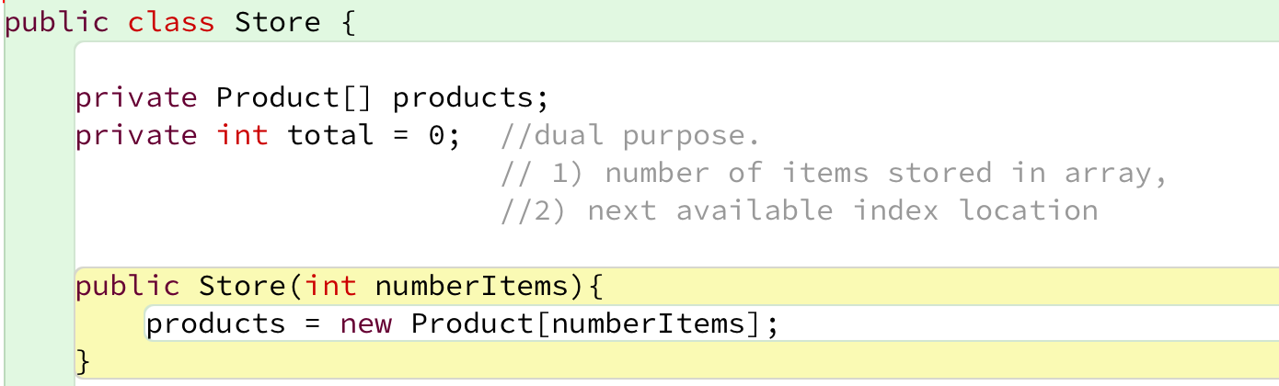
Shop V2.1 – Store – Fields and Constructor

Slide 4
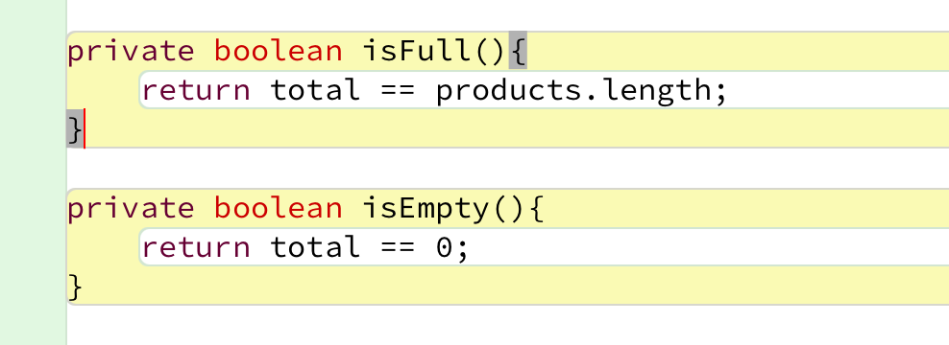
Shop V2.1 – Store (private methods)
getters
isFull() & isEmpty() return state of fields.
They are private member methods.

Slide 5
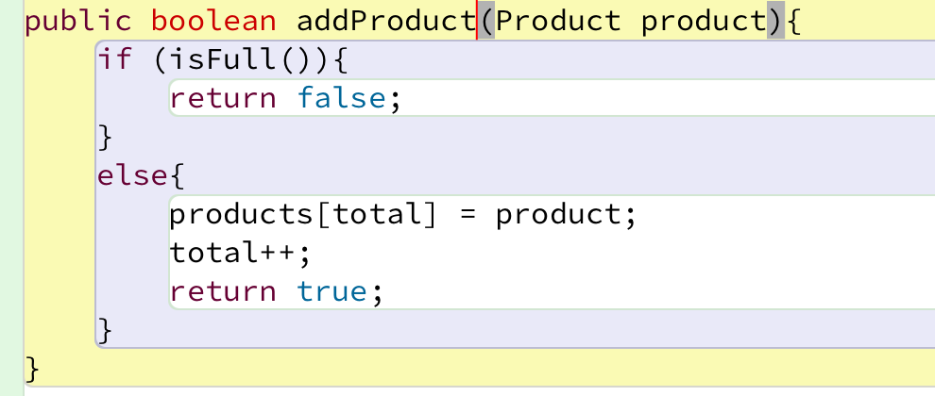
Shop V2.1 – Store (addProduct() Method)
addProduct() makes use of private method isFull()

Slide 6
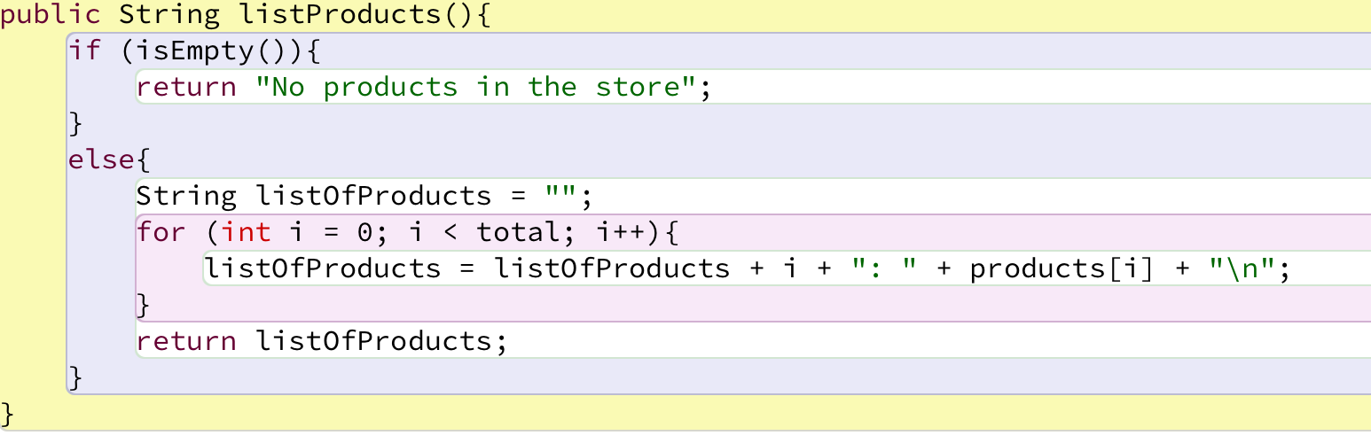
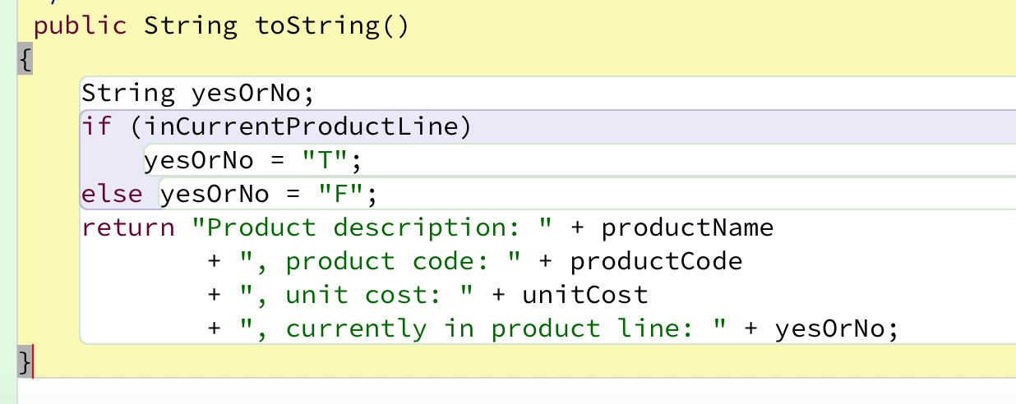
Shop V2.1 – Store (listProducts())
Product Class
list
toString ’type’ method listProducts() makes use of private method isEmpty()

Slide 7
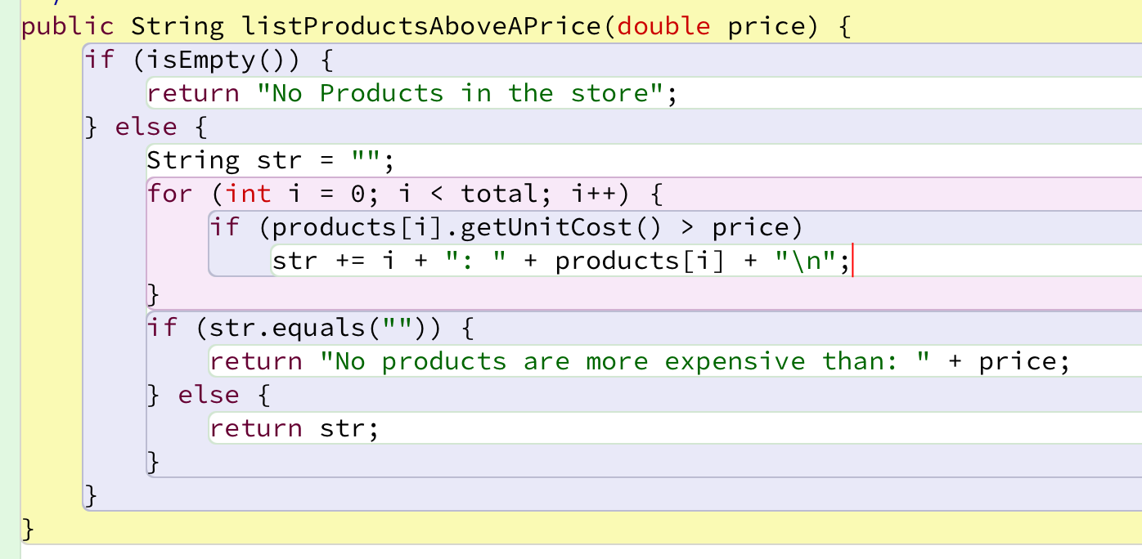
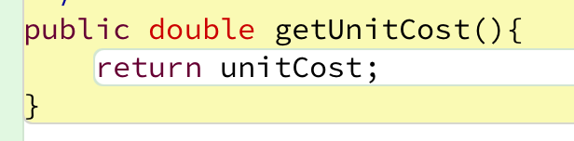
Shop V2.1 – Store (listProductsAbovePrice(..))
Product Class

Slide 8
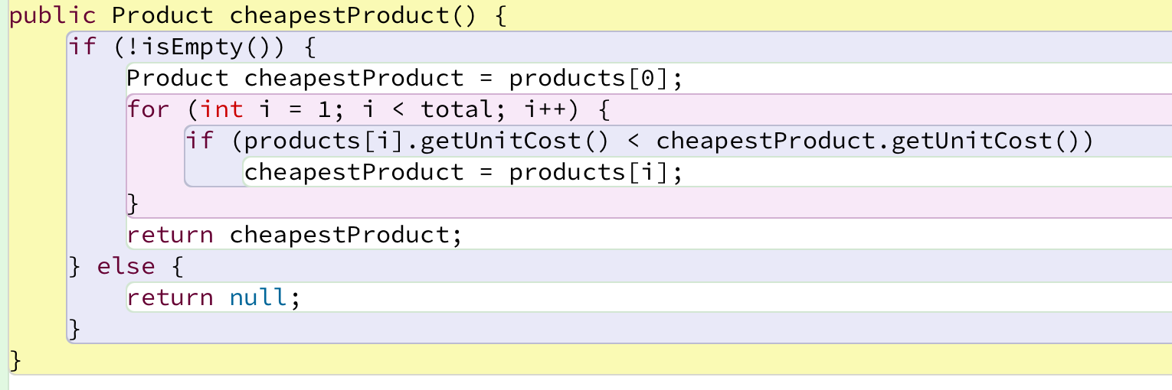
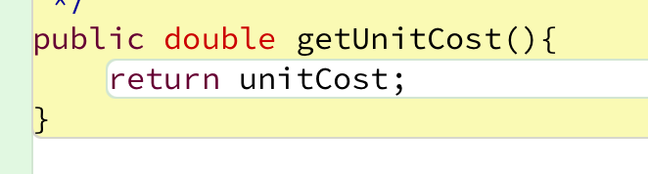
Shop V2.1 – Store (cheapestProduct())
Product Class

Slide 9
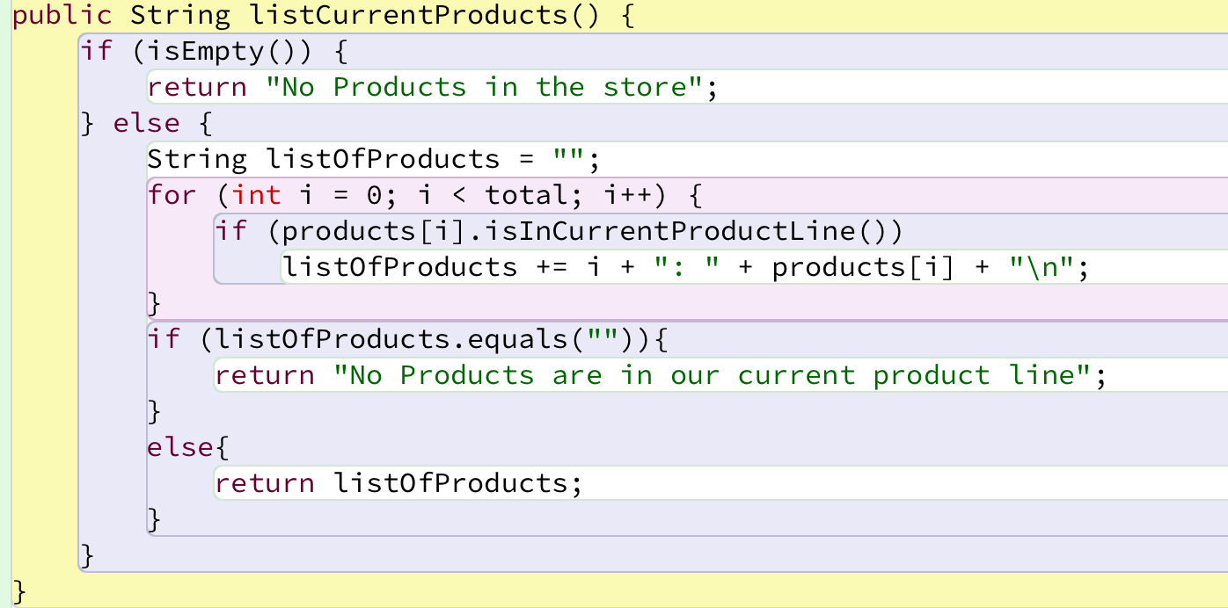
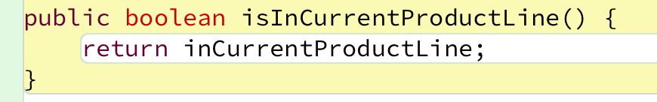
Shop V2.1 – Store (listCurrentProducts())
Product Class

Slide 10
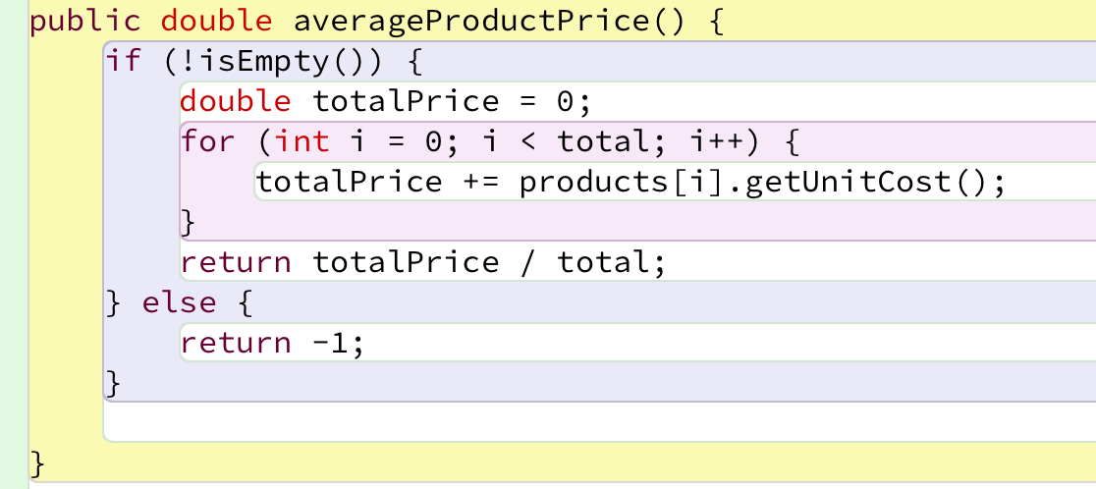
Shop V2.1 – Store (averageProductPrice())
Product Class

Slide 11
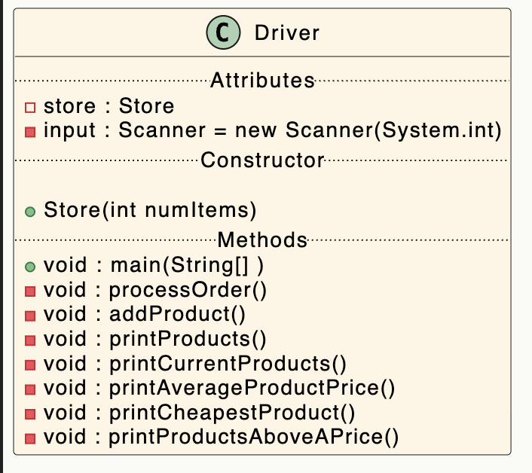
Shop V2.1 – Driver

Slide 12

Questions?

