Slide 1

Introducing the ScannerInput Class
Enhancing User Input Handling in Java
Produced
by:
Ms. Maireád Meagher
Ms Siobhan Roche
Department of Computing and Mathematics
http://www.setu.ie/

Slide 2
Recap: Scanner for User Input
Scanner is used to read user input
Example:
Scanner input = new Scanner(System.in);
int age = input.nextInt();
Problem: Buffer issues and invalid input handling

Slide 3
Common Problems with Scanner
Buffering issues when mixing nextInt() and nextLine()
No built-in input validation
Repetitive error-handling code in multiple places

Slide 4
Solution: ScannerInput Class
Encapsulates input logic
Ensures valid data types
Eliminates Scanner buffer issues
Provides a reusable interface

Slide 5
How ScannerInput Works
Example:
  int age = ScannerInput.readNextInt("Enter your age: ");
How it works:
    Prompts user for input
    Parses input inside a loop
    Catches invalid values and retries

Slide 6
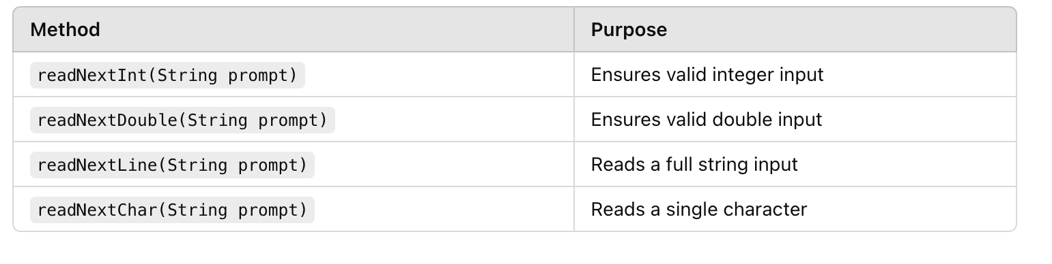
Key Methods in ScannerInput

Slide 7
Code Example
public class ScannerInput {
/**
* Read an int from the user. If the entered data isn't actually an int,
* the user is prompted again to enter the int.
*
* @param prompt The information printed to the console for the user to read
* @return The number read from the user and verified as an int.
*/
public static int readNextInt(String prompt) {
do {
var scanner = new Scanner(System.in);
try {
System.out.print(prompt);
return Integer.parseInt(scanner.next());
}
catch (NumberFormatException e) {
System.err.println("\tEnter a number please.");
}
} while (true);
}
}

Slide 8
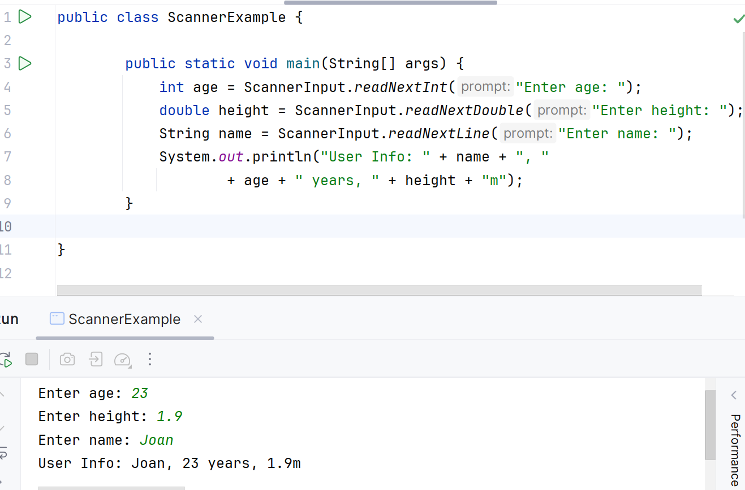
Example Usage of ScannerInput

Slide 9
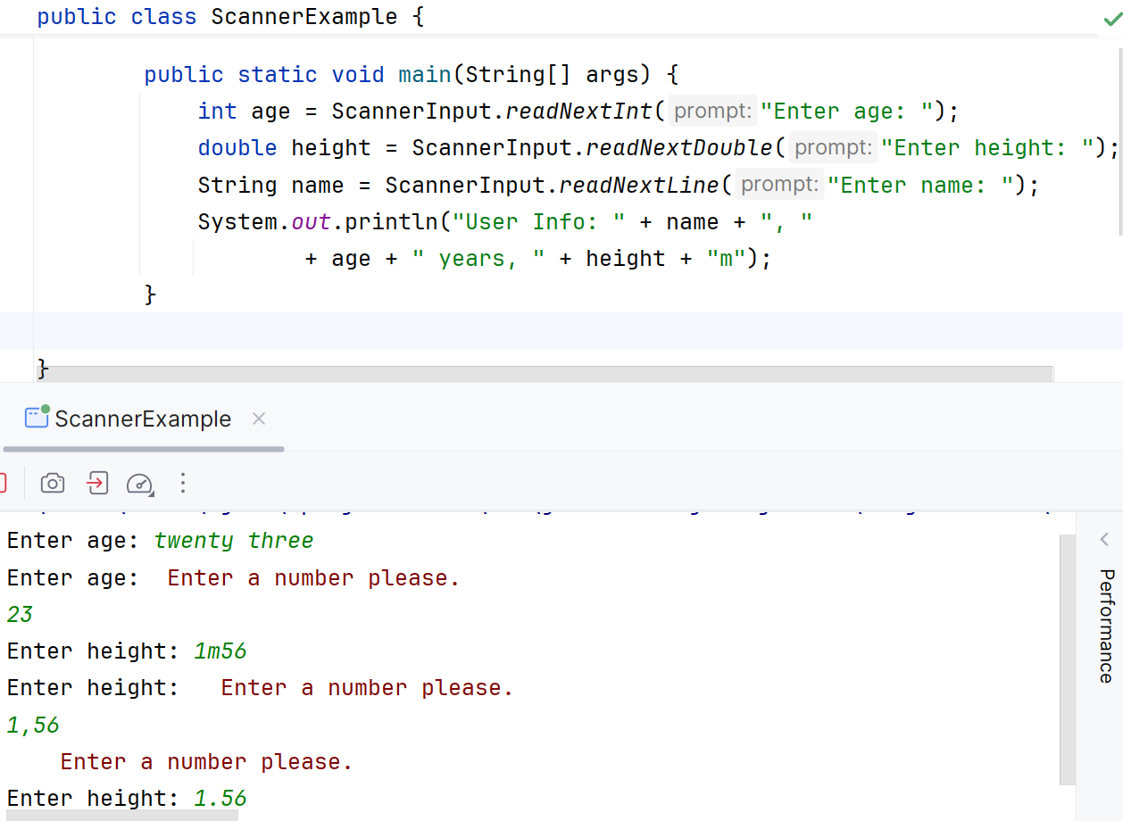
Validation Example

Slide 10
Benefits of Using ScannerInput
Prevents input errors (e.g., entering text instead of a number)
Simplifies code (no need for try-catch everywhere)
Reusable and efficient
Improves user experience

Slide 11

Any Questions?

