Slide 1


Searching
Basic searching algorithms
Produced
by:
Dr. Siobhán Drohan
Ms. Mairead Meagher
Ms. Siobhán Roche
Department of Computing and Mathematics
http://www.setu.ie/

Slide 2
Main concepts to be covered in this section
Searching
Linear Search (unsorted list)
Binary Search (sorted list)

Slide 3

Linear and binary searching
4.0

Slide 4
Searching
Generally a search method will look something like (ignore access modifier):
This method would return the position in the array of the value ‘lookingFor’ if it exists and –1 otherwise.
int search(int[] a, int size, int lookingFor)

Slide 5
Searching
Before we decide on how to search through a list we need to know whether or not the list is sorted.
Not Sorted → Linear Search
Sorted → Binary Search

Slide 6
Main concepts to be covered in this section
Searching
Linear Search (unsorted list)
Binary Search (sorted list)

Slide 7
Linear Search
public int linearsearch(int[] intArray, int size, int lookingFor)
{
int i = 0;
while (i < size)
{
if (intArray[i] == lookingFor)
return i; //this terminates the method
i++;
}
return -1; // we only get to here if we have got to
// end of list and never found item
}

Slide 8
Main concepts to be covered in this section
Searching
Linear Search (unsorted list)
Binary Search (sorted list)

Slide 9
Binary Search
If the list is sorted we make use of this (same way we search through telephone book)
The binary search is such a search and is a particularly efficient search.

Slide 10
Binary Search Algorithm
The overall algorithm works by always looking at the midpoint of the list.
If we have found what we are looking for, great.
If not…

Slide 11
Binary Search Algorithm contd.
If not...
…and the value we are looking for is less than the midpoint value…
…then, because the list is sorted, we can ‘throwaway’ all the values greater than the midpoint. So we ‘redraw’ our list to be the left-hand part of the list and repeat the procedure.

Slide 12
Binary Search Algorithm contd..
If not…
…and the value we are looking for is greater than the midpoint value…
…then (using the same logic) we ‘redraw’ the list to just include the right-hand part of the list and repeat the procedure.

Slide 13
Binary Search Code
public int binarysearch(int[] intArray, int size, int lookingFor)
{
int mid;
int left = 0;
int right = size-1;
while (left <= right)
{
mid = (left + right) / 2;
if (intArray[mid] == lookingFor)
return mid; //this terminates the method
else if (intArray[mid] > lookingFor) // element in left hand of list, if it exists.
right = mid - 1;
else if (intArray[mid] < lookingFor) // element in right hand of list, if it exists.
left = mid + 1;
}
return -1; //this terminates the method because we have gone through all list and it’s not there
}

Slide 14
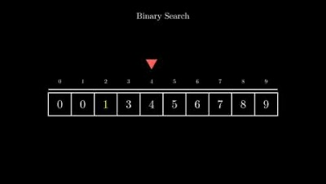
Animation of both searches
Problems with this link – use youtube link in footer.

Slide 15

Any Questions?

Slide 16


