Slide 1

More on Abstraction in Java
More on Interfaces
Produced
by:
Ms. Mairead Meagher
Dr. Siobhán Drohan
Siobhán Roche
Department of Computing and Mathematics
http://www.setu.ie/

Slide 2
Topic List
Interfaces define Types.
Recap of Social Network V8.0 – Abstract Classes and Methods
An Interface Example – Social Network V9.0.
Naming Conventions for Interfaces.

Slide 3
Interfaces Define Types
Interfaces define Types
They define common behaviour i.e. methods
Can be used to promote design to a higher level of abstraction
Can be used where multiple implementations of one abstraction are envisaged
Implementing classes are subtypes of the interface type.
Classes can implement one or more Interfaces as appropriate i.e. have more than one type.

Slide 4
Interfaces Impose Types
If a variable is declared as an Interface type:
IMammal dog;
interface IMammal
{
void eat();
void travel();
}

Slide 5
Interfaces Impose Types
If a variable is declared as an Interface type:
IMammal dog;
Then any instance of any class that implements that Interface can be assigned to that variable.
IMammal dog = new Mammal();
interface IMammal
{
void eat();
void travel();
}
public class Mammal implements IMammal{
public void eat(){
System.out.println("Mammal eats");
}
public void travel(){
System.out.println("Mammal travels");
}
}

Slide 6
Interfaces Impose Types
When you define a new interface, you are defining a new Reference Data Type.
You can use interface names anywhere you can use any other data type name.
If you define a Reference variable whose type is an interface e.g.
IMammal dog;
any object you assign to it must be an instance of a class that implements the interface e.g.
dog = new Mammal();
interface IMammal
{
void eat();
void travel();
}
public class Mammal implements IMammal{
public void eat(){
System.out.println("Mammal eats");
}
public void travel(){
System.out.println("Mammal travels");
}
}
https://docs.oracle.com/javase/tutorial/java/IandI/interfaceAsType.html

Slide 7
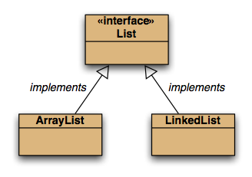
Interfaces in Collections Framework

Slide 8
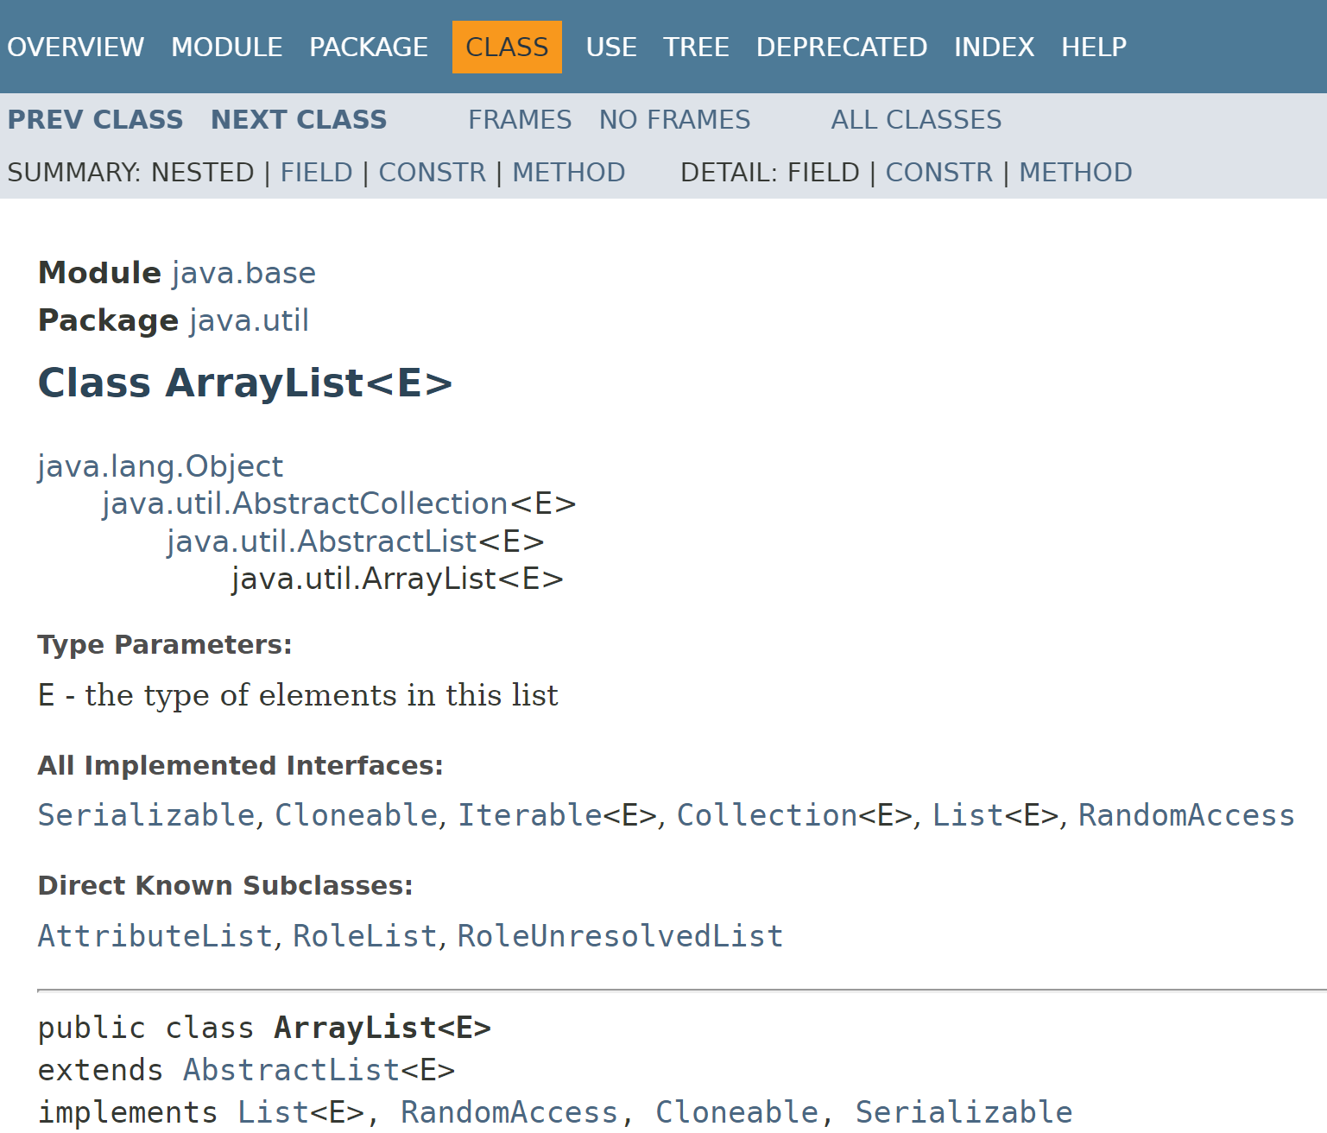
Interfaces in Collections Framework
ArrayList implements the List interface.

Slide 9
Interfaces in Collections Framework
ArrayList implements the List interface.
Recall this rule:
If you define a reference variable whose type is an interface, any object you assign to it must be an instance of a class that implements the interface.
Applying this rule to a List:
List<Product> products = new ArrayList<Product>();

Slide 10
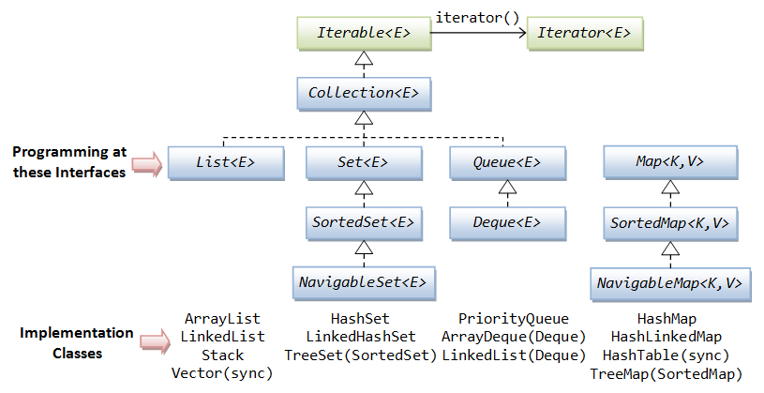
Interfaces in Collections Framework

Slide 11
Topic List
Interfaces define Types.
Recap of Social Network V8.0 – Abstract Classes and Methods
Social Network V9.0 - An Interface Example
Naming Conventions for Interfaces.

Slide 12
RECAP - Social Network V8.0 – Post and LikedPost Abstract
Driver
NewsFeed
<abstract> Post
<abstract> LikedPost
EventPost
MessagePost
PhotoPost

Slide 13
Recap - Abstract classes and methods
If you wish all subclasses of a class to implement a particular method as part of its code, simply write an abstract method heading in the superclass.
Each concrete subclass must have this method fully coded.
Each class that has an abstract method must be made abstract too.

Slide 14
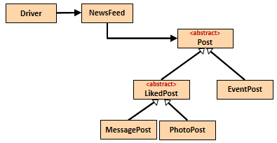
RECAP - Syntax for abstract classes
//code omitted
public abstract class Post { private String author = ""; public Post(String author) { this.author = Utilities.truncateString(author, 10); }
//code omitted }
//code omitted
public abstract class LikedPost extends Post { private int likes = 0; public LikedPost(String author){ super(author); }
//code omitted

Slide 15
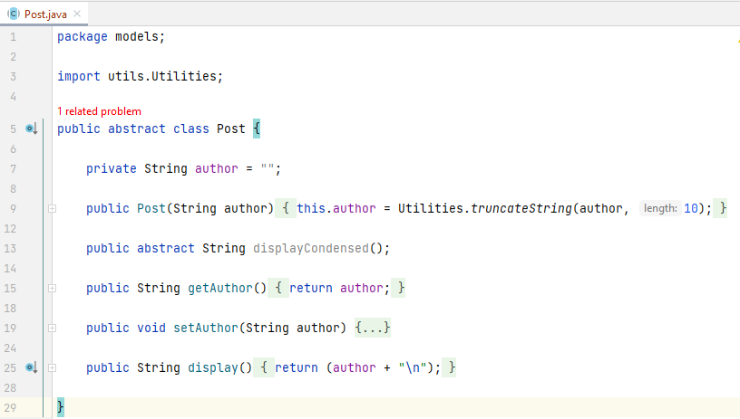
displayCondensed() in Post

Slide 16
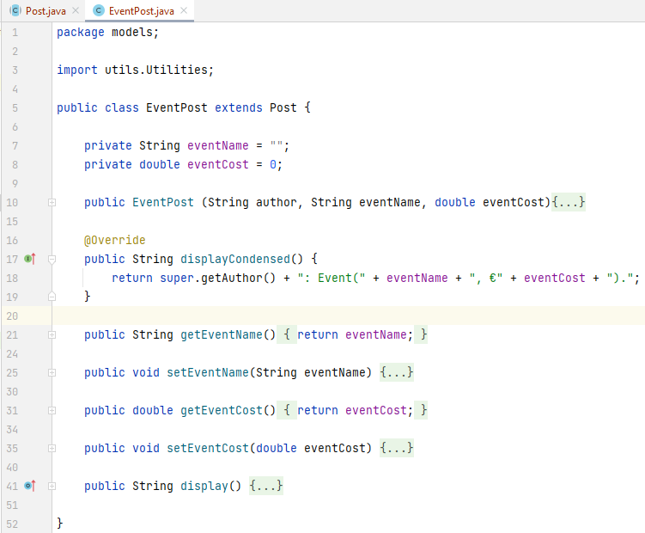
displayCondensed() in EventPost

Slide 17
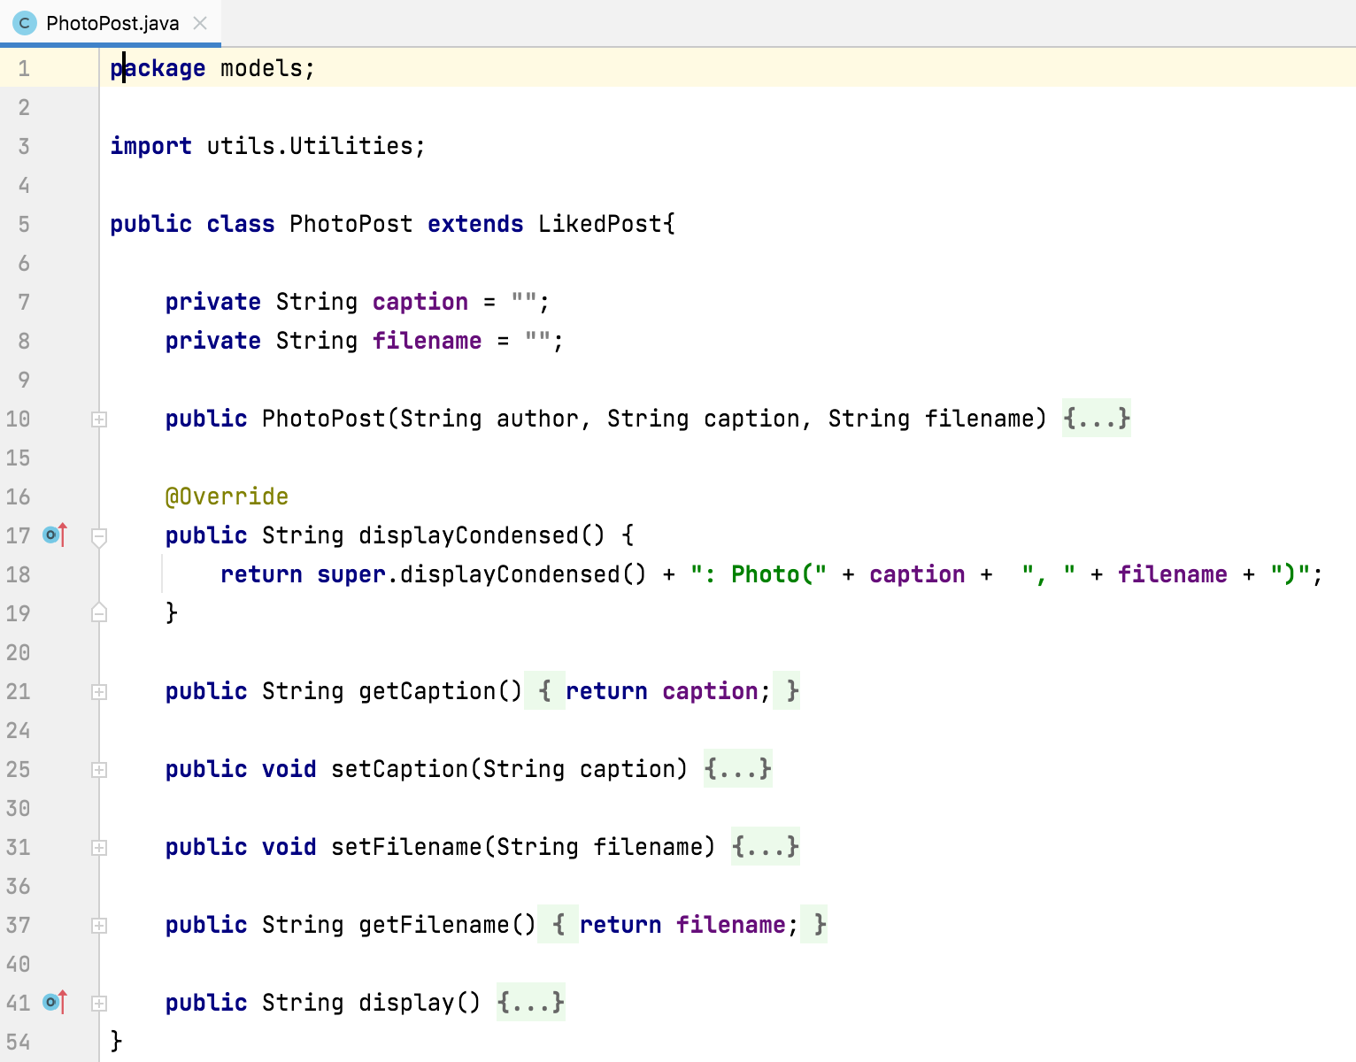
displayCondensed() in PhotoPost

Slide 18
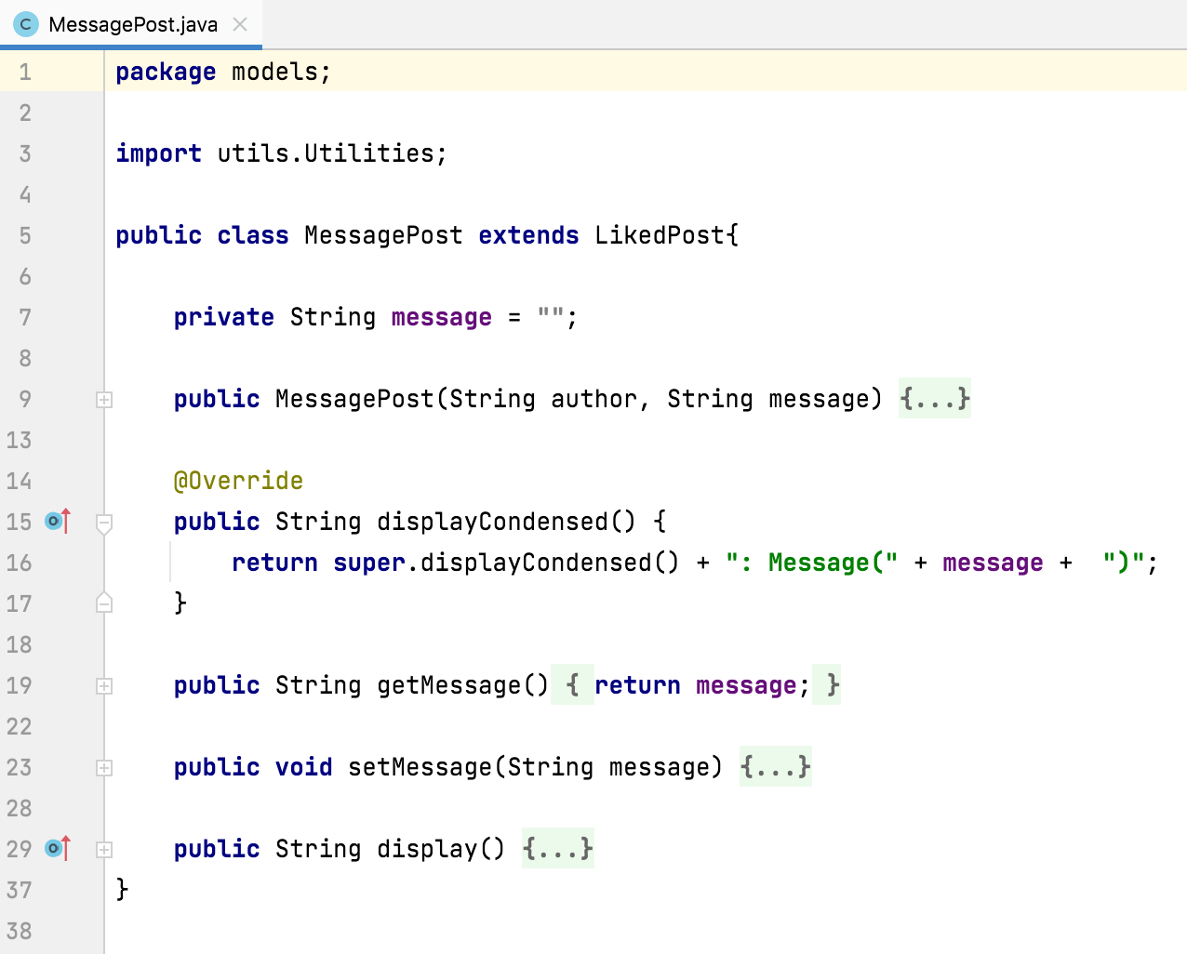
displayCondensed() in MessagePost

Slide 19
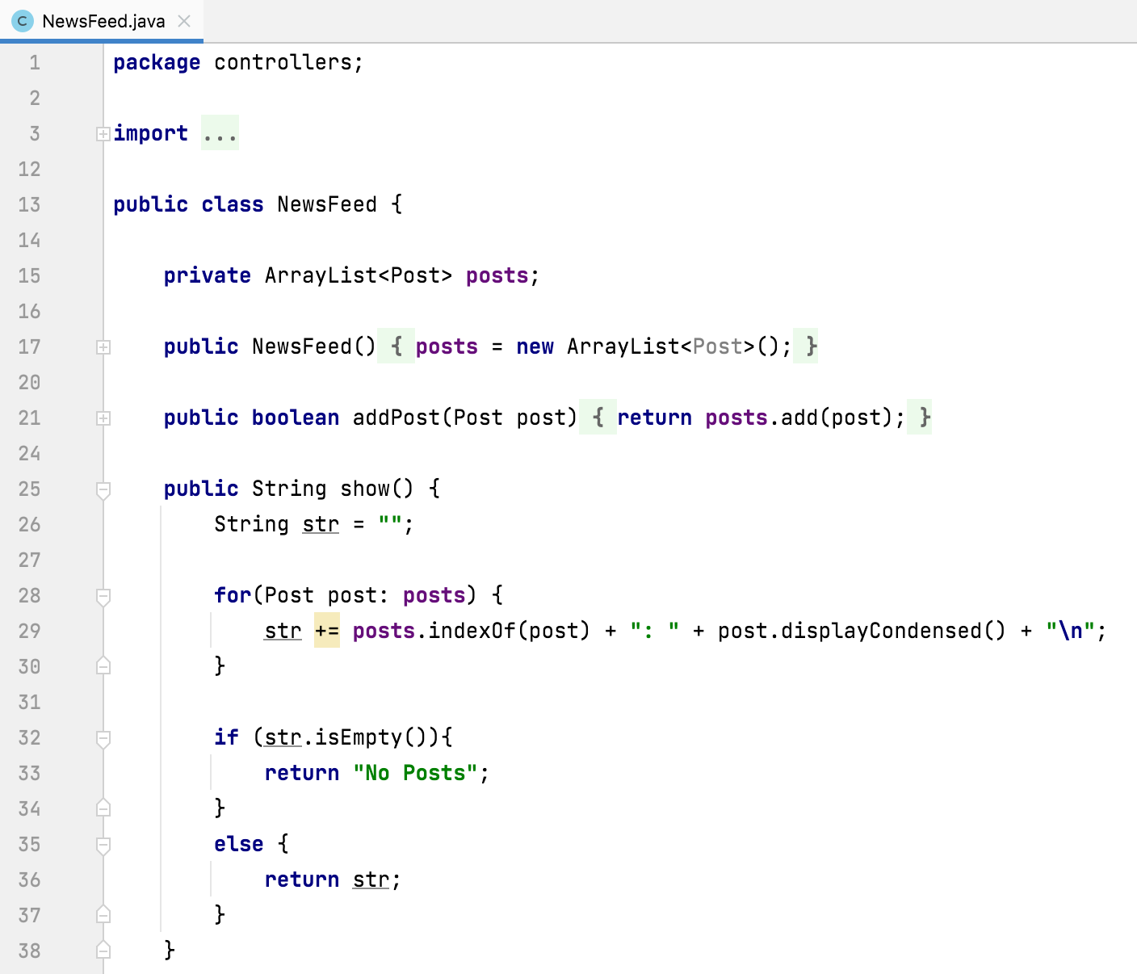
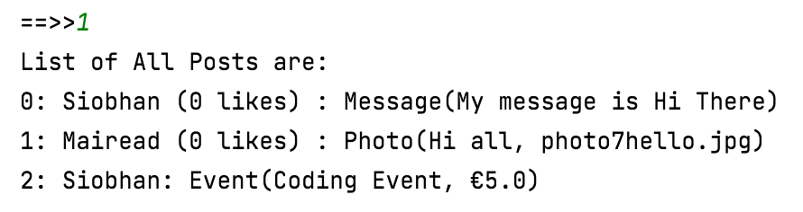
displayCondensed() in NewsFeed

Slide 20
Topic List
Interfaces define Types.
Recap of Social Network V8.0 – Abstract Classes and Methods
Social Network V9.0 - An Interface Example
Naming Conventions for Interfaces.

Slide 21
Social Network V9.0 – An Interface Example
Driver
NewsFeed
implements
ISerializer
uses
<abstract> Post
extends
extends
<abstract> LikedPost
EventPost
extends
extends
MessagePost
PhotoPost

Slide 22
Interfaces in Collections Framework

Slide 23
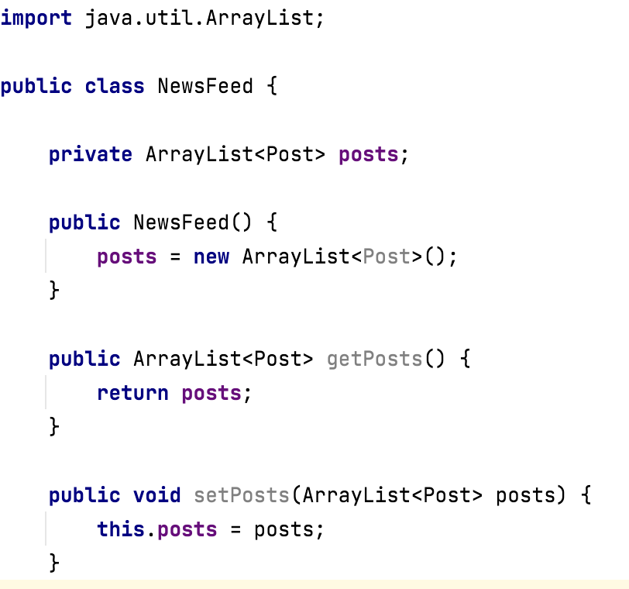
Add a getter and a setter for the posts ArrayList in NewsFeed.

Slide 24
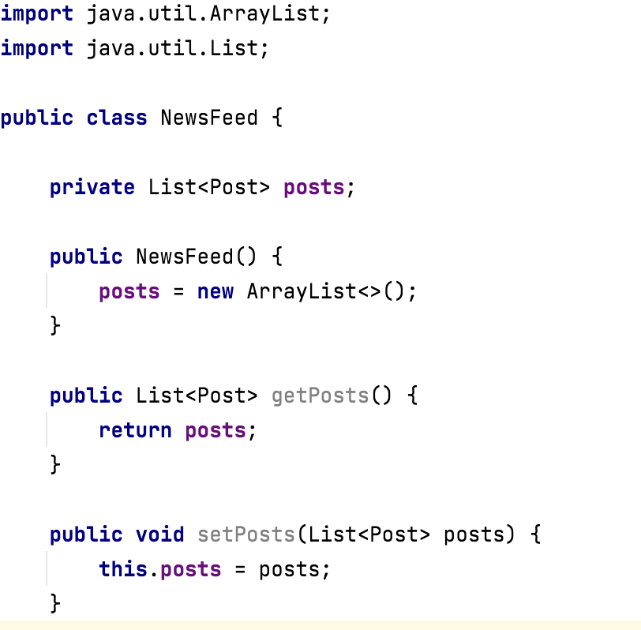
We will now refactor our app so that our posts ArrayList is defined using interfaces instead of concrete classes.

Slide 25
Interfaces in Collections Framework
Your code is more maintainable when you define collections like this:
ArrayLists:
List<Post> posts = new ArrayList<Post>();
Maps:
Map<String, String> addresses = new HashMap<String, String>();
Sets:
Set<String> words = new HashSet<String>();
Note: Include this approach in your Assignment 2.

Slide 26
Interfaces in Collections Framework
Why is code more maintainable when ArrayLists are defined like:
List<Post> posts = new ArrayList<Post>();
Answer: if we decided, at a later date, that we wanted to use a LinkedList instead of an ArrayList, we only have to make minor changes in the class i.e.
new ArrayList<Post>();
becomes
new LinkedList<Post>();
and import java.util.LinkedList;

Slide 27
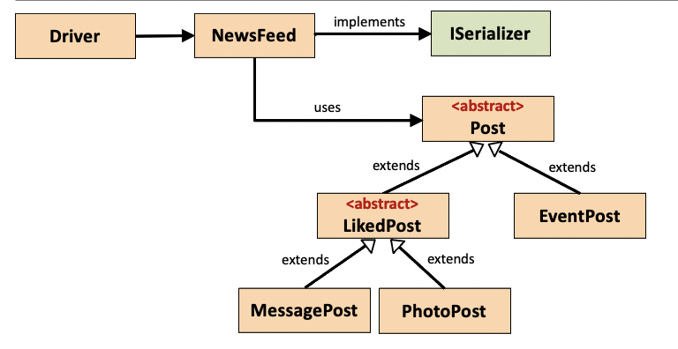
Social Network V9.0 – Adding ISerializer Interface
We have used Interfaces in our code (i.e. the List Collection) but we have not written an actual Interface entity ourselves.
Now we will write an Interface called ISerializer that imposes a design contract on all classes implementing it.
When the NewsFeed class implements this interface, it will be forced to provide an implementation for the abstract methods defined in ISerializer.

Slide 28
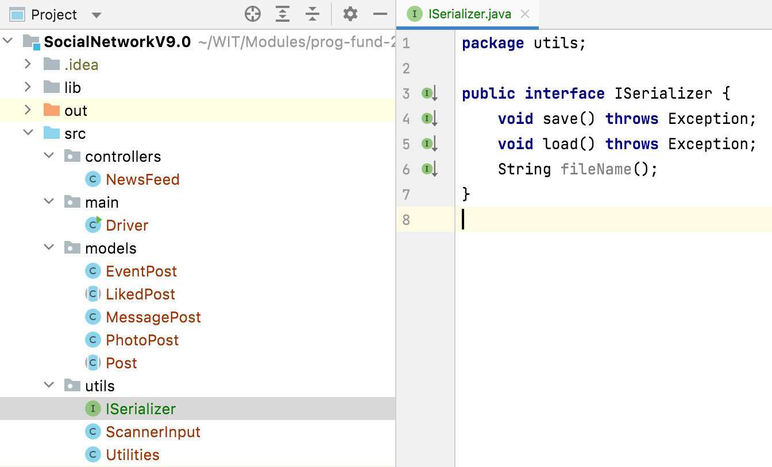
Social Network V9.0 – Create ISerializer Interface

Slide 29
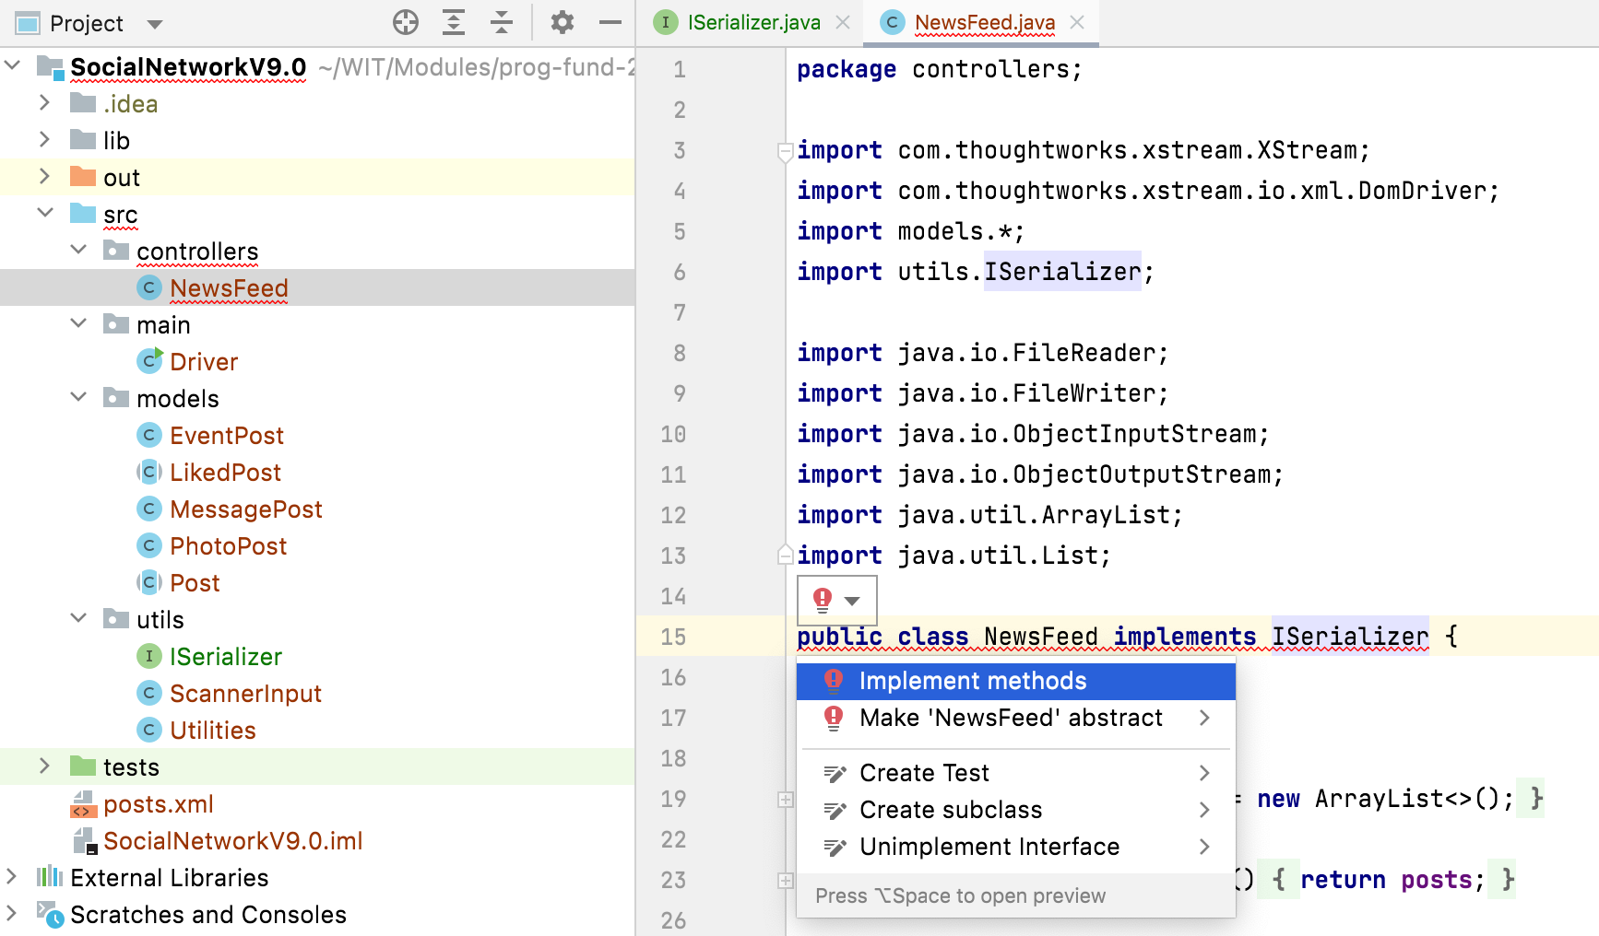
Social Network V9.0 – Implement ISerializer Interface

Slide 30
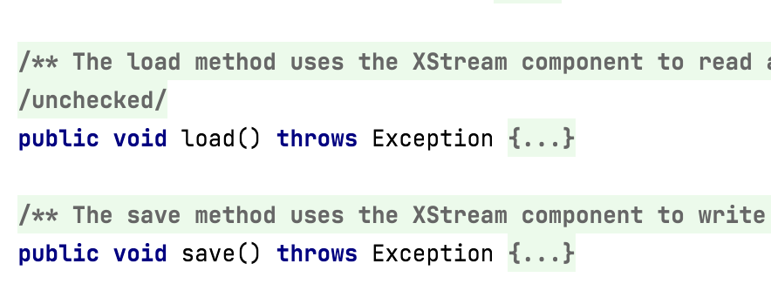
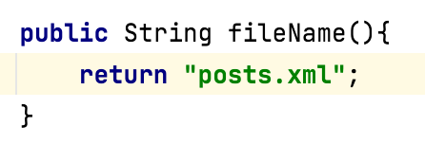
Social Network V9.0 – Implement ISerializer methods
Already Added
To be Added

Slide 31
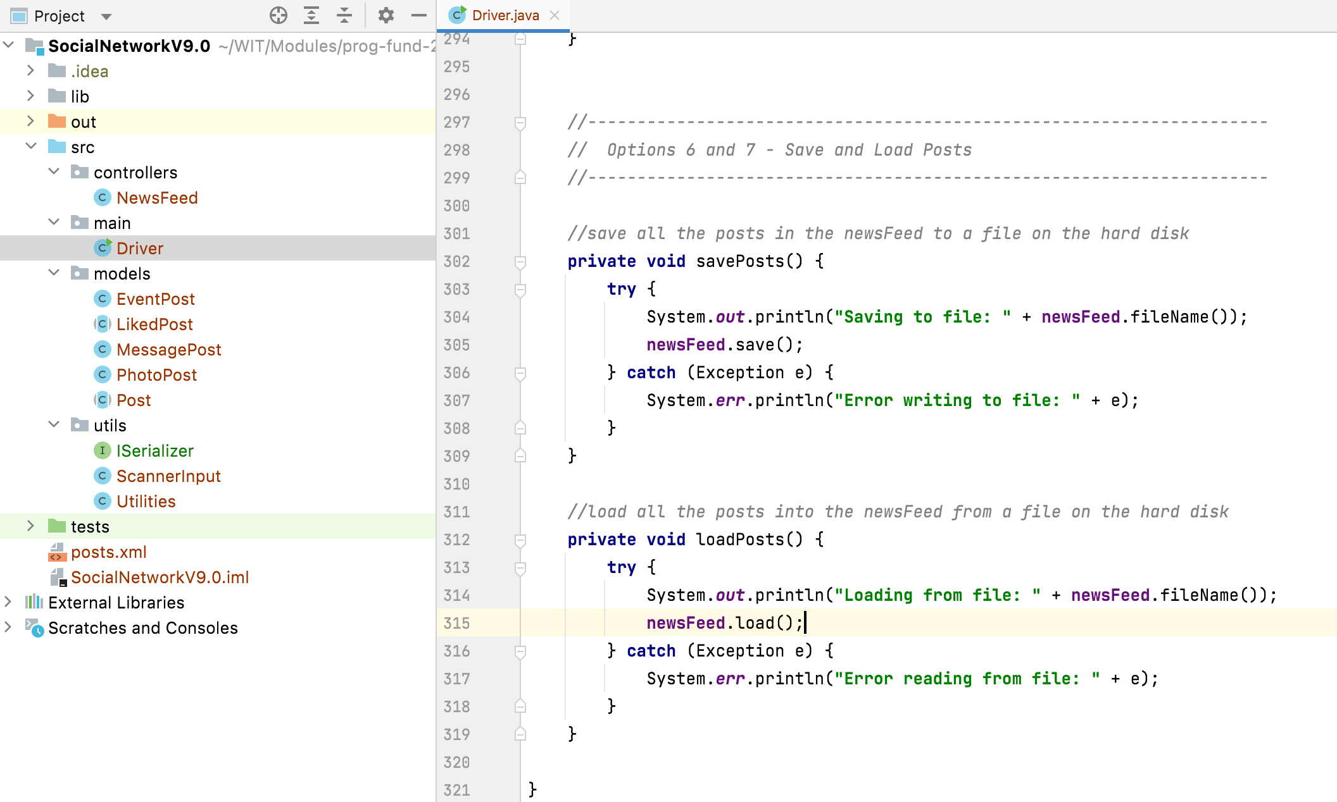
Social Network V9.0 – Using ISerializer methods

Slide 32
Topic List
Interfaces define Types.
Recap of Social Network V8.0 – Abstract Classes and Methods
Social Network V9.0 - An Interface Example
Naming Conventions for Interfaces.

Slide 33
Common Naming Conventions for Interfaces
Suffix able is often used for interfaces
Cloneable, Serializable, and Transferable
Nouns are often used for implementing classes names, and I + noun for interfaces
Interfaces: IColor, ICar, and IColoredCar
Classes: Color, Car, and ColoredCar
Nouns are often used for interfaces names, and noun+Impl for implementing classes
Interfaces: Color, Car, and ColoredCar
Classes: ColorImpl, CarImpl, and ColoredCarImpl

Slide 34

Any Questions?

