Slide 1

Sorting and Searching
ShopV8.0 - Basic sorting and searching algorithms
Produced
by:
Dr. Siobhán Drohan
Ms. Mairead Meagher
Ms. Siobhan Roche
Department of Computing and Mathematics
http://www.setu.ie/

Slide 2
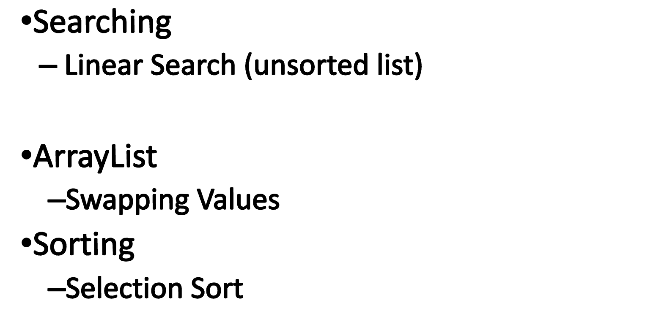
Brief overview of Searching and Sorting

Slide 3

Linear searching

Slide 4
Searching
Before we decide on how to search through a list we need to know whether or not the list is sorted.
Not Sorted → Linear Search
Sorted → Binary Search

Slide 5
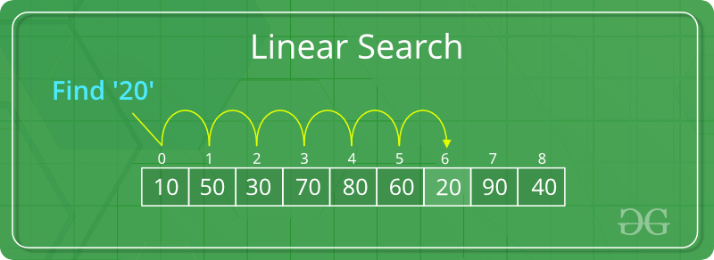
Linear Search

Slide 6
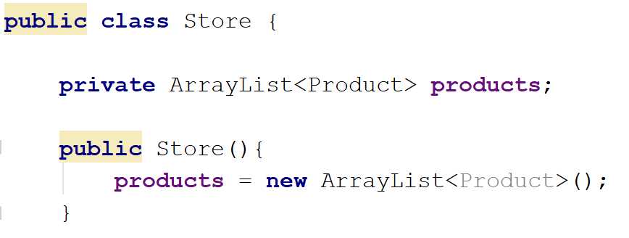
ShopV8.0 – Linear Search
Problem: We want to search the products ArrayList and return all the individual products whose product name matches, or partially matches the search word entered by the user.

Slide 7
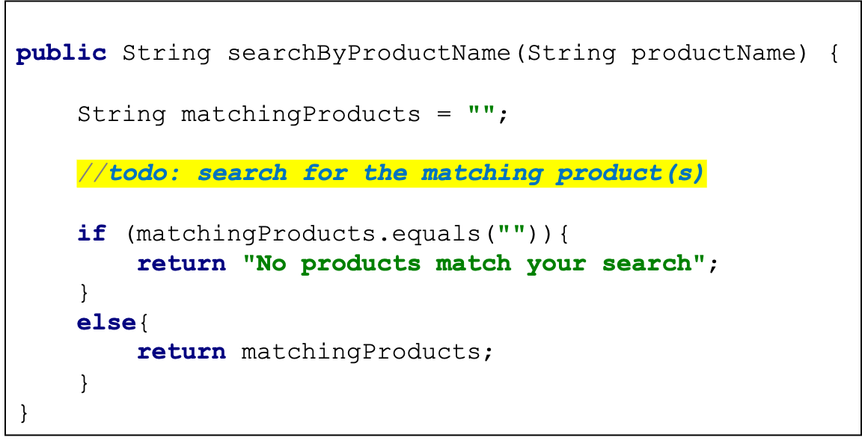
Store.java
Problem: We want to search the products ArrayList and return all the individual products whose product name matches, or partially matches the search word entered by the user.

Slide 8
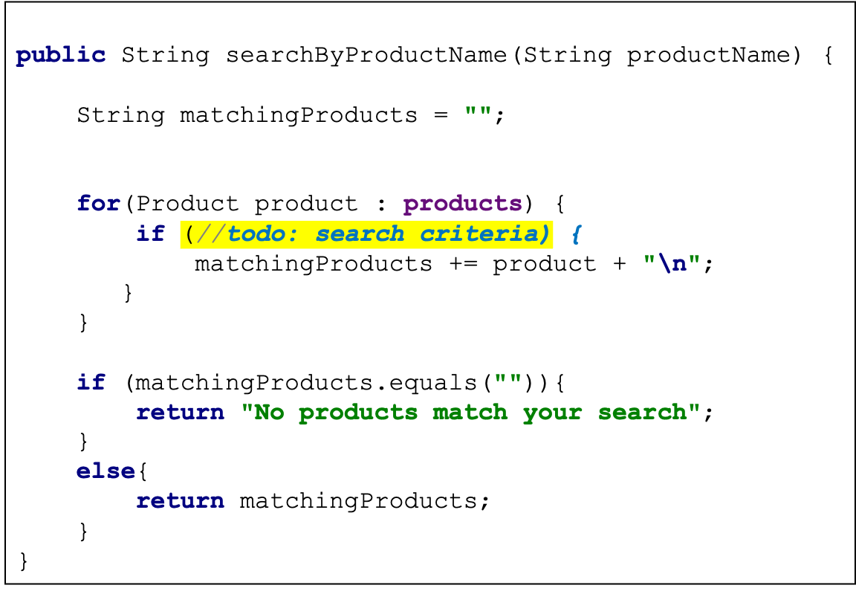
Store.java
Problem: We want to search the products ArrayList and return all the individual products whose product name matches, or partially matches the search word entered by the user.

Slide 9
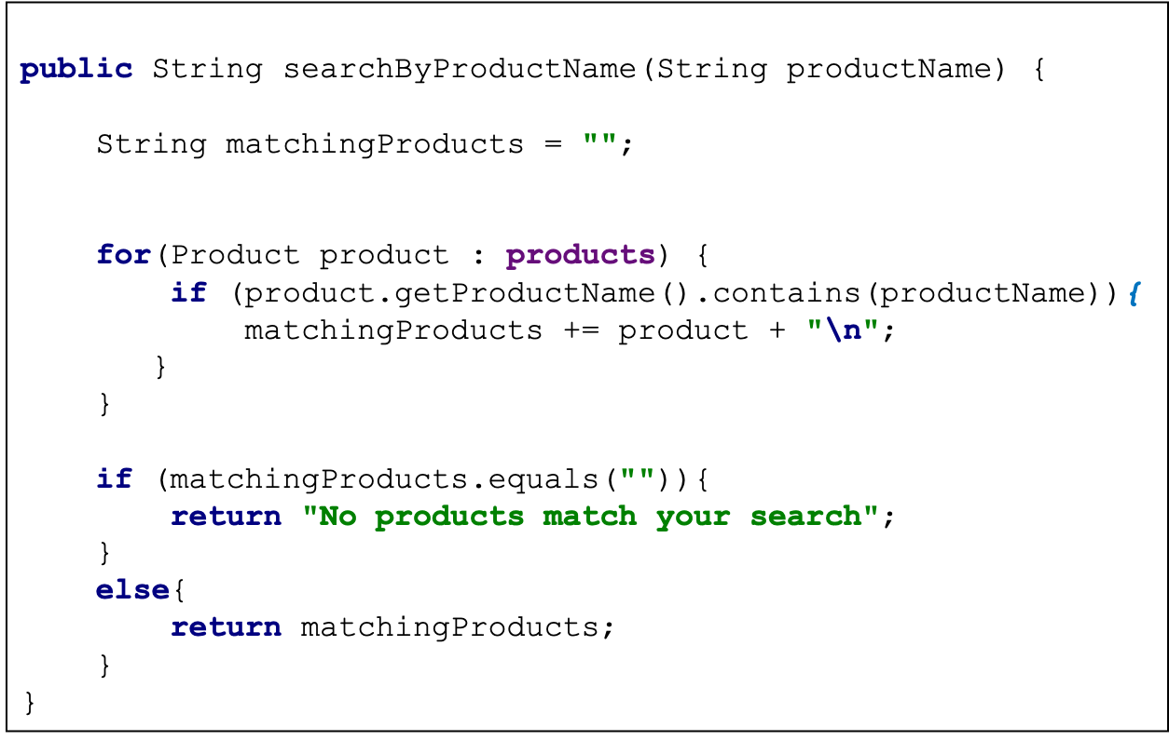
Store.java
Problem: We want to search the products ArrayList and return all the individual products whose product name matches, or partially matches the search word entered by the user.

Slide 10
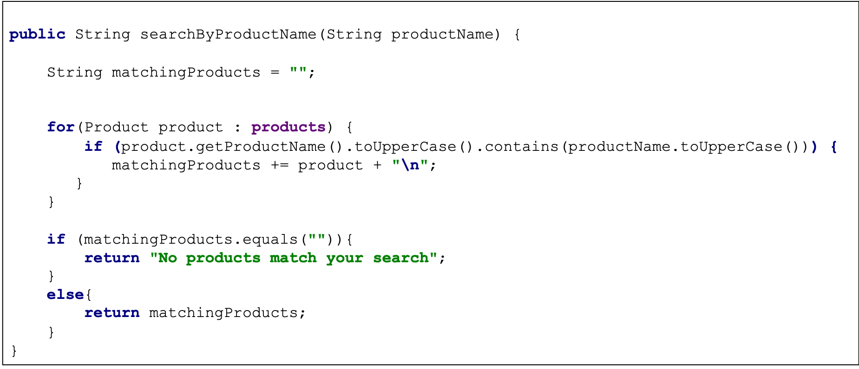
Store.java
Catering for case sensitivity
Catering for case sensitivity
Problem: We want to search the products ArrayList and return all the individual products whose product name matches, or partially matches the search word entered by the user.

Slide 11
Store.java
Adding the index number for each product
Problem: We want to search the products ArrayList and return all the individual products whose product name matches, or partially matches the search word entered by the user.

Slide 12
Driver.java
private int mainMenu() { int option = ScannerInput.readNextInt(""" ------------------------------------------------------------------ | Shop Menu | ------------------------------------------------------------------ | PRODUCT MENU | | 1) Add a product | | 2) List the Products | | 3) Update a product | | 4) Delete a product | ------------------------------------------------------------------ | PRODUCT DESCRIPTION MENU | | 5) Add a product description | | 6) List product description(s) | | 7) Update a product description | | 8) Delete a product description | ------------------------------------------------------------------ | REPORT MENU | | 10) List the current products | | 11) Display average product unit cost | | 12) Display cheapest product | | 13) List products that are more expensive than a given price | ------------------------------------------------------------------ | SEARCH AND SORT MENU | | 14) Search products by name | | 15) Sort products by name ascending | ------------------------------------------------------------------ | 20) Save products to products.xml | | 21) Load products from products.xml | | 0) Exit | ------------------------------------------------------------------ ==>> """); return option; }
switch (option) { case 1 -> addProduct(); case 2 -> printProducts(); case 3 -> updateProduct(); case 4 -> deleteProduct(); case 5 -> addDescriptionToProduct(); case 6 -> listProductDescriptions(); case 7 -> updateDescriptionInProduct(); case 8 -> deleteDescriptionFromProduct(); case 10 -> printCurrentProducts(); case 11 -> printAverageProductPrice(); case 12 -> printCheapestProduct(); case 13 -> printProductsAboveAPrice(); case 14 -> searchProductByName(); case 15 -> sortProductByName(); case 20 -> saveProducts(); case 21 -> loadProducts(); default -> System.out.println("Invalid option entered: " + option); }

Slide 13
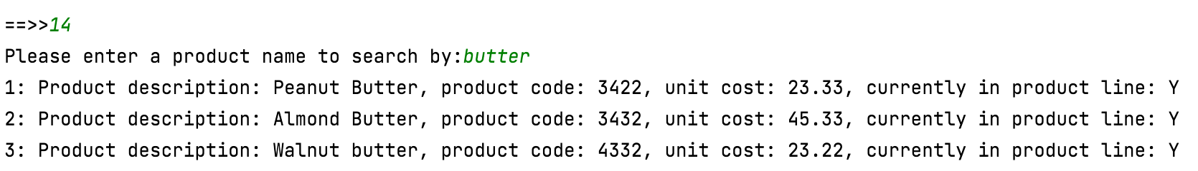
Driver.java
private void searchProductByName() { String productName = ScannerInput.readNextLine("Please enter a product name to search by:"); System.out.println(store.searchByProductName(productName)); }
switch (option) { case 1 -> addProduct(); case 2 -> printProducts(); case 3 -> updateProduct(); case 4 -> deleteProduct(); case 5 -> addDescriptionToProduct(); case 6 -> listProductDescriptions(); case 7 -> updateDescriptionInProduct(); case 8 -> deleteDescriptionFromProduct(); case 10 -> printCurrentProducts(); case 11 -> printAverageProductPrice(); case 12 -> printCheapestProduct(); case 13 -> printProductsAboveAPrice(); case 14 -> searchProductByName(); case 15 -> sortProductByName(); case 20 -> saveProducts(); case 21 -> loadProducts(); default -> System.out.println("Invalid option entered: " + option); }

Slide 14
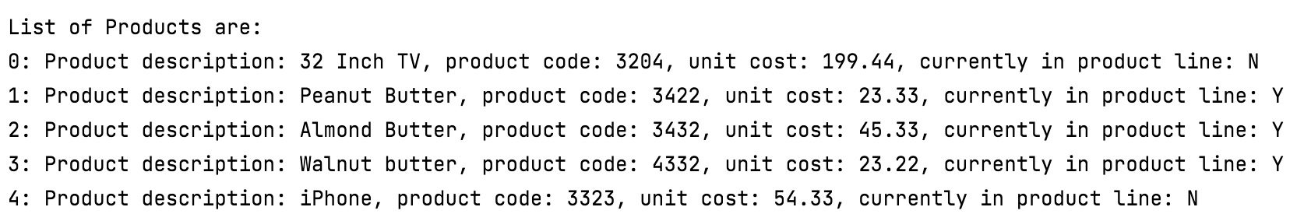
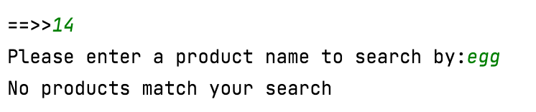
Test Data
Sample Test 1
Sample Test 2
Problem: We want to search the products ArrayList and return all the individual products whose product name matches, or partially matches the search word entered by the user.

Slide 15
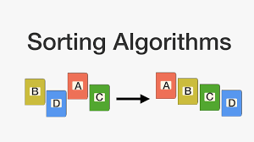
Selection Sort

Slide 16


Sorting
The human brain can very quickly sort a collection e.g. it’s straightforward to sort a group of people in height order.
For a computer to carry out this process is more difficult.

Slide 17
Sorting
A computer is quite limited in the data it can handle simultaneously and is restricted to:
Comparing two items
Swapping the items or copying one item.
In the sorting algorithm we will investigate, we will see the above two steps repeatedly used.

Slide 18

ArrayList – Swapping Values
Before we start discussing sorting, we will look at swapping two values in an ArrayList.
This swap algorithm is needed during sorting.

Slide 19
ArrayList – Swapping Values
private ArrayList<Product> products = new ArrayList<Product>();

Slide 20
ArrayList – Swapping Values
private ArrayList<Product> products = new ArrayList<Product>();
With five product objects added to the ArrayList:
products
Product name: Sugar
0
1
2
3
4
Product name: Flour
Product name: Eggs
Product name: Milk
Product name: Salt

Slide 21
ArrayList – Swapping Values
private ArrayList<Product> products = new ArrayList<Product>();
We now want to swap the objects Flour and Eggs with each other.
products
Product name: Sugar
0
1
2
3
4
Product name: Flour
Product name: Eggs
Product name: Milk
Product name: Salt

Slide 22
ArrayList – Swapping Values
private ArrayList<Product> products = new ArrayList<Product>();
Flour is index 1
Eggs is index 2
Algorithm:
Store Flour and Eggs in temporary Product variables.
Set index 1 to be the temporary Product variable holding Eggs.
Set index 2 to be the temporary Product variable holding Flour.
products
Product name: Sugar
0
1
2
3
4
Product name: Flour
Product name: Eggs
Product name: Milk
Product name: Salt

Slide 23
Store Flour and Eggs in temporary Product variables.
Set index 1 to be the temporary Product variable holding Eggs.
Set index 2 to be the temporary Product variable holding Flour.
Algorithm
private void swapProducts(ArrayList<Product> products, int currentIndex, int highestIndex) {
Product currentProduct = products.get(currentIndex); Product highestProduct = products.get(highestIndex); products.set(currentIndex, highestProduct); products.set(highestIndex,currentProduct); }
a
b
c

Slide 24
Store Flour and Eggs in temporary Product variables.
Set index 1 to be the temporary Product variable holding Eggs.
Set index 2 to be the temporary Product variable holding Flour.
Algorithm
private void swapProducts(ArrayList<Product> products, int currentIndex, int highestIndex) {
Product currentProduct = products.get(currentIndex); Product highestProduct = products.get(highestIndex); products.set(currentIndex, highestProduct); products.set(highestIndex,currentProduct); }
a
b
c
Product name: Sugar
products
0
1
2
3
4
Product name: Flour
BEFORE SWAP
Product name: Eggs
Product name: Milk
Product name: Salt

Slide 25
Store Flour and Eggs in temporary Product variables.
Set index 1 to be the temporary Product variable holding Eggs.
Set index 2 to be the temporary Product variable holding Flour.
Algorithm
private void swapProducts(ArrayList<Product> products, int currentIndex, int highestIndex) {
Product currentProduct = products.get(currentIndex); Product highestProduct = products.get(highestIndex); products.set(currentIndex, highestProduct); products.set(highestIndex,currentProduct); }
a
b
c
Product name: Sugar
products
0
1
2
3
4
Product name: Eggs
AFTER SWAP
Product name: Flour
Product name: Milk
Product name: Salt

Slide 26
Sorting
Now that we know how to swap items in an ArrayList, we can start looking at sorting Algorithms.
Many basic sorting algorithms e.g.:
Bubble sort
Selection sort
Insertion sort
.

Slide 27
What is a “Sorted List”?
We can define a sorted list as a list in which each element is in its correct position, its correct position being defined as:
All values to the left of the element are less than or equal to it and all values to the right of the element are greater than or equal to it.

Slide 28
Product name: Eggs
products
0
1
2
3
4
Product name: Flour
Product name: Milk
Product name: Salt
Product name: Sugar
All values to the left of the element are less than or equal to it and all values to the right of the element are greater than or equal to it.

Slide 29
Selection Sort Algorithm
0 1 2 3 4
8 | 5 | 3 | 4 | 2
swap
2 | 5 | 3 | 4 | 8
Iterate through all elements of the array and select the largest one (this is stored in a temporary variable).
The largest one is then swapped with the element at the end of the array.
Then reduce the size of the array by 1 and work through the array to locate the next largest element.
Repeat the above steps until the size of your array is 1.
2 | 5 | 3 | 4 | 8
swap
2 | 4 | 3 | 5 | 8
2 | 4 | 3 | 5 | 8
swap
2 | 3 | 4 | 5 | 8
No swap
2 | 3 | 4 | 5 | 8
2 | 3 | 4 | 5 | 8
Array is 1
Notes:
https://www.google.com/url?sa=i&url=https%3A%2F%2Fwww.quora.com%2FWhat-is-selection-sort&psig=AOvVaw22Trs2p8ZgdSsXIUvIDj_M&ust=1585250035172000&source=images&cd=vfe&ved=0CAIQjRxqFwoTCLCayuGqtugCFQAAAAAdAAAAABAJ

Slide 30
Selection Sort Algorithm
0 1 2 3 4
8 | 5 | 3 | 4 | 2
swap
2 | 5 | 3 | 4 | 8
Iterate through all elements of the array and select the largest one (this is stored in a temporary variable).
The largest one is then swapped with the element at the end of the array.
Then reduce the size of the array by 1 and work through the array to locate the next largest element.
Repeat the above steps until the size of your array is 1.
2 | 5 | 3 | 4 | 8
swap
2 | 4 | 3 | 5 | 8
2 | 4 | 3 | 5 | 8
swap
2 | 3 | 4 | 5 | 8
No swap
2 | 3 | 4 | 5 | 8
2 | 3 | 4 | 5 | 8
Array is 1
Notes:
https://www.google.com/url?sa=i&url=https%3A%2F%2Fwww.quora.com%2FWhat-is-selection-sort&psig=AOvVaw22Trs2p8ZgdSsXIUvIDj_M&ust=1585250035172000&source=images&cd=vfe&ved=0CAIQjRxqFwoTCLCayuGqtugCFQAAAAAdAAAAABAJ

Slide 31
Selection Sort Algorithm
0 1 2 3 4
8 | 5 | 3 | 4 | 2
swap
2 | 5 | 3 | 4 | 8
Iterate through all elements of the array and select the largest one (this is stored in a temporary variable).
The largest one is then swapped with the element at the end of the array.
Then reduce the size of the array by 1 and work through the array to locate the next largest element.
Repeat the above steps until the size of your array is 1.
2 | 5 | 3 | 4 | 8
swap
2 | 4 | 3 | 5 | 8
2 | 4 | 3 | 5 | 8
swap
2 | 3 | 4 | 5 | 8
No swap
2 | 3 | 4 | 5 | 8
2 | 3 | 4 | 5 | 8
Array is 1
Notes:
https://www.google.com/url?sa=i&url=https%3A%2F%2Fwww.quora.com%2FWhat-is-selection-sort&psig=AOvVaw22Trs2p8ZgdSsXIUvIDj_M&ust=1585250035172000&source=images&cd=vfe&ved=0CAIQjRxqFwoTCLCayuGqtugCFQAAAAAdAAAAABAJ

Slide 32
Selection Sort Algorithm
0 1 2 3 4
8 | 5 | 3 | 4 | 2
swap
2 | 5 | 3 | 4 | 8
Iterate through all elements of the array and select the largest one (this is stored in a temporary variable).
The largest one is then swapped with the element at the end of the array.
Then reduce the size of the array by 1 and work through the array to locate the next largest element.
Repeat the above steps until the size of your array is 1.
2 | 5 | 3 | 4 | 8
swap
2 | 4 | 3 | 5 | 8
2 | 4 | 3 | 5 | 8
swap
2 | 3 | 4 | 5 | 8
No swap
2 | 3 | 4 | 5 | 8
2 | 3 | 4 | 5 | 8
Array is 1
Notes:
https://www.google.com/url?sa=i&url=https%3A%2F%2Fwww.quora.com%2FWhat-is-selection-sort&psig=AOvVaw22Trs2p8ZgdSsXIUvIDj_M&ust=1585250035172000&source=images&cd=vfe&ved=0CAIQjRxqFwoTCLCayuGqtugCFQAAAAAdAAAAABAJ

Slide 33
ShopV8.0 – Selection Sort
Store.java
Problem: We want to physically sort the products ArrayList by product name ascending. This will involve swapping in and out items in the ArrayList until we have a fully sorted collection.

Slide 34
ShopV8.0 – Selection Sort
Store.java
public void sortProductsByNameAscending(){
for (int i = products.size() -1; i >= 0; i--) { int highestIndex = 0; for (int j = 0; j <= i; j++) { if (products.get(j).getProductName().compareTo( products.get(highestIndex).getProductName()) > 0) { highestIndex = j; } } swapProducts(products, i, highestIndex); } }
Problem: We want to physically sort the products ArrayList by product name ascending. This will involve swapping in and out items in the ArrayList until we have a fully sorted collection.

Slide 35
ShopV8.0 – Selection Sort
Store.java
private void swapProducts(ArrayList<Product> products, int current, int highest) { Product smaller = products.get(current); Product bigger = products.get(highest); products.set(current, bigger); products.set(highest,smaller); }
Problem: We want to physically sort the products ArrayList by product name ascending. This will involve swapping in and out items in the ArrayList until we have a fully sorted collection.

Slide 36
Driver.java
private int mainMenu() { int option = ScannerInput.readNextInt(""" ------------------------------------------------------------------ | Shop Menu | ------------------------------------------------------------------ | PRODUCT MENU | | 1) Add a product | | 2) List the Products | | 3) Update a product | | 4) Delete a product | ------------------------------------------------------------------ | PRODUCT DESCRIPTION MENU | | 5) Add a product description | | 6) List product description(s) | | 7) Update a product description | | 8) Delete a product description | ------------------------------------------------------------------ | REPORT MENU | | 10) List the current products | | 11) Display average product unit cost | | 12) Display cheapest product | | 13) List products that are more expensive than a given price | ------------------------------------------------------------------ | SEARCH AND SORT MENU | | 14) Search products by name | | 15) Sort products by name ascending | ------------------------------------------------------------------ | 20) Save products to products.xml | | 21) Load products from products.xml | | 0) Exit | ------------------------------------------------------------------ ==>> """); return option; }
switch (option) { case 1 -> addProduct(); case 2 -> printProducts(); case 3 -> updateProduct(); case 4 -> deleteProduct(); case 5 -> addDescriptionToProduct(); case 6 -> listProductDescriptions(); case 7 -> updateDescriptionInProduct(); case 8 -> deleteDescriptionFromProduct(); case 10 -> printCurrentProducts(); case 11 -> printAverageProductPrice(); case 12 -> printCheapestProduct(); case 13 -> printProductsAboveAPrice(); case 14 -> searchProductByName(); case 15 -> sortProductByName(); case 20 -> saveProducts(); case 21 -> loadProducts(); default -> System.out.println("Invalid option entered: " + option); }

Slide 37
Driver.java
private void sortProductByName() { store.sortProductsByNameAscending(); System.out.println(store.listProducts()); }
switch (option) { case 1 -> addProduct(); case 2 -> printProducts(); case 3 -> updateProduct(); case 4 -> deleteProduct(); case 5 -> addDescriptionToProduct(); case 6 -> listProductDescriptions(); case 7 -> updateDescriptionInProduct(); case 8 -> deleteDescriptionFromProduct(); case 10 -> printCurrentProducts(); case 11 -> printAverageProductPrice(); case 12 -> printCheapestProduct(); case 13 -> printProductsAboveAPrice(); case 14 -> searchProductByName(); case 15 -> sortProductByName(); case 20 -> saveProducts(); case 21 -> loadProducts(); default -> System.out.println("Invalid option entered: " + option); }

Slide 38
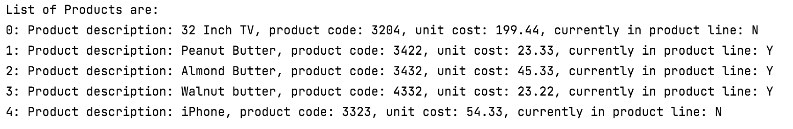
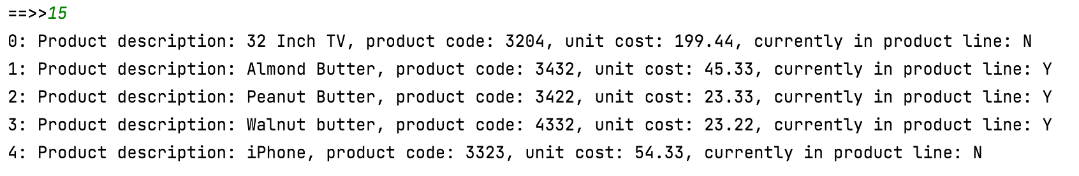
Test Data
Sorted ArrayList

Slide 39
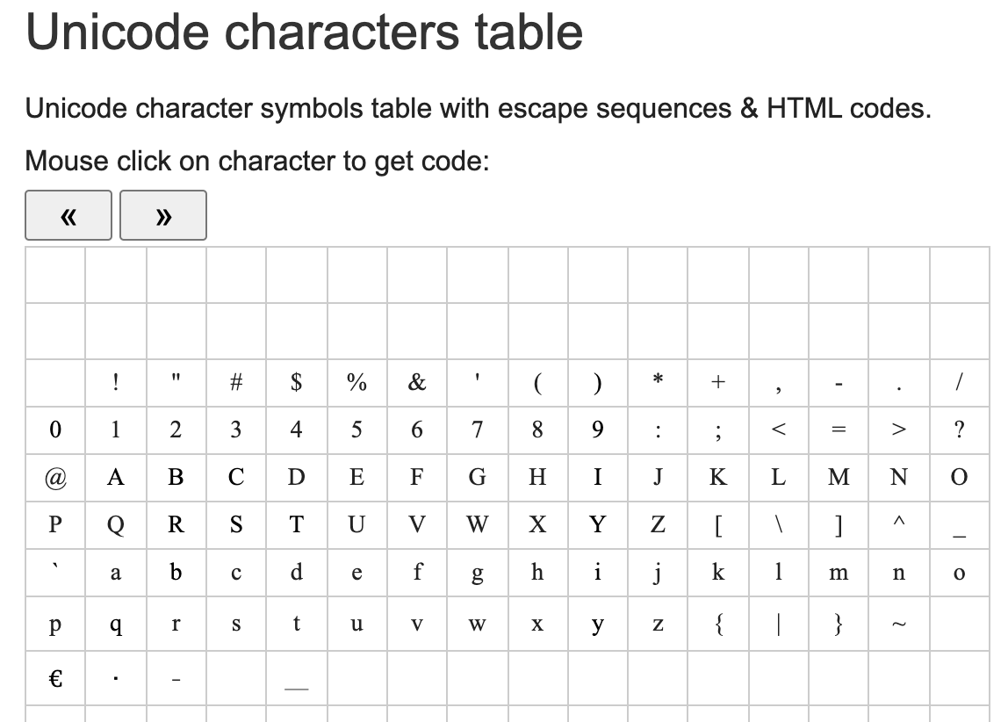
Sorted ArrayList

Slide 40

Any Questions?

