Slide 1

Introduction to ArrayLists
(based on Ch. 4, Objects First with Java - A Practical Introduction using BlueJ, © David J. Barnes, Michael Kölling)
Produced by:
Ms. Mairéad Meagher
Dr. Siobhán Drohan
Ms Siobhan Roche
Department of Computing and Mathematics
http://www.setu.ie/

Slide 2
Topic list
Grouping Objects
  Developing a basic personal notebook project using Collections
  e.g. ArrayList
Indexing within Collections
  Retrieval and removal of objects
Generic / Parameterized classes
  e.g. ArrayList
Iteration
  Using the for loop
  Using the while loop
  Using the for each loop
Next SlideDeck:
coding a Shop Project that stores an ArrayList of Products.

Slide 3
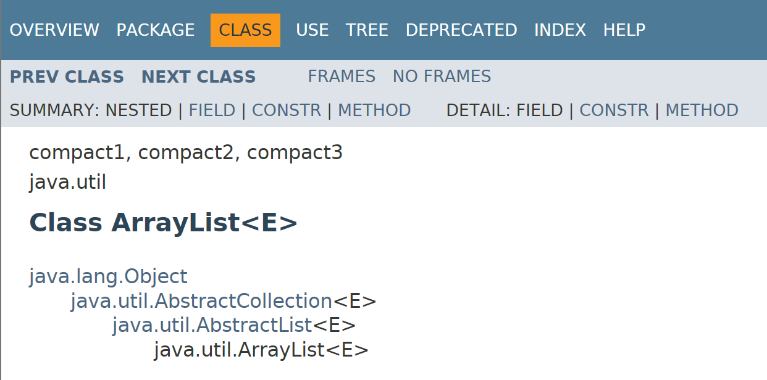
Generic/Parameterized Classes

Slide 4
Generic/Parameterized Classes
Collections are known as parameterized or generic types.
Note <E> is the parameter.
E gets replaced with some Class or Type

Slide 5
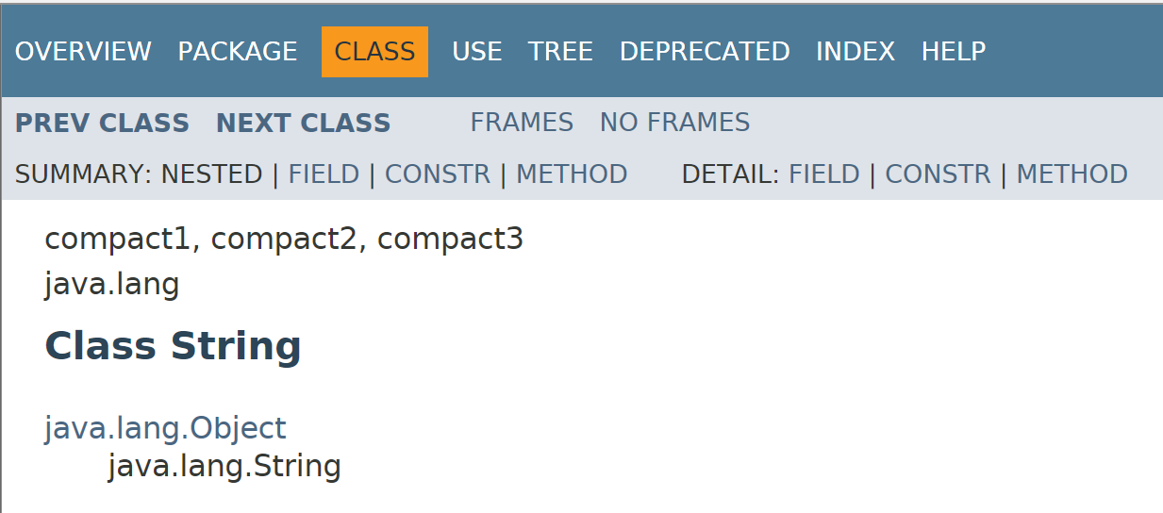
String is not parameterized.

Slide 6
Generic/Parameterized Classes
String is not parameterized.
ArrayList is parameterized.
The type parameter <E>
says what we want a list of e.g.:
  ArrayList<Person>
  ArrayList<TicketMachine>
  ArrayList<String>
  etc.

Slide 7
Topic list
Grouping Objects
  Developing a basic personal notebook project using Collections
  e.g. ArrayList
Indexing within Collections
  Retrieval and removal of objects
Generic classes
  e.g. ArrayList
Iteration
  Using the for loop
  Using the while loop
  Using the for each loop
Next SlideDeck:
coding a Shop Project that stores an ArrayList of Products.

Slide 8
Processing a whole collection (iteration)
We often want to perform some actions
an arbitrary number of times.
  E.g.,
  Print all the notes in the notebook.
  How many are there?
  Does the amount of notes in our notebook vary?
Most programming languages include loop statements to make this possible.
Loops enable us to control how many times we repeat certain actions.

Slide 9
Loops in Programming
There are three types of standard loops in (Java) programming:
  while
  for
  do while
You typically use for and while loops to iterate over your ArrayList collection,
OR
you can use another special construct associated with Collections:
  for each

Slide 10
Topic list
Grouping Objects
  Developing a basic personal notebook project using Collections
  e.g. ArrayList
Indexing within Collections
  Retrieval and removal of objects
Generic classes
  e.g. ArrayList
Iteration
  Using the for loop
  Using the while loop
  Using the for each loop
Next SlideDeck:
coding a Shop Project that stores an ArrayList of Products.

Slide 11
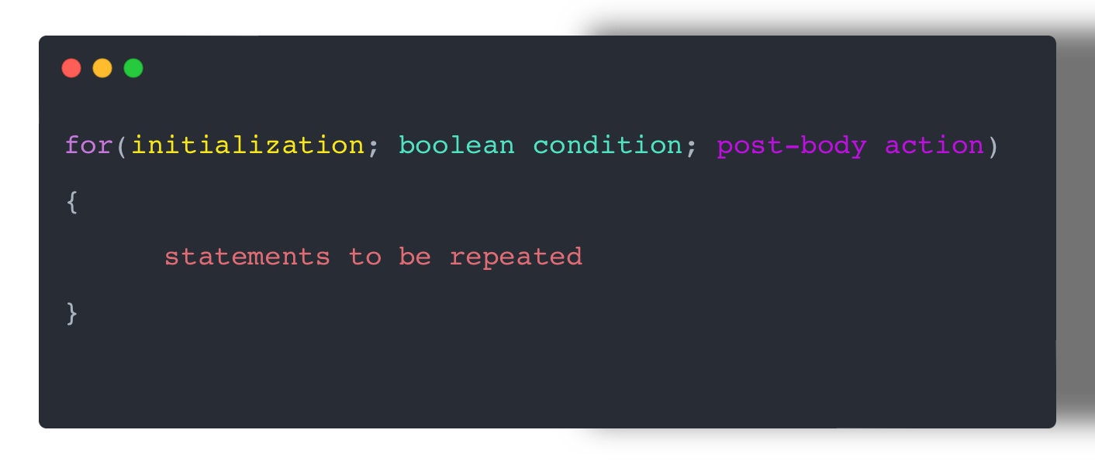
Recap: For Loop pseudo-code
General structure of a for loop

Slide 12
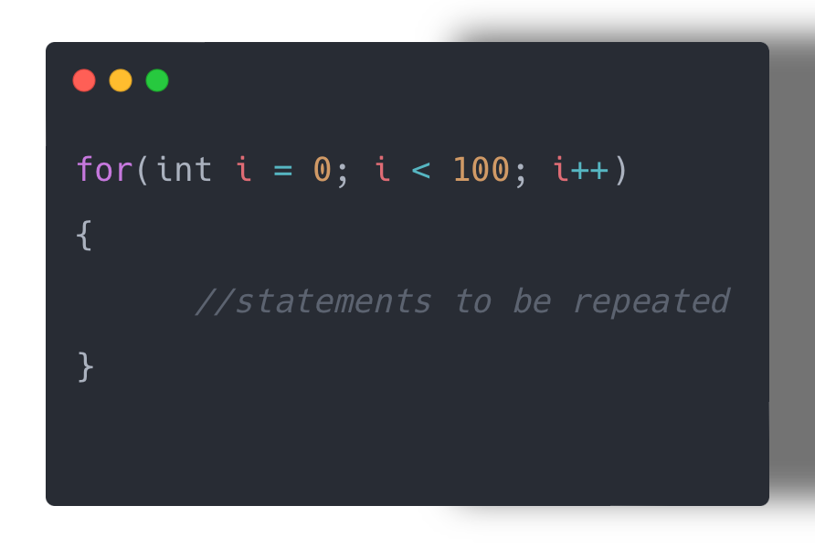
Recap: For Loop syntax

Slide 13
Recap: For Loop syntax
stage | code | Description
initialization | int i = 0 | Initialise a loop control variable (LCV) e.g. i It can include a variable declaration.
Boolean condition | i < 100 | Is a valid boolean condition that typically tests the loop control variable (LCV).
Post body action | i++ | A change to the loop control variable (LCV). Contains an assignment statement.

Slide 14
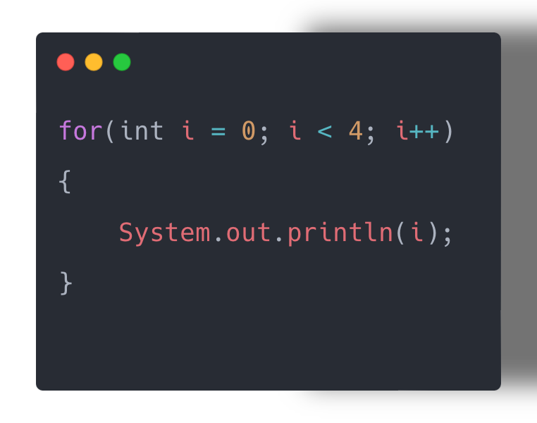
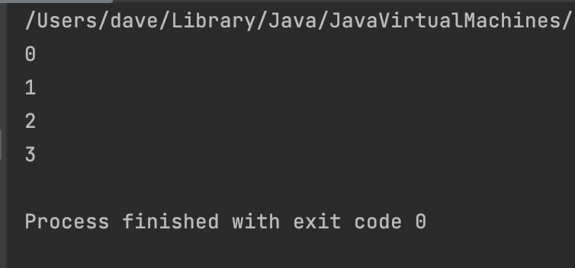
For Loop Flowchart
Start
Update count
Last item?
no
Execute statements
yes
End

Slide 15
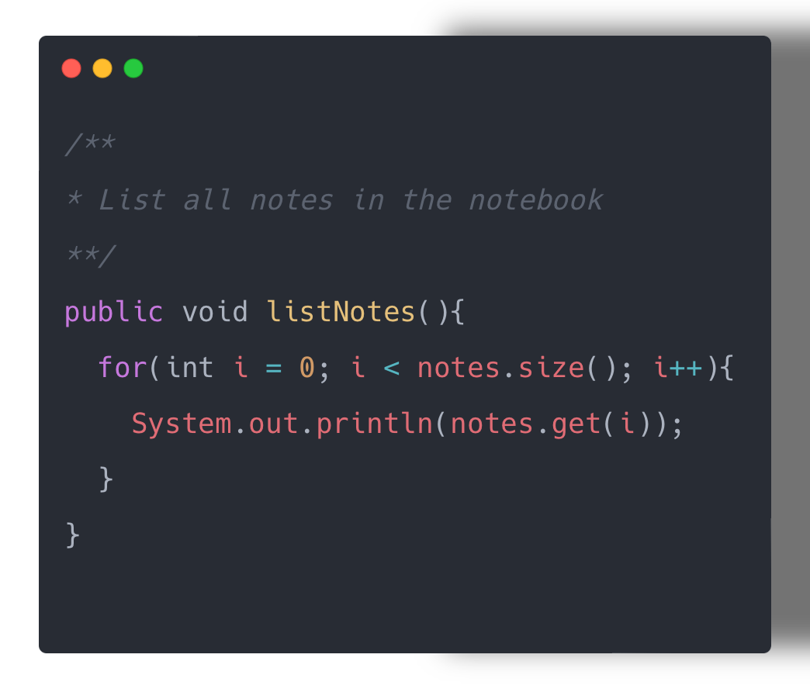
For Loop with ArrayLists (Collections)
for each value of i less than the size
of the collection;
print the next note;
and then increment i.

Slide 16
While Loop

Slide 17
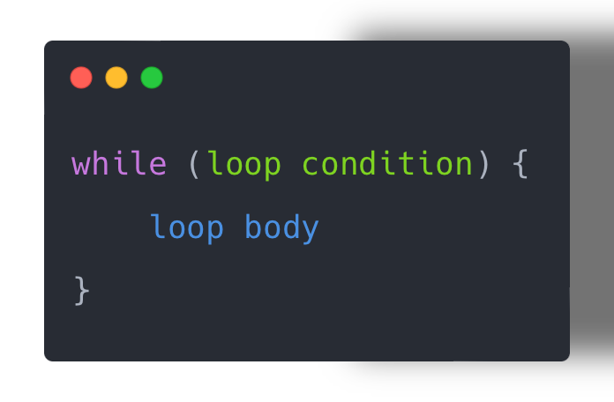
Recap: While Loop pseudo-code
General form of a while loop
  while we wish to continue, do the things in the loop body
while keyword
Boolean condition
Statements to be repeated

Slide 18
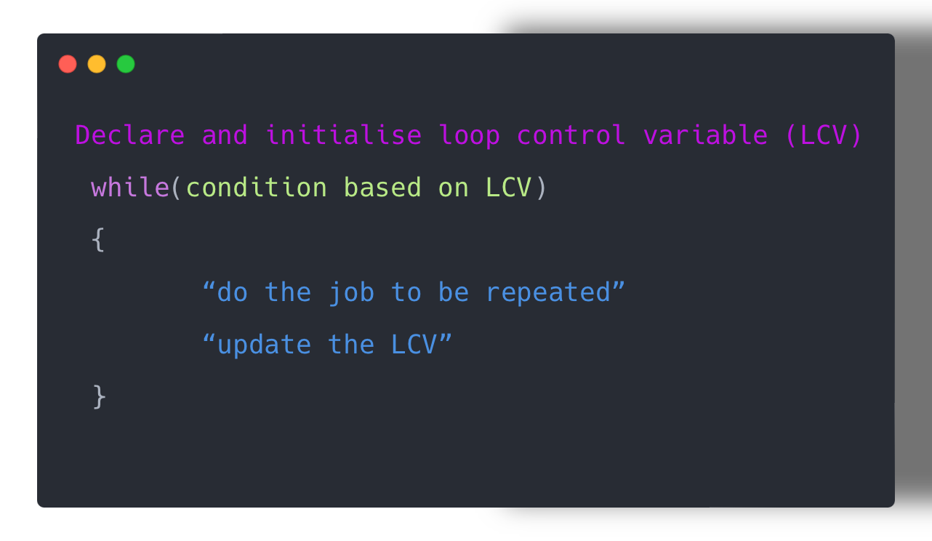
Recap: While Loop Construction
This structure should always be used

Slide 19
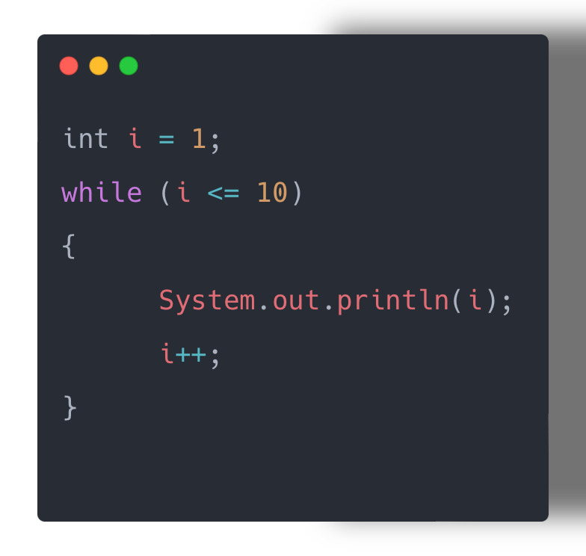
While Loop Flowchart
Start
While Condition
true
False
Execute statements
yes
End

Slide 20
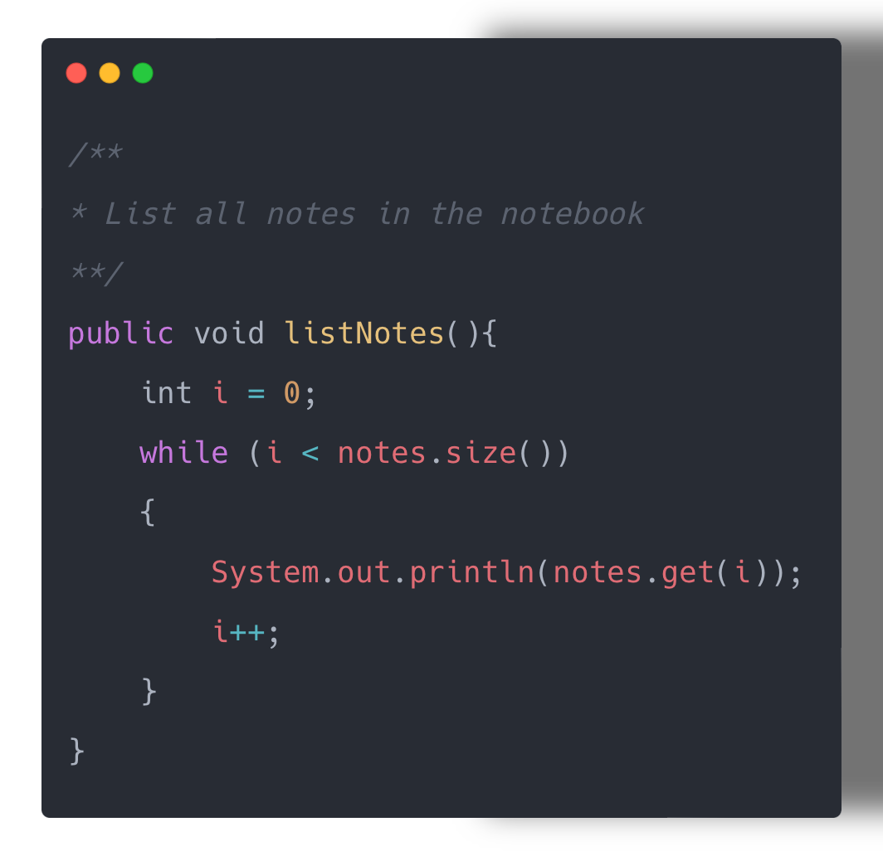
While Loop with ArrayLists
while the value of i is less than the size of the collection;
print the next note;
and then increment i by 1.

Slide 21
For vs While - LCV
Variable i is the
Loop Control Variable (LCV).
It must be initialised, tested and changed
int i = 0 is the initialisation.
i < notes.size() is the test.
i++ is the post-body action i.e. the change.

Slide 22
For Each Loop

Slide 23
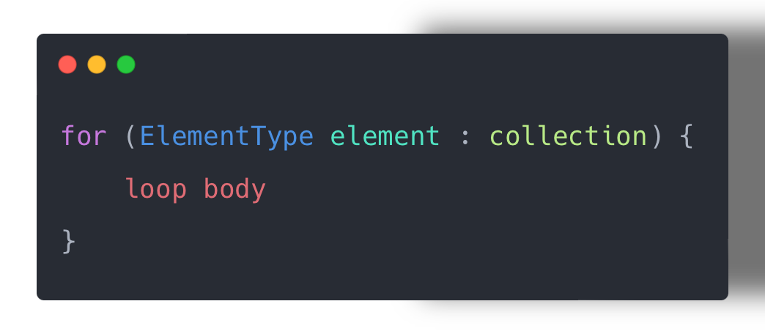
For each loop: pseudo-code
General form of a for-each loop
  For each element in collection, do the things in the loop body.
for keyword
Loop header
Statements to be repeated

Slide 24
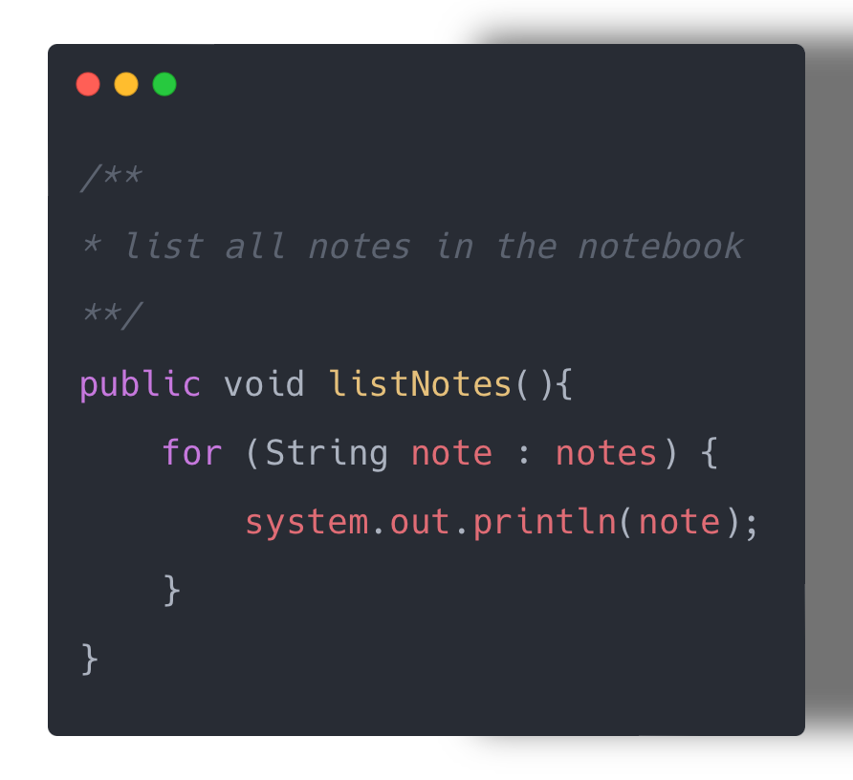
For each loop with Arraylists
for each note (of type String)
in the notes collection;
  print out note

Slide 25
For each loop
Can only be used for access
  you can’t remove the retrieved elements.
Can only loop forward in single steps.
Cannot use to compare two collections.

Slide 26
For each vs while
for-each:
  easier to write.
  safer: it is guaranteed to stop.
while:
  we don’t have to process the whole collection.
  doesn’t even have to be used with a collection.
  take care: could be an infinite loop.

Slide 27
ArrayList Collection
We specify:
  the type of collection
  e.g.: notes
  the type of objects it will contain
    e.g.: <String>
We say
  “notes is an ArrayList of String”

Slide 28
ArrayList Summary
Java Collections Framework
  ArrayList
  (part of the Java util package)
  import java.util.ArrayList;
  private ArrayList <String> notes; // declares notes as an ArrayList of Strings
  notes = new ArrayList <String>(); // Initialises notes
  notes.add(note); // add a note to the list
  notes.size(); // returns how notes in collection
  notes.get(noteNumber) // returns specific element of collection
  notes.remove(noteNumber); // deletes specific element from collection
Iterating collections
  for each

Slide 29
Comparison
myArray.length;
Array
ArrayList
Initialisation
  String[] names= new String[5];
Adding an element
  names[0] = “Siobhan”;
Accessing an element
  System.out.println(names[0]);
Modifying an Element
  names[0] = “Mary”;
Number of elements
  names.length; //returns how many elements //array can store
Remove an element
  names[0] = “”; //delete of element in array can //mean moving elements
Initialisation
  ArrayList<String> names = new ArrayList<>();
Adding an element
  names.add(“Siobhan”);
Accessing an element
  System.out.println(names.get(0));
Modifying an Element
  names.set(0, “Mary");
Number of elements
  names.size(); //returns how many elements are //stored
Remove an element
  names.remove(“Mary"); // Remove by value
  names.remove(0); // Remove by index

Slide 30
References
  https://docs.oracle.com/en/java/javase/11/docs/api/java.base/java/lang/String.html
  https://docs.oracle.com/javase/8/docs/api/java/util/ArrayList.html
  http://www.angelikalanger.com/GenericsFAQ/FAQSections/ParameterizedTypes.html#FAQ001
  https://www.programiz.com/java-programming/library/arraylist

Slide 31

Questions?

