Slide 1

Introduction to ArrayLists
(based on Ch. 4, Objects First with Java - A Practical Introduction using BlueJ, © David J. Barnes, Michael Kölling)
Produced by:
Ms. Mairéad Meagher
Dr. Siobhán Drohan
Ms Siobhan Roche
Department of Computing and Mathematics
http://www.setu.ie/

Slide 2
Topic list
Grouping Objects
  Developing a basic personal notebook project using Collections
  e.g. ArrayList
Indexing within Collections
  Retrieval and removal of objects
Generic classes
  e.g. ArrayList
Iteration
  Using the for loop
  Using the while loop
  Using the for each loop
Next SlideDeck:
coding a Shop Project that stores an ArrayList of Products.

Slide 3
The requirement to group objects
Many applications involve collections of objects:
  Personal organizers.
  Library catalogs.
  Student-record system.
The number of items to be stored varies:
  Items added.
  Items deleted.

Slide 4

Example: A personal notebook
Notes may be stored.
Individual notes can be viewed.
There is no limit to the number of notes.
It generally tells you how many notes are stored.

Slide 5
Java API: the class library
Many useful classes.
We don’t have to write everything from scratch.
Java calls its libraries, packages.
Back to the notebook:
Grouping objects is a recurring requirement.
  The java.util package
  contains classes for doing this
  …the Collections Framework.

Slide 6
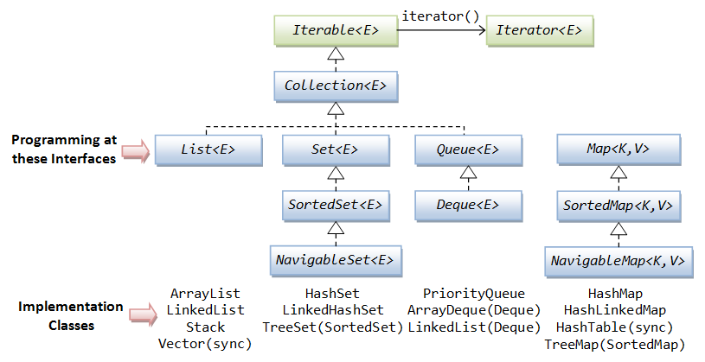
Java’s Collections Framework
Notes:
We will look at List, Set and Map in this module.

Slide 7
Java’s Collections Framework
Notes:
We will look at List, Set and Map in this module.

Slide 8
ArrayList Collection
We specify:
  the type of collection
    e.g.: ArrayList
  the type of objects it will contain
    e.g.: <String>
We say
  “ArrayList of String”
Notes:
The type must be an object…it cannot store primitive types.

Slide 9
import java.util.ArrayList;
public class Notebook
{
// Storage for an arbitrary number of notes.
private ArrayList <String> notes;
// Perform any initialization required for the notebook.
public Notebook()
{
notes = new ArrayList <String>();
}
}

Slide 10
import java.util.ArrayList;
public class Notebook
{
// Storage for an arbitrary number of notes.
private ArrayList <String> notes;
// Perform any initialization required for the notebook.
public Notebook()
{
notes = new ArrayList <String>();
}
}
import the ArrayList package

Slide 11
import java.util.ArrayList;
public class Notebook
{
// Storage for an arbitrary number of notes.
private ArrayList <String> notes;
// Perform any initialization required for the notebook.
public Notebook()
{
notes = new ArrayList <String>();
}
}
declares notes as a private
“ArrayList of <String>”

Slide 12
import java.util.ArrayList;
public class Notebook
{
// Storage for an arbitrary number of notes.
private ArrayList <String> notes;
// Perform any initialization required for the notebook.
public Notebook()
{
notes = new ArrayList <String>();
}
}
notes is initialised by calling
the constructor using new
Note new and ()

Slide 13
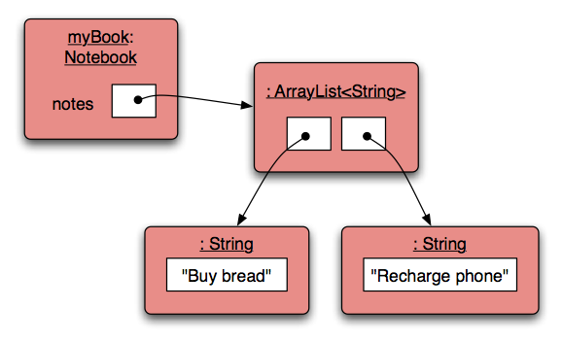
Object structures with ArrayList

Slide 14
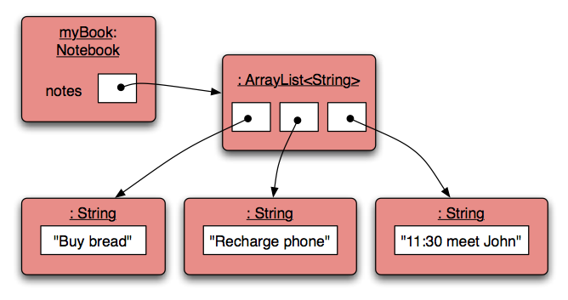
Adding a third note

Slide 15
Features of the ArrayList Collection
It increases its capacity as necessary.
It keeps a private count
  size() accessor.
It keeps the objects in order.
?
Details of how all this is done are hidden.
  Does that matter?
  Does not knowing how, prevent us from using it?
Notes:
ANSWER = NO

Slide 16
import java.util.ArrayList;
public class Notebook
{
private ArrayList <String> notes;
public Notebook(){
notes = new ArrayList <String> ();
}
public void storeNote(String note){
notes.add(note);
}
public int numberOfNotes(){
return notes.size();
}
}
Adding a new note
of type String
Returning the
number of notes

Slide 17
Topic list
Grouping Objects
  Developing a basic personal notebook project using Collections
  e.g. ArrayList
Indexing within Collections
  Retrieval and removal of objects
Generic classes
  e.g. ArrayList
Iteration
  Using the for loop
  Using the while loop
  Using the for each loop
Next SlideDeck:
coding a Shop Project that stores an ArrayList of Products.

Slide 18

ArrayList: Index numbering

Slide 19
Retrieving an object – showNote()
public void showNote (int noteNumber)
{
if(noteNumber < 0) {
// This is not a valid note number.
}
else if(noteNumber < numberOfNotes()) {
System.out.println(notes.get(noteNumber));
}
else {
// This is not a valid note number.
}
}
Index
validity
checks
Retrieve and
print the note

Slide 20
Removing an object
public void removeNote(int noteNumber)
{
if(noteNumber < 0) {
// This is not a valid note number, so do nothing.
}
else if(noteNumber < numberOfNotes()) {
// This is a valid note number.
notes.remove(noteNumber);
}
else {
// This is not a valid note number, so do nothing.
}
}
Index
validity
checks
Delete the note at
the specific index

Slide 21
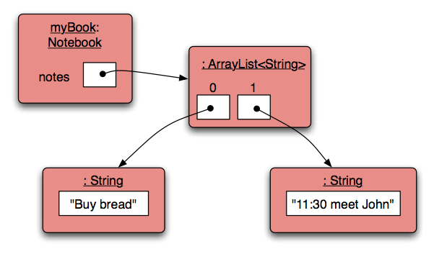
Removal may affect numbering

Slide 22
Removal may affect numbering
BEFORE
AFTER
1
2
3
1
2
NOTE the change in numbering

Slide 23
Topic list
Grouping Objects
  Developing a basic personal notebook project using Collections
  e.g. ArrayList
Indexing within Collections
  Retrieval and removal of objects
Generic / Parameterized classes
  e.g. ArrayList
Iteration
  Using the for loop
  Using the while loop
  Using the for each loop
Next SlideDeck:
coding a Shop Project that stores an ArrayList of Products.

Slide 24
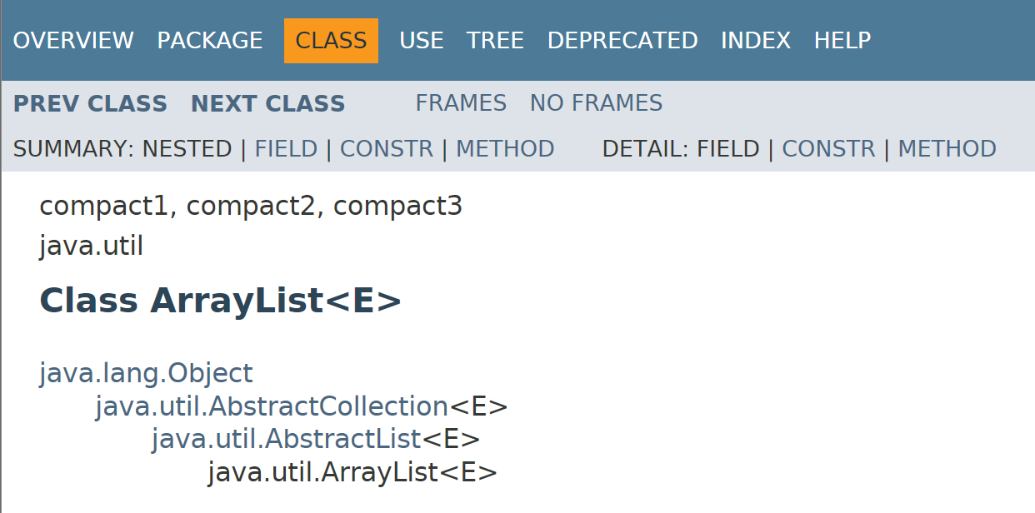
Generic/Parameterized Classes

Slide 25
Generic/Parameterized Classes
Collections are known as parameterized or generic types.
Note <E> is the parameter.
E gets replaced with some Class or Type

Slide 26
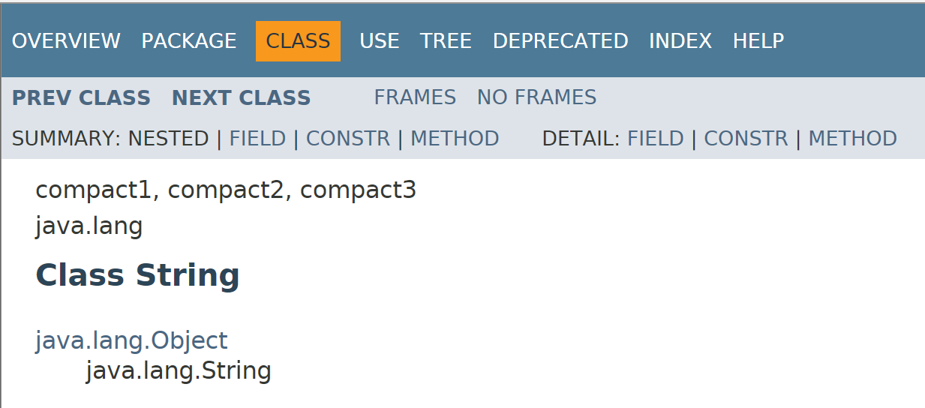
String is not parameterized.

Slide 27
Generic/Parameterized Classes
String is not parameterized.
ArrayList is parameterized.
The type parameter <E>
says what we want a list of e.g.:
  ArrayList<Person>
  ArrayList<TicketMachine>
  ArrayList<String>
  etc.

Slide 28
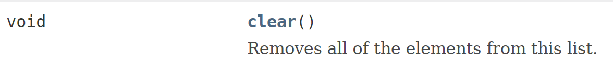
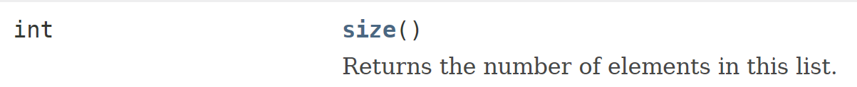
Generic/Parameterized classes
ArrayList implements list functionality:

Slide 29
Topic list
Grouping Objects
  Developing a basic personal notebook project using Collections
  e.g. ArrayList
Indexing within Collections
  Retrieval and removal of objects
Generic classes
  e.g. ArrayList
Iteration
  Using the for loop
  Using the while loop
  Using the for each loop
Next SlideDeck:
coding a Shop Project that stores an ArrayList of Products.

Slide 30
Processing a whole collection (iteration)
We often want to perform some actions
an arbitrary number of times.
  E.g.,
  Print all the notes in the notebook.
  How many are there?
  Does the amount of notes in our notebook vary?
Most programming languages include loop statements to make this possible.
Loops enable us to control how many times we repeat certain actions.

Slide 31
Loops in Programming
There are three types of standard loops in (Java) programming:
  while
  for
  do while
You typically use for and while loops to iterate over your ArrayList collection,
OR
you can use another special construct associated with Collections:
  for each

Slide 32
Topic list
Grouping Objects
  Developing a basic personal notebook project using Collections
  e.g. ArrayList
Indexing within Collections
  Retrieval and removal of objects
Generic classes
  e.g. ArrayList
Iteration
  Using the for loop
  Using the while loop
  Using the for each loop
Next SlideDeck:
coding a Shop Project that stores an ArrayList of Products.

Slide 33
Recap: for loop pseudo-code
General form of a for loop
for(initialization; boolean condition; post-body action)
{
statements to be repeated
}

Slide 34
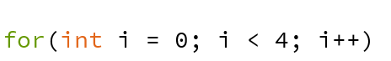
Recap: for loop syntax
for(initialization; boolean condition; post-body action)
{
statements to be repeated
}

Slide 35
Recap: for loop syntax
initialization | int i = 0; | Initialise a loop control variable (LCV) e.g. i. It can include a variable declaration.
boolean condition | i < 4; | Is a valid boolean condition that typically tests the loop control variable (LCV).
post-body action | i++ | A change to the loop control variable (LCV). Contains an assignment statement.

Slide 36
Recap: for loop flowchart
boolean
condition?
true
statement(s)
update
for(int i = 0; i < 4; i++)
{
System.out.println(i);
}
Console Output:
false
0
1
2
3

Slide 37
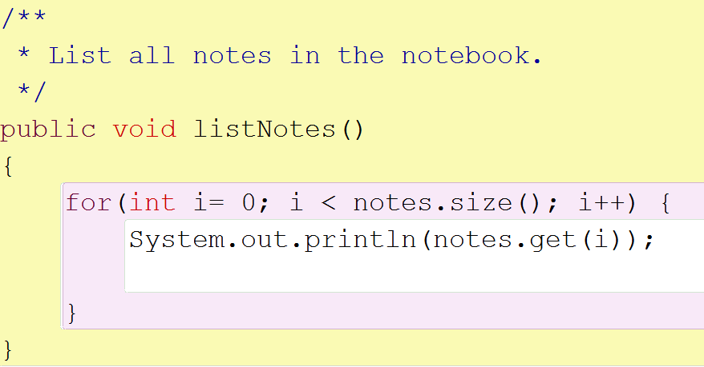
for loop: for iterating over a collection
Increment index by 1
for each value of i less than the size of the collection,
print the next note, and then increment i

Slide 38
Topic list
Grouping Objects
  Developing a basic personal notebook project using Collections
  e.g. ArrayList
Indexing within Collections
  Retrieval and removal of objects
Generic classes
  e.g. ArrayList
Iteration
  Using the for loop
  Using the while loop
  Using the for each loop
Next SlideDeck:
coding a Shop Project that stores an ArrayList of Products.

Slide 39
Recap: while loop pseudo code
General form of a while loop
while keyword
boolean condition
while(loop condition) {
loop body
}
Statements to be repeated
Pseudo-code expression of the actions of a while loop
while we wish to continue, do the things in the loop body

Slide 40
Recap: while loop construction
Declare and initialise loop control variable (LCV)
while(condition based on LCV)
{
“do the job to be repeated”
“update the LCV”
}
This structure should always be used

Slide 41
Recap: while loop flowchart
true
boolean
condition?
statement(s)
int i = 1;
while (i <= 10)
{
System.out.println(i);
i++;
}
false

Slide 42
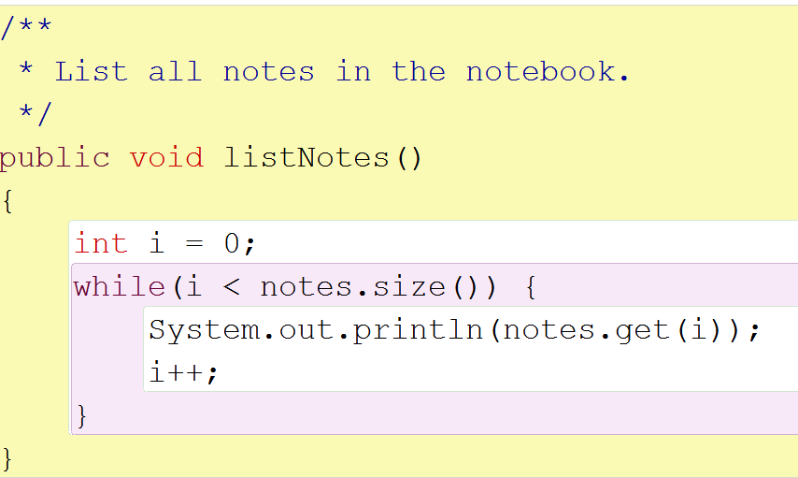
while loop: iterating over a collection
Increment i
by 1
while the value of i is less than the size of the collection,
print the next note, and then increment i

Slide 43
for versus while
Variable i is the
Loop Control Variable (LCV). It must be initialised, tested and changed.
int i = 0 is the initialisation.
i < notes.size() is the test.
i++ is the post-body action i.e. the change.

Slide 44
Topic list
Grouping Objects
  Developing a basic personal notebook project using Collections
  e.g. ArrayList
Indexing within Collections
  Retrieval and removal of objects
Generic classes
  e.g. ArrayList
Iteration
  Using the for loop
  Using the while loop
  Using the for each loop
Next SlideDeck:
coding a Shop Project that stores an ArrayList of Products.

Slide 45
for each loop: pseudo code
General form of the for-each loop
for keyword
loop header
for(ElementType element : collection) {
loop body
}
Statement(s) to be repeated
Pseudo-code expression of the actions of a for-each loop
For each element in collection, do the things in the loop body.

Slide 46
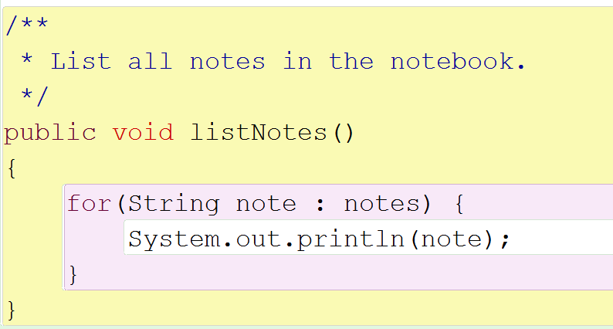
for each loop: iterating over a collection
for each note in the notes collection, print out note

Slide 47
for each loop
Can only be used for access;
  you can’t remove the retrieved elements.
Can only loop forward in single steps.
Cannot use to compare two collections.

Slide 48
for each versus while
for-each:
  easier to write.
  safer: it is guaranteed to stop.
while:
  we don’t have to process the whole collection.
  doesn’t even have to be used with a collection.
  take care: could be an infinite loop.

Slide 49
Summary
Java Collections Framework
  ArrayList
import java.util.ArrayList;
private ArrayList <String> notes;
notes = new ArrayList <String>();
notes.add(note);
notes.size();
notes.get(noteNumber)
notes.remove(noteNumber);
Iterating collections
  for each
    for (String note : notes) {System.out.println(note);}

Slide 50

Questions?

