Slide 1

Inheritance
Exploring Polymorphism
Produced
by:
Ms. Mairéad Meagher
Dr. Siobhán Drohan
Ms Siobhan Roche
Department of Computing and Mathematics
http://www.setu.ie/

Slide 2
Lectures and Labs
This weeks lectures and labs are based on examples in:
Objects First with Java - A Practical Introduction using BlueJ, © David J. Barnes, Michael Kölling (https://www.bluej.org/objects-first/)

Slide 3
Topic List
Method polymorphism
Static and dynamic type
Overriding
Dynamic method lookup
Protected access

Slide 4
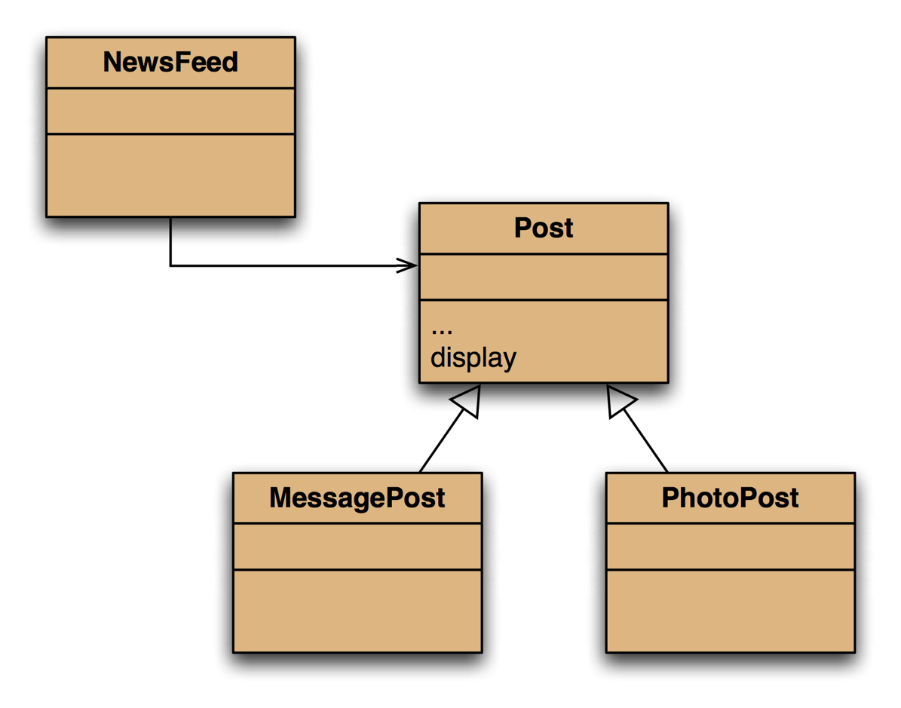
Social Network V5.0 – Inheritance Hierarchy

Slide 5
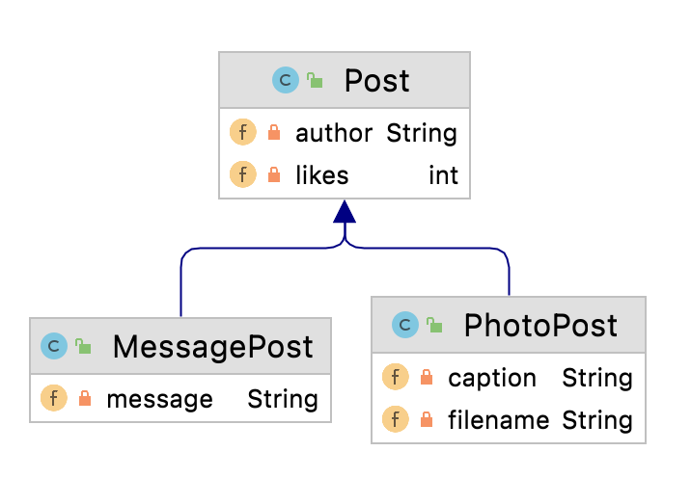
Testing the display method…
Create this MessagePost
0: Leonardo da Vinci
2 people like this.
Had a great idea this morning.
But now I forgot what it was. Something to do with flying ...
Create this PhotoPost
1: Alexander Graham Bell
4 people like this.
experiment.jpg
I think I might call this thing 'telephone'.

Slide 6
Testing the display method…
0: Leonardo da Vinci
2 people like this.
Had a great idea this morning.
But now I forgot what it was. Something to do with flying ...
1: Alexander Graham Bell
4 people like this.
experiment.jpg
I think I might call this thing 'telephone'.
What we want
0: Leonardo da Vinci
2 people like this.
1: Alexander Graham Bell
4 people like this.
What we have

Slide 7
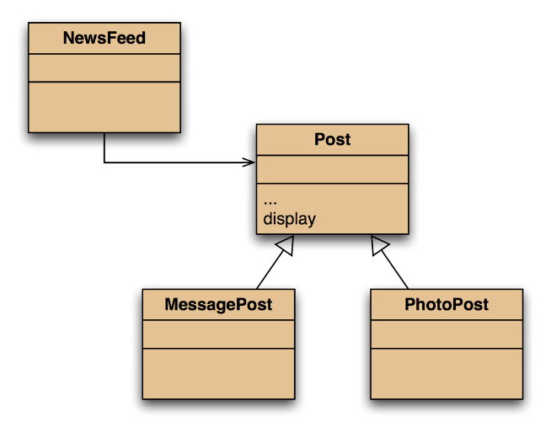
The problem
The display method in Post only prints the common fields.
Inheritance is a one-way street:
A subclass inherits the superclass fields.
The superclass knows nothing about its subclass’s fields.

Slide 8
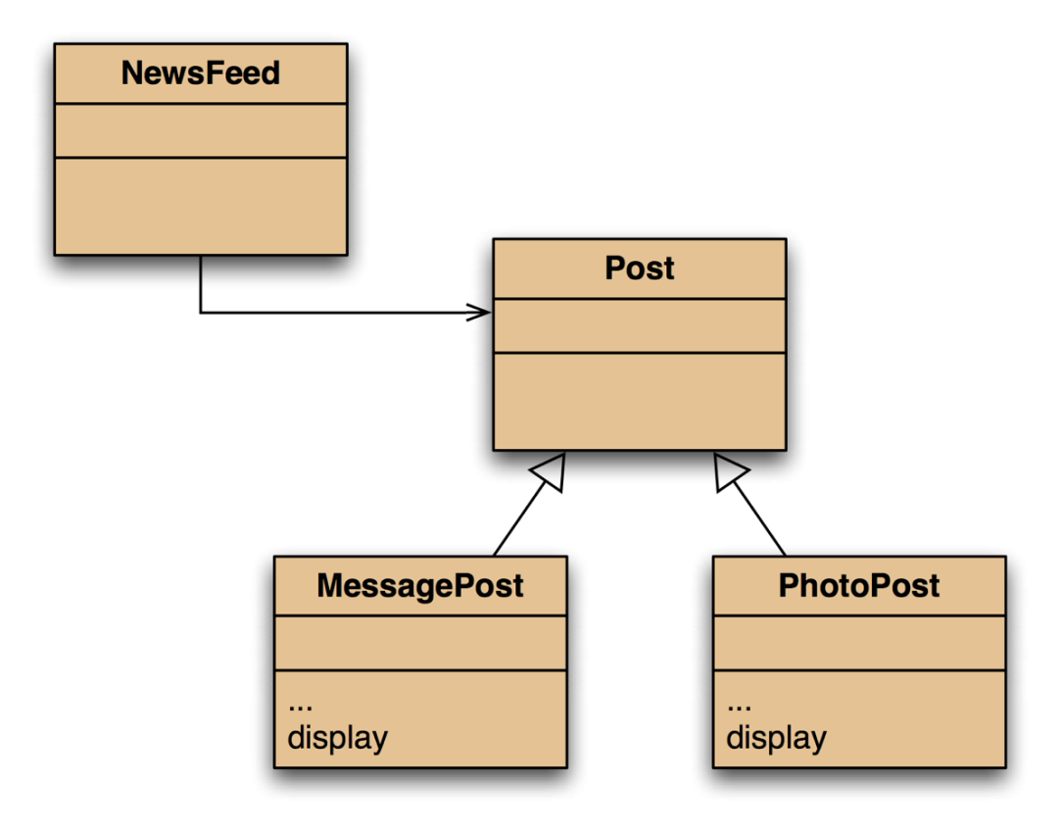
Attempting to solve the problem?
Place display where it has access to the information it needs.
Each subclass has its own version.
But:
Post’s fields are private.
NewsFeed cannot find a display method in Post.

Slide 9
Topic List
Method polymorphism
Static and dynamic type
Overriding
Dynamic method lookup
Protected access

Slide 10
Static type and dynamic type
A more complex type hierarchy requires further concepts to describe it.
Some new terminology:
static type
dynamic type
method dispatch/lookup

Slide 11
Static and dynamic type
What is the type of c1?
Car c1 = new Car();
What is the type of v1?
Vehicle v1 = new Car();
The type of the object a variable refers to is its dynamic type.
The declared type of a variable is its static type.

Slide 12
Static and dynamic type
The compiler’s job is to check for static-type violations.
What is the type of v1?
Vehicle v1 = new Car();
The type of the object a variable refers to is its dynamic type.
The declared type of a variable is its static type.

Slide 13
Recall our attempt to solve this problem…
0: Leonardo da Vinci
2 people like this.
Had a great idea this morning.
But now I forgot what it was. Something to do with flying ...
1: Alexander Graham Bell
4 people like this.
experiment.jpg
I think I might call this thing 'telephone'.
What we want
0: Leonardo da Vinci
2 people like this.
1: Alexander Graham Bell
4 people like this.
What we have

Slide 14

Recall our attempt to solve this problem…
We placed display in each subclass where it has access to the information it needs.
But:
Post’s fields are private and NewsFeed cannot find a display method in Post.
for(Post post : posts) { post.display(); // Compile-time error (static-type violation)
// method display() is not found in the
// Post class
}

Slide 15
Topic List
Method polymorphism
Static and dynamic type
Overriding
Dynamic method lookup
Protected access

Slide 16

Overriding - the solution to our problem
display method in both super- and subclasses.
Satisfies both static and dynamic type checking.

Slide 17
Overriding
Superclass and subclass define methods with the same signature.
Each has access to the fields of its class.
Superclass satisfies static type check.
Subclass method is called at runtime – it overrides the superclass version.
What becomes of the superclass version?

Slide 18
Topic List
Method polymorphism
Static and dynamic type
Overriding
Dynamic method lookup
Protected access

Slide 19
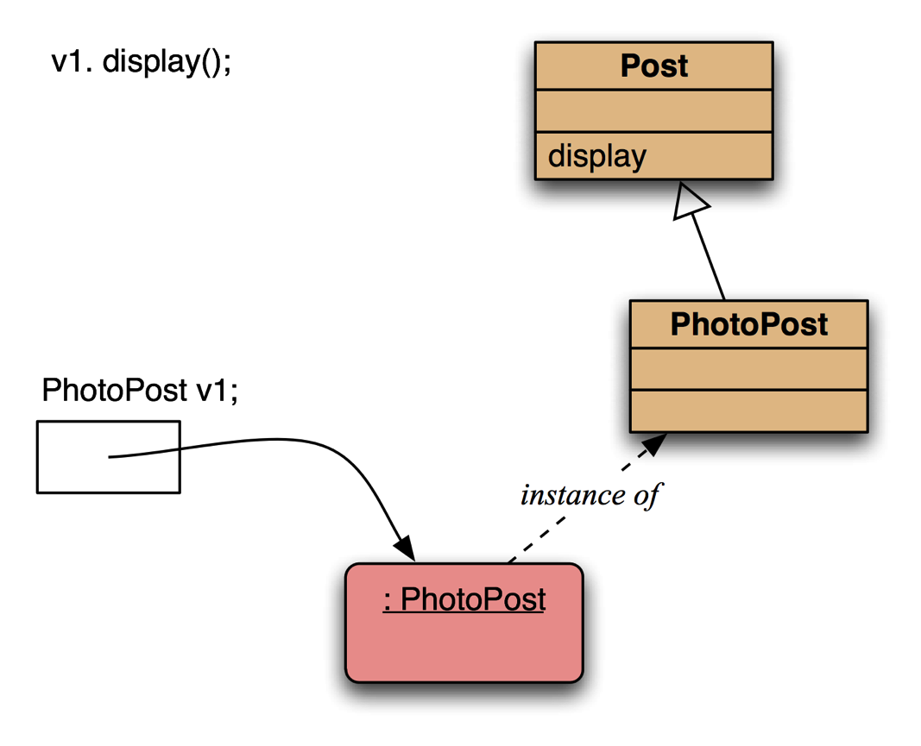
Dynamic method lookup
Inheritance but no overriding.
The inheritance hierarchy is ascended, searching for a match.

Slide 20
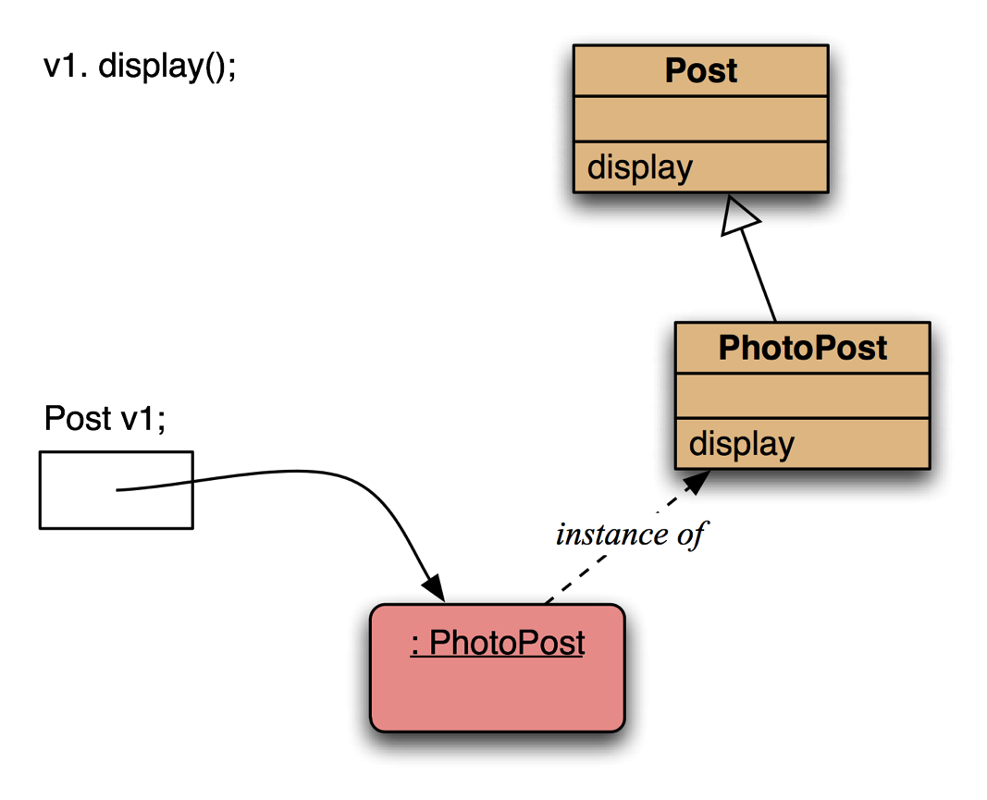
Dynamic method lookup
Polymorphism and overriding.
The ‘first’ version found is used.

Slide 21
Dynamic method lookup summary
The variable is accessed.
The object stored in the variable is found.
The class of the object is found.
The class is searched for a method match.
If no match is found, the superclass is searched.
This is repeated until a match is found, or the class hierarchy is exhausted.
Overriding methods take precedence.

Slide 22
Super call in methods
Overridden methods are hidden ...
... but we often still want to be able to call them.
An overridden method can be called from the method that overrides it.
super.method(...)
Recall we used super in our constructors.

Slide 23
Calling an overridden method
Post
public String display() { String str = ""; str += (author + "\n"); if(likes > 0) { str += (" - " + likes + " people like this.\n"); } else { str += "0 likes.\n"; } return str; }
MessagePost
public String display() { String str = super.display(); if (!message.isEmpty()){ str += "\t" + message + "\n"; } return str; }

Slide 24
Method polymorphism
We have been discussing polymorphic method dispatch.
A polymorphic variable can store objects of varying types.
Method calls are polymorphic.
The actual method called depends on the dynamic object type.

Slide 25
The instanceof operator
Used to determine the dynamic type.
Can recover ‘lost’ type information.
Usually precedes assignment with a cast to the dynamic type:
if(post instanceof MessagePost) { MessagePost msg = (MessagePost) post; … e.g. then access MessagePost methods via msg object … }

Slide 26
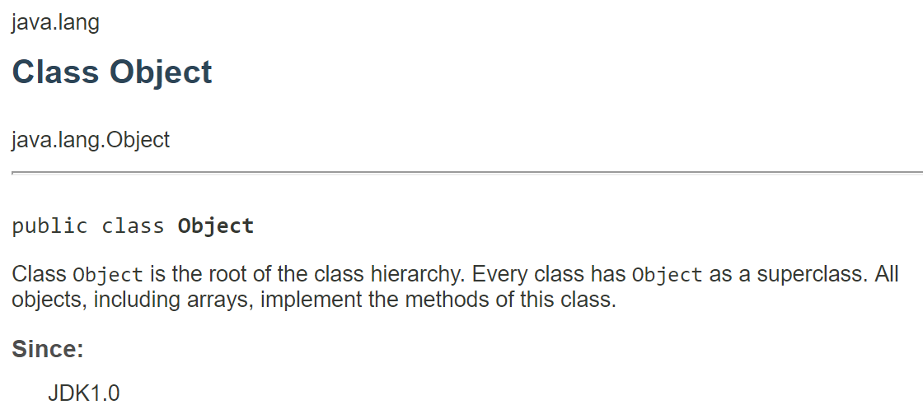
Recall the Object class…

Slide 27
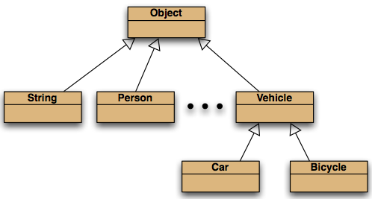
Recall the Object class…
All classes inherit from Object.

Slide 28
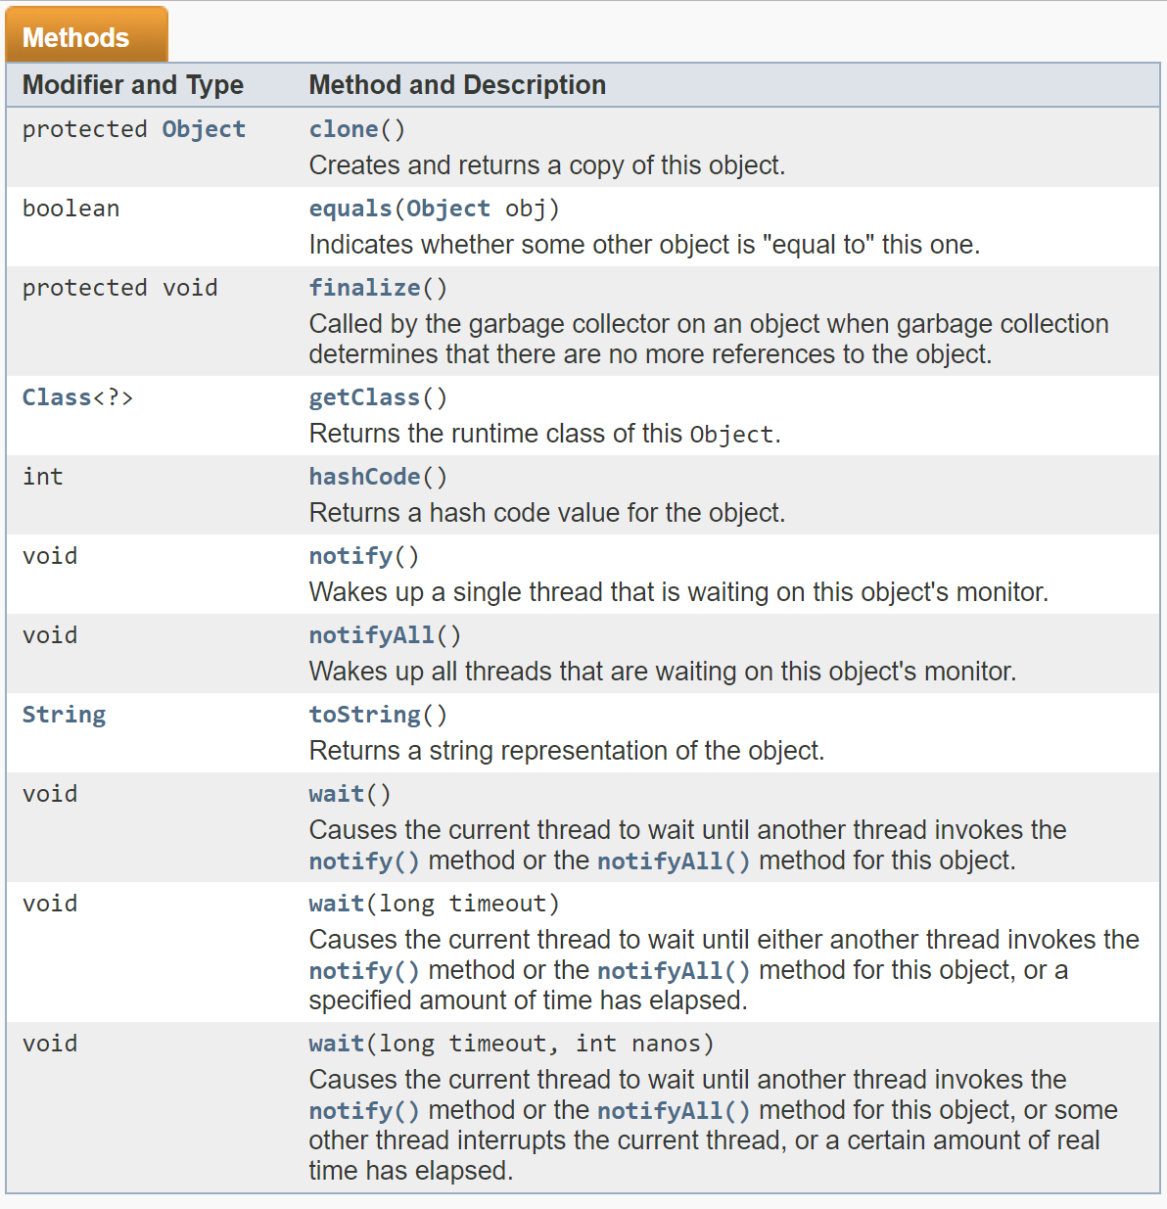
Methods in Object are inherited by all classes.
Any of these may be overridden.

Slide 29
The toString method is commonly overridden:
public String toString()
Returns a string representation of the object.

Slide 30
Overriding toString in Post
public String toString()
{
String text = author + "\n";
if(likes > 0) {
text += " - " + likes + " people like this.\n";
}
else {
text += "\n";
}
}

Slide 31
Overriding toString
Explicit print methods can often be omitted from a class:
System.out.println(post.toString());
Calls to println with just an object automatically result in toString being called:
System.out.println(post);

Slide 32
Topic List
Method polymorphism
Static and dynamic type
Overriding
Dynamic method lookup
Protected access

Slide 33
Protected access
Private access in the superclass may be too restrictive for a subclass.
The closer inheritance relationship is supported by protected access.
Protected access is more restricted than public access.

Slide 34
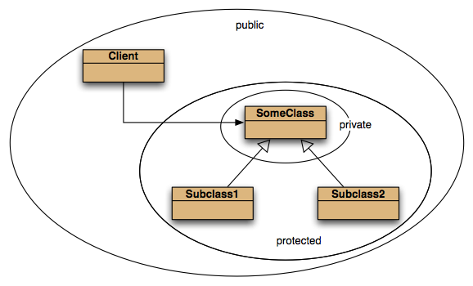
Access levels

Slide 35
Review
The declared type of a variable is its static type.
Compilers check static types.
The type of an object is its dynamic type.
Dynamic types are used at runtime.
Methods may be overridden in a subclass.
Method lookup starts with the dynamic type.
Protected access supports inheritance.

Slide 36

Any Questions?

