Slide 1

More Sophisticated Behaviour
Technical Support System V1.0
Produced
by:
Dr. Siobhán Drohan
Ms. Mairéad Meagher
Ms. Siobhán Roche
Department of Computing and Mathematics
http://www.setu.ie/

Slide 2
Lectures and Labs
The Tech Support System lectures and labs are based on examples in Chapter 5 of:
Objects First with Java - A Practical Introduction using BlueJ, © David J. Barnes, Michael Kölling

Slide 3
Topic List
Recap of Library Classes (Java’s API).
Interface Vs Implementation.
Technical Support System V1:
Three Classes:
InputReader class
Responder class
SupportSystem class

Slide 4
The Java class library (API)
API: Application Programmers’ Interface
Thousands of classes.
Tens of thousands of methods.
Many useful classes that make life much easier.
A competent Java programmer must be able to work with the libraries.
Documentation of the Java libraries is in HTML format (generated using javadoc comments).
Readable in a web browser.

Slide 5
Using library classes
Classes from the library must be imported
using an import statement
exception are classes from java.lang
import javax.swing.*;
import javax.swing.JOptionPane;
They can then be used like classes from the current project.

Slide 6
Working with the library
You should:
know some important packages/classes by name.
know how to find out about other classes.
Remember:
We only need to know the interface, not the implementation.
API contains the interface description for all library classes.

Slide 7
Topic List
Recap of Library Classes (Java’s API).
Interface Vs Implementation.
Technical Support System V1:
Overview of the System
Three Classes:
InputReader class
Responder class
SupportSystem class

Slide 8
Interface vs implementation
The documentation includes:
Class name;
Class description;
List of constructors and methods
Return values and parameters for constructors and methods
Description of the purpose of each constructor and method
the interface of the class

Slide 9
Interface vs implementation
The documentation does not include
private fields
(most fields are private)
private methods
the bodies
(source code) for each method
the implementation of the class

Slide 10
Topic List
Recap of Library Classes (Java’s API).
Interface Vs Implementation.
Technical Support System V1:
Overview of the System
Three Classes:
InputReader class
Responder class
SupportSystem class

Slide 11
Technical Support System V1
Console based system.
01
Textual dialog system
02
you enter text on the console and the system will provide a response.
System always responds with the same String:
03
“That sounds interesting. Tell me more…”

Slide 12
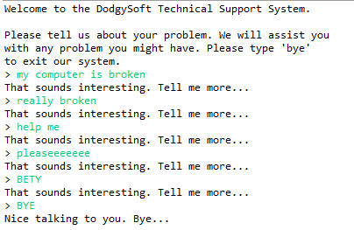
Technical Support System V1
Sample

Slide 13
Topic List
Recap of Library Classes (Java’s API).
Interface Vs Implementation.
Technical Support System V1:
Overview of the System
Three Classes:
InputReader class
Responder class
SupportSystem class

Slide 14
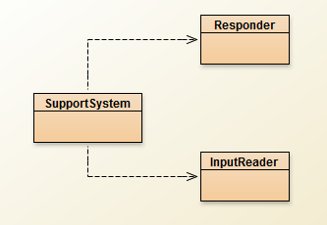
Class Diagram

Slide 15
Topic List
Recap of Library Classes (Java’s API).
Interface Vs Implementation.
Technical Support System V1:
Overview of the System
Three Classes:
InputReader class
Responder class
SupportSystem class

Slide 16
import java.util.Scanner;
public class InputReader{
Scanner input;
public InputReader(){
input = new Scanner(System.in);
}
/**
* Read a line of text from the console and return it as a String.
*
* @return A String typed by the user.
*/
public String getInput() {
System.out.print("> "); // print prompt
String inputLine = input.nextLine().trim().toLowerCase();
return inputLine;
}
}

Slide 17
Topic List
Recap of Library Classes (Java’s API).
Interface Vs Implementation.
Technical Support System V1:
Overview of the System
Three Classes:
InputReader class
Responder class
SupportSystem class

Slide 18
public class Responder{
/**
* Construct a Responder - nothing to do
*/
public Responder(){
}
/**
* Generate a response.
* @return A string that should be displayed as the response
*/
public String generateResponse(){
return "That sounds interesting. Tell me more...";
}
}

Slide 19
Topic List
Recap of Library Classes (Java’s API).
Interface Vs Implementation.
Technical Support System V1:
Overview of the System
Three Classes:
InputReader class
Responder class
SupportSystem class

Slide 20
public class SupportSystem{
private InputReader reader;
private Responder responder;
public SupportSystem() {
reader = new InputReader();
responder = new Responder();
}
public static void main(String[] argvs){
SupportSystem app = new SupportSystem();
app.start();
}
public void start(){
printWelcome();
String input = reader.getInput();
while(! input.startsWith("bye")) {
String response = responder.generateResponse();
System.out.println(response);
input = reader.getInput();
}
printGoodbye();
}
More on next slide >>

Slide 21
private void printWelcome(){
System.out.println("Welcome to the DodgySoft Technical Support System.");
System.out.println();
System.out.println("Please tell us about your problem. We will assist you");
System.out.println("with any problem you might have. Please type 'bye'");
System.out.println("to exit our system.");
}
private void printGoodbye(){
System.out.println("Nice talking to you. Bye...");
}
}

Slide 22
Main loop structure
public void start(){
printWelcome();
String input = reader.getInput();
while(! input.startsWith("bye")) {
String response = responder.generateResponse();
System.out.println(response);
input = reader.getInput();
}
printGoodbye();
}
Get input
while(input does not start with “bye”){
do something (i.e. print response)
Get some new input
}

Slide 23

Any Questions?

