Slide 1

More Sophisticated Behaviour
Technical Support System V2.0
Produced
by:
Ms. Mairéad Meagher
Dr. Siobhán Drohan
Ms. Siobhán Roche
Department of Computing and Mathematics
http://www.setu.ie/

Slide 2
Topic List
Recap: Technical Support System V1
Technical Support System V2
Overview of the System
Responder class
Random

Slide 3
Technical Support System V1
A console based system.
A textual dialog system i.e. you enter text on the console and the system will provide a response.
In this version, the system responds with the same String always:
“That sounds interesting. Tell me more…”

Slide 4
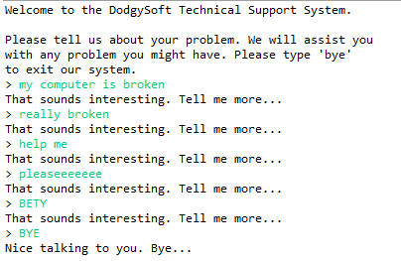
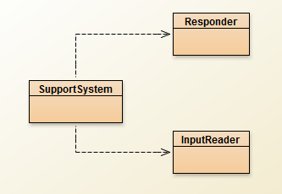
Technical Support System V1

Slide 5
Topic List
Recap: Technical Support System V1
Technical Support System V2
Overview of the System
Responder class
Random

Slide 6
Technical Support System V2
A console based, textual dialog system.
The system provides a random response from a list of pre-defined responses
"That sounds interesting. Tell me more..."
"I need a bit more information on that."
"Have you checked that you do not have a dll conflict?"
"That is explained in the manual. Have you read the manual?“
"That's not a bug, it's a feature!"
"Could you elaborate on that?“
etc.
repository

Slide 7
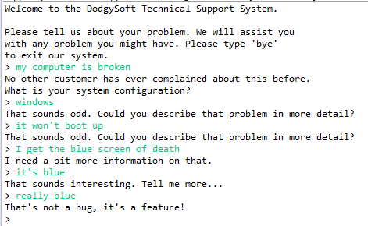
Technical Support System V2
Sample

Slide 8
Class Diagram V2
No change at class level

Slide 9
import java.util.Scanner;
public class InputReader{
Scanner input;
public InputReader(){
input = new Scanner(System.in);
}
/**
* Read a line of text from the console and return it as a String.
*
* @return A String typed by the user.
*/
public String getInput() {
System.out.print("> "); // print prompt
String inputLine = input.nextLine().trim().toLowerCase();
return inputLine;
}
}
No change in this class

Slide 10
public class SupportSystem{
private InputReader reader;
private Responder responder;
public SupportSystem() {
reader = new InputReader();
responder = new Responder();
}
public static void main(String[] argvs){
SupportSystem app = new SupportSystem();
app.start();
}
public void start(){
printWelcome();
String input = reader.getInput();
while(! input.startsWith("bye")) {
String response = responder.generateResponse();
System.out.println(response);
input = reader.getInput();
}
printGoodbye();
}
No change in this class

Slide 11
private void printWelcome(){
System.out.println("Welcome to the DodgySoft Technical Support System.");
System.out.println();
System.out.println("Please tell us about your problem. We will assist you");
System.out.println("with any problem you might have. Please type 'bye'");
System.out.println("to exit our system.");
}
private void printGoodbye(){
System.out.println("Nice talking to you. Bye...");
}
}
No change in this class

Slide 12
Topic List
Recap: Technical Support System V1
Technical Support System V2
Overview of the System
Responder class
Random

Slide 13
This class will change - to generate a random response
//V1 code
public class Responder{
/**
* Construct a Responder - nothing to do
*/
public Responder(){
}
/**
* Generate a response.
* @return A string that should be displayed as the response
*/
public String generateResponse(){
return "That sounds interesting. Tell me more...";
}
}

Slide 14
Repository of Responses
Instead of responding with:
"That sounds interesting. Tell me more...";
We would like to respond with a random response from a repository of responses
"That sounds interesting. Tell me more..."
"I need a bit more information on that."
"Have you checked that you do not have a dll conflict?"
"That is explained in the manual. Have you read the manual?“
"That's not a bug, it's a feature!"
"Could you elaborate on that?“
etc.
But how do we randomise the selection of a response?
repository

Slide 15
Topic List
Recap: Technical Support System V1
Technical Support System V2
Overview of the System
Responder class
Random

Slide 16
Using Random
The library class Random can be used to generate random numbers
import java.util.Random; // import the library class
...
Random randomGenerator = new Random(); // declare & init variable
...
//random int number (no upper or lower bound)
int index1 = randomGenerator.nextInt();
//random number between 0 (inclusive) and 100 (exclusive)
int index2 = randomGenerator.nextInt(100);

Slide 17
import java.util.ArrayList;
public class Responder{
private ArrayList<String> responses;
public Responder() {
responses = new ArrayList<String>();
fillResponses();
}
private void fillResponses() {
responses.add("That sounds odd. Could you describe that problem in more detail?");
responses.add("No other customer has ever complained about this before. \n" +
"What is your system configuration?");
responses.add("That sounds interesting. Tell me more...");
responses.add("I need a bit more information on that.");
responses.add("Have you checked that you do not have a dll conflict?");
responses.add("That is explained in the manual. Have you read the manual?");
responses.add("Your description is a bit wishy-washy. Have you got an expert\n" +
"there with you who could describe this more precisely?");
responses.add("That's not a bug, it's a feature!");
responses.add("Could you elaborate on that?");
}
}
V2.0 Responder…changes
The Responder class declares a private ArrayList of Strings called responses, which is initialised in the constructor.
This is used by fillResponses()
to create the repository of responses.

Slide 18
import java.util.ArrayList;
import java.util.Random;
public class Responder{
private Random randomGenerator; // declare
private ArrayList<String> responses;
public Responder() {
randomGenerator = new Random(); // init
responses = new ArrayList<String>(); fillResponses();
}
public String generateResponse() {
// Pick a random number between 0 (inclusive) and the size
// of the ArrayList (exclusive).
int index = randomGenerator.nextInt(responses.size()); // repo size
return responses.get(index);
}
V2.0 Responder changes…
to return a random response from a repository of responses.

Slide 19

Any Questions?

