Slide 1


More Sophisticated Behaviour
Technical Support System V3.0
Produced
by:
Dr. Siobhán Drohan
Ms. Mairéad Meagher
Ms. Siobhán Roche
Department of Computing and Mathematics
http://www.setu.ie/

Slide 2
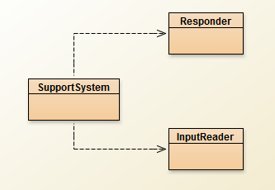
Topic List
Recap: Technical Support System V2
Technical Support System V3
Overview
3 classes:
Responder
InputReader
SupportSystem
Class Development
Responder class
Generating a related response
ArrayList
Map and HashMap
InputReader class
Tokenizing Strings
Set and HashSet
Responder class
Finishing the class
SupportSystem class
A small change.

Slide 3
Recap: Technical Support System V2
A console based, textual dialog system.
In this version, the system provides a random response from a list of pre-defined responses e.g.:
"That sounds interesting. Tell me more..."
"I need a bit more information on that."
"Have you checked that you do not have a dll conflict?"
"That is explained in the manual. Have you read the manual?“
" That's not a bug, it's a feature!"
"Could you elaborate on that?“
etc.

Slide 4
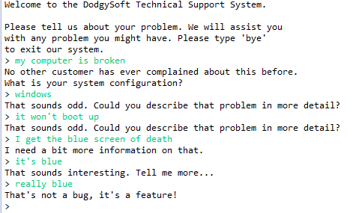
Recap: Technical Support System V2

Slide 5
Topic List
Recap: Technical Support System V2
Technical Support System V3
Overview
3 classes:
Responder
InputReader
SupportSystem
Class Development
Responder class
Generating a related response
ArrayList
Map and HashMap
InputReader class
Tokenizing Strings
Set and HashSet
Responder class
Finishing the class
SupportSystem class
A small change.

Slide 6
Technical Support System V3
A console based, textual dialog system.
Based on the user input,
the system provides a context-sensitive, generated response from a list of pre-defined responses.
If the system cannot find a suitable generated response, it returns a random one.

Slide 7
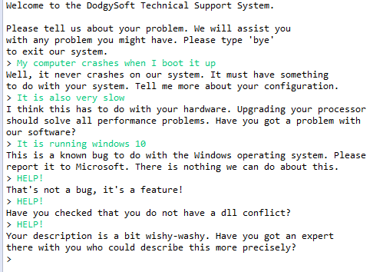
Technical Support System V3
Context
Sensitive
Random

Slide 8
Topic List
Recap: Technical Support System V2
Technical Support System V3
Overview
3 classes:
Responder
InputReader
SupportSystem
Class Development
Responder class
Generating a related response
ArrayList
Map and HashMap
InputReader class
Tokenizing Strings
Set and HashSet
Responder class
Finishing the class
SupportSystem class
A small change.

Slide 9
How do we influence the generated response?
What if we had a set of words
that are likely to occur in a typical question?
What if we then associated these words
with particular responses?
Then, if the user input contains a known word,
generate a related response!
Key | Value
Word | Response

Slide 10


ArrayList
Q: Can we use an ArrayList for this purpose?
i.e. Will it let us store “key=value” pairs?
A: No!
i.e. We need a different data structure.
A Map stores “key=value” pairs

Slide 11
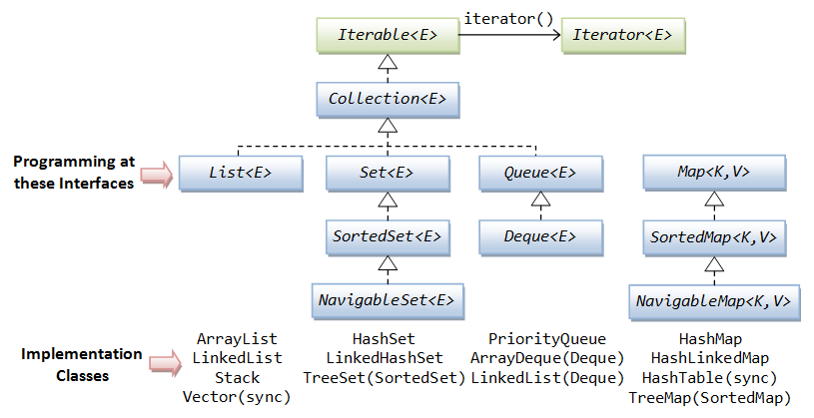
RECAP: Java’s Collections Framework
in Java
Notes:
We looked at List in talk 8, Set and Map in this talk, in addition to Iterator

Slide 12
RECAP: Java’s Collections Framework
in Java
Notes:
We looked at List in talk 8, Set and Map in this talk, in addition to Iterator

Slide 13
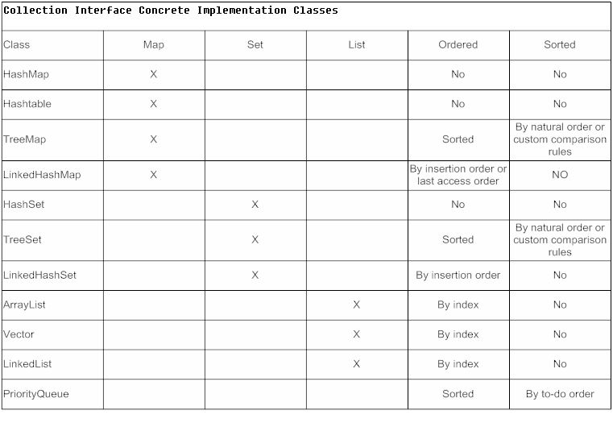

Slide 14

Topic List
Recap: Technical Support System V2
Technical Support System V3
Overview
3 classes:
Responder
InputReader
SupportSystem
Class Development
Responder class
Generating a related response
ArrayList
Map and HashMap
InputReader class
Tokenizing Strings
Set and HashSet
Responder class
Finishing the class
SupportSystem class
A small change.

Slide 15

Maps
Maps are collections
that contain pairs of values.
Pairs consist of :
key
value.
Lookup works by supplying a key, and retrieving a value.
E.g. telephone book
use the name to look up a phone number.
Key | Value
Word | Response

Slide 16
Using Maps
A MAP with String keys & String values.
:HashMap
"Charles Nguyen"
"(531) 9392 4587"
"Lisa Jones"
"(402) 4536 4674"
"William H. Smith"
"(998) 5488 0123"

Slide 17
ArrayList Vs Map
ArrayList
Map
each entry stores one object
you use an integer index to lookup the object
each entry has a pair of objects (key=value).
you use the key object to lookup the value object

Slide 18
More on Map
Maps are ideal for one-way lookup using the key.
Using Maps to Look up a value associated with a key is easy!
However, reverse lookup (finding a key for a value) is not so easy.
E.g. looking up a number in the phonebook, to find the persons name
A map cannot contain duplicate keys;
A key can map to at most one value.
Java provides 4 Map classes:
HashMap, HashTable, TreeMap & Linked HashMap
We will use the HashMap class.

Slide 19

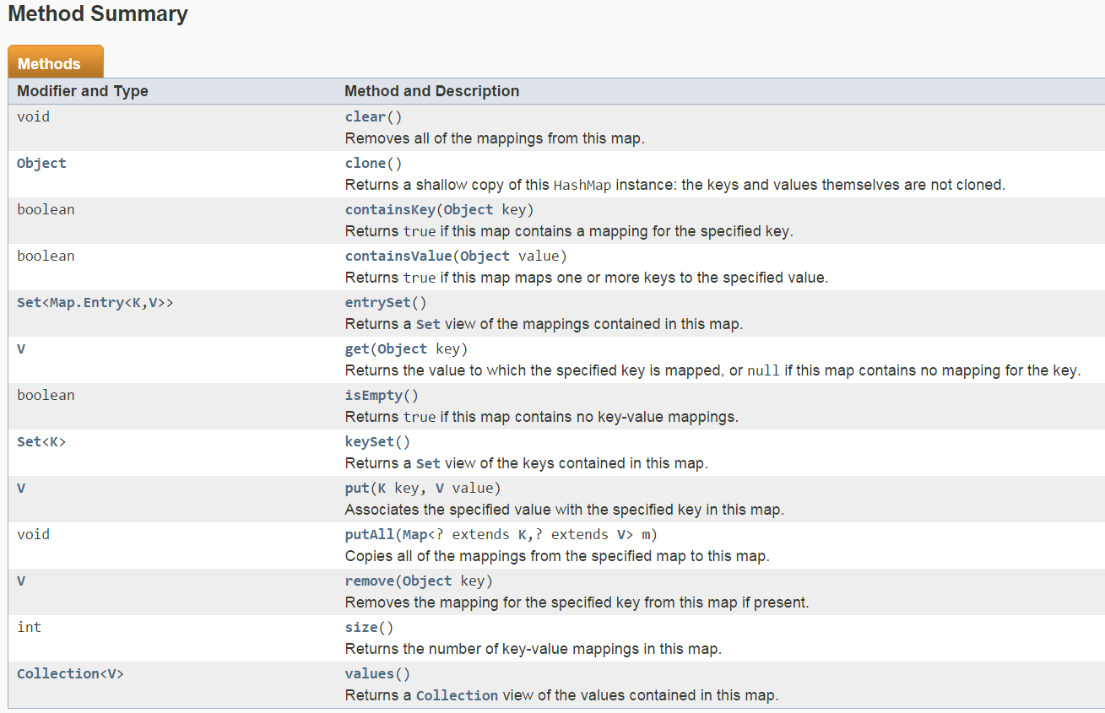
HashMap Methods

Slide 20

Using HashMap
HashMap <String, String> phoneBook = new HashMap<String, String>();
phoneBook.put("Charles Nguyen", "(531) 9392 4587");
phoneBook.put("Lisa Jones", "(402) 4536 4674");
phoneBook.put("William H. Smith", "(998) 5488 0123");
String phoneNumber = phoneBook.get("Lisa Jones");
System.out.println(phoneNumber);
Lookup
Console Output:
(402) 4536 4674
:HashMap
"Charles Nguyen"
"(531) 9392 4587"
"Lisa Jones"
"(402) 4536 4674"
"William H. Smith"
"(998) 5488 0123"
Notes:
phoneBook is a hashmap of pairs of String objects.

Slide 21
HashMap in Tech Support System V3
In the Responder class, we will now use HashMap to store “Key-Value” pairs for context-sensitive responses e.g.
Key | Value
windows | This is a known bug to do with the Windows operating system. Please report it to Microsoft. There is nothing we can do about this.
slow | I think this has to do with your hardware. Upgrading your processor should solve all performance problems. Have you got a problem with our software?
bug | Well, you know, all software has some bugs. But our software engineers are working very hard to fix them. Can you describe the problem a bit further?
performance | Performance was quite adequate in all our tests. Are you running any other processes in the background?

Slide 22
HashMap in Tech Support System V3
responseMap.put("crashes", "Well, it never crashes on our system. It must have something\n" + "to do with your system. Tell me more about your configuration.");
Whenever someone enters the word “crashes”, we can look up and print the attached response.
Lets look at the HashMap code in the Responder class!

Slide 23
import java.util.HashMap;
import java.util.ArrayList;
import java.util.Random;
public class Responder
{
// Used to map key words to responses.
private HashMap<String, String> responseMap;
// Default responses to use if we don't recognise a word.
private ArrayList<String> defaultResponses;
private Random randomGenerator;
public Responder()
{
responseMap = new HashMap<String, String>();
fillResponseMap();
defaultResponses = new ArrayList<String>();
fillDefaultResponses();
randomGenerator = new Random();
}
V3.0 Responder changes (in red)

Slide 24
V3.0 Responder changes (in red)
private void fillDefaultResponses() {
defaultResponses.add("That sounds odd. Could you describe that problem in more detail?");
defaultResponses.add("No other customer has ever complained about this before. \n" +
"What is your system configuration?");
defaultResponses.add("That sounds interesting. Tell me more...");
defaultResponses.add("I need a bit more information on that.");
defaultResponses.add("Have you checked that you do not have a dll conflict?");
defaultResponses.add("That is explained in the manual. Have you read the manual?");
defaultResponses.add("Your description is a bit wishy-washy. Have you got an expert\n" +
"there with you who could describe this more precisely?");
defaultResponses.add("That's not a bug, it's a feature!");
defaultResponses.add("Could you elaborate on that?");
}
private String pickDefaultResponse()
{
// Pick a random number for the index in the default response list.
// The number will be between 0 (inclusive) and the size of the list (exclusive).
int index = randomGenerator.nextInt(defaultResponses.size());
return defaultResponses.get(index);
}

Slide 25
V3.0 Responder changes (in red)
private void fillResponseMap()
{
responseMap.put("crash",
"Well, it never crashes on our system. It must have something\n" +
"to do with your system. Tell me more about your configuration.");
responseMap.put("crashes",
"Well, it never crashes on our system. It must have something\n" +
"to do with your system. Tell me more about your configuration.");
responseMap.put("slow",
"I think this has to do with your hardware. Upgrading your processor\n" +
"should solve all performance problems. Have you got a problem with\n" +
"our software?");
responseMap.put("performance",
"Performance was quite adequate in all our tests. Are you running\n" +
"any other processes in the background?");
responseMap.put("bug",
"Well, you know, all software has some bugs. But our software engineers\n" +
"are working very hard to fix them. Can you describe the problem a bit\n" +
"further?");
responseMap.put("buggy",
"Well, you know, all software has some bugs. But our software engineers\n" +
"are working very hard to fix them. Can you describe the problem a bit\n" +
"further?");
responseMap.put("windows",
"This is a known bug to do with the Windows operating system. Please\n" +
"report it to Microsoft. There is nothing we can do about this.");
// and so on…
}

Slide 26
Topic List
Recap: Technical Support System V2
Technical Support System V3
Overview
3 classes:
Responder
InputReader
SupportSystem
Class Development
Responder class
Generating a related response
ArrayList
Map and HashMap
InputReader class
Tokenizing Strings
Set and HashSet
Responder class
Finishing the class
SupportSystem class
A small change.

Slide 27
Tokenizing Strings
We have a HashMap
containing a series of words with appropriate responses.
Now we need to search the String of words the user entered on the console
to see if they typed in any of the words stored in the HashMap.
We need to “split” the String of words entered by the user
into individual words
and store them in a collection (e.g. Array)
Tokenizing Strings.
We need a new data structure to store these words just once
A Set stores uniques values

Slide 28
Set
A Set is a collection
that stores each individual element at most once
(i.e. unique elements).
It does not maintain any specific order.
The coding for Set is very similar to ArrayList coding.

Slide 29
Using sets
import java.util.HashSet;
import java.util.Iterator;
...
HashSet<String> mySet = new HashSet<String>();
mySet.add("one");
mySet.add("two");
mySet.add("three");
Iterator<String> it = mySet.iterator();
while(it.hasNext()) {
call it.next() to get the next object
do something with that object
}
Compare this to ArrayList code!

Slide 30
What is the Difference between Set and List?
List (e.g. ArrayList):
keeps all elements entered in the desired order,
provides access to elements by index
can contain the same element multiple times.
Set (e.g. HashSet):
No specific order
ensures each element is in the set at most once
(entering an element a second time has no effect).

Slide 31
Returning to Tokenizing Strings
InputReader class

Slide 32
V2 Code
// V2 Code
import java.util.Scanner;
public class InputReader{
Scanner input;
public InputReader(){
input = new Scanner(System.in);
}
/**
* Read a line of text from standard input (the text terminal),
* and return it as a String.
*
* @return A String typed by the user.
*/
public String getInput() {
System.out.print("> "); // print prompt
String inputLine = input.nextLine().trim().toLowerCase();
return inputLine;
}
}
In V3, we modify this code to split out the input (stored in inputLine)
into a primitive array of Strings >>>

Slide 33
Changes for V3
// V3 Code
import java.util.Scanner;
public class InputReader{
Scanner input;
public InputReader(){
input = new Scanner(System.in);
}
public HashSet<String> getInput()
{
System.out.print("> "); // print prompt
String inputLine = input.nextLine().trim().toLowerCase();
String[] wordArray = inputLine.split(" "); // split at spaces
// add words from array into hashset
HashSet<String> words = new HashSet<String>();
for (String word : wordArray) {
words.add(word);
}
return words;
}
}
1) Split up the inputLine object at spaces, storing each word in a wordArray of String[]
2) Declare & initialise words as a HashSet of String
3) For each word in the wordArray, add that word to the words HashSet
4) Return the HashSet of words

Slide 34
Topic List
Recap: Technical Support System V2
Technical Support System V3
Overview
3 classes:
Responder
InputReader
SupportSystem
Class Development
Responder class
Generating a related response
ArrayList
Map and HashMap
InputReader class
Tokenizing Strings
Set and HashSet
Responder class
Finishing the class
SupportSystem class
A small change.

Slide 35
import java.util.HashMap;
import java.util.HashSet;
import java.util.ArrayList;
import java.util.Iterator;
import java.util.Random;
public class Responder
{
// Used to map key words to responses.
private HashMap<String, String> responseMap;
// Default responses to use if we don't recognise a word.
private ArrayList<String> defaultResponses;
private Random randomGenerator;
public Responder()
{
responseMap = new HashMap<String, String>();
fillResponseMap();
defaultResponses = new ArrayList<String>();
fillDefaultResponses();
randomGenerator = new Random();
}
V3.0 Responder Class MORE changes (in red) to handle a HashSet of Strings passed into the generateResponse() method.

Slide 36
public String generateResponse (HashSet<String> words)
{
Iterator<String> it = words.iterator();
while(it.hasNext()) {
String word = it.next();
String response = responseMap.get(word);
if(response != null) {
return response;
}
}
// If we get here, none of the words from the input line were recognized.
// In this case we pick one of our default responses (what we say when
// we cannot think of anything else to say...)
return pickDefaultResponse();
}
V3.0 Responder Class MORE changes (in red) to handle a HashSet of Strings passed into the generateResponse() method.

Slide 37
Topic List
Recap: Technical Support System V2
Technical Support System V3
Overview
3 classes:
Responder
InputReader
SupportSystem
Class Development
Responder class
Generating a related response
ArrayList
Map and HashMap
InputReader class
Tokenizing Strings
Set and HashSet
Responder class
Finishing the class
SupportSystem class
A small change.

Slide 38
// V2 code
public class SupportSystem
{
private InputReader reader;
private Responder responder;
public SupportSystem() {
reader = new InputReader();
responder = new Responder();
}
public static void main(String[] argvs){
SupportSystem app = new SupportSystem();
app.start();
}
public void start(){
printWelcome();
String input = reader.getInput();
while(! input.startsWith("bye")) {
String response = responder.generateResponse();
System.out.println(response);
input = reader.getInput();
}
printGoodbye();
}
In V3 we change this class, mainly in the start() method >>>

Slide 39
V3 Code
import java.util.HashSet;
public class SupportSystem
{
private InputReader reader;
private Responder responder;
public SupportSystem() {
reader = new InputReader();
responder = new Responder();
}
public static void main(String[] argvs){
SupportSystem app = new SupportSystem();
app.startSupport();
}
public void startSupport(){
printWelcome();
HashSet<String> input = reader.getInput();
while(!input.contains("bye")) {
String response = responder.generateResponse(input);
System.out.println(response);
input = reader.getInput();
}
printGoodbye();
}
V3 Uses a
HashSet of Strings called input which is passed to generateResponse()
startSupport() replaces start()

Slide 40

Any Questions?

