Slide 1

Introduction to Module
Content, Structure and the JVM
Produced
by:
Ms. Mairead Meagher
Ms. Siobhan Roche
Department of Computing and Mathematics
http://www.setu.ie/

Slide 2
Agenda
Lecturers / Tutors
Module Structure & Delivery
Technologies
Module Assessment (Assignments)
Ethos

Slide 3
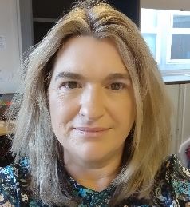
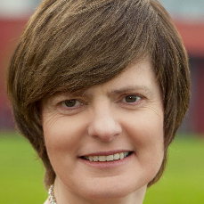
Introducing your lecturers / tutors
Siobhan Roche
Mairead Meagher
Groups : W3, W4
Email: mairead.meagher@setu.ie
Email: siobhan.roche@setu.ie
Groups : W1(Forensics and Physics), W2

Slide 4
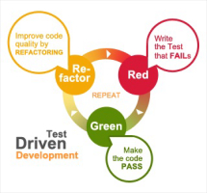



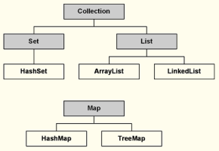
Module Content
Notes:
These technologies are the software development technologies/approaches that we will teach in the course.

Slide 5
Module Structure and Delivery
12 weeks of delivery
2 Lectures
3 hours of Labs

Slide 6



Learning Technologies
DESKTOP APPS:
Notes:
These technologies are used to deliver the course

Slide 7


Programming Technologies
Notes:
These technologies are the software development technologies/approaches that we will teach in the course.

Slide 8
Learning Technologies
Notes:
These technologies are used to deliver the course

Slide 9

Calendar
Week No | Type | Date Starts
1 | Tuition | 19/01/2026
2 | Tuition | 26/01/2026
3 | Tuition | 02/02/2026
4 | Tuition | 09/02/2026
Mid-term | Reading | 16/02/2026
5 | Tuition | 23/02/2026
6 | Tuition | 02/03/2026
7 | Tuition | 09/03/2026
8 | Tuition | 16/03/2026
9 | Tuition | 23/03/2026
Easter | Reading | 30/03/2026
Easter | Reading | 06/04/2026
10 | Tuition | 13/04/2026
11 | Tuition | 20/04/2026
12 | Tuition | 27/04/2026
Study Week | Reading | 04/05/2026

Slide 10
Module Content
100% CA:
  Assignment 1
  Assignment 2
Focus on:
  Menu Driven Systems (console based)
  Data Structures
  CRUD and Persistence (XML)
  Exceptions
  Inheritance, Polymorphism and Abstraction

Slide 11
Ethos
Self-directed learning outside of lectures / labs.
Inquisitive and motivated.
Help your peers (use #Slack!).
Engagement and staying current with the module.
All work submitted must be your own work.
  all code/approaches given in the module by us can be re-used / re-purposed in your assignments.

Slide 12

Questions?

