Slide 1

IntelliJ
Lets get started in our new IDE
Produced
by:
Dr. Siobhán Drohan,
Ms. Mairead Meagher,
Ms. Siobhán Roche.
Department of Computing and Mathematics
http://www.setu.ie/

Slide 2
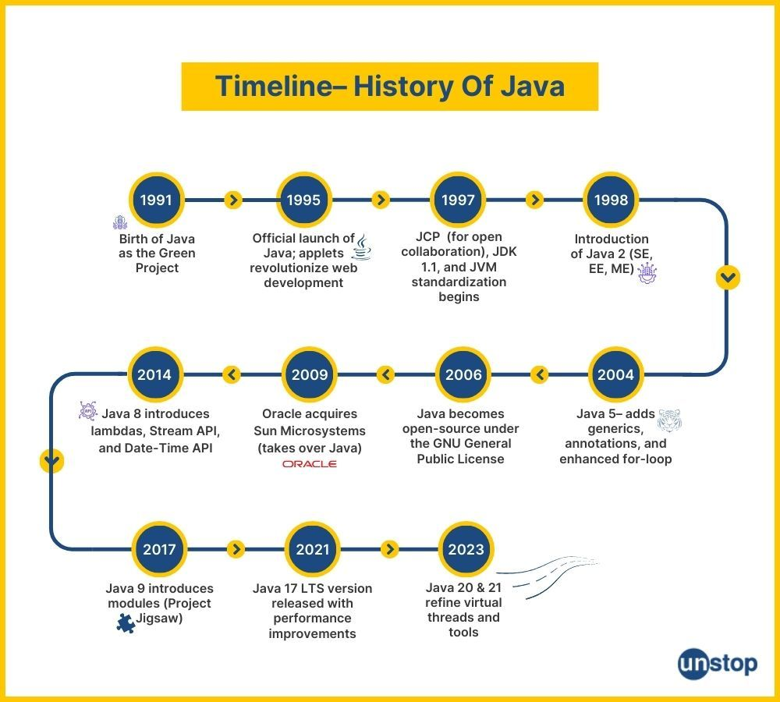

Slide 3
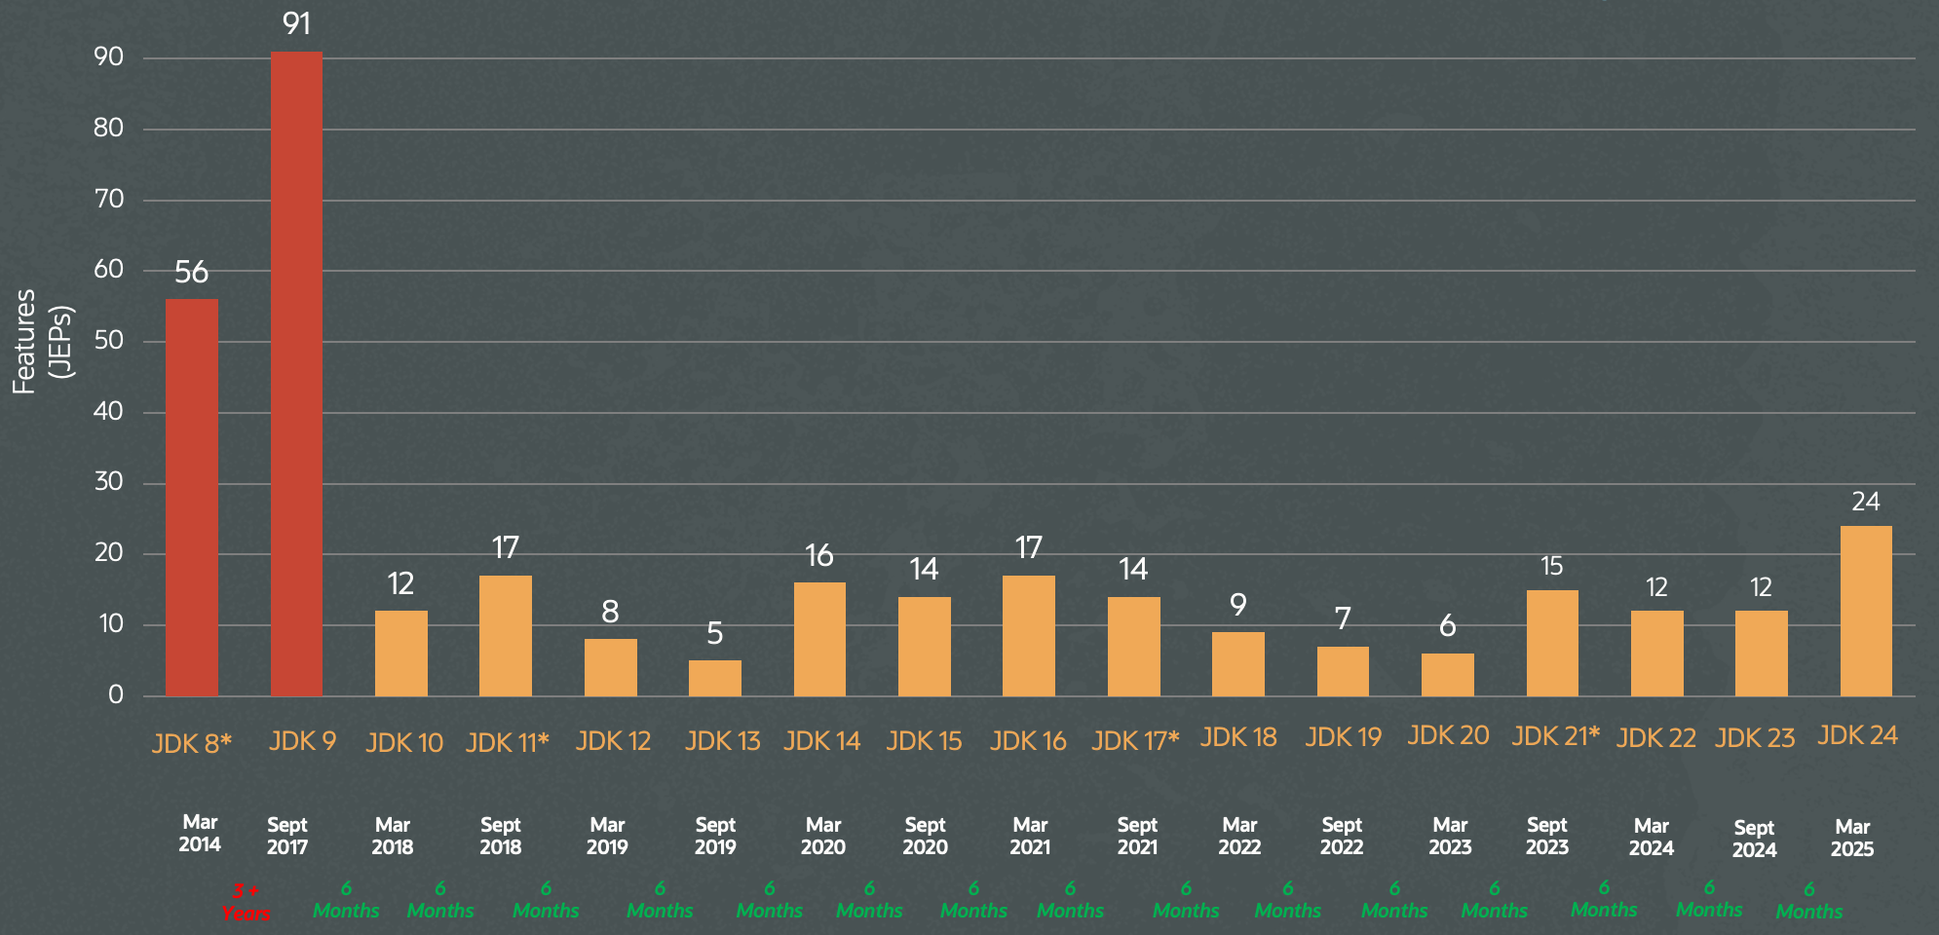
JDK releases – 6 month cycle

Slide 4
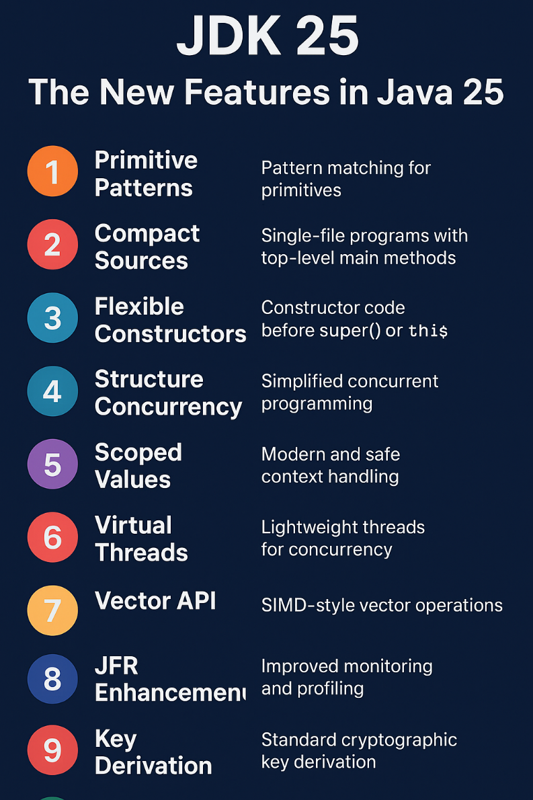
What version of JDK should I install?
The most up to date version that is available
  Currently Java 25

Slide 5
What is an IDE?
An IDE (Integrated Development Environment) is a software application that bundles all the necessary tools a programmer needs for software development into a single, easy-to-use graphical interface.
An IDE (Integrated Development Environment) allows you to
  quickly create applications by combining a source-code editor with the ability to compile and run your code,
  integration with build, test and debug tools, version control systems, and so on.
  search and navigate your codebase in ways your file system won’t.

Slide 6
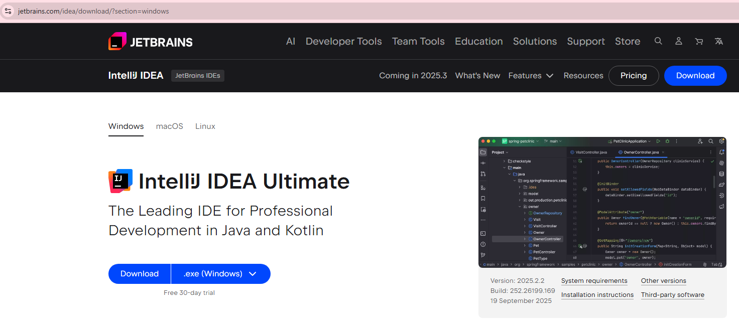
IntelliJ - An industry standard IDE

Slide 7
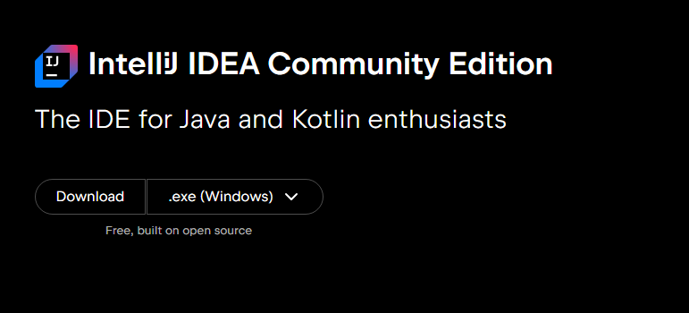
Community Edition
You can scroll past the Ultimate version, and choose the free Community Version

Slide 8
Hello World
IntelliJ

Slide 9
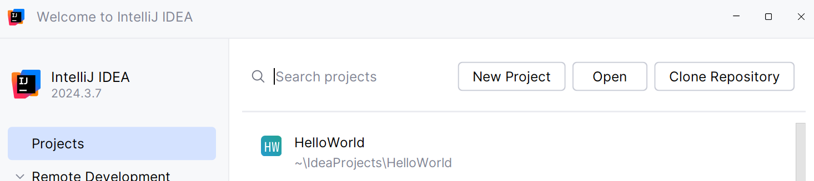
Launch IntelliJ
We can create a new project from the Welcome screen,
or we can go to File | New | Project in the main menu.

Slide 10
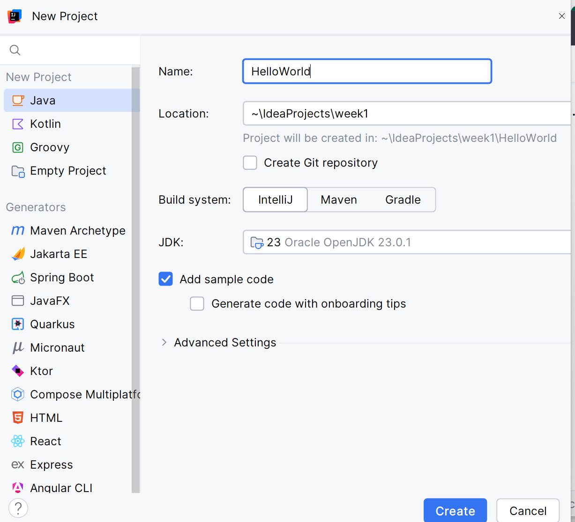
New Java Project
name
location
Jdk version
Create

Slide 11
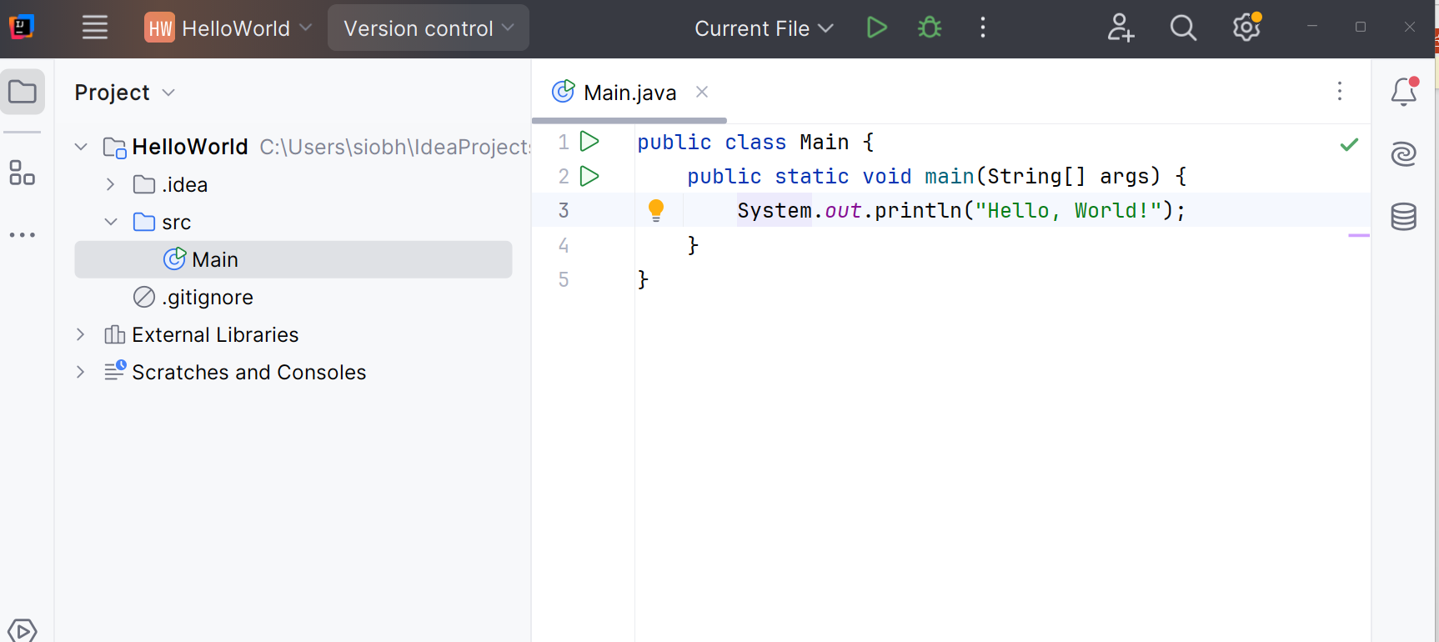
New Project – main method

Slide 12
Run app

Slide 13
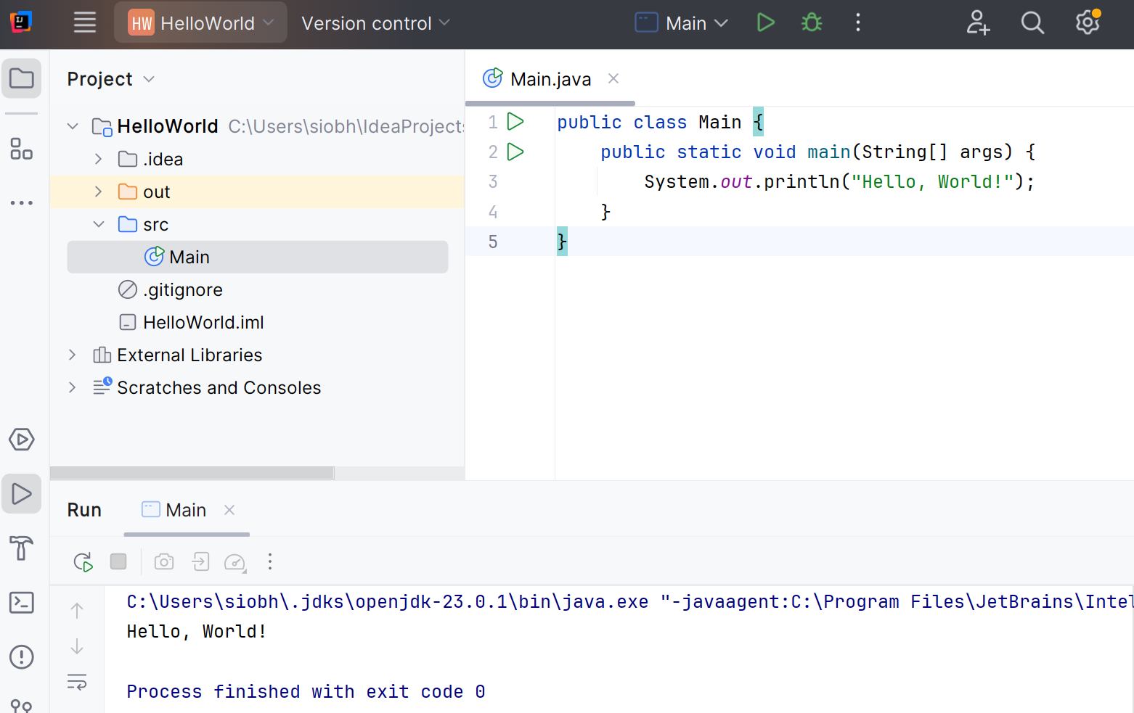
Console output

Slide 14
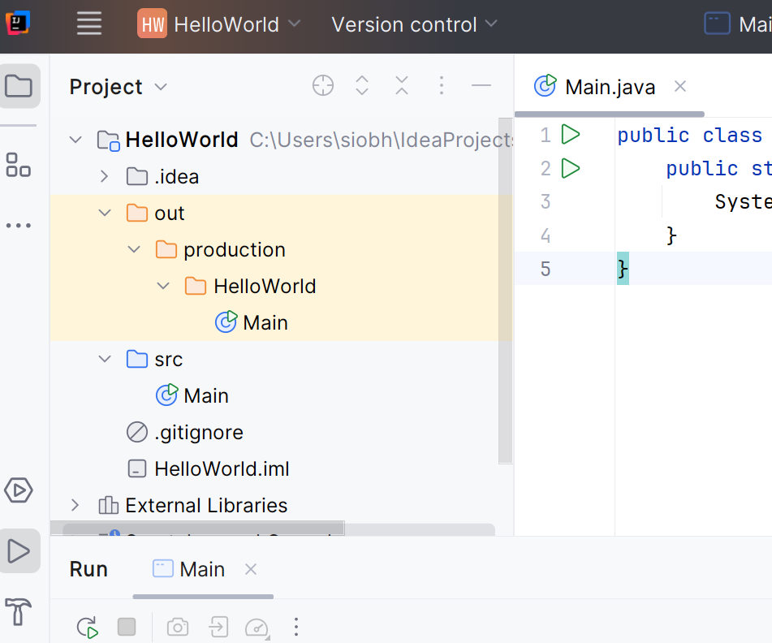
Project File
.class file
(compiled)
.java file
(source)

Slide 15

Questions?

