Slide 1

Inheritance
Improving Structure with Inheritance
Produced
by:
Dr. Siobhán Drohan
Mr. Colm Dunphy
Mr. Diarmuid O’Connor
Dr. Frank Walsh
Department of Computing and Mathematics
http://www.wit.ie/

Slide 2
Lectures and Labs
This week’s lectures and labs are based on examples in:
  Objects First with Java - A Practical Introduction using BlueJ, © David J. Barnes, Michael Kölling (https://www.bluej.org/objects-first/)

Slide 3
Topic List
Social Network V1
Inheritance hierarchies
Social Network V2
Coding inheritance hierarchies
  Super and subclasses
  Using constructors in these hierarchies
Social Network V3
  Deeper hierarchies
  Advantages of using inheritance
Subtyping and Substitution
Polymorphic variables / Collections
  Includes casting, wrapper classes, autoboxing /unboxing

Slide 4

Social Network V1
v1
A small, prototype SOCIAL NETWORK.
Supports a News Feed with posts.
POSTS:
  MessagePost:
    multi-line text message.
  PhotoPost:
    photo and caption.
  Operations
    e.g., search, display and remove.

Slide 5
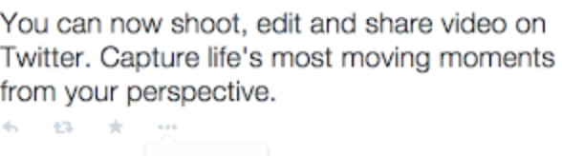

SOCIAL NETWORK
NEWS FEED
Multi Line Text
POSTS
Photo

Slide 6
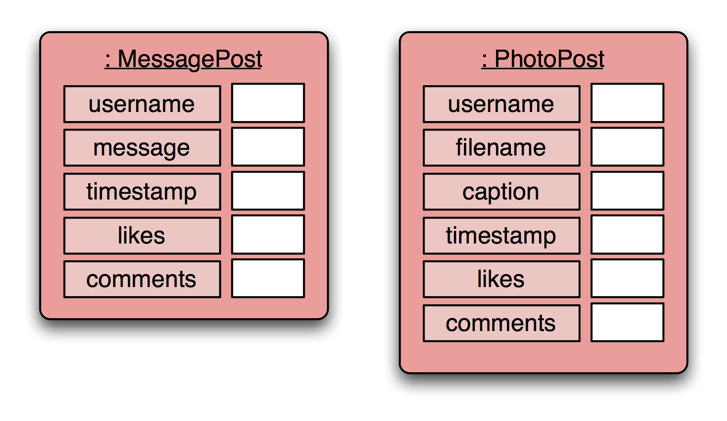
Social Network V1 - Objects
MessagePost: multi-line text message.
PhotoPost: photo and caption.
one object per post; each object stores details for one particular post.
Notes:
one object per post; each object stores details for one particular post.

Slide 7
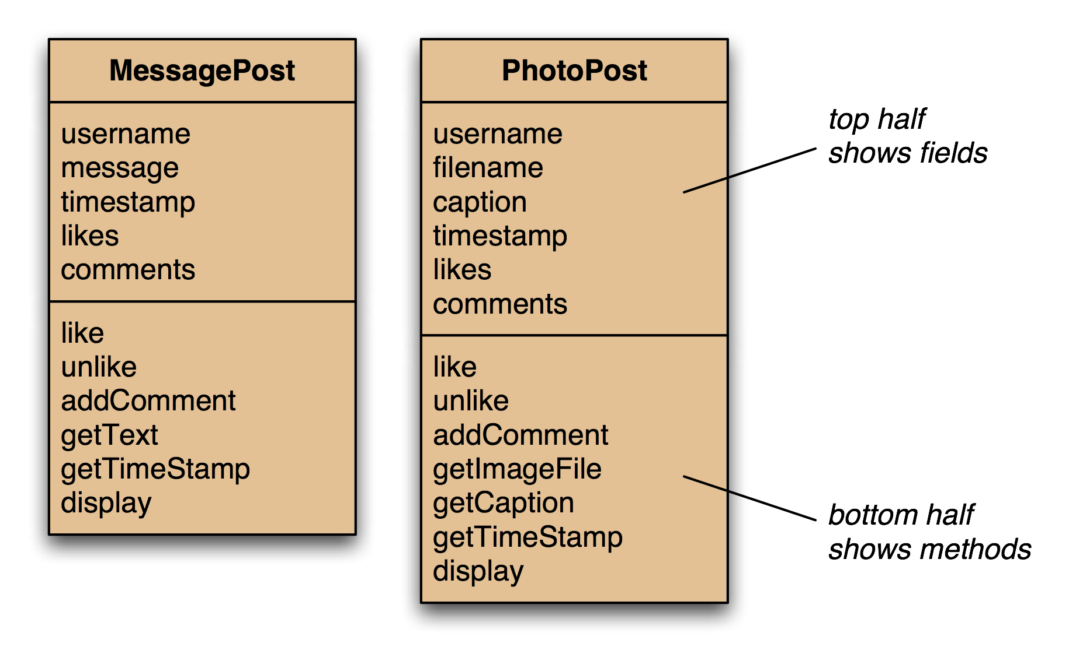
Social Network V1 - Classes
Notes:
add the obvious methods (getters and setters); not complete here - just examples

Slide 8
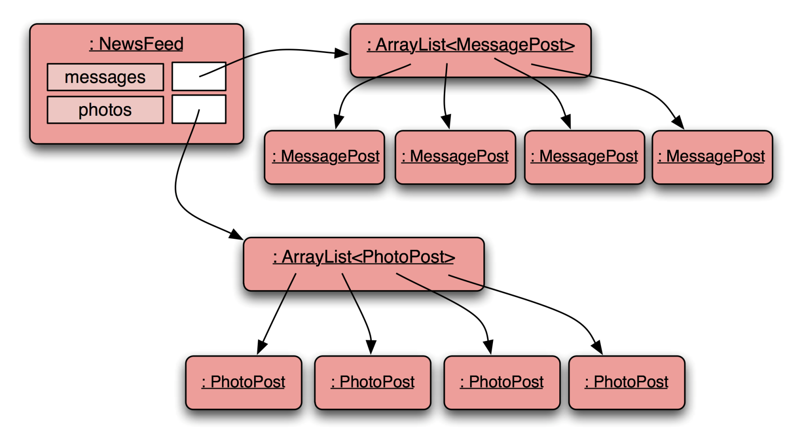
Social Network V1 - Object model
Notes:
Newsfeed object will hold two collections: one for MessagePosts, one for PhotoPosts

Slide 9
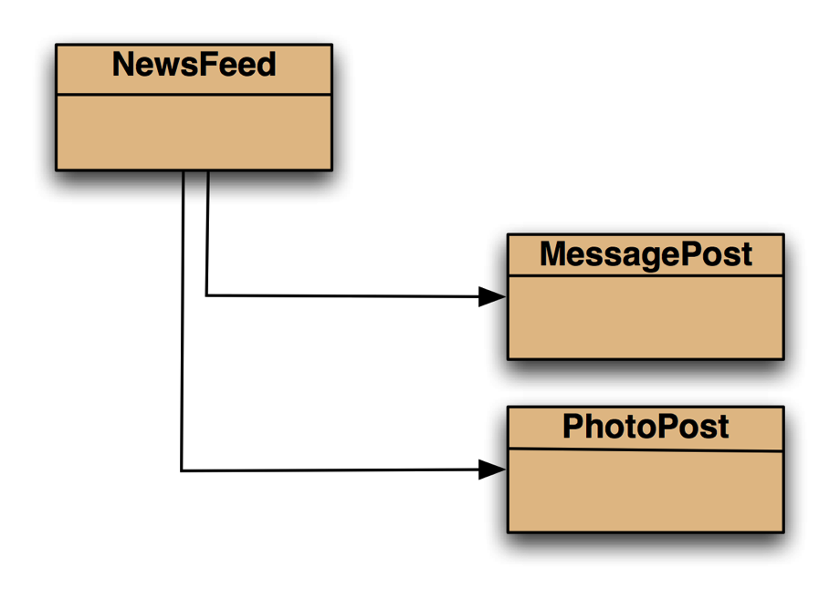
Social Network V1 - Class diagram
Notes:
class diagram is simple (ArrayList not shown in BlueJ)

Slide 10
MessagePost source code
public class MessagePost
{
private String username;
private String message;
private long timestamp;
private int likes;
private ArrayList<String> comments;
public MessagePost(String author, String text)
{
username = author;
message = text;
timestamp = System.currentTimeMillis();
likes = 0;
comments = new ArrayList<String>();
}
public void addComment(String text) ...
public void like() ...
public void display() ...
...
}
Just an outline…
Notes:
extract from MessagePost code - nothing unusual, just an ordinary class

Slide 11
PhotoPost source code
public class PhotoPost
{
private String username;
private String filename;
private String caption;
private long timestamp;
private int likes;
private ArrayList<String> comments;
public PhotoPost(String author, String filename,
String caption)
{
username = author;
this.filename = filename;
this.caption = caption;
timestamp = System.currentTimeMillis();
likes = 0;
comments = new ArrayList<String>();
}
public void addComment(String text) ...
public void like() …
public void display() …
...
}
Just an outline…
Notes:
extract from PhotoPost code
QUESTION: (how does it differ from MessagePost code?)

Slide 12
NewsFeed source code
public class NewsFeed
{
private ArrayList<MessagePost> messages;
private ArrayList<PhotoPost> photos;
...
public void show()
{
for(MessagePost message : messages) {
message.display();
System.out.println(); // empty line between posts
}
for(PhotoPost photo : photos) {
photo.display();
System.out.println(); // empty line between posts
}
}
}
Notes:
extract from NewsFeed code.

Slide 13
Topic List
Social Network V1
Inheritance hierarchies
Social Network V2
Coding inheritance hierarchies
  Super and subclasses
  Using constructors in these hierarchies
Social Network V3
  Deeper hierarchies
  Advantages of using inheritance
Subtyping and Substitution
Polymorphic variables / Collections
  Includes casting, wrapper classes, autoboxing /unboxing

Slide 14
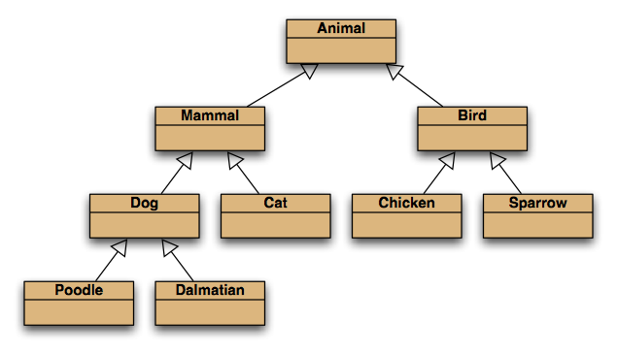
Inheritance hierarchies
Is-a
Notes:
inheritance hierarchies are nothing unusual. we see them all the time.
(a masters student is a students is a person...)

Slide 15
Inheritance hierarchies
Q: Create an inheritance hierarchy for something that you can relate to
MusicFormat
AnalogFormat
DigitalFormat
Cassette
Vinyl
DCC
DAT
MD
CD
Audio File
Is-a
.MP3
.AAC
single
album
single
album
7”
12”
Notes:
inheritance hierarchies are nothing unusual. we see them all the time.
(a masters student is a students is a person...)

Slide 16
Topic List
Social Network V1
Inheritance hierarchies
Social Network V2
Coding inheritance hierarchies
  Super and subclasses
  Using constructors in these hierarchies
Social Network V3
  Deeper hierarchies
  Advantages of using inheritance
Subtyping and Substitution
Polymorphic variables / Collections
  Includes casting, wrapper classes, autoboxing /unboxing

Slide 17
Recap: Social Network V1 - Class diagram
Notes:
class diagram is simple (ArrayList not shown in BlueJ)

Slide 18
Critique of Social Network V1
Code duplication:
  MessagePost and PhotoPost classes very similar (large parts are identical)
  makes maintenance difficult/more work
  introduces danger of bugs through incorrect maintenance
Code duplication in NewsFeed class as well.
Notes:
we note a lot of code duplication.
this is one problem with this solution (there are others)

Slide 19
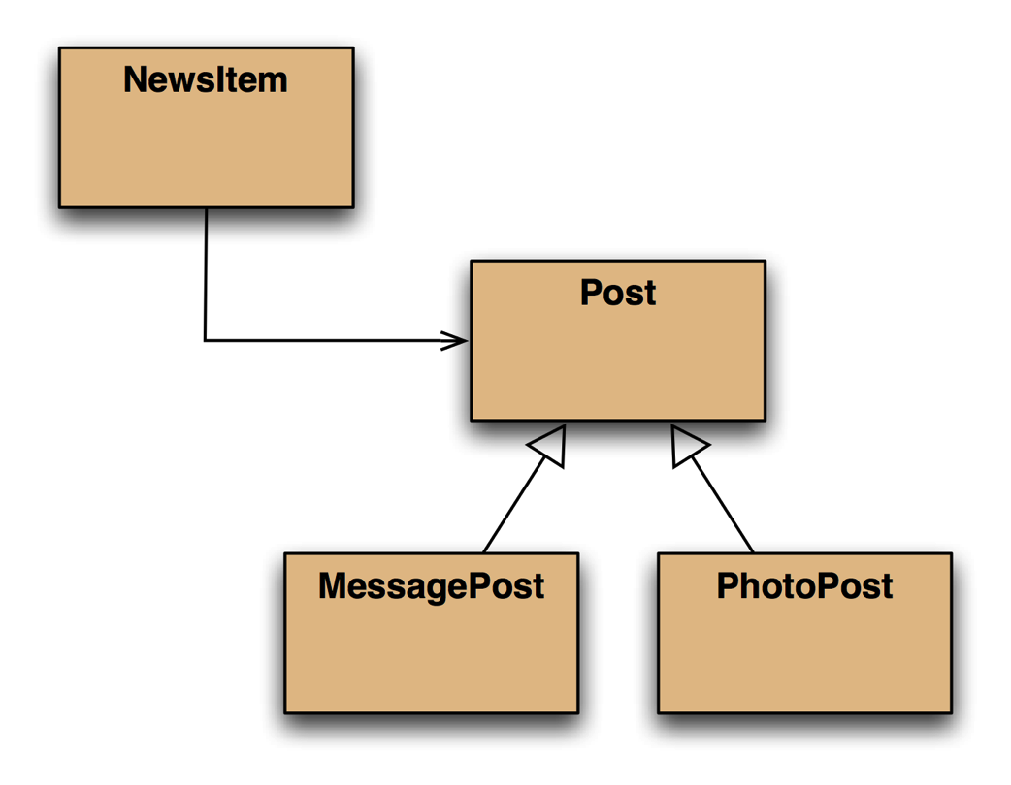
Social Network V2 - Class diagram
v2
Notes:
Newsitem now only knows about Post rather than the subclasses.

Slide 20
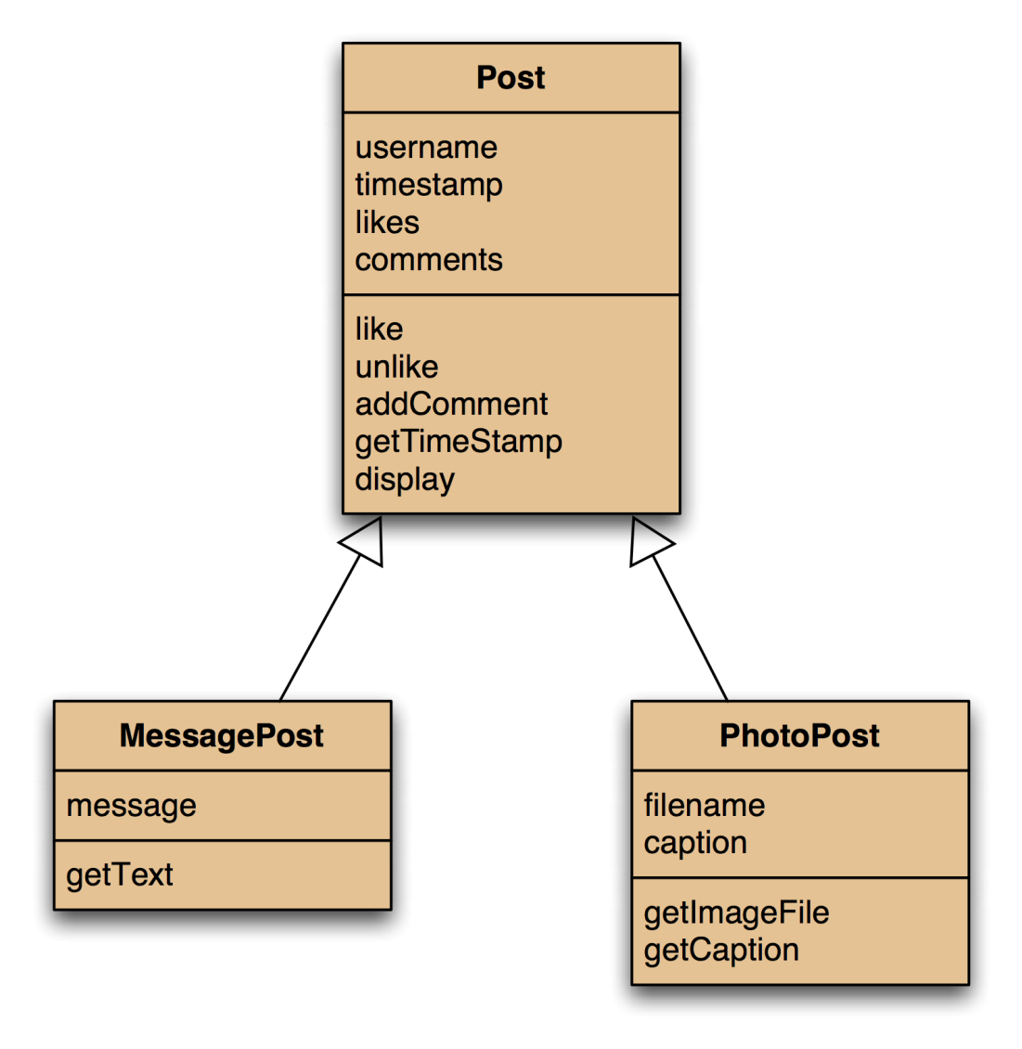
Social NetworkV2 - Using inheritance
Notes:
solution: inheritance.
make superclass with common attributes, make subclasses

Slide 21
Social NetworkV2 - Using inheritance
Superclass
Common attributes
extends
Inherit superclass attributes
and add their own specific attributes.
Subclasses
Notes:
solution: inheritance. make superclass with common attributes, make subclasses

Slide 22
Social Network V2 – Inheritance Summary
define one superclass
  Post
define subclasses for
  MessagePost
  PhotoPost
the superclass
  defines common attributes (via fields)
the subclasses
  inherit the superclass attributes (fields)
  add other specific attributes (fields)

Slide 23
Topic List
Social Network V1
Inheritance hierarchies
Social Network V2
Coding inheritance hierarchies
  Super and subclasses
  Using constructors in these hierarchies
Social Network V3
  Deeper hierarchies
  Advantages of using inheritance
Subtyping and Substitution
Polymorphic variables / Collections
  Includes casting, wrapper classes, autoboxing /unboxing

Slide 24
Inheritance in Java - extends
public class Post
{
...
}
no change here
change here
public class MessagePost extends Post
{
...
}
public class PhotoPost extends Post
{
...
}
Notes:
syntax for inheritance: ‘extends’ keyword

Slide 25
Superclass
public class Post
{
private String username;
private long timestamp;
private int likes;
private ArrayList<String> comments;
// constructor and methods omitted.
}
we define common fields in superclass
Notes:
we define common fields in superclass

Slide 26
Subclasses
public class MessagePost extends Post
{
private String message;
// constructor and methods omitted.
}
public class PhotoPost extends Post
{
private String filename;
private String caption;
// constructor and methods omitted.
}
we add subclass fields; inherit superclass fields
subclass objects will have all fields
Notes:
we add subclass fields; inherit superclass fields
subclass objects will have all fields.

Slide 27
Inheritance and Constructors
- superclass
public class Post
{
private String username;
private long timestamp;
private int likes;
private ArrayList<String> comments;
/**
* Initialise the fields of the post.
*/
public Post(String author)
{
username = author;
timestamp = System.currentTimeMillis();
likes = 0;
comments = new ArrayList<String>();
}
// methods omitted
}
Notes:
how do we initialise the fields?
superclass: nothing unusual.

Slide 28
Inheritance and Constructors
- subclass
public class MessagePost extends Post
{
private String message;
/**
* Constructor for objects of class MessagePost
*/
public MessagePost (String author, String text)
{
super(author);
message = text;
}
// methods omitted
}
subclass: must call superclass constructor!
Must take values for all fields that we want to initialise.
Notes:
subclass: must call superclass constructor!
Must take values for all fields that we want to initialise.

Slide 29
Superclass constructor call
Subclass constructors must always contain a 'super' call.
If none is written, the compiler inserts one (without parameters)
  works only, if the superclass has a constructor without parameters
‘super’ call must be the first statement in the subclass constructor.

Slide 30
Topic List
Social Network V1
Inheritance hierarchies
Social Network V2
Coding inheritance hierarchies
  Super and subclasses
  Using constructors in these hierarchies
Social Network V3
  Deeper hierarchies
  Advantages of using inheritance
Subtyping and Substitution
Polymorphic variables / Collections
  Includes casting, wrapper classes, autoboxing /unboxing

Slide 31
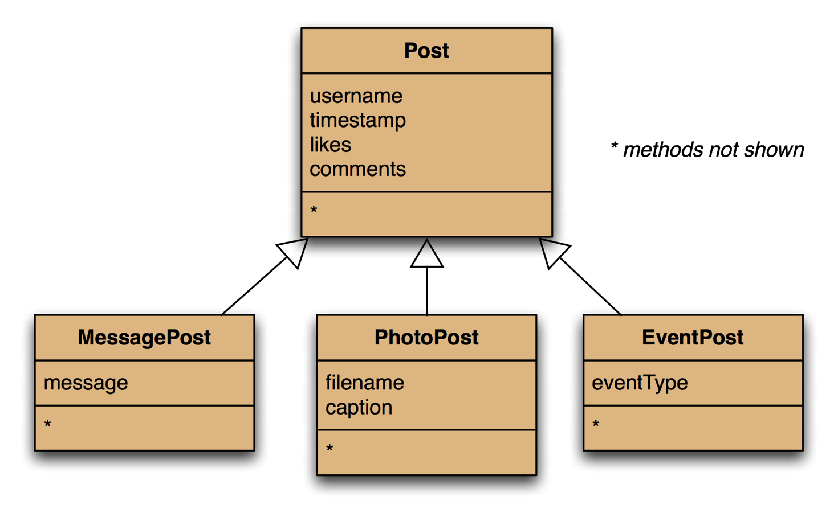
Social Network V3 - Adding more item types
v3
Notes:
it is now much easier to add new types.
common attributes do not need to be rewritten.

Slide 32
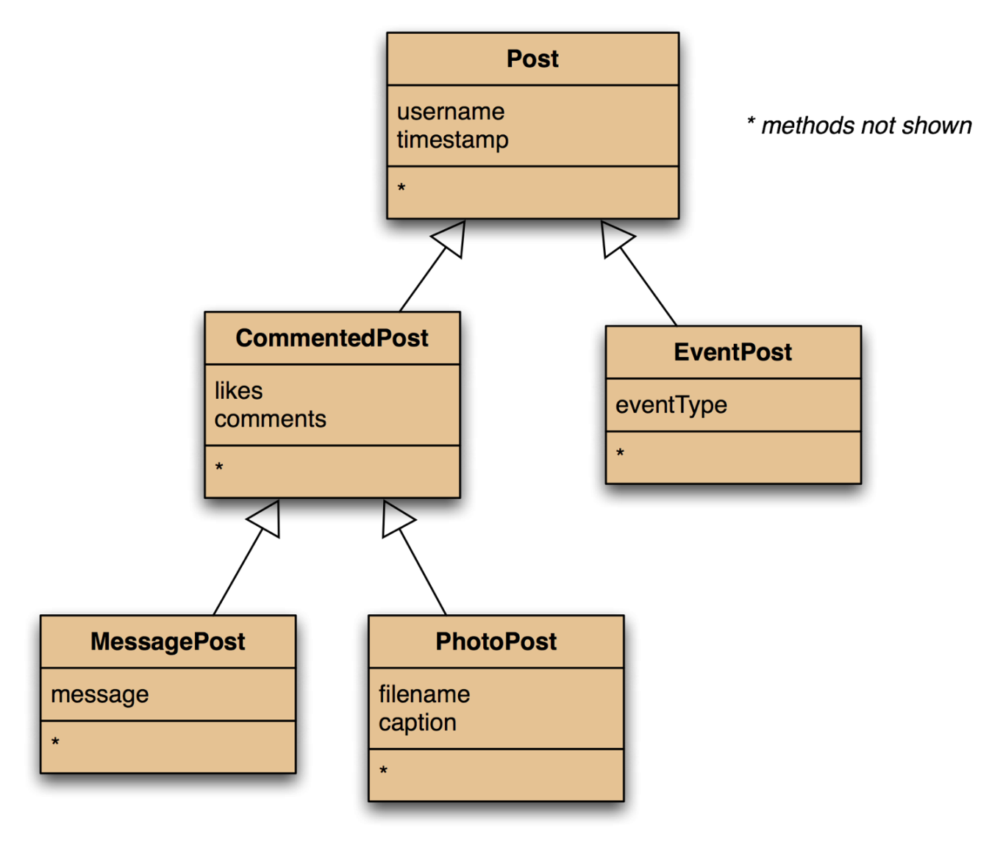
Social Network V3 - Deeper hierarchies
Notes:
when adding new types, the hierarchy may be extended

Slide 33
Topic List
Social Network V1
Inheritance hierarchies
Social Network V2
Coding inheritance hierarchies
  Super and subclasses
  Using constructors in these hierarchies
Social Network V3
  Deeper hierarchies
  Advantages of using inheritance
Subtyping and Substitution
Polymorphic Variables / Collections
  Includes casting, wrapper classes, autoboxing /unboxing

Slide 34
Advantages of inheritance
Inheritance (so far) helps with:
Avoiding code duplication
Code reuse
Easier maintenance
Extendibility

Slide 35
public class NewsFeed
{
private ArrayList<Post> posts;
/**
* Construct an empty news feed.
*/
public NewsFeed()
{
posts = new ArrayList<Post>();
}
/**
* Add a post to the news feed.
*/
public void addPost(Post post)
{
posts.add(post);
}
...
}
REVISED NewsFeed source code
Code is simplified
&
code duplication
in the client class is avoided!
Notes:
note: code duplication in class NewsFeed removed as well!
only one field, one ArrayList creation, one add method

Slide 36
/**
* Show the news feed. Currently: print the
* news feed details to the terminal.
*/
public void show()
{
for(Post post : posts) {
post.display();
System.out.println(); // Empty line ...
}
}
REVISED NewsFeed source code
Notes:
...and only one loop in the showmethod.

Slide 38
Topic List
Social Network V1
Inheritance hierarchies
Social Network V2
Coding inheritance hierarchies
  Super and subclasses
  Using constructors in these hierarchies
Social Network V3
  Deeper hierarchies
  Advantages of using inheritance
Subtyping and Substitution
Polymorphic variables / Collections
  Includes casting, wrapper classes, autoboxing /unboxing

Slide 39
Subtyping
First, we had:
public void addMessagePost(MessagePost message)
public void addPhotoPost(PhotoPost photo)
Now, we have:
public void addPost(Post post)
We call this method with:
PhotoPost myPhoto = new PhotoPost(...);
feed.addPost(myPhoto);
or:
MessagePost myMessage = new MessagePost(...);
feed.addPost(myMessage);
Notes:
i.e. we pass in a sub type

Slide 40
Subclasses and subtyping
Classes define types.
Subclasses define subtypes.
Substitution:
  objects of subclasses can be used
  where objects of supertypes are required.
Notes:
i.e. is-a relationship comes in here….a subtype is-a supertype
(follow the direction of the inheritance arrows)

Slide 41
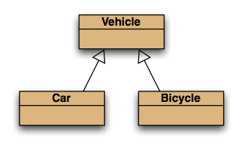
Subtyping and assignment
subclass objects may be assigned to superclass variables
Vehicle v1 = new Vehicle();
Vehicle v2 = new Car();
Vehicle v3 = new Bicycle();

Slide 42
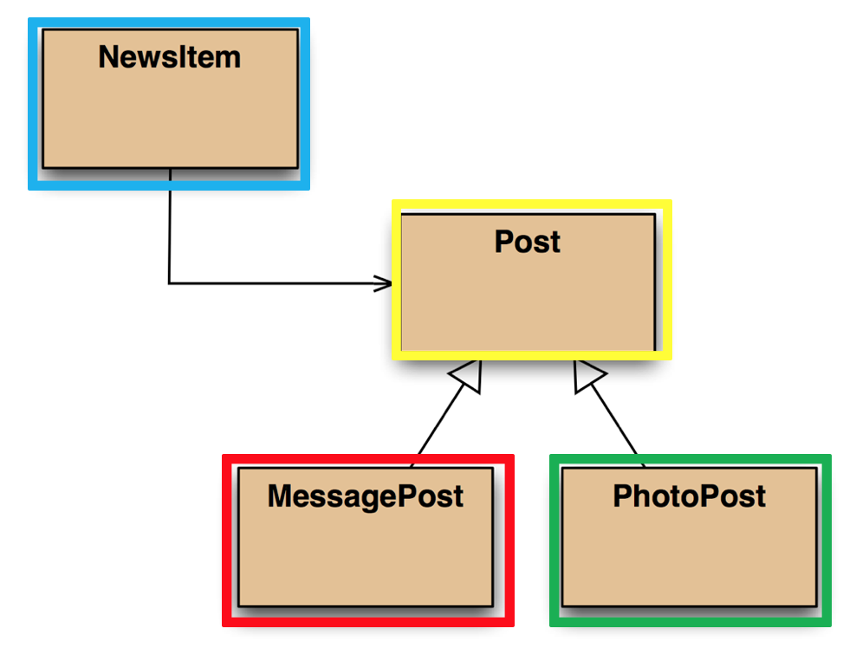
Subtyping and parameter passing
public class NewsFeed
{
public void addPost(Post post)
{
...
}
}
PhotoPost photo = new PhotoPost(...);
MessagePost message = new MessagePost(...);
feed.addPost(photo);
feed.addPost(message);
v2
subclass objects may be used as actual parameters
when a superclass is required.
In other words in this example the superclass post has a method addPost that expects a Post parameter.
You can call addPost but pass in a parameter which is a subclass of Post e.g. a PhotoPost or MessagePost

Slide 43
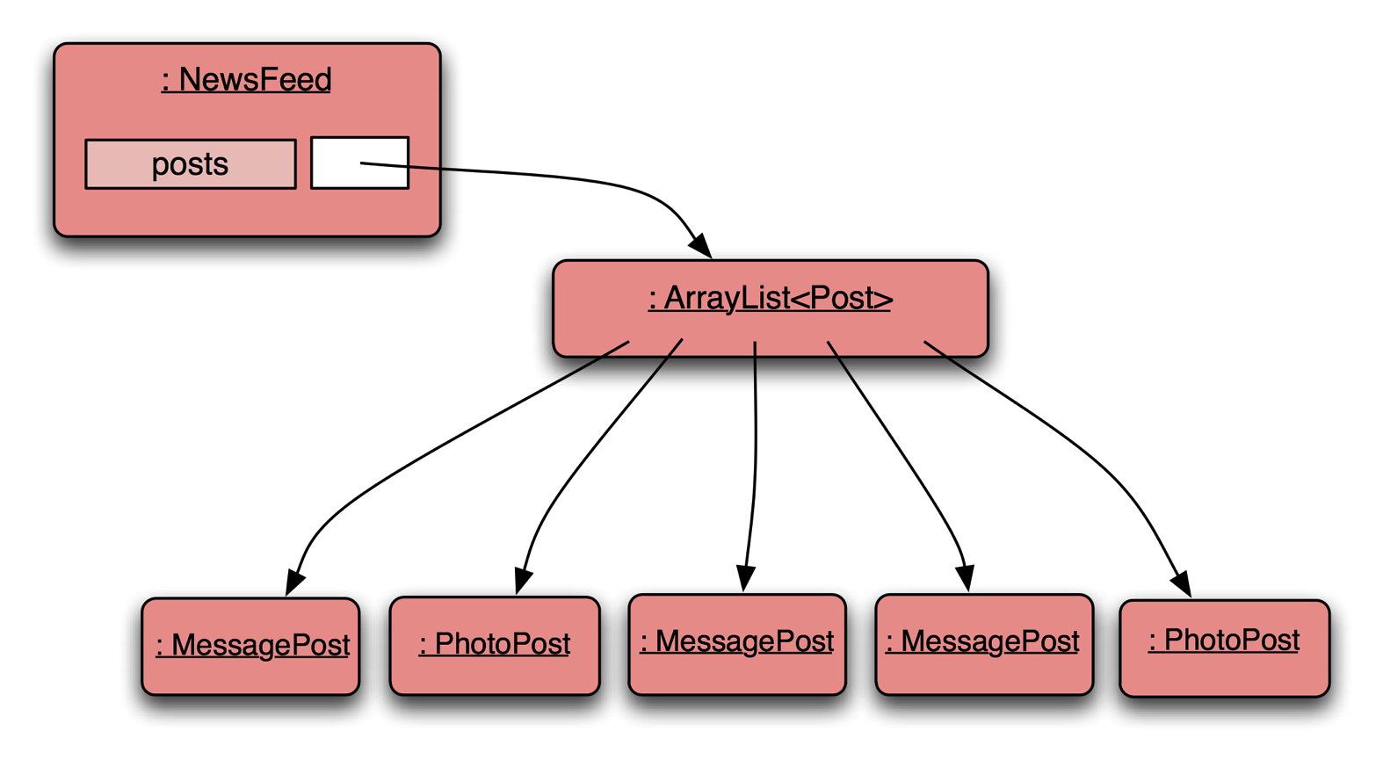
Social Network V2 - Object diagram
NewsFeed object
holds a single mixed collection
Notes:
NewsFeed object will hold a single, mixed collection

Slide 44
Topic List
Social Network V1
Inheritance hierarchies
Social Network V2
Coding inheritance hierarchies
  Super and subclasses
  Using constructors in these hierarchies
Social Network V3
  Deeper hierarchies
  Advantages of using inheritance
Subtyping and Substitution
Polymorphic
  Variables
  Collections
  casting, wrapper classes, autoboxing /unboxing

Slide 45
7 a) Polymorphic variables
Object variables in Java are polymorphic
  They can hold objects of
    more than one type
    the declared type
    subtypes (of the declared type).

Slide 46
Social Network V2 – polymorphic ArrayList of Post
Notes:
NewsFeed object will hold a single, mixed collection

Slide 47
Casting
Vehicle v;
Car c = new Car();
We can assign subtype to supertype (note arrow direction)!
v = c; // correct (car is-a vehicle)
But we cannot assign a supertype to subtype (cannot go against the arrows)!
c = v; // compile-time error!
Without (CASTING)
c = (Car) v; //casting…correct (only if the vehicle really is a Car!)

Slide 48
Casting
An object type in parentheses - ().
Used to overcome 'type loss'.
The object is not changed in any way.
A runtime check is made to ensure the object really is of that type:
  ClassCastException if it isn't!
Use it sparingly.

Slide 49
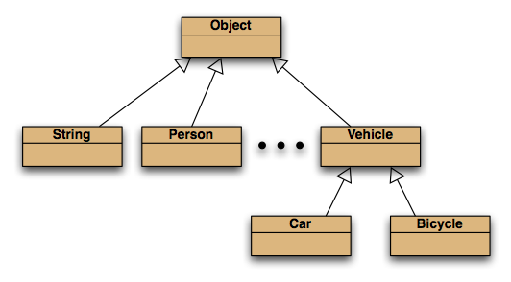
The Object class
All classes inherit from Object.

Slide 50
Topic List
Social Network V1
Inheritance hierarchies
Social Network V2
Coding inheritance hierarchies
  Super and subclasses
  Using constructors in these hierarchies
Social Network V3
  Deeper hierarchies
  Advantages of using inheritance
Subtyping and Substitution
Polymorphic
  Variables
  Collections
    Casting
    wrapper classes,
    autoboxing /unboxing

Slide 51
7 b) Polymorphic collections
All collections are polymorphic.
The elements could simply be of type Object.
public void add (Object element)
public Object get (int index)
Usually avoided…
  we typically use a type parameter with the collection.

Slide 52
7 b) Polymorphic collections
With a type parameter the degree of polymorphism:
ArrayList<Post> is limited.
    Collection methods are then typed.
Without a type parameter,
ArrayList<Object> is implied.
    Likely to get an “unchecked or unsafe operations” warning.
    More likely to have to use casts.

Slide 53
Collections and primitive types
Potentially, all objects can be entered into collections
  because collections can accept elements of type Object
  and all classes are subtypes of Object.
Great! But what about the primitive types:
int, boolean, etc.?

Slide 54
Wrapper classes
Primitive types are not object types.
Primitive-type values must be wrapped in objects, to be stored in a collection!
Wrapper classes exist for all primitive types:
primitive type
int
float
char
...
wrapper class
Integer
Float
Character
...
Note that there is no simple mapping rule from primitive name to wrapper name!

Slide 55
Wrapper classes
int i = 18;
Integer iwrap = new Integer(i);
wrap the value
…
int value = iwrap.intValue();
unwrap it
In practice, autoboxing and unboxing mean we don't often have to do this explicitly

Slide 56
Autoboxing and unboxing
private ArrayList<Integer> markList;
…
public void storeMark(int mark)
{
markList.add(mark);
}
autoboxing
i.e. we don’t have to worry about explicitly wrapping mark above
int firstMark = markList.get(0);
unboxing
Or explicitly unwrapping the first mark in the list markList.get(0)

Slide 57
Summary
if you use collections (e.g. ArrayList, Map, Set, etc.)
of a primitive type (int, long, boolean, char, float, double),
you will need to use wrapper classes (Integer, Boolean, Character, Float, Double)
in the declaration of the collection
e.g. private ArrayList<Integer> markList;
To add an int to this ArrayList of integers, we would wrap the int by using the Integer() constructor method.
To remove an int from this ArrayList of integers, we would unwrap the int by using the intValue() method of the Integer wrapper class.
Autoboxing and unboxing removes the need to use the wrap and unwrap methods in the wrapper class as it’s handled automatically.
  However it is less efficient than doing it explicitly. If performance becomes an issue, you would revert to explicitly using the wrapping and unwrapping methods rather than relying on autoboxing and unboxing.

Slide 58
Summary
  Polymorphic Variables
  Polymorphic Collections
    casting,
    wrapper classes,
    autoboxing /unboxing

Slide 59

Any Questions?

Slide 60
Review
Inheritance allows the definition of classes as extensions of other classes.
Inheritance
  avoids code duplication
  allows code reuse
  simplifies the code
  simplifies maintenance and extending
Variables can hold subtype objects.
Subtypes can be used wherever supertype objects are expected (substitution).

