Slide 1


Debugging
Help with finding bugs in your code
Produced
by:
Dr. Siobhán Drohan
Ms. Mairéad Meagher
Siobhan Roche
Department of Computing and Mathematics
http://www.setu.ie/

Slide 2
Topic List
What are bugs?
What are debuggers?
How do I use them?

Slide 3
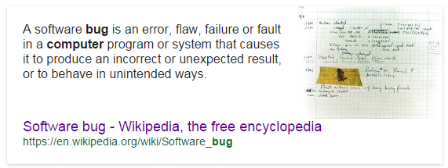
What are bugs?

Slide 4

Bugs can be frustrating to find/fix

Slide 5
Topic List
What are bugs?
What are debuggers?
How do I use them?

Slide 6
Help is at hand…debuggers!
A debugger can be used to fix bugs
…hence the name debugger!

Slide 7
Debugger
A debugger is a software tool that
  helps in examining how an application executes
  allows programmers execute an application one statement at a time.
    Step, step into, step out.
  typically provides functions
    to stop and start a program at selected points in the source code(breakpoints)
    to examine the values of variables (watch, trace)

Slide 8
Debugger
Debuggers are especially useful when your program contains logical errors.
  i.e. errors that the compiler will not pickup but that lead to incorrect results
  e.g. if your syntax is correct but the logic of your problem solution is faulty.
Using the debugger, you can trace how each of the calculations and changes made to fields/variables happen and hopefully figure out where the error is occurring.

Slide 9
Topic List
What are bugs?
What are debuggers?
How do I use them?

Slide 10
Debugger
Most IDEs come with a debugger; IntelliJ has one.
We are going to use the IntelliJ Debugger to step through the debugging of a small program
  The program iterates over a primitive array of int and prints out the largest number in the array.

Slide 11
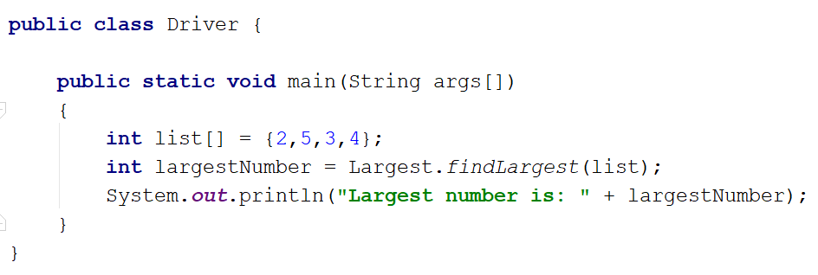
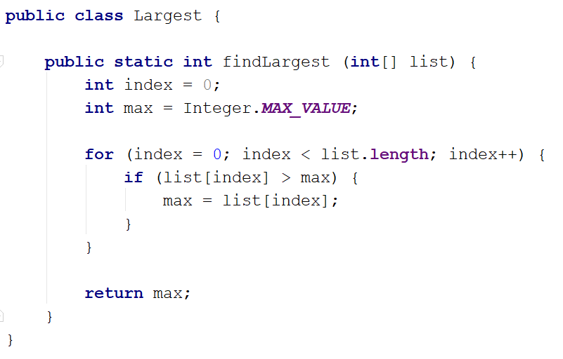
Given this code…
We are expecting this output:
Largest number is: 5
But we get:
Largest number is: 2147483647

Slide 12
Let’s debug the code in IntelliJ to help us find the error…

Slide 13
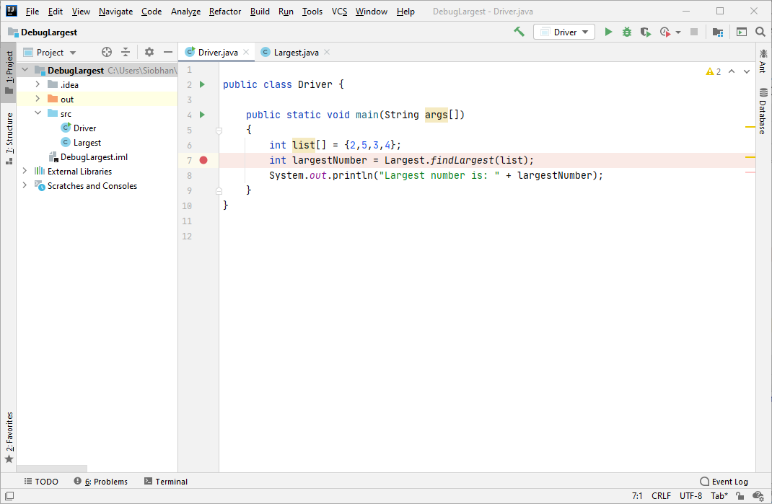
1
Click in the grey margin beside line 7. This will set up a breakpoint on this line.

Slide 14
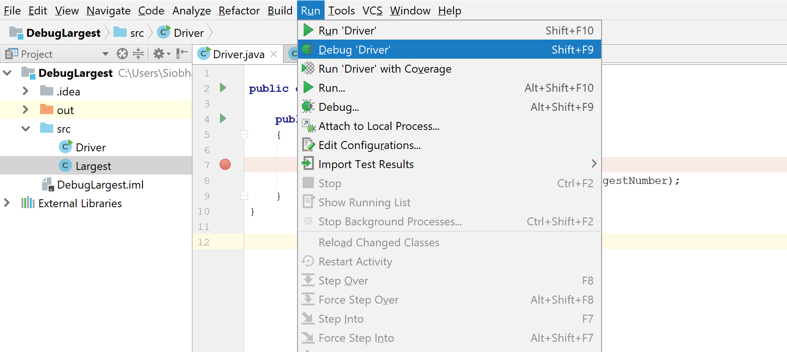
2
From the Run menu, select Debug ‘Driver’.

Slide 15
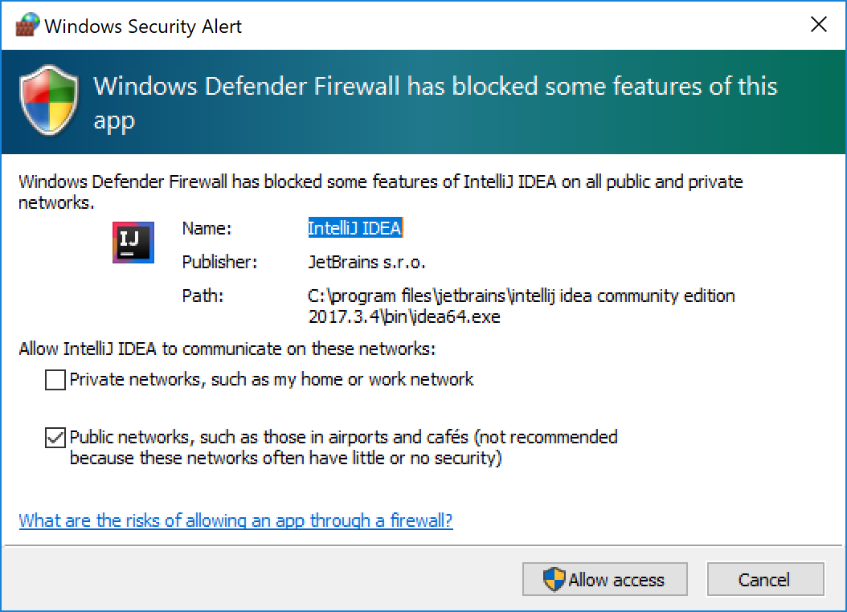
3
If this window appears, click on “Allow access”.

Slide 16
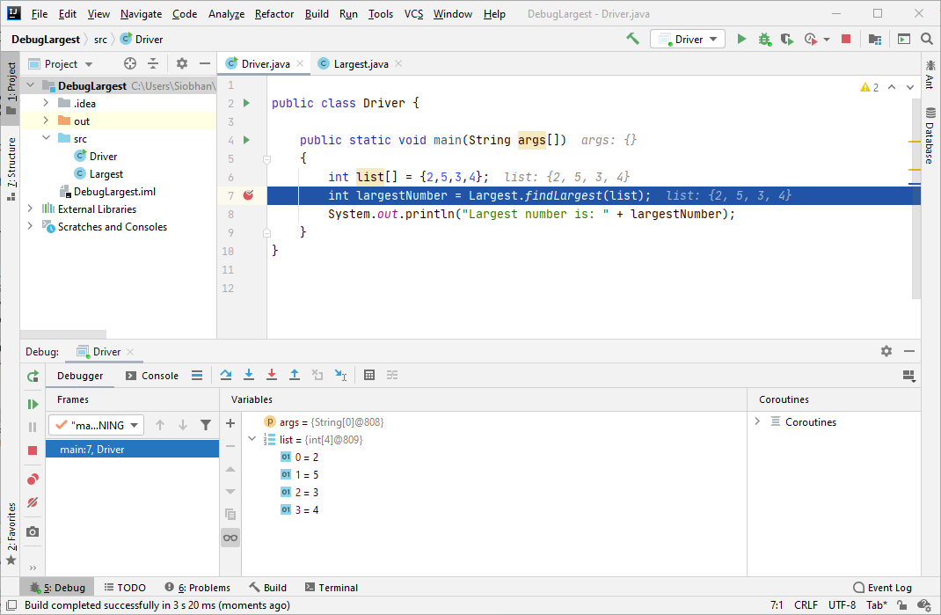
4
You are now in Debug mode…the program has stopped just before executing line 7.

Slide 17
5
‘Step Into’ the findLargest method…

Slide 18
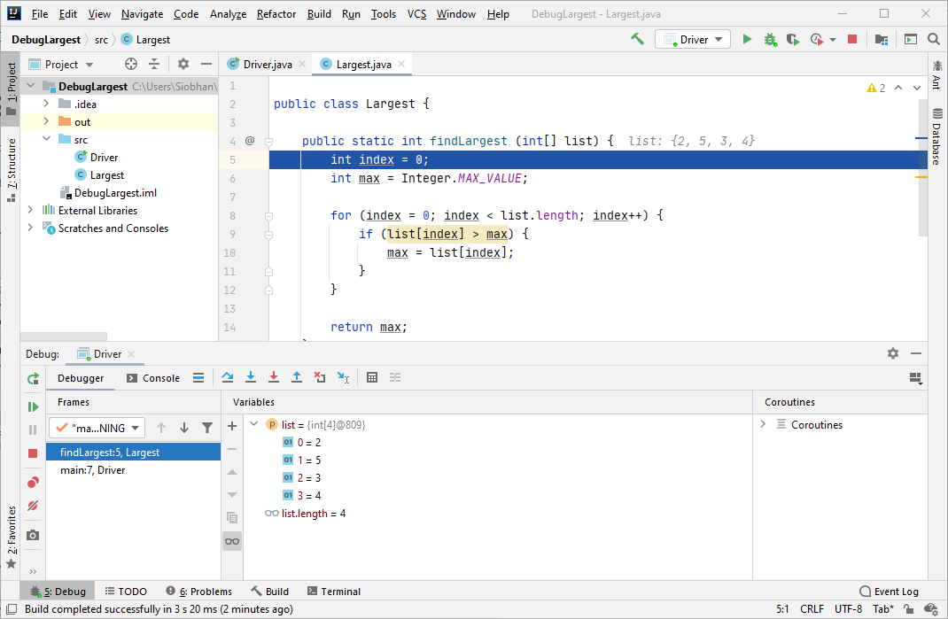
6
Now that we are in the findLargest method, we want to execute each line while monitoring the value of Max. This should help us locate the error…

Slide 19
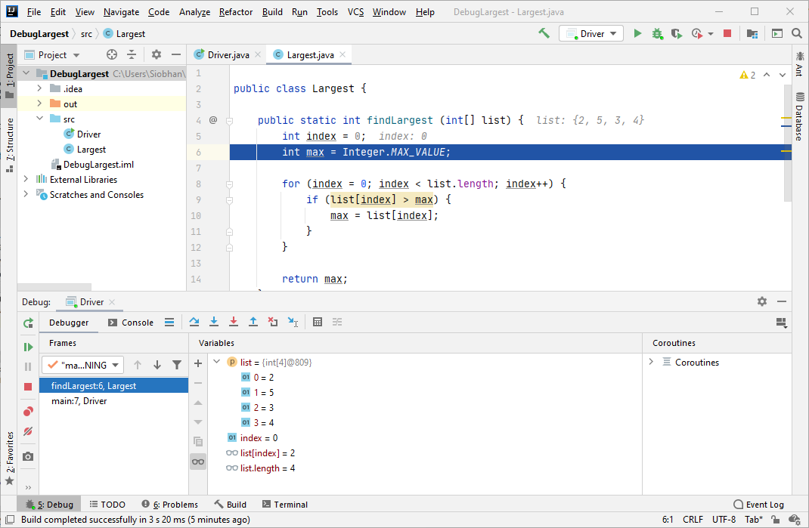
7
‘Step Into’ again → execution now stopped on line 6

Slide 20
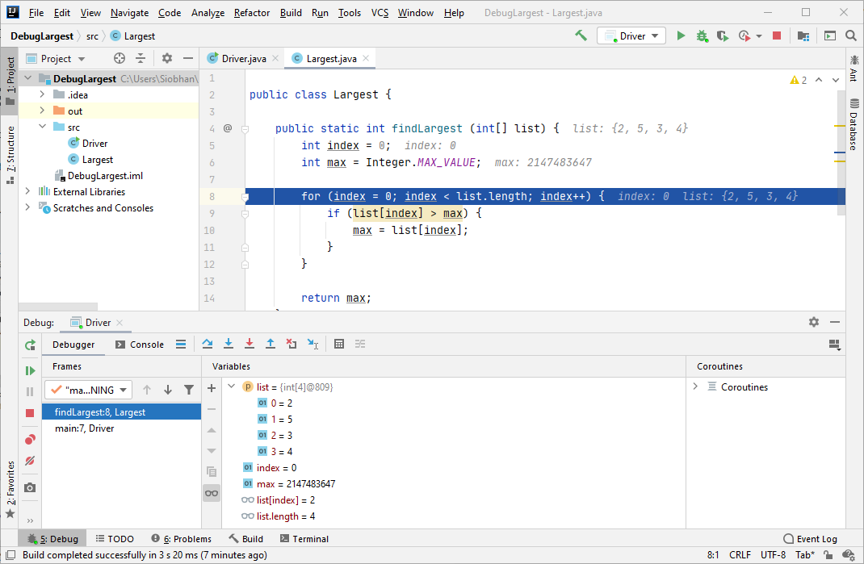
8
Step Into → execution now stopped on line 8…note the value of max.

Slide 21
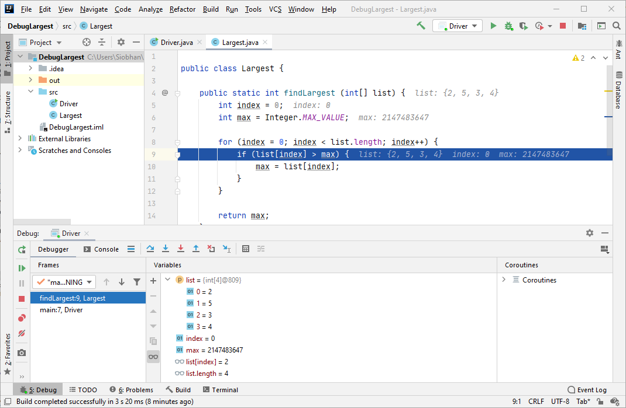
9
Step Into → execution now stopped on line 9…

Slide 22

10
Step Into → execution now stopped back on line 8…
can you see the problem?

Slide 23
Max is set to the maximum possible value an int can be.

Slide 24
No value in the list will be greater than this max value

Slide 25
This is the bug…
we should have set
the max value
to the first value in the list.

Slide 26
Fixing the bug
Instead of the line of code:
  int max = Integer.MAX_VALUE;
We need:
  int max = list[0];

Slide 27
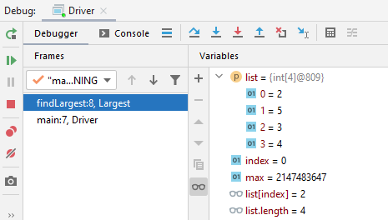
Some IntelliJ debugger buttons…

Slide 28
Some Debugger buttons…
Step Over
to step over the next method call (without entering it) at the currently executing line of code.

Slide 29
Some Debugger buttons…
Step Into
step into the next method call at the currently executing line of code.

Slide 30
Some Debugger buttons…
Step Out
executes the remaining lines of a method in which the current execution point lies.
The next statement displayed is the statement following the method call.

Slide 31
Some Debugger buttons…
Resume Program
resume the execution of the currently suspended program; it will stop again at the next available breakpoint (if any).

Slide 32

Some Debugger buttons…
Terminate
to terminate the launch associated with the selected debug target
i.e. stop the program.

Slide 33
Some Debugger buttons…
Show breakpoints
show all the breakpoints (in a pop up window) in the program.

Slide 34
Some Debugger buttons…
Rerun program
start the program again.

Slide 35

Now it’s your turn!
– practice using the debugger on this code (there is a step in your labs to provide support).

Slide 36

Any Questions?

