Slide 1

Abstraction
Classes and Methods
Produced
by:
Dr. Siobhán Drohan
Mairead Meagher
Siobhan Roche
Department of Computing and Mathematics
http://www.setu.ie/

Slide 2
Topic List
Abstract vs Concrete
Abstract Methods and Classes
Social Network V7.0 (RECAP)
Social Network V8.0 (with abstraction)

Slide 3
Abstract vs Concrete
Abstract
Implementation delayed
→ abstract method has no code
→ cannot instantiate an abstract class (it has, by definition “unfinished” methods)
Concrete
Ready to go.
Everything up to now has been concrete.

Slide 4
Topic List
Abstract vs Concrete
Abstract Methods and Classes
Social Network V7.0 (RECAP)
Social Network V8.0 (with abstraction)

Slide 5
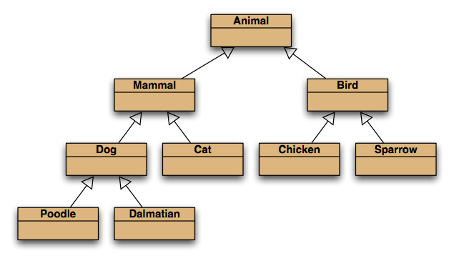
Recap: Inheritance hierarchies
“is a” relationship!
However, we have no pets who are an ‘Animal’, they are either a Dog, a Cat, a Chicken, etc.
Notes:
inheritance hierarchies are nothing unusual. we see them all the time.
(a masters student is a students is a person...)

Slide 6
Abstract Methods
Abstract methods have abstract in the signature.
Abstract methods have no body.
‘We promise to write this later. Every (concrete) subclass of this class will have this implemented in the subclass.’
Abstract methods make the class abstract.
Think about why this is?

Slide 7
Abstract Classes
An abstract class is a class that contains zero or more abstract methods.
Any class that has an abstract method must be declared abstract.
Abstract classes cannot be instantiated.
Abstract classes function as a “base” for subclasses.
→ abstract classes can be subclassed.
Concrete subclasses complete the implementation.

Slide 8
Topic List
Abstract vs Concrete
Abstract Methods and Classes
Network-V7 (RECAP)
Network-V8 (with abstraction)

Slide 9
RECAP: Social Network V7.0 – Deeper Hierarchy
Driver
NewsFeed
Post
LikedPost
EventPost
MessagePost
PhotoPost

Slide 10
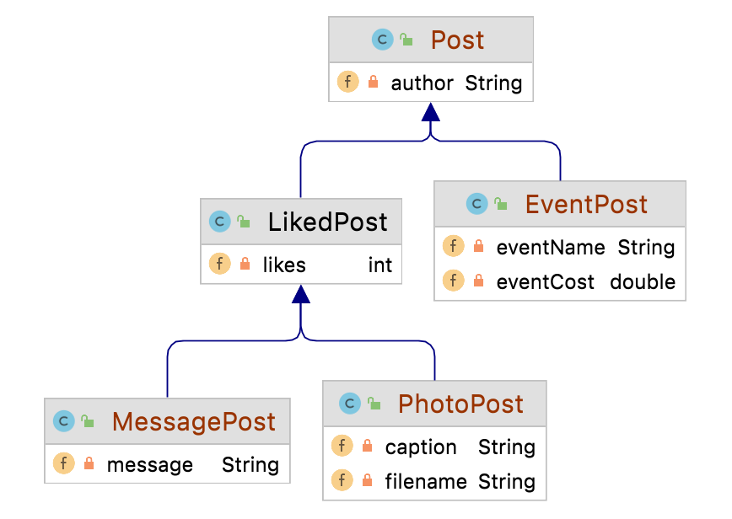
RECAP: Social Network V7.0 – Deeper Hierarchy

Slide 11
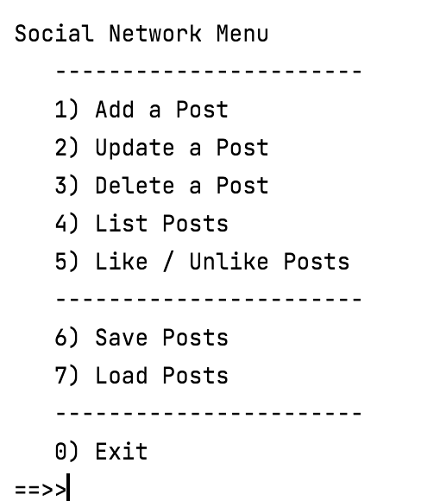
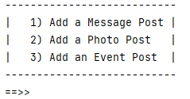

RECAP: Social Network V7.0 – Driver
Our news feed displays MessagePost, PhotoPost and EventPost objects.
We never create a Post object but our ArrayList is of Post.

Slide 12
Topic List
Abstract vs Concrete
Abstract Methods and Classes
Social Network V7.0 (RECAP)
Social Network V8.0 (with abstraction)

Slide 13
Social Network V8.0 (Post as an abstract class)
We can never create a ‘post’ object
We cannot instantiate one.
In Post, we define fields, methods that can be used later for all subclasses (using super)
e.g. display(), constructor..

Slide 14
Social Network V8.0 – Post and LikedPost Abstract
Driver
NewsFeed
<abstract> Post
<abstract> LikedPost
EventPost
MessagePost
PhotoPost

Slide 15
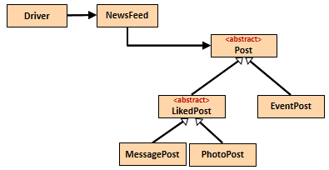
Syntax for abstract classes
//code omitted
public abstract class Post { private String author = ""; public Post(String author) { this.author = Utilities.truncateString(author, 10); }
//code omitted }
//code omitted
public abstract class LikedPost extends Post { private int likes = 0; public LikedPost(String author){ super(author); }
//code omitted

Slide 16
Abstract methods
If you wish all subclasses of a class to implement a particular method as part of its code, simply write an abstract method heading in superclass.
Each concrete subclass must have this method fully coded.

Slide 17
displayCondensed() – new abstract method
Currently our display method, displays the contents over a few lines.
Let’s add a new method, displayCondensed(), but this time, condense the display to only ONE line.
We will add this as an abstract method in Post; this will mean that each concrete class that inherits from Post MUST provide an implementation of it.

Slide 18
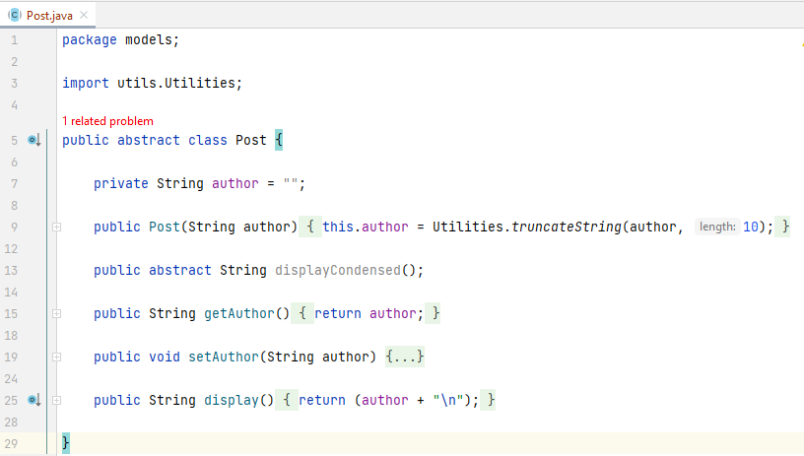
displayCondensed() in Post

Slide 19
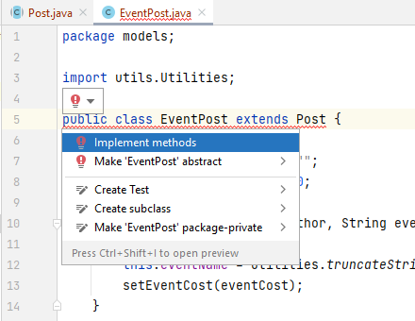
displayCondensed() in EventPost
The compiler is complaining that the concrete classes in the hierarchy have no implementation of displayCondensed()

Slide 20
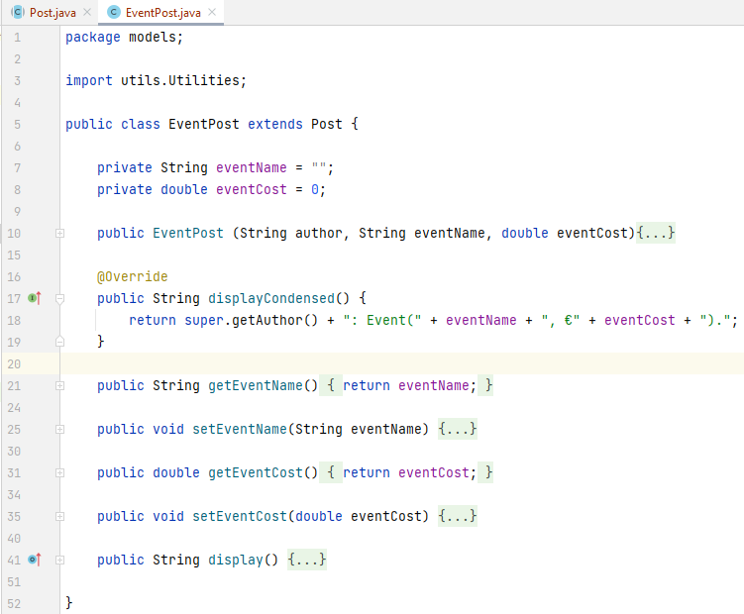
displayCondensed() in EventPost

Slide 21
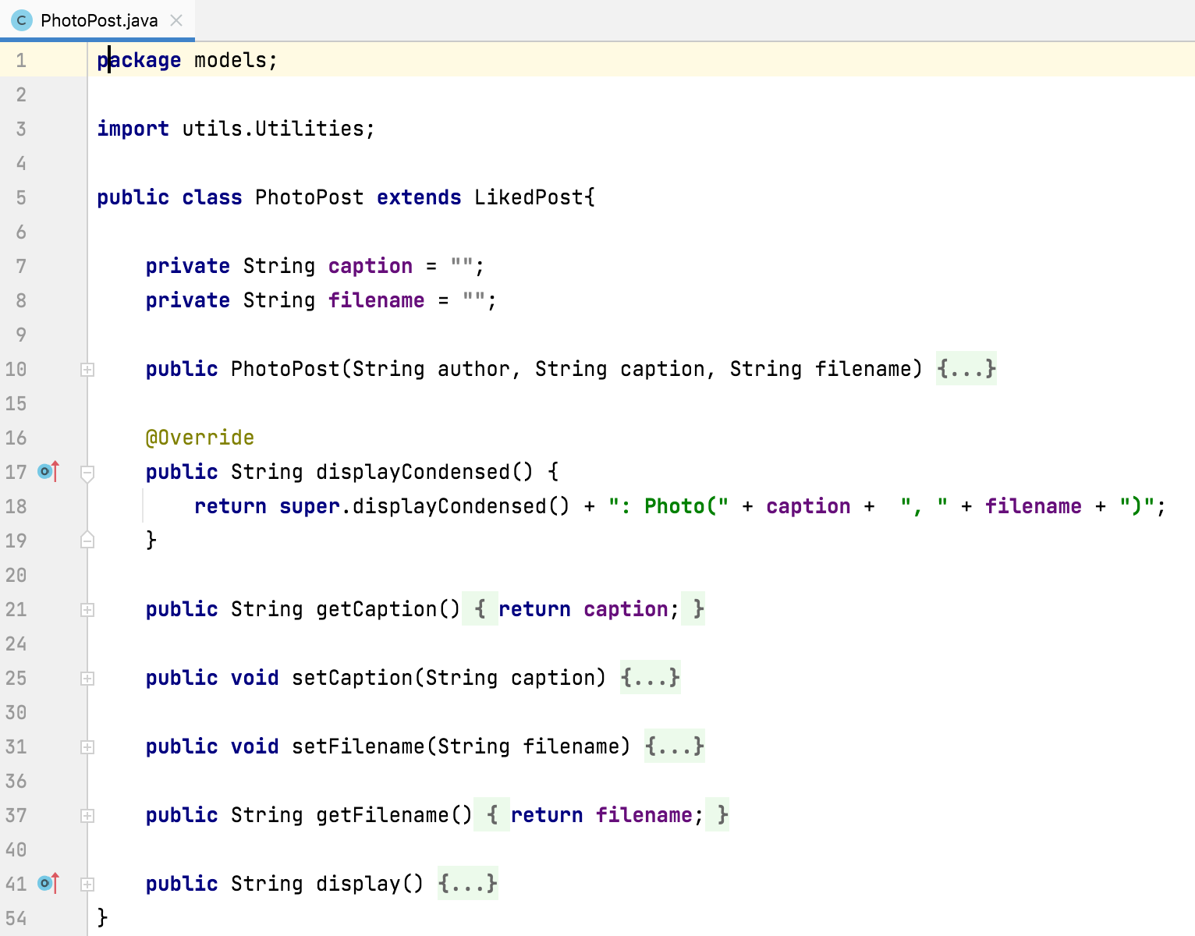
displayCondensed() in PhotoPost

Slide 22
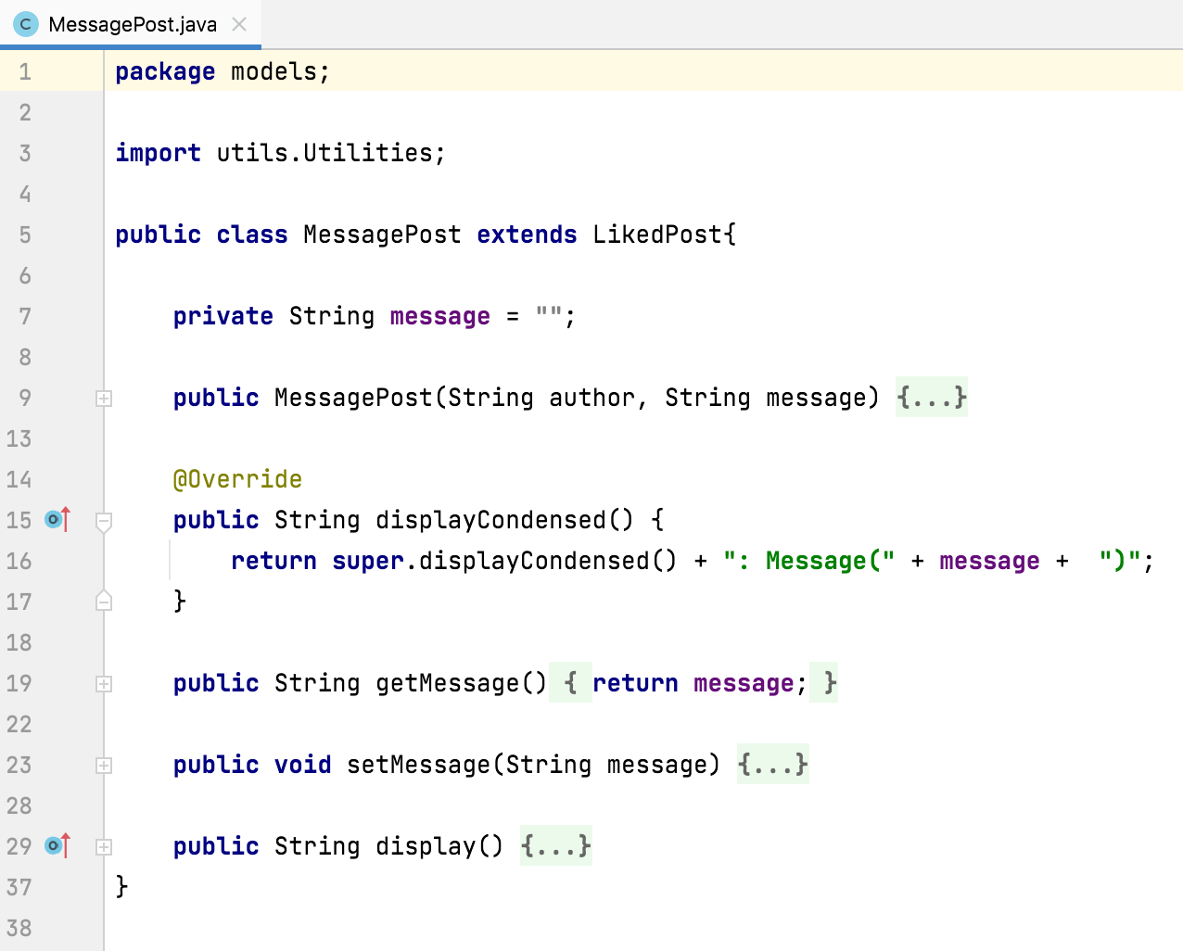
displayCondensed() in MessagePost

Slide 23
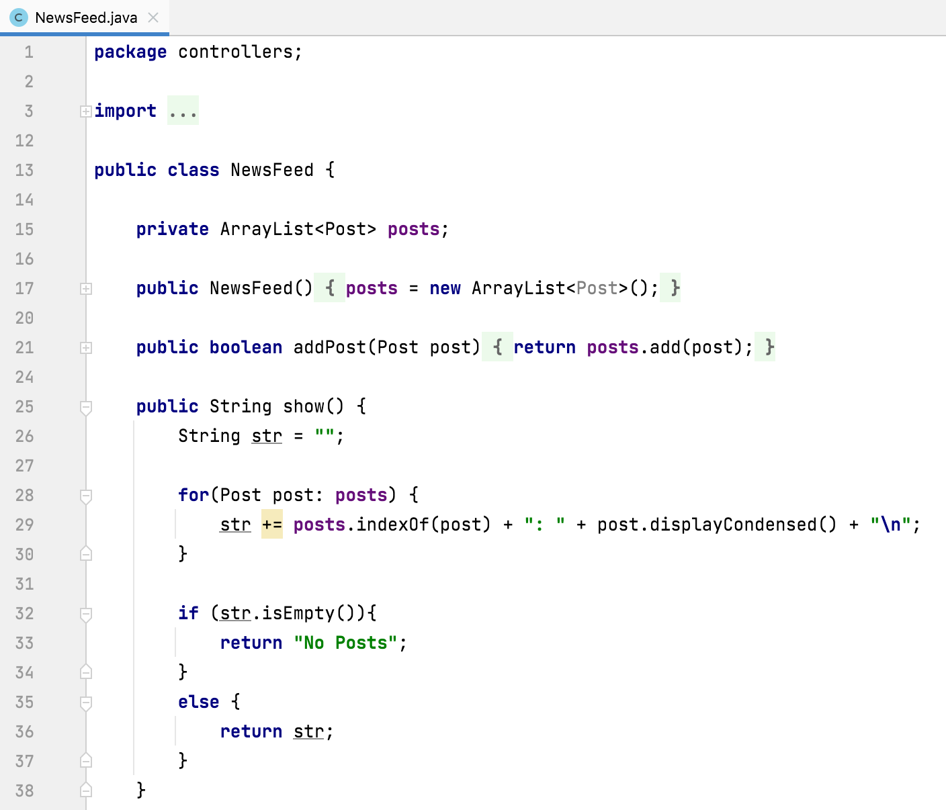
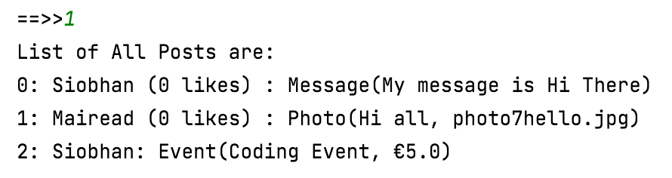
displayCondensed() in NewsFeed

Slide 24
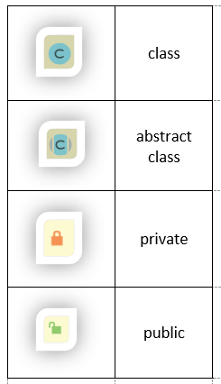
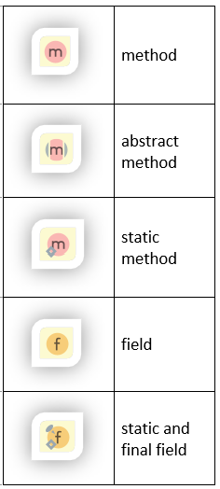
IntelliJ UML Decorators

Slide 25
Interfaces Topic
Next, we will look at interfaces which are used when you can see a ‘multiple inheritance’ in your class design.
Multiple inheritance is not allowed in Java so we use interfaces instead.

Slide 26

Any Questions?

