Slide 1

Sorting and Searching
Basic sorting and searching algorithms
Produced
by:
Dr. Siobhán Drohan
Ms. Mairead Meagher
Department of Computing and Mathematics
http://www.setu.ie/

Slide 2
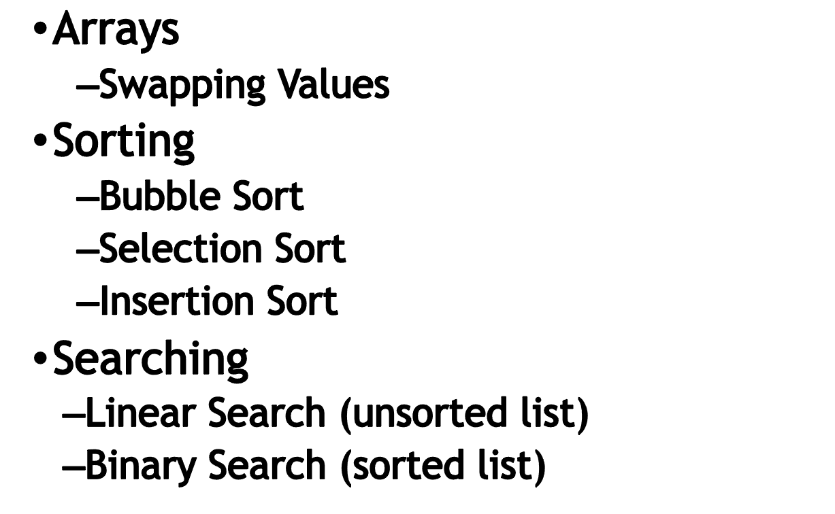
Main concepts to be covered in this section

Slide 3

Arrays – Swapping Values
Before we start discussing sorting, we will look at swapping two values in an array.
This swap algorithm is needed during searching.
Notes:
Objects First with Java
© David J. Barnes and Michael Kölling

Slide 4
Arrays – Swapping Values
An array of integer values has been created called intArray:
private int[] intArray = new int[20];
Exercise 1: write a few lines of code that will swap the contents of index position 2 with index position 3.
Notes:
Objects First with Java
© David J. Barnes and Michael Kölling

Slide 5
Arrays – Swapping Values
Solution 1:
  int temp = intArray[2];
  intArray[2] = intArray[3];
  intArray[3] = temp;
Notes:
Objects First with Java
© David J. Barnes and Michael Kölling

Slide 6
Arrays – Swapping Values
Note if we want to make this code more usable, we will write a method that takes as parameters the name of the array, and the positions of the values you wish to swap e.g.
Notes:
Objects First with Java
© David J. Barnes and Michael Kölling

Slide 7
Arrays – Swapping Values
private void swap(int[] intArray,int i,int j)
{
  int temp = intArray[i];
  intArray[i] = intArray[j];
  intArray[j] = temp;
}
Notes:
Objects First with Java
© David J. Barnes and Michael Kölling

Slide 8
Sorting
The human brain can very quickly sort a collection e.g. it would be straightforward to sort a group of people in height order.
For a computer to carry out this process is more difficult.

Slide 9
Sorting
A computer is quite limited in the data it can handle simultaneously and is restricted to:
    Comparing two items
    Swapping the items or copying one item.
In the sorting algorithms we will investigate, we will see the above two steps repeatedly used.

Slide 10
Sorting
In this introduction to sorting algorithms we will compare three basic algorithms
  Bubble sort
  Selection sort
  Insertion sort

Slide 11
What is a “Sorted List”?
We can define a sorted list (which we will implement as an integer array to start with) as a list in which each element is in its correct position, its correct position being defined as (if we see the list as a horizontal list and assuming ascending order) :
  All values to the left of the element are less than or equal to it and all values to the right of the element are greater than or equal to it.

Slide 12
Sorting – Bubble Sort
In the bubble sort, a collection of elements is rearranged by repeatedly comparing neighbouring elements and either swapping the elements or leaving them unchanged depending on their relative sizes (for numbers).

Slide 13
Sorting – Bubble Sort
At the end of the first cycle through the array, 1 item will be in its correct position (the largest, or smallest, bubbles up to one end of the array).
For example in an array of integers arranged in increasing integer size, the largest integer should be in the highest index position in the array.

Slide 14
Sorting – Bubble Sort
In the next pass through the array, each element is once again compared to its neighbour but there is now no need to compare the final element in the array because this is already known to be the largest.

Slide 15
Sorting – Bubble Sort
Exercise 2:
Write a method called bubbleSort()
  which takes an array of integers as its argument
  and prints out the elements of a sorted array with integer size increasing with index position.

Slide 16
Solution 2:
public void bubbleSort(int[] intArray, int size)
{
for(int j = size - 1; j >= 0; j--)
{
for(int i = 0; i< j; i++)
{
if (intArray [i] > intArray [i+1])
swap(intArray, i, i+1);
}
}
print(intArray);
}

Slide 17
Sorting – Bubble Sort
What if the Array was already sorted?
This solution does not take into consideration that the list could already be sorted.
The following solution does by checking is there a swap performed during a pass. If there was no swap on a previous run, it means the list is already sorted and we can exit or stop sorting.

Slide 18
Solution 2:
public int[] bubbleSort(int[] array)
{
boolean swappedOnPrevRun = true;
while(swappedOnPrevRun)
{
swappedOnPrevRun = false;
for (int i = 0; i < array.length - 1;i++)
{
if (array[i] > array[i+1])
{
swappedOnPrevRun = true;
swap(array, i, i+1); }
}
}
return array;
}

Slide 19
Efficiency in Sorting?
The bubble sort algorithm is one of the most inefficient sorting algorithms – however, it could be used where performance isn’t an issue.
Selection sort is more efficient than Bubble sort.

Slide 20
Selection Sort Algorithm
Iterate through all elements of the array and select the largest one (this is stored in a temporary variable).
The largest one is then swapped with the element at the end of the array.
Then reduce the size of the array by 1 and work through the array to locate the next largest element.
Repeat the above steps until the size of your array is 1.

Slide 21
The Selection Sort Algorithm
Firstly we need to find the position of the largest element.
  Exercise: Write a method called findPosOfLargest, that accepts:
    an array of ints
    an int called size (depicting the size of the array)
    as parameters. This method returns the position
    of the largest element in the array of int passed
    in as the parameter.

Slide 22
Solution:
private int findPosOfLargest(int[] intArray, int size)
{
int largestPosSoFar = 0;
for (int i = 1; i < size; i++)
{
if (intArray[i] > intArray[largestPosSoFar])
largestPosSoFar = i;
}
return largestPosSoFar;
}

Slide 23
The Selection Sort Algorithm
Secondly, we need to write the method that reduces the size of the array by 1 and works through the array to locate the next largest element. This method will be repeated until the size of your array is 1.
public void selectionSort(int[] intArray)
{
for (int i = intArray.length; i > 0; i--)
{
int posLargest = findPosOfLargest(intArray, i);
swap(intArray, posLargest, i-1);
}
}

Slide 24
Selection Sort in one method
private int[] selectionSortOneMethod(int[] intArray)
{
for (int i = intArray.length - 1; i >= 0; i--)
{
int highestIndex = i;
for (int j = i; j >= 0; j--)
{
if (intArray[j] > intArray[highestIndex])
{
highestIndex = j;
}
}
swap(intArray, i, highestIndex);
}
return intArray;
}

Slide 25
Selection Sort Algorithm
Our selection sort algorithm searches for the largest element and places it at the end of the array.
It can also be written so that you select the smallest element and place it at the start of the array.
Homework – re-write the above code so that it looks for the smallest element and places it at the start of the array!

Slide 26
Insertion Sort
This approach essentially splits the array into two sections – a sorted section initially empty and an unsorted section.
The basic idea is that the sorted section grows by 1 element with each cycle through the code (the unsorted section must therefore reduce in size by 1).

Slide 27
Insertion Sort contd.
Within the sorted section, the elements are in order.
We will spilt up the code into two parts, firstly we write a method that inserts an element into an already sorted list.

Slide 28
Insertion Sort contd.
public void insertElem(int[] intArray, int size, int newnumber)
{
int i = size-1;
while (i >=0 && intArray[i] > newnumber)
// need to ensure it doesn’t fall over the start(i = -1)
{
intArray[i+1] = intArray[i];
i--;
}
intArray[i+1] = newnumber;
size++;
}

Slide 29
Insertion Sort contd.
public void insertionSort(int[] intArray, int size)
{
for (int i = 1; i <size; i++)
insertElem(intArray, i, intArray[i]);
}
We then repeatedly call this method to insert the first (leftmost) element of the unsorted list into the ‘so-far’ sorted list.

Slide 30

Linear and binary searching
4.0
Notes:
Objects First with Java
© David J. Barnes and Michael Kölling

Slide 31
Searching
Generally a search method will look something like (ignore access modifier):
  int search(int[] a, int size, int looking_for)
This method would return the position in the array of the value ‘looking_for’ if it exists and –1 otherwise.

Slide 32
Searching
Before we decide on how to search through a list we need to know whether or not the list is sorted.
  Not Sorted → Linear Search
  Sorted → Binary Search

Slide 33
Linear Search
public int linearsearch(int[] intArray, int size, int looking_for)
{
int i = 0;
while (i < size)
{
if (intArray[i] == looking_for)
return i; //this terminates the method
i++;
}
return -1; // we only get to here if we have got to
// end of list and never found item
}

Slide 34
Binary Search
If the list is sorted we make use of this (same way we search through telephone book)
The binary search is such a search and is a particularly efficient search.

Slide 35
Binary Search Algorithm
The overall algorithm works by always looking at the midpoint of the list.
If we have found what we are looking for, great.
If not…

Slide 36
Binary Search Algorithm contd.
If not...
…and the value we are looking for is less than the midpoint value…
…then, because the list is sorted, we can ‘throwaway’ all the values greater than the midpoint. So we ‘redraw’ our list to be the left-hand part of the list and repeat the procedure.

Slide 37
Binary Search Algorithm contd.
If not…
…and the value we are looking for is greater than the midpoint value…
…then (using the same logic) we ‘redraw’ the list to just include the right-hand part of the list and repeat the procedure.

Slide 38
Binary Search Code
public int binarysearch(int[] intArray, int size, int looking_for)
{
int mid;
int left = 0;
int right = size-1;
while (left <= right)
{
mid = (left + right) / 2;
if (intArray[mid] == looking_for)
return mid; //this terminates the method
else if (intArray[mid] > looking_for) // element in left hand of list, if is exists.
right = mid - 1;
else if (intArray[mid] < looking_for) // element in right hand of list, if is exists.
left = mid + 1;
}
return -1;
}

