Slide 1

Introduction to Module
Content, Structure and the JVM
Produced
by:
Dr. Siobhán Drohan
Ms. Mairead Meagher
Department of Computing and Mathematics
http://www.setu.ie/

Slide 2
Topics list
Module Content and Structure.
Java Language:
  Files in Java.
  Java Virtual Machine (JVM).
  main() method.

Slide 3
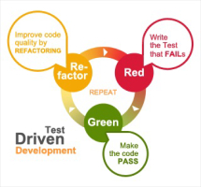
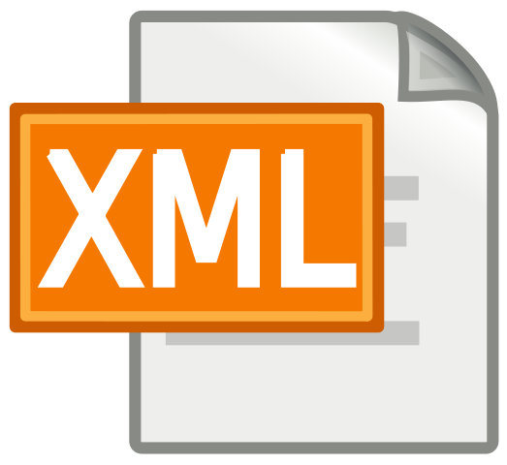


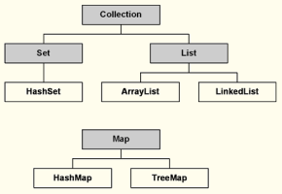
Module Content
Notes:
These technologies are the software development technologies/approaches that we will teach in the course.

Slide 4
Module Content
100% CA:
  Assignment 1
  Assignment 2
Focus on:
  Menu Driven Systems (console based)
  Data Structures
  CRUD and Persistence (XML)
  Exceptions
  Inheritance, Polymorphism and Abstraction

Slide 5
Topics list
Module Content and Structure.
Java Language:
  Files in Java.
  Java Virtual Machine (JVM).
  main() method.

Slide 6
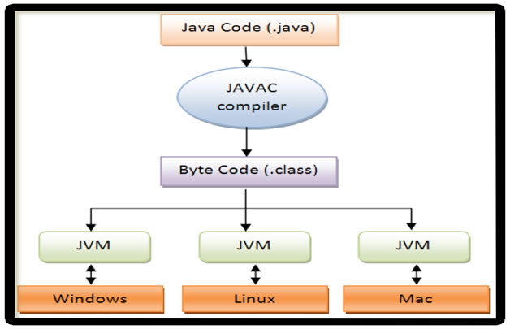
Files in Java (1)
Platform
independent
Platform
specific
http://viralpatel.net/blogs/java-virtual-machine-an-inside-story/
Notes:
http://viralpatel.net/blogs/java-virtual-machine-an-inside-story/

Slide 7
Files in Java (3)
Java code is written in .java file.
  code contains one or more Java language constructs
  e.g. Classes, Methods, Variable, Objects etc.
Compiling this code generates a .class file
A .class file
  “byte code”
  the input to Java Virtual Machine (JVM)
  The JVM (for a specific platform)
    reads this byte code
    interprets it as machine code instructions (for that platform)
    and executes the program (on that platform)
http://viralpatel.net/blogs/java-virtual-machine-an-inside-story/

Slide 8
Topics list
Module Content and Structure.
Java Language:
  Files in Java.
  Java Virtual Machine (JVM).
  main() method.

Slide 9
Java Virtual Machine (JVM)
A “virtual” computer that resides in
the “real” computer as a software process.
Gives Java the flexibility of platform independence.
The .class files can be run on any OS, once a JVM has been installed
  (NB: JVM is installed when you install the JDK).
http://viralpatel.net/blogs/java-virtual-machine-an-inside-story/

Slide 10
Topics list
Module Content and Structure.
Java Language:
  Files in Java.
  Java Virtual Machine (JVM).
  main() method.

Slide 11
main() method
When you want to run a java project, the Java Virtual Machine (JVM) invokes the main() method in the project.
For the JVM to recognise it, the main() method must have a specific method signature.
public static void main(String[] args)
{
...
}

Slide 12
main() method - signature
“main” must exist
“main” must be public
“main” must be static (class method)
“main” must have a String array parameter
Only “main” can be invoked automatically.
public static void main(String[] args)
{
...
}

Slide 13
The main() method typically…
public static void main(String[] args)
{
Driver driver= new Driver();
driver.runMenu();
}
Creates an object
Calls the first method

Slide 14

Questions?

