Slide 1
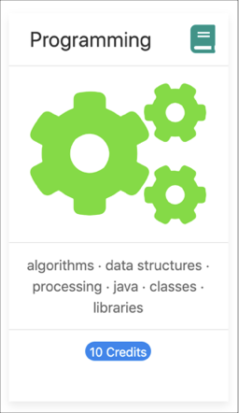

Programming Fundamentals
An Introduction to the module
Produced by:
Ms. Mairead Meagher
Ms. Siobhan Roche
Department of Computing and Mathematics
setu.ie

Slide 2
Agenda
Lecturers / Tutors
Module Structure & Delivery
Technologies
Module Assessment (Assignments)
Troubleshooting Labs
Ethos

Slide 3

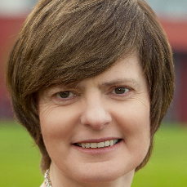
Introducing your lecturers / tutors
Siobhan Roche
Mairead Meagher
Groups : W3, W4
Email: mairead.meagher@setu.ie
Email: siobhan.roche@setu.ie
Groups : W1(Forensics and Physics), W2

Slide 4
Module Structure
12 weeks of delivery
2 Lectures
3 hours of Labs

Slide 5



Learning Technologies
DESKTOP APPS:
Notes:
These technologies are used to deliver the course

Slide 6


Programming Technologies
Notes:
These technologies are the software development technologies/approaches that we will teach in the course.

Slide 7

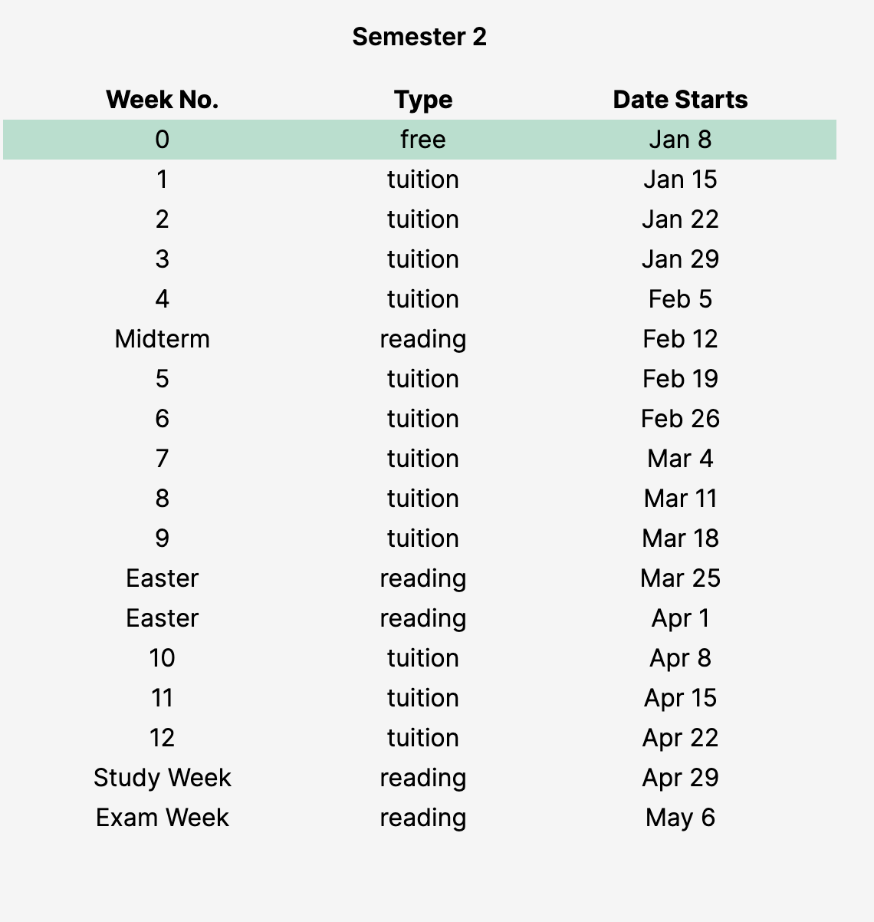
Calendar

Slide 8
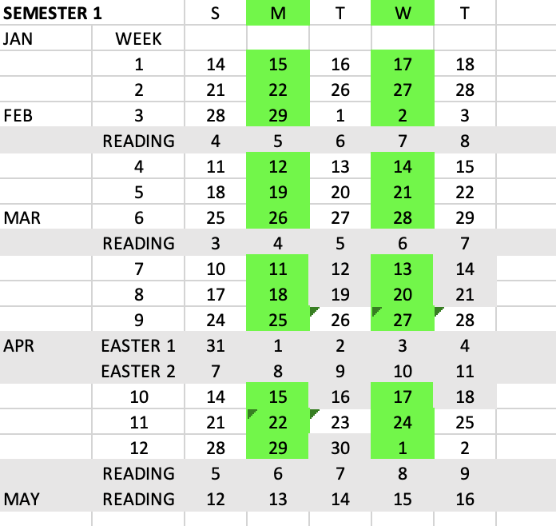

Slide 9


Week | Lecture
1 | Intro to Processing
 | Animate your Drawings
2 | If statement and Events
 | Iteration (for and while)
3 | Methods
 | More on Methods
4 | IntelliJ, JVM and I/O
5 | Strings and Intro to Classes
6 | Arrays
Week | Lecture
7 | Classes and Encapsulation
 | Arrays and Classes
8 | Grouping Objects (ArrayLists)
9 | Menu and CRUD
 | Persistence (XML) and Exceptions
10 | Collections (Map and Set)
11 | Inheritance and Polymorphism
12 | Assignment Studio
Notes:
IDE – Integrated Development Environment

Slide 10
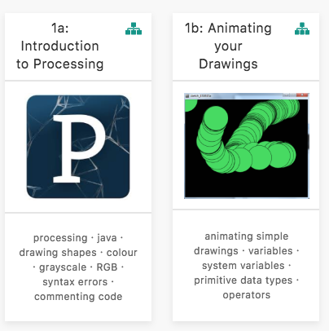
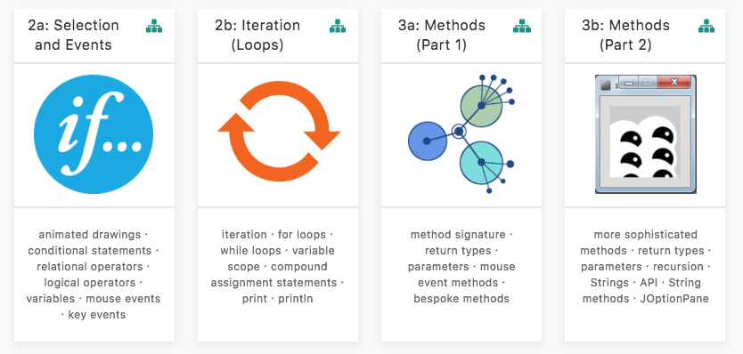
Assignment 1
(P1)

Slide 11
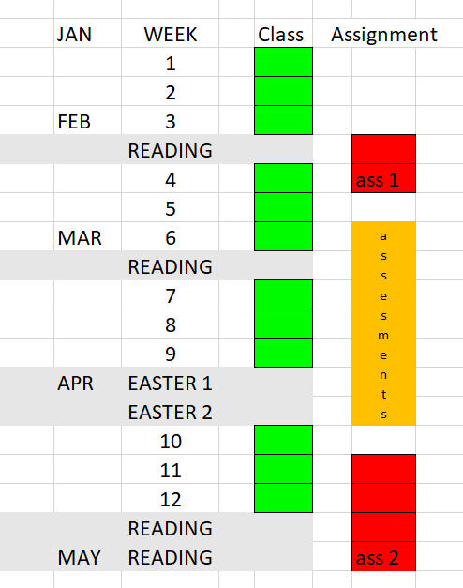
ASSESSMENT
25%
%
reflects difficulty
and
time required
15%
60%

Slide 12
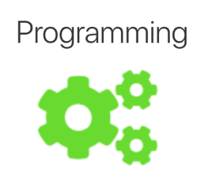

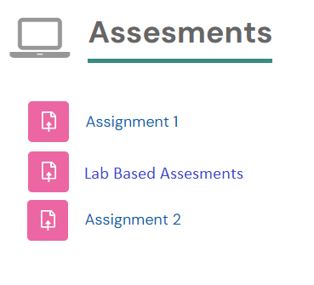


Online
Interviews / Demos

Slide 13
Assignments
100% Continuous Assessment (CA).
All Individual assignments
  (no team-based ones).
Submit via Moodle assignment dropboxes.
Hard deadlines;
extensions only permitted if mitigating circumstances apply.
Interviews

Slide 14
Troubleshooting labs
...during the lab sessions
Post the issue in Slack;
think of it as asking a question in a traditional classroom.
Include any screen shots, screen recordings, etc.
you think might help with solving the problem.
We encourage classmates to help each other (peer learning),
if you know the answer to another student’s issue,
please do respond.
All our responses will be via Slack
so that all students can see the resolution.
for private issues, use DM in Slack

Slide 15
Troubleshooting labs
…outside of the lab sessions
Search #Slack Chatroom
Check Google / StackOverflow
(or equivalent) for possible solution
Post the issue on #Slack
programming channel

Slide 16
Ethos
Self-directed learning outside of lectures / labs.
Inquisitive and motivated.
Help your peers (use #Slack!).
Engagement and staying current with the module.
All work submitted must be your own work.
  all code/approaches given in the module by us can be re-used / re-purposed in your assignments.

Slide 17

Introduction to Processing

Slide 18

What is Processing?
Processing is a
programming language, development environment, and online community
  …can be used to develop static or interactive online material
  and data visualisations.
  …is often used by visual artists.
  …produces visual and interactive representations of programming code.

Slide 19
What is Processing?
Different programming languages can be used with Processing e.g. :
  Java: ver 4 uses Java 17, ver 3 uses Java 8.
  JavaScript (p5.js)
  Python
It can be used on different platforms :
  Windows, OSX, Linux and now Android

Slide 20
Why are we using Processing?
Processing is increasingly used
to teach computer
programming fundamentals (https://processing.org/overview/)
Notes:
Can visually the result of your programming code.
Visual confirmation that your code is correct.
Little “ceremony” around getting a piece of code to work…simple IDE and you can have a program with only one line of code if you wish.
Helps with understanding flow of control e.g. sequence, selection (if), iteration (loops)

Slide 21
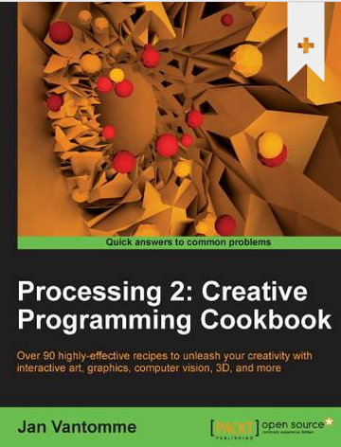
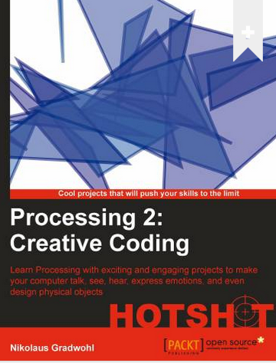
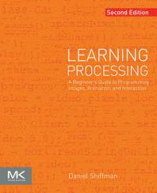
Some eBooks in WIT library
https://library.wit.ie/Resources/ebooks

Slide 22
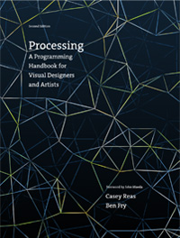
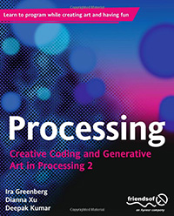
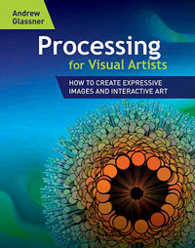
Processing Books
https://processing.org/books/

Slide 23

Quick Quiz

Slide 24

Please start coding in Processing using the induction lab
Notes:
We are using version 3

Slide 25

Questions?

