Slide 1

Recap of OO concepts
Objects, classes, methods and more.
Produced
by:
Ms. Mairead Meagher
Ms Siobhan Roche
Department of Computing and Mathematics
http://www.setu.ie/

Slide 2
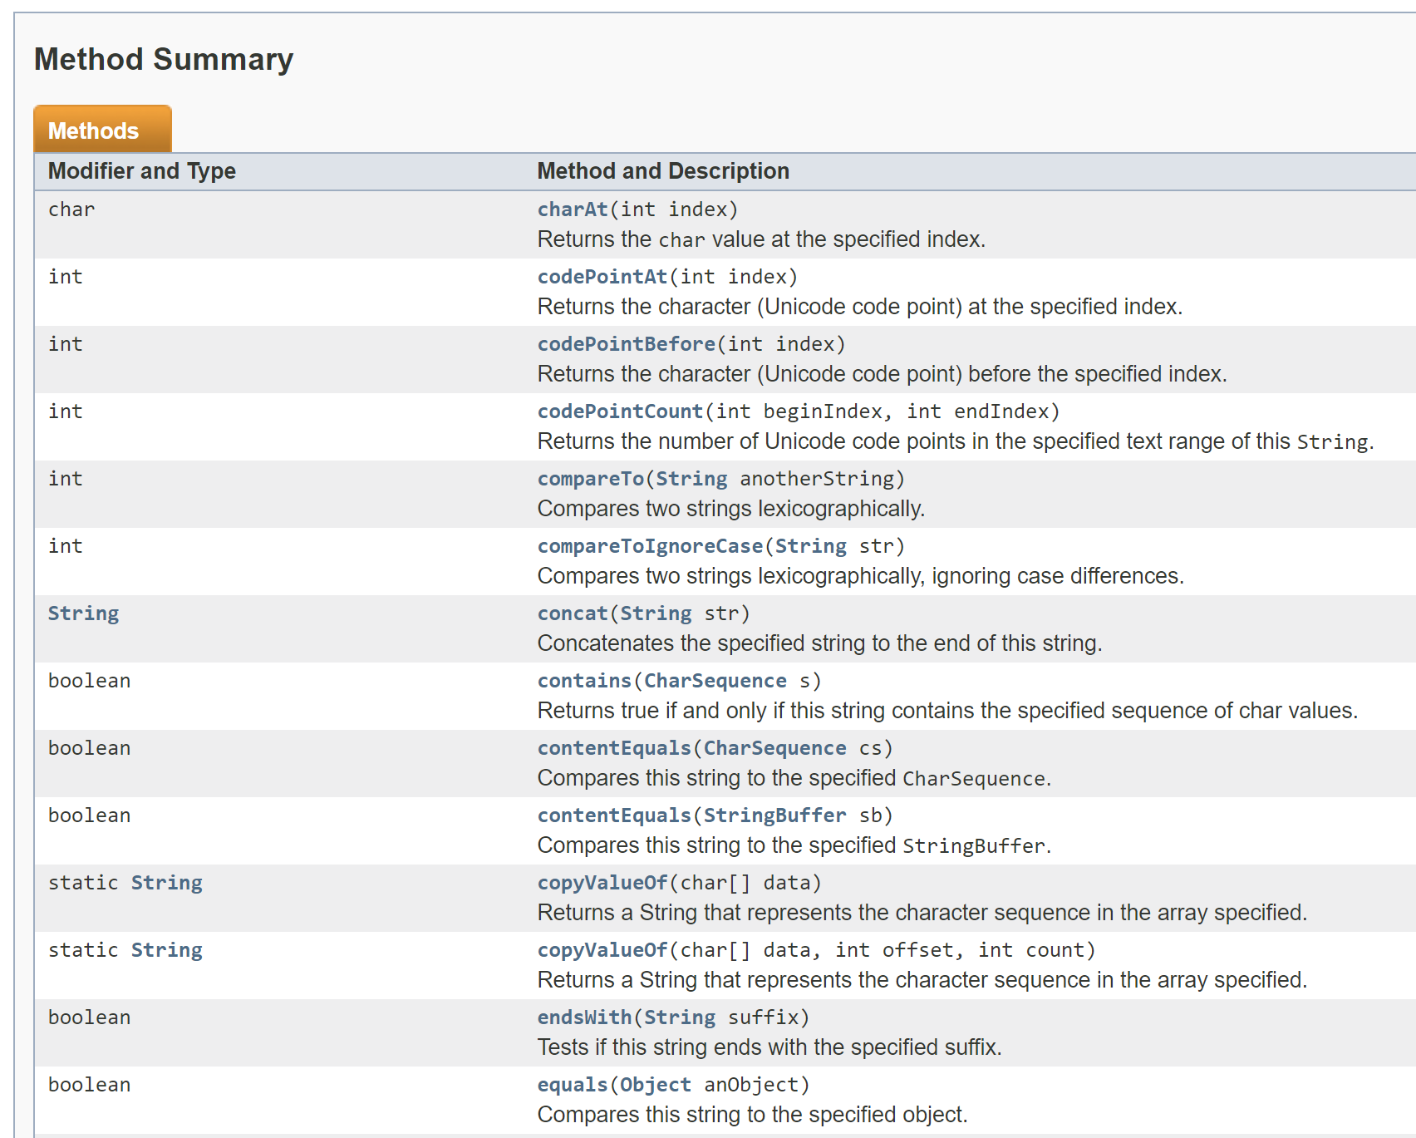
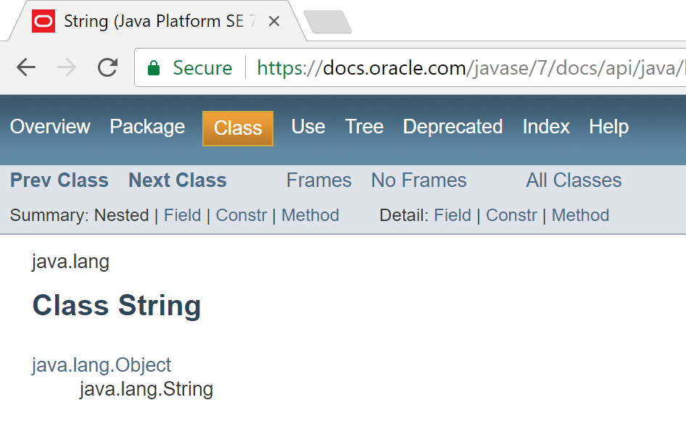
Classes and Objects
A class
  defines a group of related methods (functions) and fields (variables / properties).

Slide 3
Classes and Objects
An object
  is a single instance of a class
  i.e. an object is created (instantiated) from a class.
String is the Class
String a;
&FFCC
a is the Object,
which contains “Hello”
&FFCC
“Hello”

Slide 4
Classes and Objects – Many Objects
Many objects can be constructed from a single class definition.
Each object must have a unique name within the program.

Slide 5
Shop
Ver 1.0

Slide 6
Shop V1.0 - Product
We will recap object oriented concepts through the study of a new class called Product.
Driver
Product

Slide 7
Shop V1.0 - Product
Driver
The Product class stores details about a product
  name
  code
  unit cost
  in the current product line or not?
Product

Slide 8
Shop V1.0 - Driver
Driver
The Driver class
  has the main() method.
  reads the product details from the user (via the console)
  creates a new Product object.
  prints the product object
  (to the console)
Driver is covered in the next lecture.
Product

Slide 9
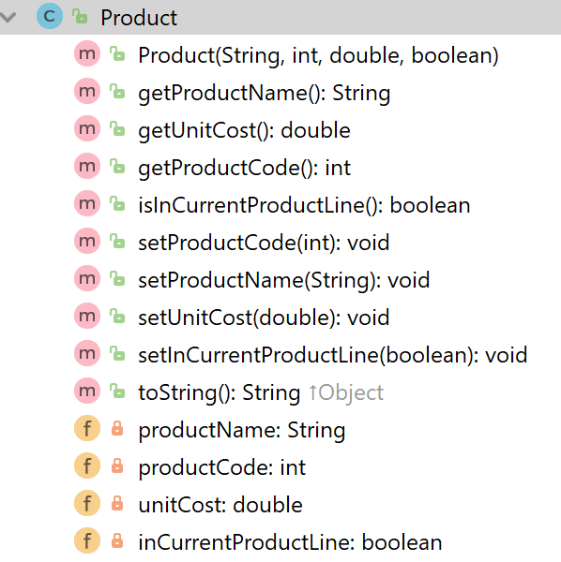
A Product Class…
Object Type/ Class Name
i.e. Product
The C icon means it is a Class.
The open padlock means it is public.

Slide 10
A Product Class…fields
The f icon means it is a field.
Fields
i.e. the attributes / properties
of the class

Slide 11
A Product Class…fields
field type
field name
The closed padlock means it is private.
The f icon means it is a field.
Fields
i.e. the attributes / properties
of the class

Slide 12
A Product Class… constructor
Constructor
i.e. for building objects.
The m icon means it is a method.
The open padlock means it is public.
Constructors have same name as the class
Four parameters;
one for each field.

Slide 13
A Product Class… fields and constructor
public class Product {
private String productName;
private int productCode;
private double unitCost;
private boolean inCurrentProductLine;
public Product (String productName, int productCode,
double unitCost, boolean inCurrentProductLine){
this.productName = productName;
this.productCode = productCode;
this.unitCost = unitCost;
this.inCurrentProductLine = inCurrentProductLine;
}

Slide 14
A Product Class… methods
The open padlock means it is public.
The m icon means it is a method.
Methods
i.e. the behaviours of the class

Slide 15
A Product Class… methods
Return type
Method name

Slide 16
A Product Class… getters
getters

Slide 17
Getters (Accessor Methods)
Accessor methods
  return information about the state of an object
    i.e. the values stored in the fields.
A ‘getter’ method
  is a specific type of accessor method and typically:
    contains a return statement
    (as the last executable statement in the method).
    defines a return type.
    does NOT change the object state.

Slide 18
Getters
return type
visibility modifier
method name
parameter list (empty)
public double getUnitCost()
{
return unitCost;
}
return statement
start and end of method body (block)

Slide 19
A Product Class…getters
public String getProductName(){
return productName;
}
public double getUnitCost(){
return unitCost;
}
public int getProductCode() {
return productCode;
}
public boolean isInCurrentProductLine() {
return inCurrentProductLine;
}

Slide 20
A Product Class…setters
setters

Slide 21
Setters (Mutator methods)
Mutator methods
  change (i.e. mutate!) an object’s state.
A ‘setter’ method
  is a specific type of mutator method and typically:
    contains an assignment statement
    takes in a parameter
    changes the object state.

Slide 22
Setters
return type
visibility modifier
method name
parameter
public void setUnitCost(double unitCost)
{
this.unitCost = unitCost;
}
field being mutated
assignment
statement
Value passed
as a parameter

Slide 23
A Product Class…setters
public void setProductCode(int productCode) {
this.productCode = productCode;
}
public void setProductName(String productName) {
this.productName = productName;
}
public void setUnitCost(double unitCost) {
this.unitCost = unitCost;
}
public void setInCurrentProductLine(boolean inCurrentProductLine) {
this.inCurrentProductLine = inCurrentProductLine;
}

Slide 24
Getters/Setters
For each instance field in a class, you are normally asked to write:
  A getter
    Return statement
  A setter
    Assignment statement

Slide 25
A Product Class…toString
toString():
Builds and returns a String containing a user-friendly representation of the object state.

Slide 26
A Product Class…
public String toString()
{
return "Product description: " + productName
+ ", product code: " + productCode
+ ", unit cost: " + unitCost
+ ", currently in product line: " + inCurrentProductLine;
}
Sample Console Output if we printed a Product Object:
Product description: 24 Inch TV, product code: 23432, unit cost: 399.99, currently in product line: true

Slide 27
toString()
This is a useful method and you will write a toString() method for most of your classes.
When you print an object, Java automatically calls the toString() method
e.g.
Product product = new Product();
//both of these lines of code do the same thing
System.out.println(product);
System.out.println(product.toString());

Slide 28
Encapsulation in Java – steps 1-3
Encapsulation Step | Approach in Java
1. Wrap the data (fields) and code acting on the data (methods) together as single unit. | public class ClassName { Fields Constructors Methods }
2. Hide the fields from other classes. | Declare the fields of a class as private.
3. Access the fields only through the methods of their current class. | Provide public setter and getter methods to modify and view the fields values.
http://www.tutorialspoint.com/java/java_encapsulation.htm

Slide 29
A Product Class… An Encapsulated Class
1. Product class wraps the data (fields) and code acting on the data (methods) together as single unit.

Slide 30
A Product Class… An Encapsulated Class
1. Product class wraps the data (fields) and code acting on the data (methods) together as single unit.
2. Fields are hidden from other classes.

Slide 31
A Product Class… An Encapsulated Class
1. Product class wraps the data (fields) and code acting on the data (methods) together as single unit.
2. Fields are hidden from other classes.
3. Access the fields only through the methods of Product (e.g. getter and setter methods).

Slide 32
Using the Product Class
1
private Product product;
product
null
Declaring an object product, of type Product.

Slide 33
Using the Product Class
1
private Product product;
product
Declaring an object product, of type Product.
2
product = new Product(“TV”, 1234, 149.99, true);
product
Calls the Product constructor to build the product object in memory.
productName
“TV”
productCode
1234
unitCost
149.99
inCurrentProductLine
true

Slide 34
Multiple Product Objects
private Product product = new Product(“TV”, 1234, 149.99, true);
product
product
productName
“TV”
productCode
1234
unitCost
149.99
inCurrentProductLine
true

Slide 35
Multiple Product Objects
private Product product = new Product(“TV”, 1234, 149.99, true);
private Product phone = new Product(“iPhone8”, 1001, 349.99, false);
product
phone
product
phone
productName
“TV”
productName
“iPhone8”
productCode
1234
productCode
1001
unitCost
149.99
unitCost
349.99
inCurrentProductLine
true
inCurrentProductLine
false

Slide 36

Questions?

