Slide 1

Recap of Java Programming Language
Variables, selection, iteration and more.
Produced
by:
Ms. Mairead Meagher
Ms Siobhan Roche
Department of Computing and Mathematics
http://www.setu.ie/

Slide 2
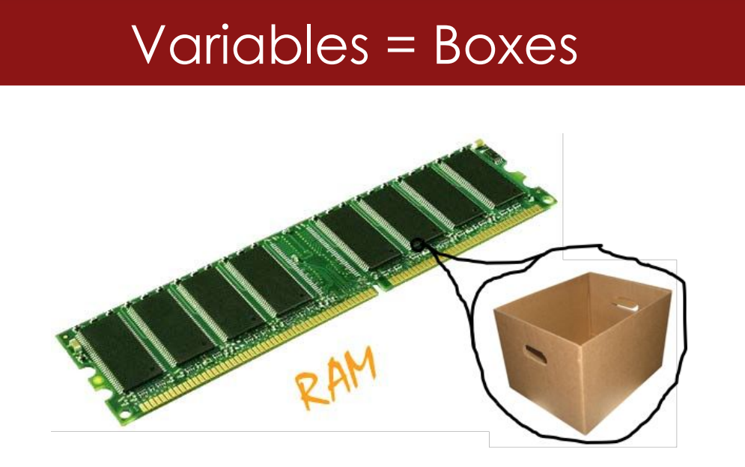
Variables
Variables are containers for storing data in your program. They have a type (e.g., int, String) and can be used to represent various types of information.

Slide 3
Primitive Data Types
byte:
  Size: 8 bits
  Range: -128 to 127
short:
  Size: 16 bits
  Range: -32,768 to 32,767
int:
  Size: 32 bits
  Range: -2^31 to 2^31 - 1
long:
  Size: 64 bits
  Range: -2^63 to 2^63 – 1
float:
  Size: 32 bits
  Range: Approximately ±3.4e^38 (7 significant digits)
double:
  Size: 64 bits
  Range: Approximately ±1.8e^308 (15 significant digits)
char:
  Size: 16 bits
  Represents a single Unicode character
boolean:
  Represents true or false
These primitive data types are the building blocks for storing numeric and boolean values in Java. It's important to choose the appropriate data type based on the range and precision needed for a particular variable.

Slide 4
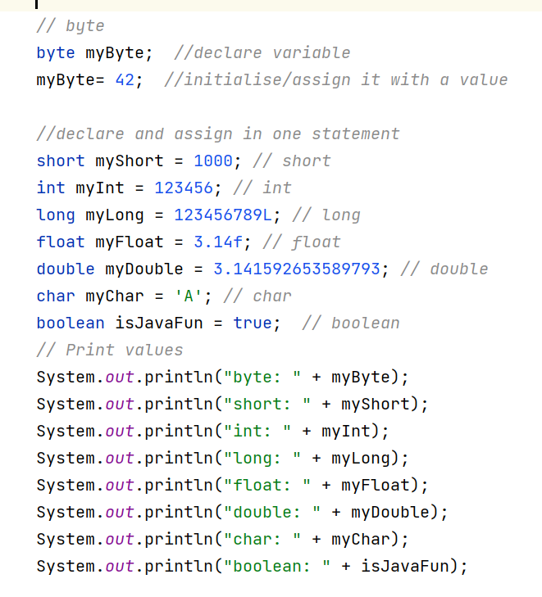
Code Example

Slide 5
Variable Exercise
Declare an integer variable named myAge and initialise it with your age.
Declare a String variable named myName and initialise it with your name.
Print both variables to the console.

Slide 6
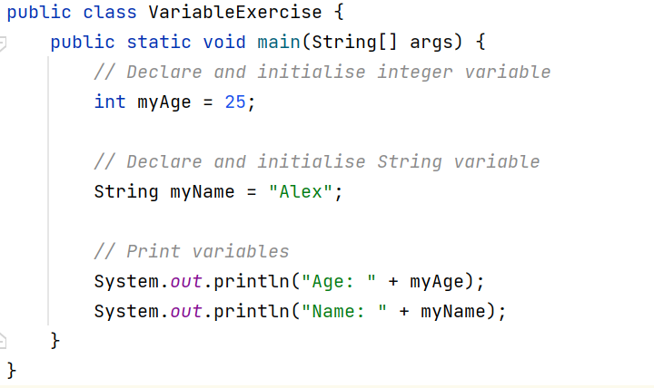
Variable Solution

Slide 7
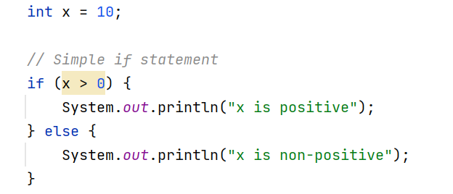
Selection (if statement)
The 'if' statement allows us to make decisions in our code based on conditions. If a condition is true, one set of statements executes; otherwise, another set executes.

Slide 8



Exercise – if statement
Write a Java program that takes a user's age as input and prints "You are a minor" if the age is less than 18; otherwise, print "You are an adult."

Slide 9
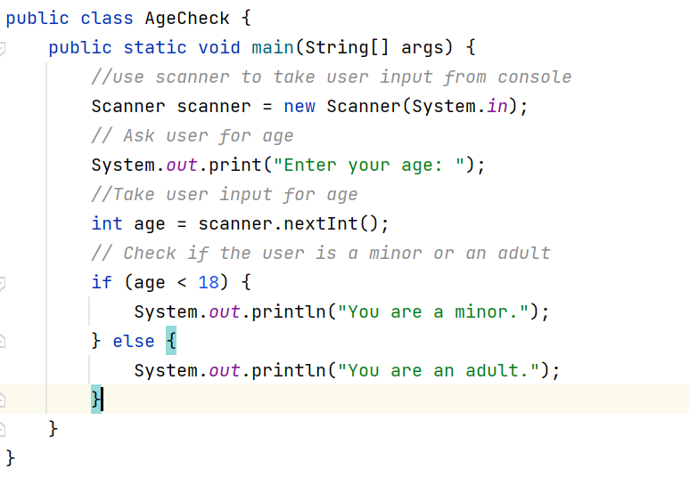
Solution – if statement

Slide 10
Iteration in Java
Loops are essential for repeating actions in your code.
We learnt about :
  for loop
  while loop
  do-while loop.

Slide 11
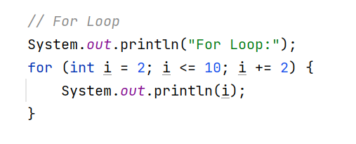
For loop

Slide 12
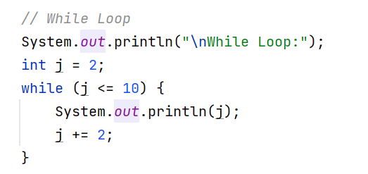
While Loop

Slide 13
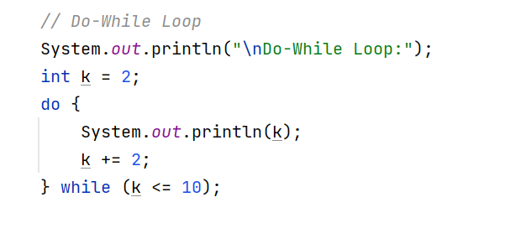
Do - While Loop

Slide 14
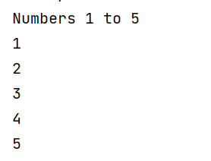
Exercise - Loop
Use a loop to print the numbers from 1 to 5 (inclusive) to the console.

Slide 15
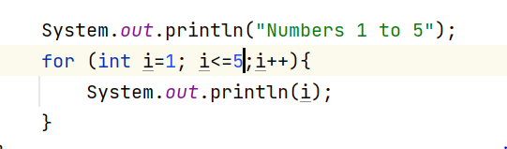
Solution – loop
Using for loop

Slide 16
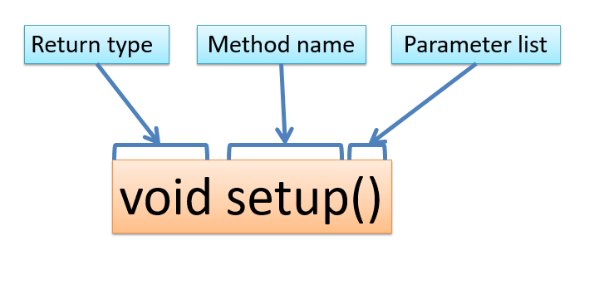
Functions in Java (Methods)
Functions, or methods in Java, are blocks of code that perform a specific task. They promote code modularity and reusability.

Slide 17
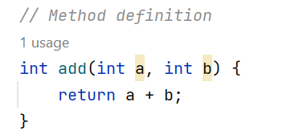
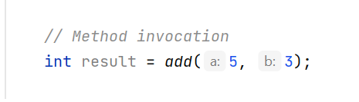
Method Definition and use

Slide 18
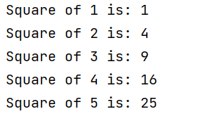
Exercise - Methods
Create a method called calculateSquare that takes an integer parameter and returns its square. Use this method to calculate and print the squares of the numbers 1 to 5.

Slide 19
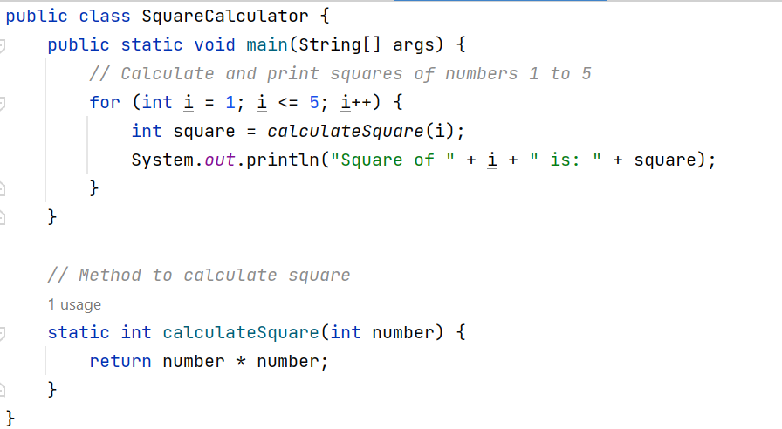
Solution - Methods

Slide 20
Understanding the 'static' Keyword
The 'static' keyword is used in Java for class-level elements. Static variables are shared among all instances of a class, and static methods belong to the class rather than an instance.

Slide 21
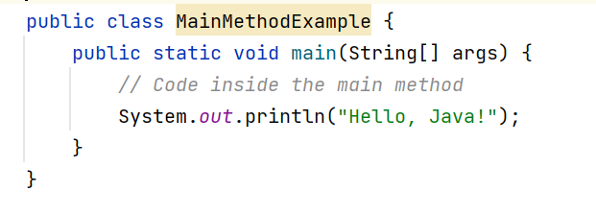
The Main Method in Java
public: The main method must be declared as public so that it can be accessed by the Java runtime environment when starting the program.
static: The main method is declared as static to allow it to be called without creating an instance of the class. This is necessary because the Java runtime environment invokes the main method directly.
void: The main method does not return any value (returns void). It is meant to execute a series of statements and does not produce a result.
main: The name of the method. It serves as the entry point for the Java program.
(String[] args): The method parameter. args is an array of strings that can be used to pass command-line arguments when running the Java program.

Slide 22
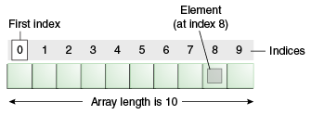
Arrays
Arrays allow us to store multiple values of the same type under a single name.

Slide 23
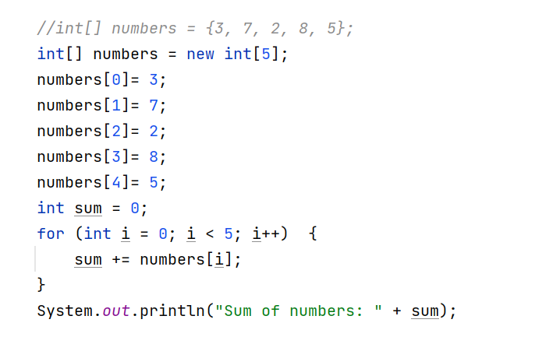
Arrays Example

Slide 24
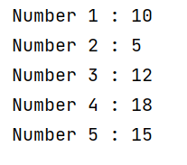
Exercise - Array
Declare an array of integers named numbers with values 10, 5, 12, 18, and 15. Write a loop to print each of these numbers

Slide 25
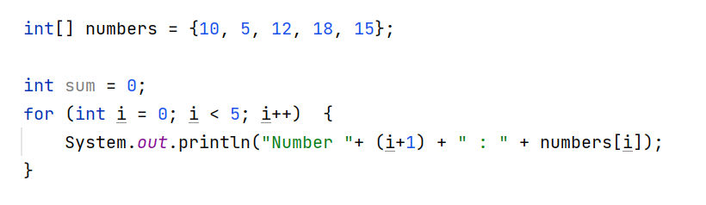
Solution - Array

Slide 26
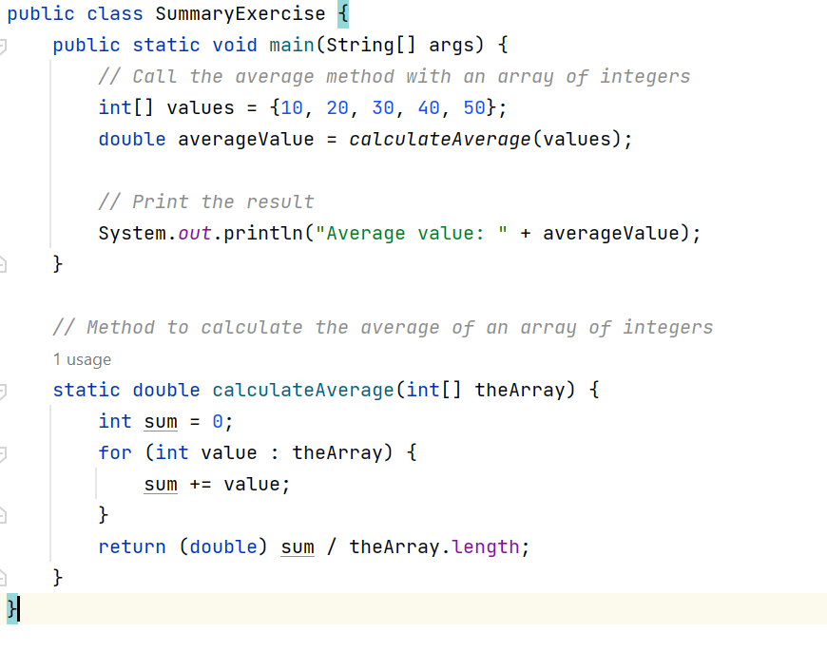
Summary

Slide 27

Questions?

