Slide 1

Iteration in Programming
while loops and loop control variable
Produced
by:
Ms. Mairead Meagher
Dr. Siobhán Drohan
Ms Siobhan Roche
Department of Computing and Mathematics
http://www.setu.ie/

Slide 2
Topics list
Repetition in Programming – Intro to looping
Use of loops (while loops).

Slide 3
Recap: Boolean conditions
A boolean condition is an expression that evaluates to either true or false e.g.
x<50
Boolean conditions can be used to control:
  Selection i.e. if statements and
  Iteration i.e. loops (we will look at these now).

Slide 4
Repetition in Programming
Computers are very good at repetition.
Example:
  calculate pay for 1000 employees.
  You should use the same calculate pay algorithm 1000 times.
  You don’t write the calculate pay algorithm 1000 times; instead you include it in a loop.

Slide 5
Form of loop
Write the all the numbers between 1 and 5 inclusive
  Without loop:
  System.out.println(1);
  System.out.println(2);
  System.out.println(3);
  System.out.println(4);
  System.out.println(5);

Slide 6
Form of loop
Write the all the numbers between 1 and 5 inclusive
  With a loop:
    do this 5 times
  System.out.println(i);
  With the value of i going from 1 to 5
    (We’ll revisit this at the end of the slides)
Notes:
We add 20 because its 10 for the height of the rectangle +10 for the gap

Slide 7
Topics list
Repetition in Programming – Intro to looping
Use of loops (while loops).

Slide 8
Loops in Programming
There are three types of loop in (Java) programming:
  while loops
  for loops
  do while loops

Slide 9
while loop pseudo code
General form of a while loop
while keyword
boolean condition
while(loop condition) {
loop body
}
Statements to be repeated
Pseudo-code expression of the actions of a while loop
while we wish to continue, do the things in the loop body

Slide 10
Construction of while loop
Declare and initialise loop control variable (LCV)
while(boolean condition based on LCV is true)
{
“do the job to be repeated”
“update the LCV”
}
This structure should always be used
Notes:
The “update the LCV” should always update it so that the Boolean condition will eventually evaluation to false.

Slide 11
while loop Flowchart
true
int i = 1; //i is the LCV
while(i <=5)
{
System.out.println(i);
i++;
}
boolean
condition?
statement(s)
false

Slide 12

Example - while
Declare and initialise loop control variable (LCV)
while(boolean condition based on LCV is true)
{
“do the job to be repeated”
“update the LCV”
}
int i = 1; //i is the LCV
while(i <=5)
{
System.out.println(i);
i++;
}
Notes:
int yCoordinate = 60;
size(600, 300);
background(102);
fill(255);
noStroke();
int i = 0;
while(i < 4)
{
rect(50, yCoordinate, 500, 10);
yCoordinate += 20;
i++;
}

Slide 13
Example – while
1. Declare and initialise loop control variable (LCV)
int i = 1; //i is the LCV
while(i <=5)
{
System.out.println(i);
i++;
}
2. boolean condition based on LCV
“do the job to be repeated”
“update the LCV”
Notes:
int yCoordinate = 60;
size(600, 300);
background(102);
fill(255);
noStroke();
int i = 0;
while(i < 4)
{
rect(50, yCoordinate, 500, 10);
yCoordinate += 20;
i++;
}

Slide 14
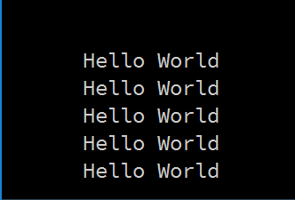
Some Study Exercises
This basic while loop, produces this output.
  int i = 1;
  while (i <=5)
  {
  System.out.println("Hello World");
  i++;
  }

Slide 15
Form of loop - revisited
Write the all the numbers between 1 and 5 inclusive
  With a loop:
    do this 5 times
  System.out.println(i);
  With the value of i going from 1 to 5
Notes:
We add 20 because its 10 for the height of the rectangle +10 for the gap

Slide 16
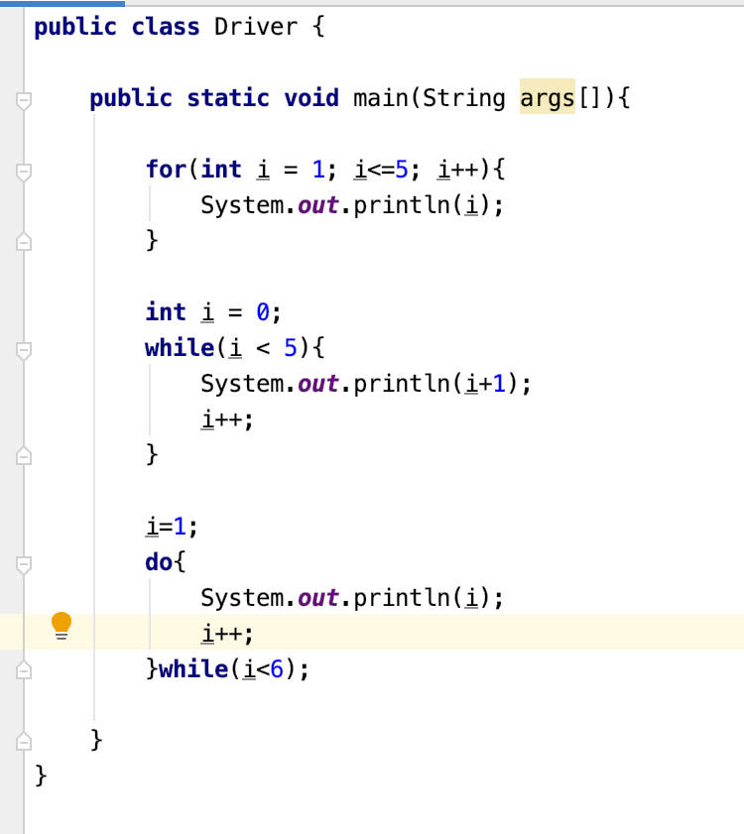
Solution – Whats the difference?

Slide 17
Some Study Exercises
Change the code so that “Hello World” is printed out 10 times.
Change the code so that the numbers from 1 to 10 (inclusive) are printed out, one line at a time.
Change the code so that the numbers from 10 to 1 are printed out.

Slide 18

Questions?

