Slide 1

Menu Driven Apps
Loops, menus and the switch statement
Produced
by:
Ms. Maireád Meagher
Dr. Siobhán Drohan
Ms Siobhan Roche
Department of Computing and Mathematics
http://www.setu.ie/

Slide 2
Topics list
Loops
  Loop Control Variables
  Arrays and counter controlled loops
  Arrays and sentinel based loops
  Arrays and flag-based loops
switch statement.
A simple menu using switch.
ShopV3.0 – adding a menu.

Slide 3
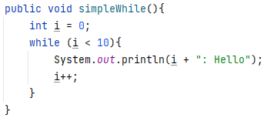
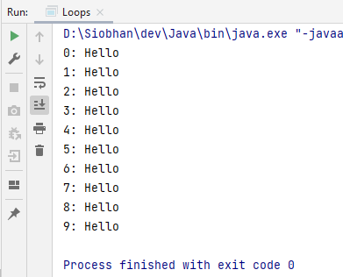
Recap - Loop Control Variable
This loop is a counter-controlled while loop
1. Initialise
2. Test i.e. boolean condition
3. Update directly before end of loop
Notes:
public class Loops {
public static void main(String args[]){
new Loops();
}
public Loops(){
simpleWhile();
}
public void simpleWhile(){
int i = 0;
while (i < 10){
System.out.println(i);
i++;
}
}
}

Slide 4
Topics list
Loops
  Loop Control Variables
  Arrays and counter controlled loops
  Arrays and sentinel based loops
  Arrays and flag-based loops
switch statement.
A simple menu using switch.
ShopV3.0 – adding a menu.

Slide 5
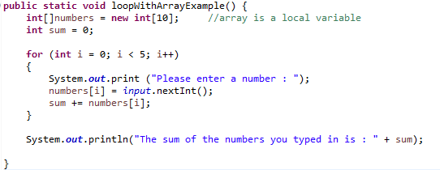
Recap - Counter-Controlled for Loop

Slide 6
Recap - Counter-Controlled Loops
Sometimes we know when we are coding, we know how many inputs we will have.
The previous slide displays an example of this.
Other times, we find out at run time how many inputs we have…an example of this is on the next slide.

Slide 7
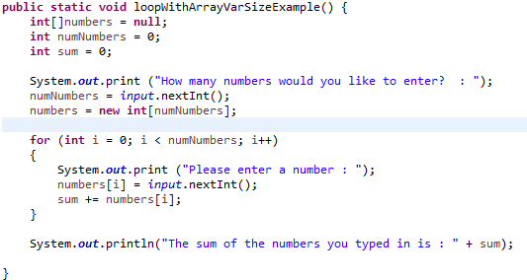
Recap - Counter-Controlled for Loop
Here, we know at run-time how many inputs we have.

Slide 8
Topics list
Loops
  Loop Control Variables
  Arrays and counter controlled loops
  Arrays and sentinel based loops
  Arrays and flag-based loops
switch statement.
A simple menu using switch.
ShopV3.0 – adding a menu.

Slide 9
Sentinel-based loops
Use this type of loop when you do not know how many inputs you will have.
The end of input is signalled by a special value.
  e.g. if you are calculating the ‘average of ages of people in the room’, write a program that will continually take in ages until, say, -1 is entered.
  -1 would be the sentinel value.

Slide 10
Structure
Concept of Loop Control Variable is vital here.
The loop continuation is solely based on the input, so the variable containing the information is the Loop Control Variable.
Initialise the Loop Control Variable before entry into the loop.
Remember to ‘update the Loop Control Variable’ just before the end of the loop.

Slide 11
Try this exercise
Write a loop to read in and add up a set of integers. Keep going until the value ‘-1’ is inputted.
What is your Loop Control Variable?
Note: in this exercise, you do not need to store the values in an array…we will do this in a few slides time.

Slide 12
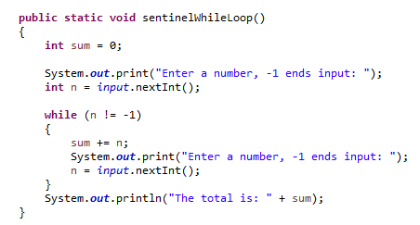
Solution
1. Initialise
2. LCV Condition
3. Update LCV directly before end of loop

Slide 13
Next step in the exercise
We need to record how many inputs have happened.
Try to change the previous solution so that you know at the end how many numbers have been inputted.
At the end, print the sum and number of inputs.

Slide 14
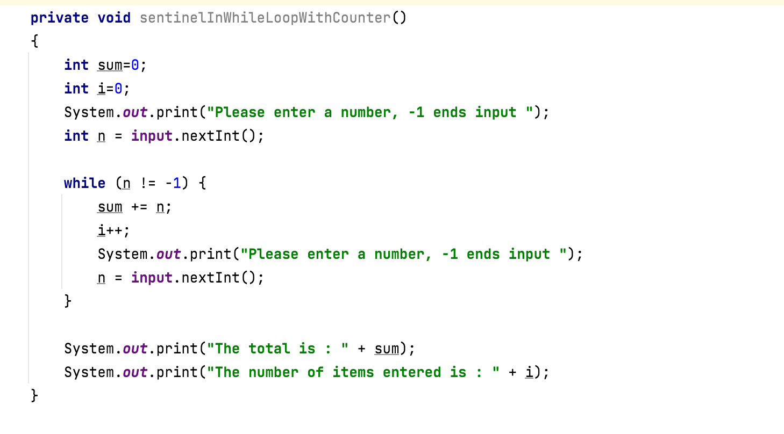
Code with number of inputs

Slide 15
Try this now - using arrays
Same structure as before, but now we want to store the input.
Re-write the code on the previous slide, but store the data in an array.
NOTE:
  Assume the max number of inputs possible is 100 (i.e. size of array).
  We also need to know how many inputs actually happened.

Slide 16
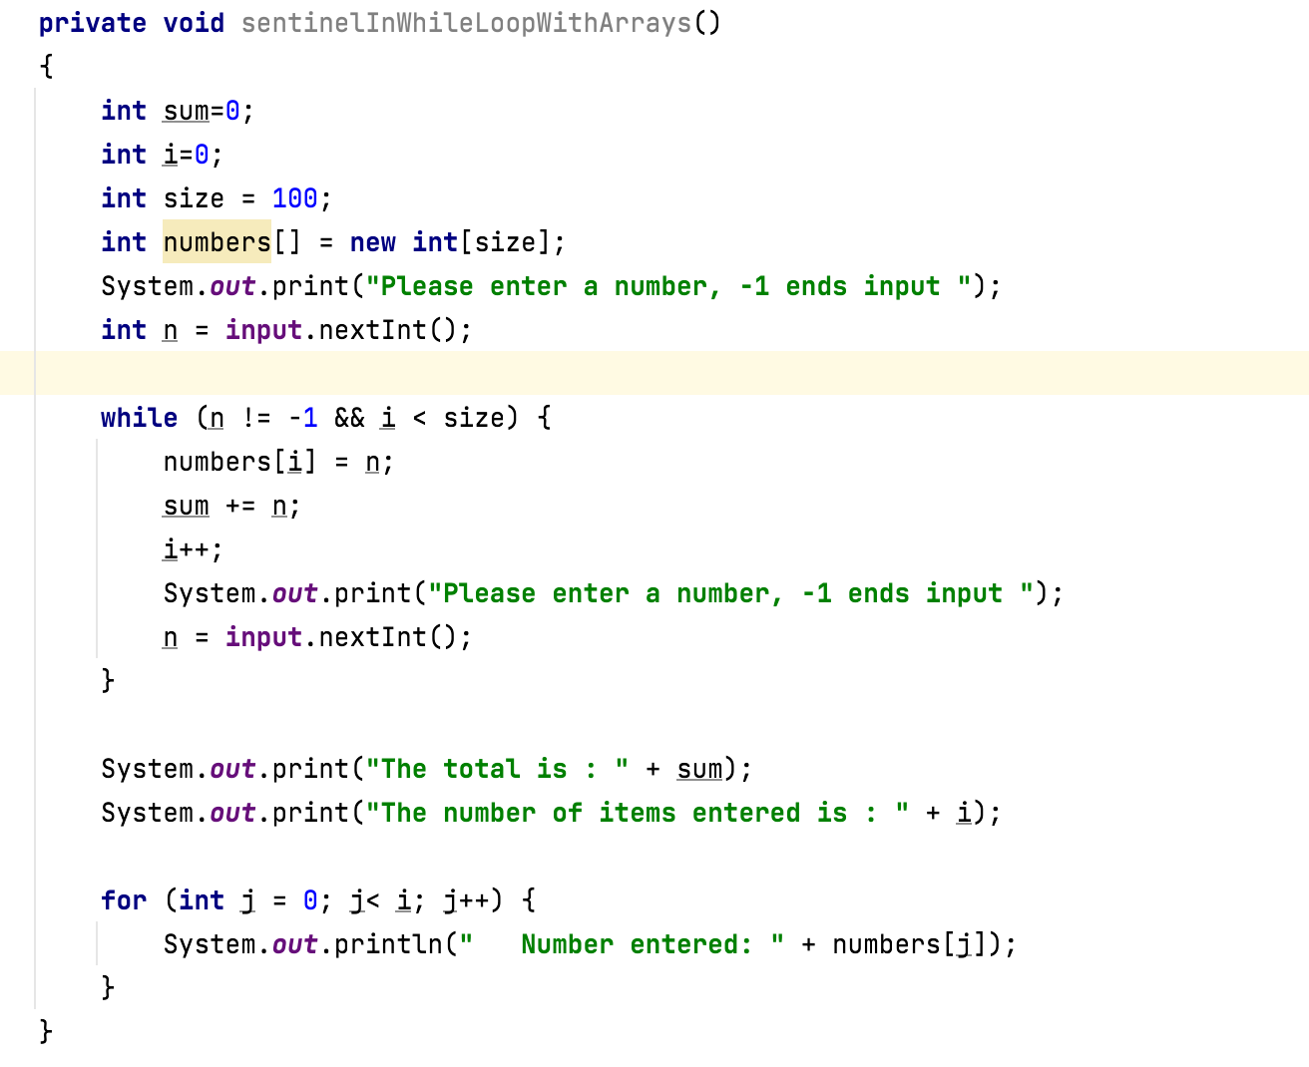
Solution – storing inputs

Slide 17
Topics list
Loops
  Loop Control Variables
  Arrays and counter controlled loops
  Arrays and sentinel based loops
  Arrays and flag-based loops
switch statement.
A simple menu using switch.
ShopV3.0 – adding a menu.

Slide 18
Flag-Based Loops
These are used when you want to examine a collection of data to check for a property. Once a property has been established, it cannot be ‘unestablished’.
‘Once the flag is raised, it cannot be taken down’
e.g. to check if any of the numbers in an array is odd.
Once we have found any odd number the ‘found odd’ property is established. We never should change that property back

Slide 19
Flag-Based Loops - example
Given a populated array of numbers, cycle over the array to see if any numbers are odd.
If you find:
  At least one odd number, print out to the user that there is at least one odd number.
  No odd numbers, inform the user of this.

Slide 20
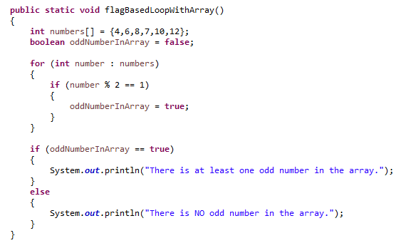
Solution: check if ‘any numbers odd’

Slide 21
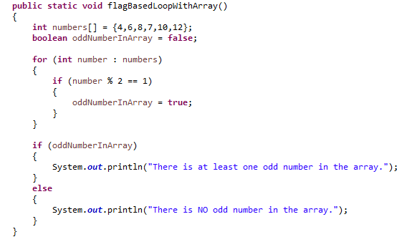
Better code...
Use of boolean variable in condition

Slide 22
What about having a
flag-based loop in a method with a
boolean return type?

Slide 23
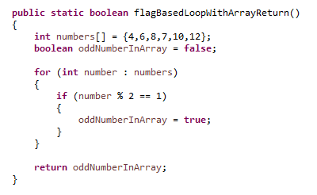
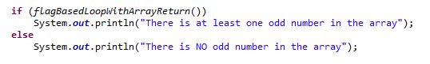
Code with boolean return type
Calling the method and handling the returned boolean

Slide 24
Topics list
Loops
  Loop Control Variables
  Arrays and counter controlled loops
  Arrays and sentinel based loops
  Arrays and flag-based loops
switch statement.
A simple menu using switch.
ShopV3.0 – adding a menu.

Slide 25
The switch statement
The switch statement works in exactly the same way as a set of if statements,
but is more compact and readable.
The switch statement switches on a single value to one of an arbitrary number of cases.
We have used the switch statement before – now we can look at it in more details.

Slide 26
The switch statement

Slide 27
The switch statement
A switch statement can have any number of case labels.
The default case is optional; if no default is given, it may happen that no case is executed.
Can switch on int, char or String.
Good Resource: https://blog.codeleak.pl/2020/05/switch-as-an-expression-in-java.html

Slide 28
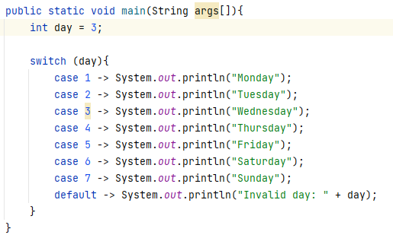
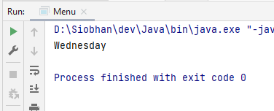
The switch statement – int example
Notes:
private static void intSwitch(){
int day = 3;
switch (day){
case 1 -> System.out.println("Monday");
case 2 -> System.out.println("Tuesday");
case 3 -> System.out.println("Wednesday");
case 4 -> System.out.println("Thursday");
case 5 -> System.out.println("Friday");
case 6 -> System.out.println("Saturday");
case 7 -> System.out.println("Sunday");
default -> System.out.println("Invalid day: " + day);
}
}

Slide 29
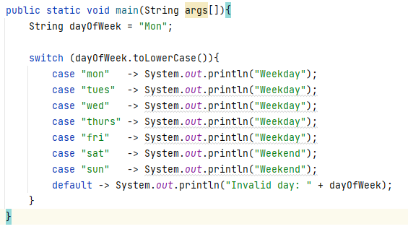
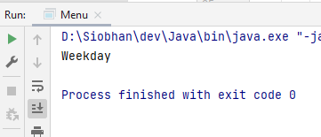
The switch statement – String example
Notes:
private static void stringSwitchLong(){
String dayOfWeek = "Mon";
switch (dayOfWeek.toLowerCase()){
case "mon" -> System.out.println("Weekday");
case "tues" -> System.out.println("Weekday");
case "wed" -> System.out.println("Weekday");
case "thurs" -> System.out.println("Weekday");
case "fri" -> System.out.println("Weekday");
case "sat" -> System.out.println("Weekend");
case "sun" -> System.out.println("Weekend");
default -> System.out.println("Invalid day: " + dayOfWeek);
}
}

Slide 30
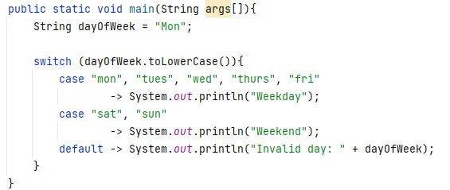
The switch statement – String example
DRY code – Don’t Repeat Yourself!
Notes:
private static void stringSwitchCondensed(){
String dayOfWeek = "Mon";
switch (dayOfWeek.toLowerCase()){
case "mon", "tues", "wed", "thurs", "fri"
-> System.out.println("Weekday");
case "sat", "sun" -> System.out.println("Weekend");
default -> System.out.println("Invalid day: " + dayOfWeek);
}
}

Slide 31
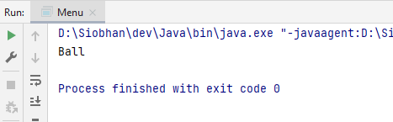
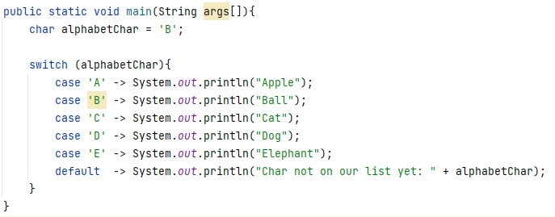
The switch statement – char example
Notes:
private static void charSwitch(){
char alphabetChar = 'B';
switch (alphabetChar){
case 'A' -> System.out.println("Apple");
case 'B' -> System.out.println("Ball");
case 'C' -> System.out.println("Cat");
case 'D' -> System.out.println("Dog");
case 'E' -> System.out.println("Elephant");
default -> System.out.println("Char not on our list yet: " + alphabetChar);
}
}

Slide 32
Topics list
Loops
  Loop Control Variables
  Arrays and counter controlled loops
  Arrays and sentinel based loops
  Arrays and flag-based loops
switch statement.
A simple menu using switch.
ShopV3.0 – adding a menu.

Slide 33
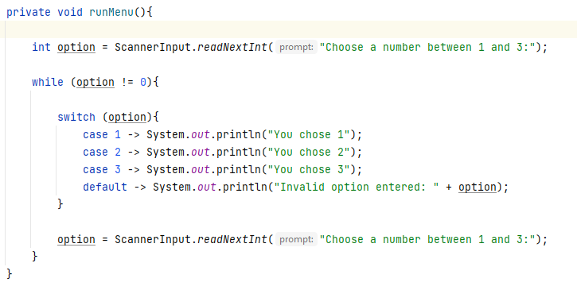
Now loop on the switch statement
Note the use of the Loop Control Variable, option.

Slide 34
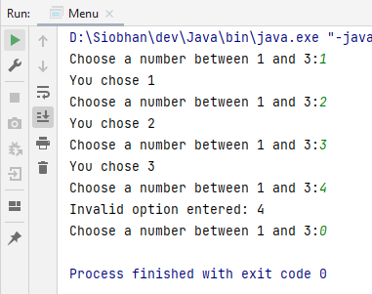
This gives the following output
Notes:
private void runMenu(){
int option = ScannerInput.readNextInt("Choose a number between 1 and 3:");
while (option != 0){
switch (option){
case 1 -> System.out.println("You chose 1");
case 2 -> System.out.println("You chose 2");
case 3 -> System.out.println("You chose 3");
default -> System.out.println("Invalid option entered: " + option);
}
option = ScannerInput.readNextInt("Choose a number between 1 and 3:");
}
}

Slide 35
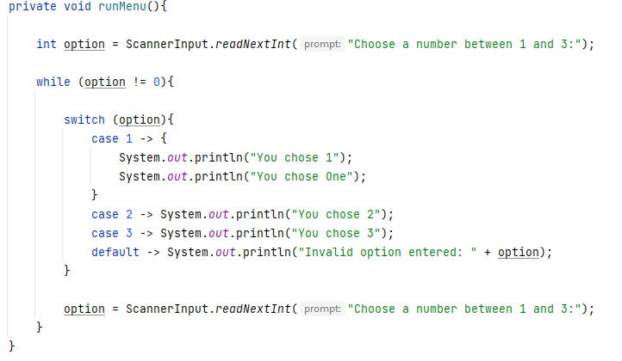
If you wanted more than one line of code associated with a case, just declare a code block:

Slide 36
Topics list
Loops
  Loop Control Variables
  Arrays and counter controlled loops
  Arrays and sentinel based loops
  Arrays and flag-based loops
switch statement.
A simple menu using switch.
ShopV3.0 – adding a menu.

Slide 37
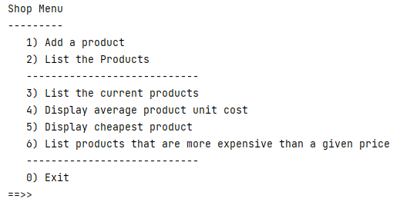
Adding a basic menu to Shop…

Slide 38
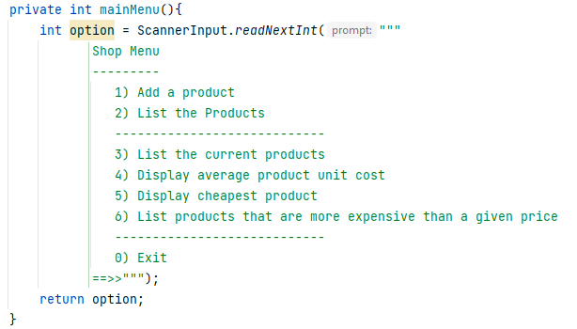
Menu to be displayed…
Driver Class

Slide 39
Menu to be displayed…
Driver Class
We are using Raw Strings (the triple double quotes) to format the output for the menu.
This is a newish feature in Java – if it doesn’t work, update your JDK.

Slide 40
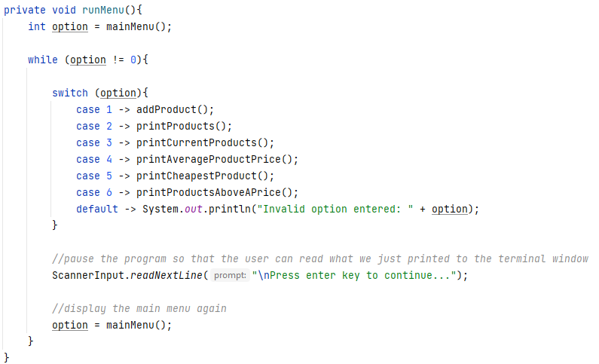
Handling the menu input…
Driver Class

Slide 41
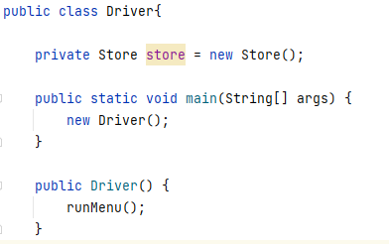
Calling the menu on startup…
Driver Class

Slide 42
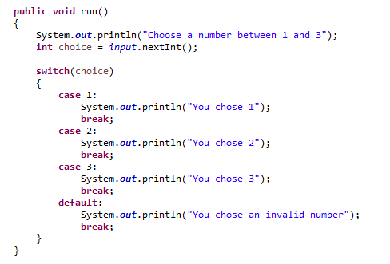
NOTE: A simple menu using the older format of the switch statement
A break statement is needed after each case, otherwise execution “falls” into the next statement regardless.
You should use the newer version

Slide 43

Questions?

