Slide 1

Some miscellaneous concepts
Static Variables & Methods, Javadoc and Calculated Data
Produced
by:
Ms. Mairéad Meagher
Dr. Siobhán Drohan
Ms Siobhan Roche
Department of Computing and Mathematics
http://www.setu.ie/

Slide 2
Topic List
Static Variables
Static Methods
Javadoc
Storing calculated data

Slide 3
Instance vs Static (Class) Variables
Instance
Static
Multiple objects created from the same class blueprint,
each have their own distinct copies of instance variables.
For variables that are common to all objects (instances)
Use the static modi fier.
Fields that have the static modifier in their declaration are called:
static fields
or
class variables.
https://docs.oracle.com/javase/tutorial/java/javaOO/classvars.html

Slide 4
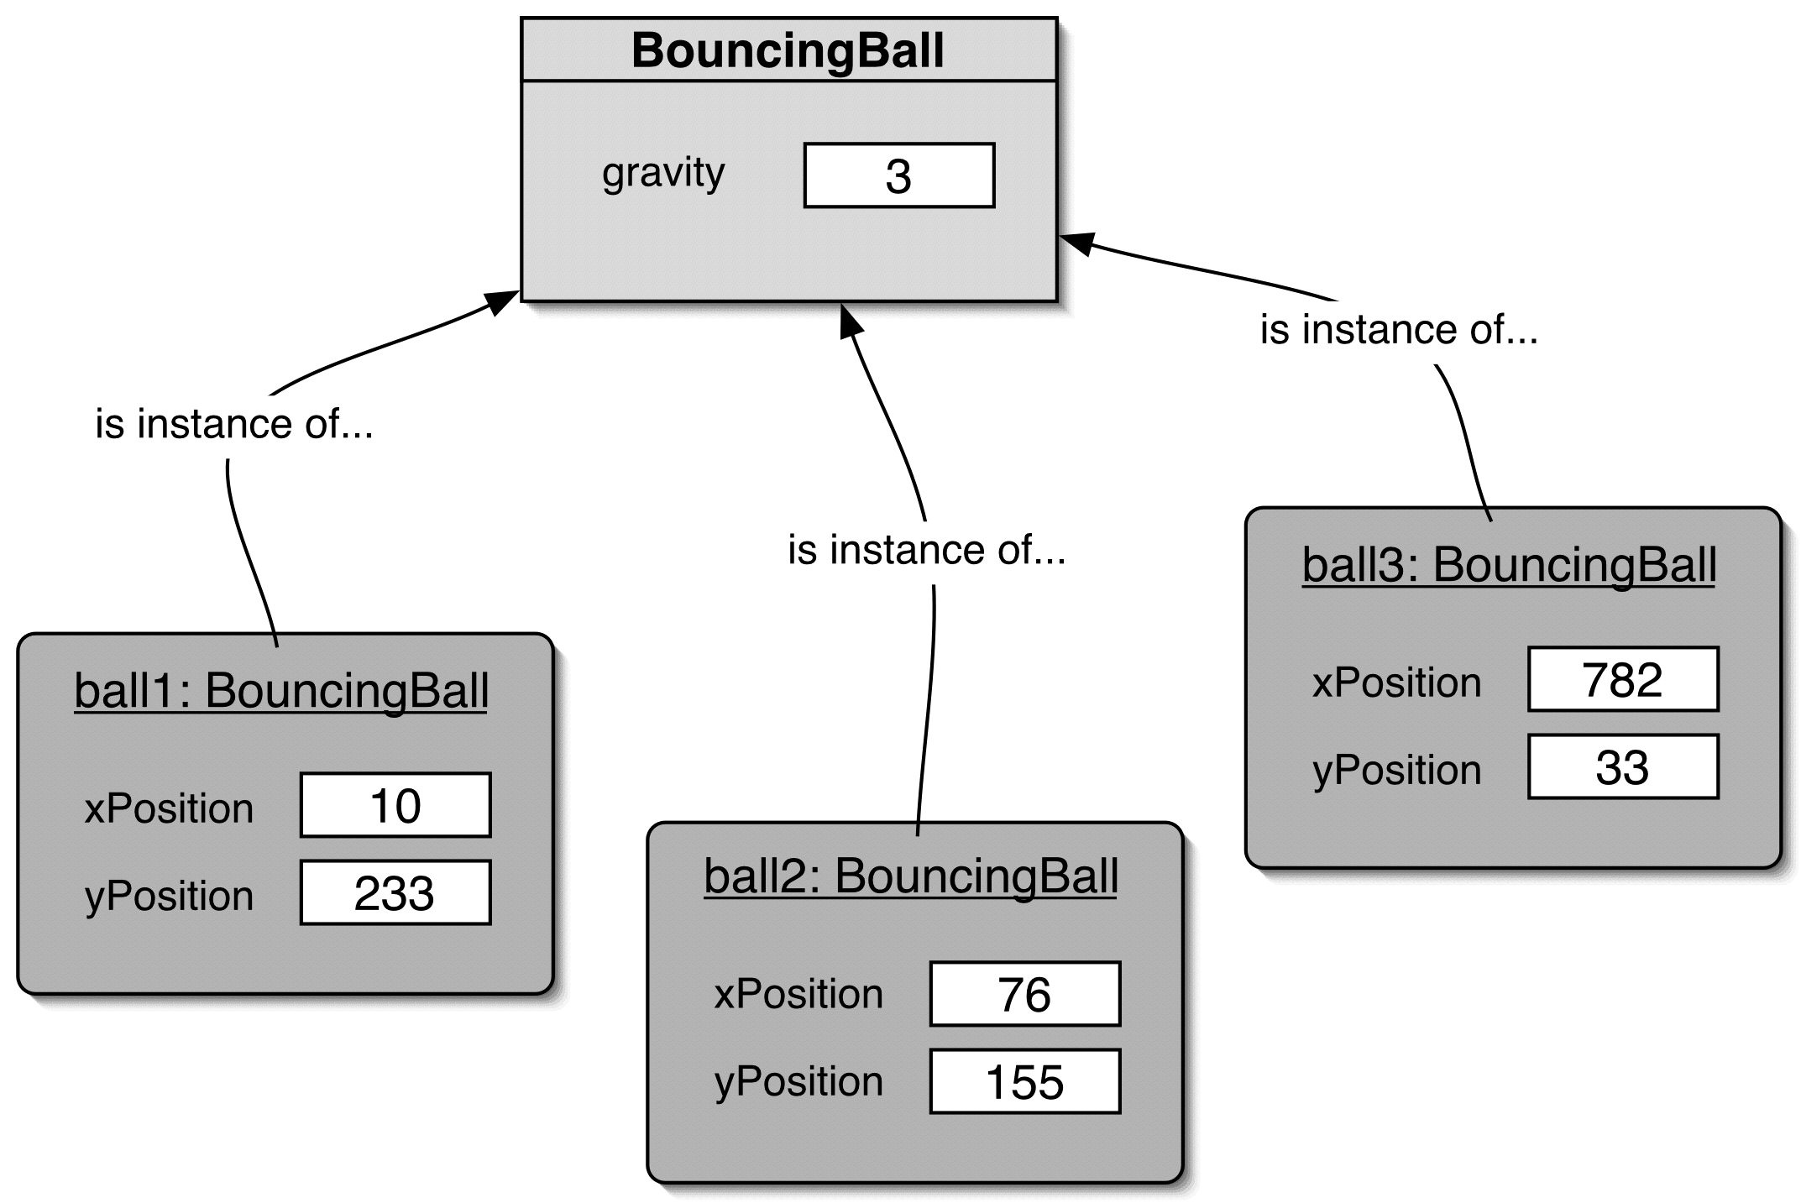
Instance vs Static (Class) Variables
private static int gravity = 3;

Slide 5
CONSTANTS
private static final int GRAVITY = 3;
private : access modifier, as usual
static : class variable
final : constant (cannot change the value).
*Naming standard for final fields is ALL CAPITALS.

Slide 6
Topic List
Static Variables
Static Methods
Javadoc
Storing calculated data

Slide 7
Static Methods
Java supports static methods
as well as static variables.
Static methods
  have the static modifier in their declarations
  should be invoked with the class name,
  without the need for creating an instance of the class, as in:
ClassName.methodName(args)

Slide 8

Static Methods
private static int gravity = 3;
public static int getGravity()
{
return gravity;
}
A common use for static methods is to access static fields.
  E.g. we could add a static method to the BouncingBall class to access the gravity static field:
Notes:
int g = BouncingBall.getGravity();

Slide 9
Topic List
Static Variables
Static Methods
Javadoc
Storing calculated data

Slide 10

Writing class documentation
Your own classes should be documented the same way library classes are.
Other people should be able to use your class without reading the implementation.
Make your class a 'library class'!

Slide 11
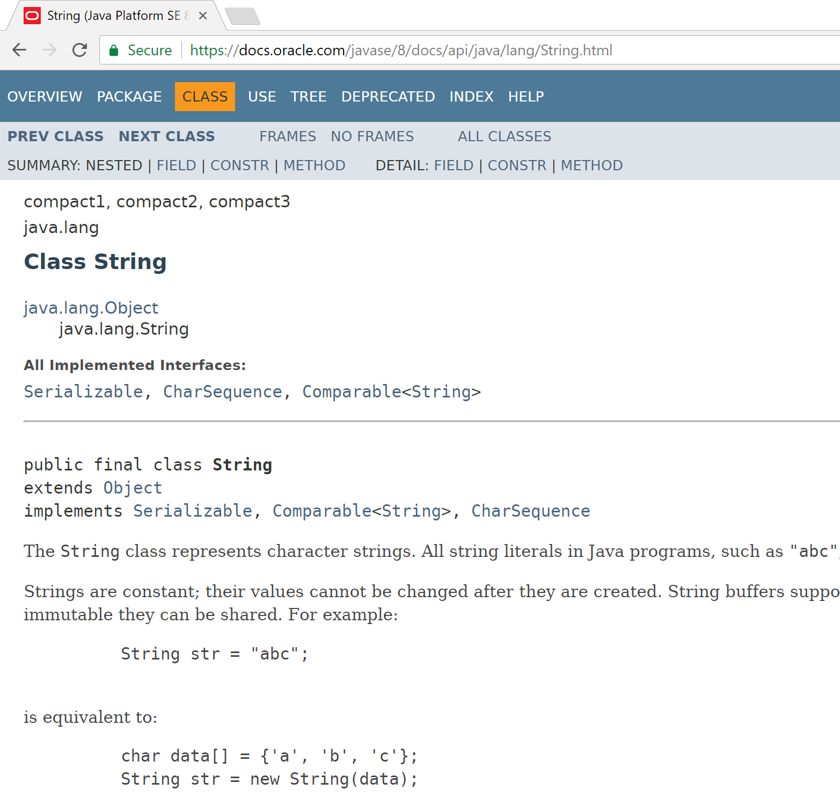
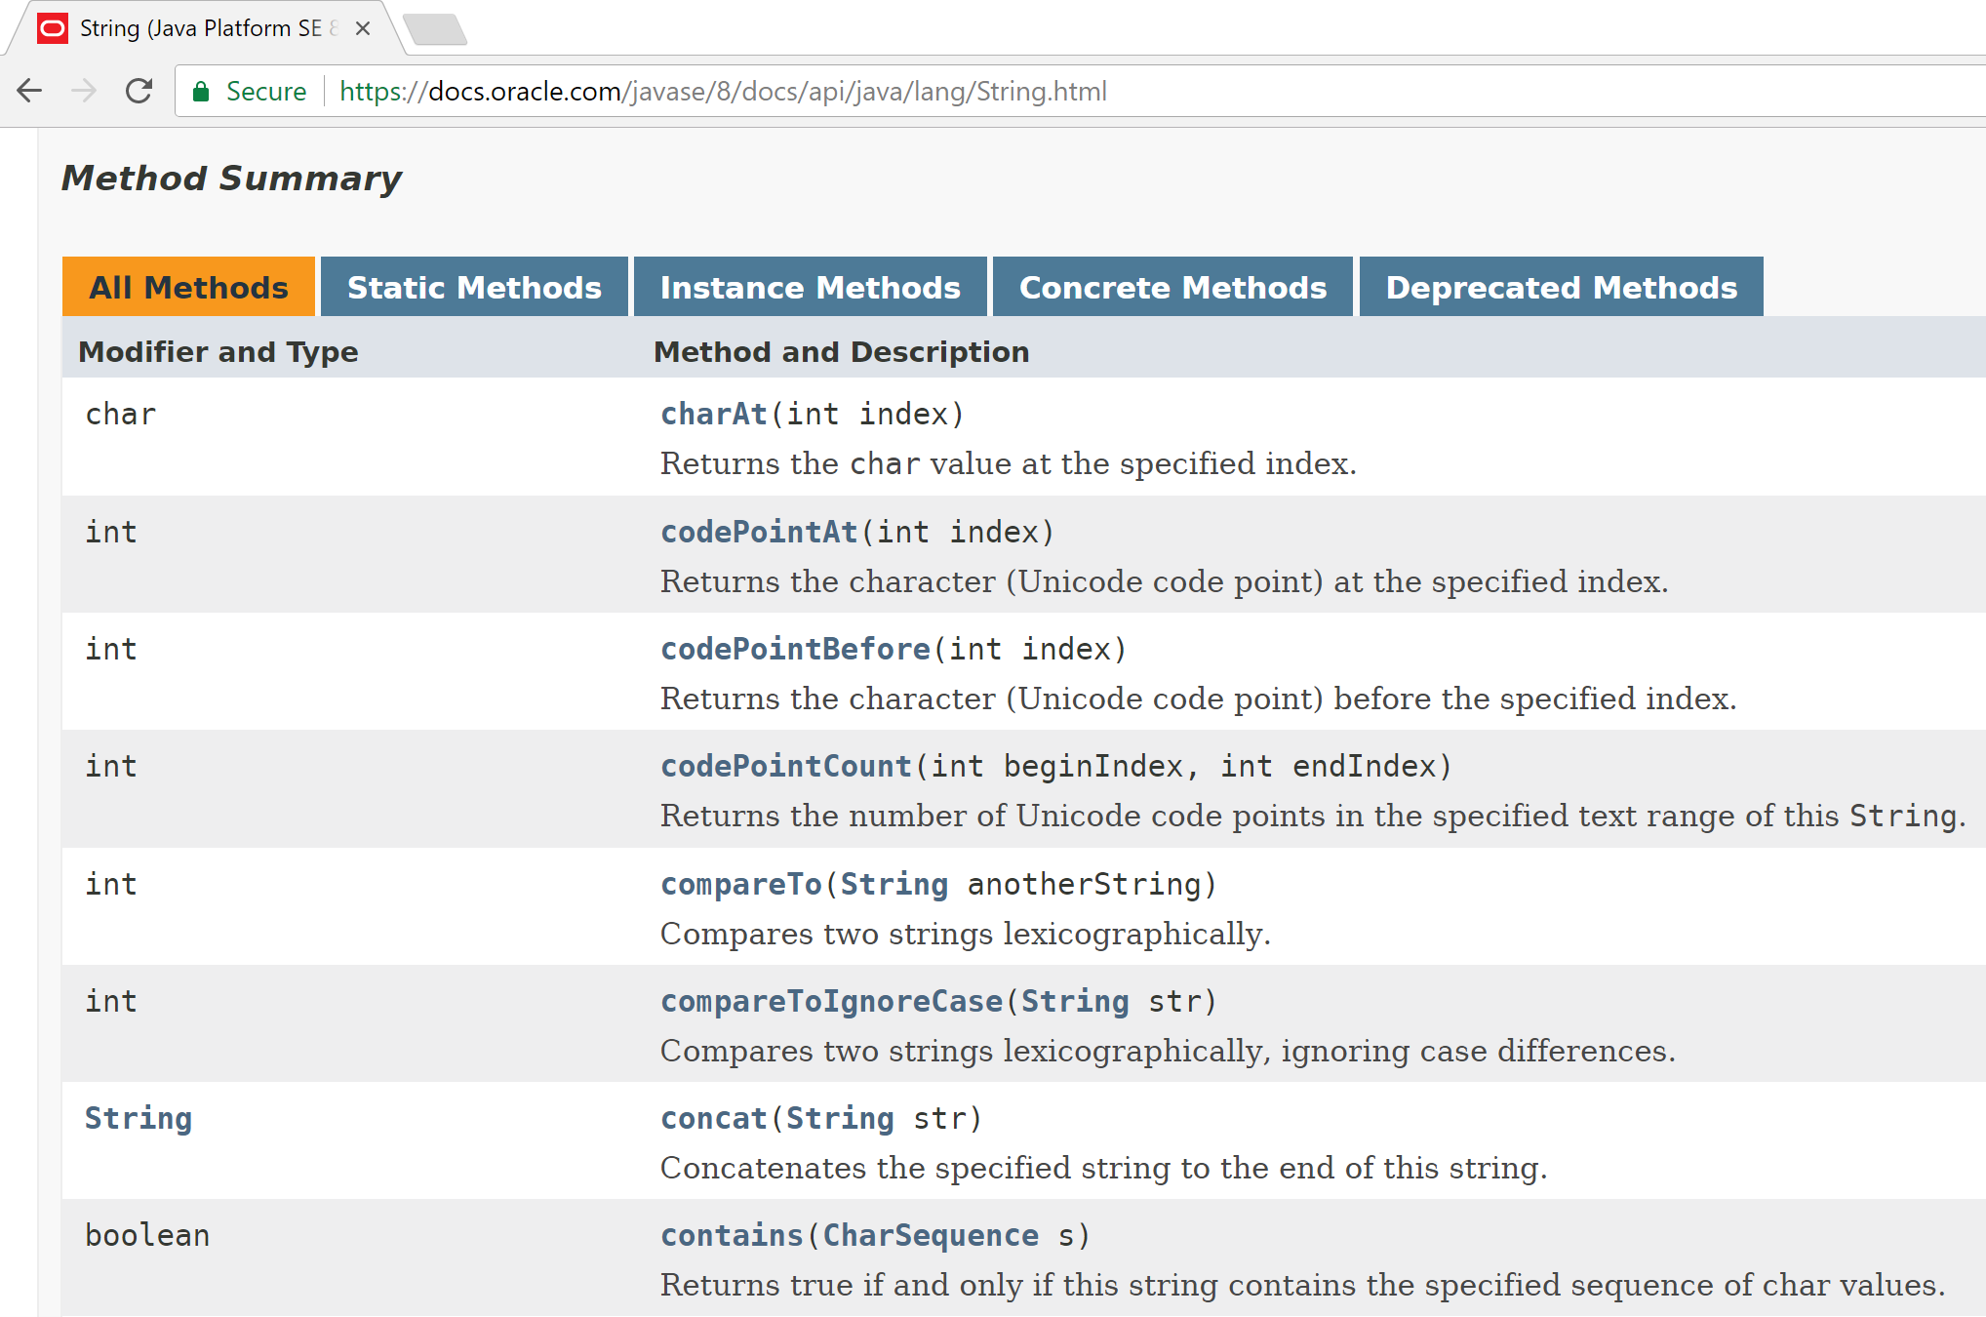
Example of Library Documentation

Slide 12
Elements of documentation - class
Documentation for a class should include:
class name
comment describing the overall purpose and characteristics of the class
version number
authors’ names
constructor documentation (for all constructors)
method documentation (for all methods)

Slide 13
Elements of documentation - methods
The documentation for each constructor and method should include:
  method name
  return type
  return value description
  method purpose and function description
  parameter names and types
  parameter description (for each parameter)

Slide 14
Javadoc
javadoc comment - start symbol:
/**
Immediately before a…
  class declaration is read as a class comment.
  method signature is read as a method comment.
Other special key symbols for formatting documentation include:
@version
@author
@param
@return

Slide 15
Javadoc
Class comment:
/**
* The Responder class represents a response
* generator object. It is used to generate an
* automatic response.
*
* @author Michael Kölling and David J. Barnes
* @version 1.0 (30.Mar.2006)
*/

Slide 16
Javadoc
Method comment:
/**
* Read a line of text from standard input (the text
* terminal), and return it as a set of words.
*
* @param prompt A prompt to print to screen.
* @return A set of Strings, where each String is
* one of the words typed by the user
*/
public HashSet<String> getInput(String prompt)
{
...
}

Slide 17
Topic List
Static Variables
Static Methods
Javadoc
Storing calculated data

Slide 18
The danger lurking within!

Slide 19
Calculated data
netSalary is calculated data.
public class Employee
{
private double salary;
private double deductions;
private double netSalary;
//
//
public void calculateNetSalary()
{
netSalary = salary – deductions;
}
public void setSalary(double salary)
{
this.salary = salary;
}
}
!!! DATA INTEGRITY WARNING !!!
netSalary field can contain stale data.
Don’t store netSalary in a field
Calculate this when needed instead
calculateNetSalary()
NB: setSalary()
doesn’t recalculate the net salary?

Slide 20
Calculated data
public class Employee
{
private double salary;
private double deductions;
//
public double calculateNetSalary()
{
return (salary – deductions);
}
public void setSalary(double salary)
{
this.salary = salary;
}
}
netSalary field
is no longer declared.
calculateNetSalary()
now returns the result
of the calculation.
No calculated data is stored, so no stale data!

Slide 21
Summary
Static Variables
  Class variables
  Shared between multiple instances
  Add final turns it into a CONSTANT
Static Methods
  Used for accessing static variables
Javadoc
  Modifying comments means we can run the Javadoc compiler on our code to generate the documentation similar to Java library documentation
Storing calculated data
  Don’t!
  Write a method instead to calculate at runtime
  Avoids STALE data

Slide 22

Any Questions?

