Slide 1

Packages in Java
Using a derivation of the Model View Controller
Produced
by:
Dr. Siobhán Drohan
Ms. Mairead Meagher
Ms. Siobhan Roche
Department of Computing and Mathematics
http://www.setu.ie/

Slide 2
Using Packages
Evolving Shop to use a Package Structure

Slide 3
Why Packages?
We use folders or directories in our computers for the classification and accessibility of various files;
In Java, Packages are similar to folders, which are mainly used to organize classes and interfaces(we see interfaces later).

Slide 4
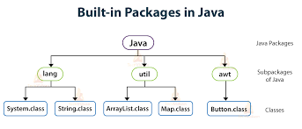
Why Packages?
Packages help us to write better and manageable code by preventing naming conflicts. Java provides some built-in packages which we can use:

Slide 5
Why Packages?
We can similarly structure our Projects to categorise our classes.
So how should we categorise our classes?
Much work has been done on ‘Design Patterns’

Slide 6
Design Patterns
A Design Pattern is an important concept in Computer Science.
A software design pattern is a general, reusable solution to a commonly occurring problem within a given context in software design. (Wikipedia)
Model-View Controller is an important one

Slide 7
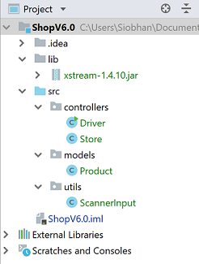
Our Structure
We break down our classes into the following sub-packages:
models – has the ‘bottom level’ classes, e.g. Product
controllers – this contains the classes that do the ‘heavy lifting’ and the user interface classes
utils – this contains any Utility classes

Slide 8
Shop – packages
We now look at the changes we need to make in the ‘packaged’ classes.

Slide 9
Accessing Packages or Classes from Another Package
If we want to access all the classes and interfaces of an existing package then we use the import statement. We can do it in three different ways:
import package.*;
  By using * after the import statement, we can access all the classes of the package but not the sub-packages.
import package.classname;
fully qualified name.

Slide 10
Shop – utilities and packages
Refactor your Shop project to create this package structure.
  Right-click on the src folder and select New → Package. Enter “models” as the package name.
  Repeat this process and create two other packages called “controllers” and “utils”.

Slide 11
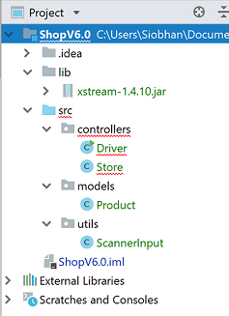
Shop – utilities and packages
Copy the Shop classes into package locations specified in the screen shot.

Slide 12
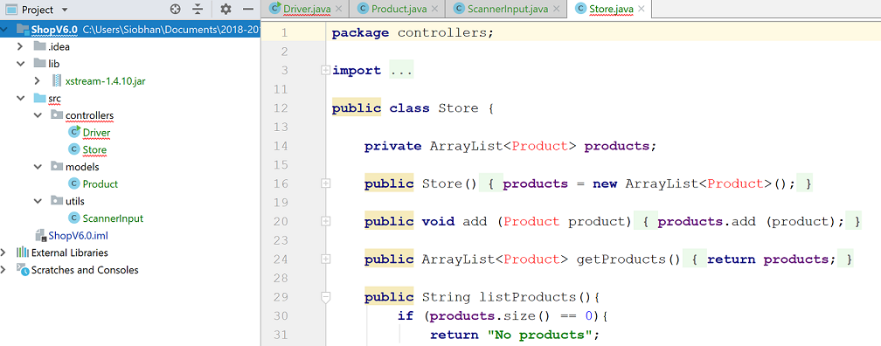
Shop – utilities and packages
This move caused the following error: The Product class can’t be found in the Driver and Store class.

Slide 13
Shop – utilities and packages
To fix this error, use IntelliJ’s Alt + Enter to:
import models.Product; into Driver and Store classes.
import utils.ScannerInput; into Driver.

Slide 14
Shop – utilities and packages
The errors are now gone.
Test the app to make sure it is running as expected.
We will use packages in this way for the remainder of the module.

Slide 15

Any Questions?

