Slide 1


Utilities
Creating reusable validation methods
Produced
by:
Dr. Siobhán Drohan
Ms. Mairéad Meagher
Ms. Siobhan Roche
Department of Computing and Mathematics
http://www.setu.ie/

Slide 2
Validating Product Code
Must be between 1000 and 9999 inclusive.
When a Product is instantiated and the productCode is not matching those values, productCode should be -1.
package models;
public class Product {
private String productName = "";
private int productCode = -1;
private double unitCost = 0;
private boolean inCurrentProductLine = false;
public Product(String productName, int productCode, double unitCost, boolean inCurrentProductLine) {
this.productName = productName;
if ((productCode >= 1000) && (productCode <= 9999)){
this.productCode = productCode;
}
this.unitCost = unitCost;
this.inCurrentProductLine = inCurrentProductLine;
}
public int getProductCode() {
return productCode;
}
public void setProductCode(int productCode) {
if ((productCode >= 1000) && (productCode <= 9999)){ {
this.productCode = productCode;
}
}
}

Slide 3
Validating Product Code
Repeated Code breaks the DRY principle. Don’t Repeat Yourself!
package models;
public class Product {
private String productName = "";
private int productCode = -1;
private double unitCost = 0;
private boolean inCurrentProductLine = false;
public Product(String productName, int productCode, double unitCost, boolean inCurrentProductLine) {
this.productName = productName;
if ((productCode >= 1000) && (productCode <= 9999)){
this.productCode = productCode;
}
this.unitCost = unitCost;
this.inCurrentProductLine = inCurrentProductLine;
}
public int getProductCode() {
return productCode;
}
public void setProductCode(int productCode) {
if ((productCode >= 1000) && (productCode <= 9999)){ {
this.productCode = productCode;
}
}
}

Slide 4

Utility Classes and Helper Methods
To avoid repeated code like this, we can write a “helper” method that will perform this validation for us.
We try to make these helper methods as RE-USABLE as possible.
We generally store these RE-USABLE helper methods in Utility classes.
These Utility classes can then be reused in any of our future projects.
Any project can have any number of Utility classes e.g. ScannerInput is a Utility class!

Slide 5
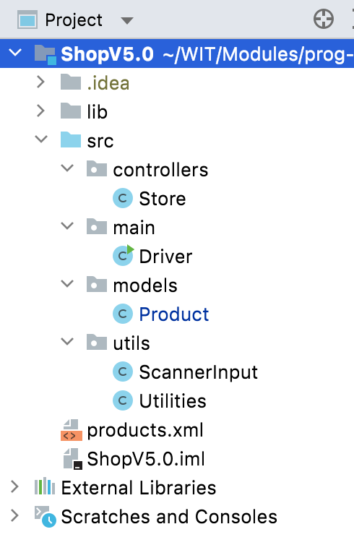
Utilities Class
package utils;
public class Utilities {
/**
* This method returns true if the numberToCheck is between min and max (both inclusive)
*
* @param numberToCheck The number whose range is being checked.
* @param min The minimum range number to check against (inclusive)
* @param max The maximum range number to check against (inclusive)
* @return Returns true if numberToCheck is between min and max (both inclusive), false otherwise.
*/
public static boolean validRange(int numberToCheck, int min, int max) {
return ((numberToCheck >= min) && (numberToCheck <= max));
}
}

Slide 6
Using the Utility method: validRange in the Product class.
package models;
import utils.Utilities;
public class Product {
private String productName = "";
private int productCode = -1;
private double unitCost = 0;
private boolean inCurrentProductLine = false;
public Product(String productName, int productCode, double unitCost, boolean inCurrentProductLine) {
this.productName = productName;
setProductCode(productCode);
this.unitCost = unitCost;
this.inCurrentProductLine = inCurrentProductLine;
}
public int getProductCode() {
return productCode;
}
public void setProductCode(int productCode) {
if (Utilities.validRange(productCode, 1000, 9999)) {
this.productCode = productCode;
}
}
}

Slide 7
Validating Strings Using Utilities

Slide 8
public class Product {
private String productName = "";
private int productCode = -1;
private double unitCost = 0;
private boolean inCurrentProductLine = false;
public Product(String productName, int productCode, double unitCost, boolean inCurrentProductLine) {
if (productName.length() <= 20){
this.productName = productName;
}else{
productName.substring(0,20);
}
setProductCode(productCode);
this.unitCost = unitCost;
this.inCurrentProductLine = inCurrentProductLine;
}
public void setProductName(String productName) {
if (productName.length() <= 20) {
this.productName = productName;
}
}
}
Product Class – validate productName without utility methods (to max of 20 chars).

Slide 9
Utilities Class – add two new methods
/**
* This method returns a string that was passed as a parameter, truncated to a specific length, also
* passed as a parameter. If the original String is less than the passed length, then the original string is just returned.
*
* @param stringToTruncate The string that will be truncated to a specific length
* @param length The length to which to truncate the string to
* @return The string truncated to a specific length
*/
public static String truncateString(String stringToTruncate, int length){
if (stringToTruncate.length() <= length) {
return stringToTruncate;
}
else{
return stringToTruncate.substring(0, length);
}
}
/**
* This method takes in a string, passed as a parameter and valdiates whether it is less than or equal to
* a specific length or not.
*
* @param strToCheck The string that will be checked to see if it is a specific length
* @param maxLength The length that the string will be validated against
* @return True if the string is less than or equal the max length and false otherwise.
*/
public static boolean validateStringLength(String strToCheck, int maxLength){
return strToCheck.length() <= maxLength;
}

Slide 10
import utils.Utilities;
public class Product {
private String productName = "";
private int productCode = -1;
private double unitCost = 0;
private boolean inCurrentProductLine = false;
public Product(String productName, int productCode, double unitCost, boolean inCurrentProductLine) {
this.productName = Utilities.truncateString(productName, 20);
setProductCode(productCode);
this.unitCost = unitCost;
this.inCurrentProductLine = inCurrentProductLine;
}
public void setProductName(String productName) {
if (Utilities.validateStringLength(productName, 20)) {
this.productName = productName;
}
}
Product Class – using two new methods to validate productName.

Slide 11

Any Questions?

