Slide 1


Programming Fundamentals
Inheritance: Introduction
Produced By:
Dr. Siobhán Drohan, Ms Mairead Meagher, Ms Siobhan Roche

Slide 2
Introduction to Inheritance in Java
Inheritance is a fundamental feature of object-oriented programming (OOP) that allows a class to inherit properties and behaviours from another class.
It promotes code reusability, extensibility, and organisation by allowing new classes to be built upon existing classes

Slide 3
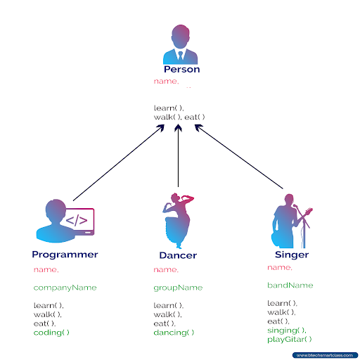
Basic Concept
Parent Class (Superclass/Base Class):
  Defines common properties and behaviours shared by multiple classes.
  Also referred to as superclass or base class.
Child Class (Subclass/Derived Class):
  Inherits properties and behaviours from the parent class.
  Can have its own additional properties and behaviours.
  Also referred to as subclass or derived class.

Slide 4
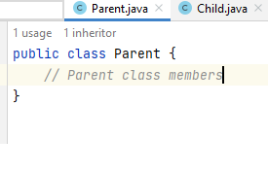
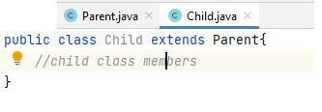
Syntax for Inheritance in Java
extends
Indicates that a class is inheriting from another class

Slide 5
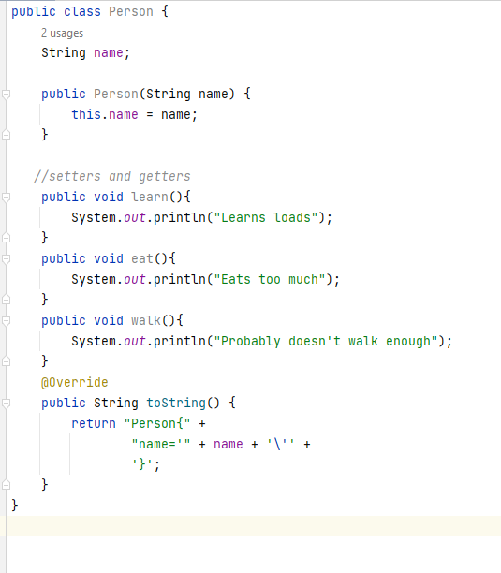
Example - Person

Slide 6
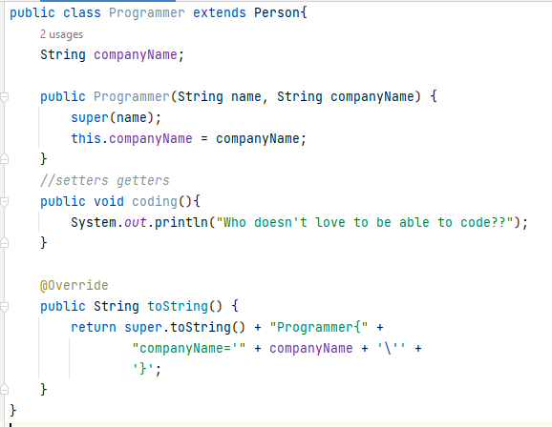
Example - Programmer

Slide 7
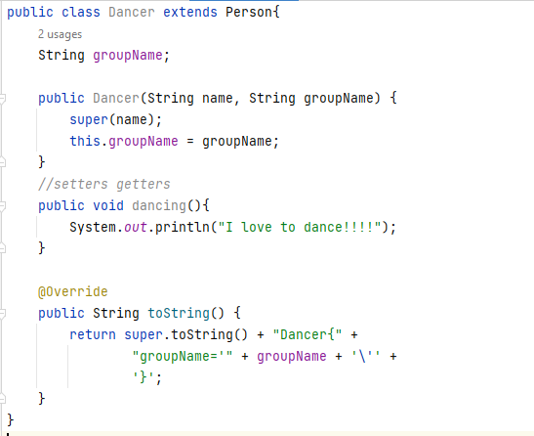
Example - Dancer

Slide 8
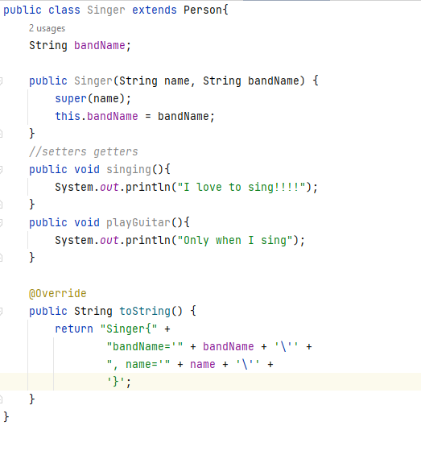
Example - Singer

Slide 9
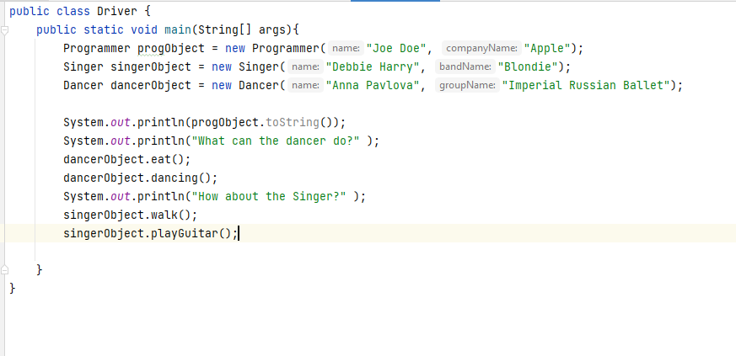
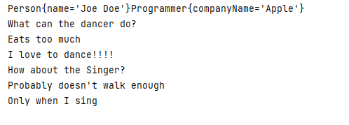
Example - Driver

Slide 10

Any Questions?

