Slide 1

toString() in Java
Short note on toString()
Produced
by:
Dr. Siobhán Drohan
Ms. Mairead Meagher
Ms. Siobhan Roche
Department of Computing and Mathematics
http://www.setu.ie/

Slide 2
Why toString()
What if we wish to print out the contents of an object?
We could just use getters wherever we need to access the values?
We have a better way…
toString()

Slide 3
toString()
We will start to write a toString() method for each class.
  It will be public
  It can be basic or complicated
Then other classes can get a ’string’ version of the object at any time.
This is useful if we wish to
  Examine an object’s value
  Print out an object for reporting purposes.

Slide 4
toString()
We will firstly write a toString() for a simple class (Spot)
Then we will develop a class (Spots) whose main function is to have an array of Spot.
  We will write a toString() for this collection
  This toString() uses the Spot toString()..

Slide 5
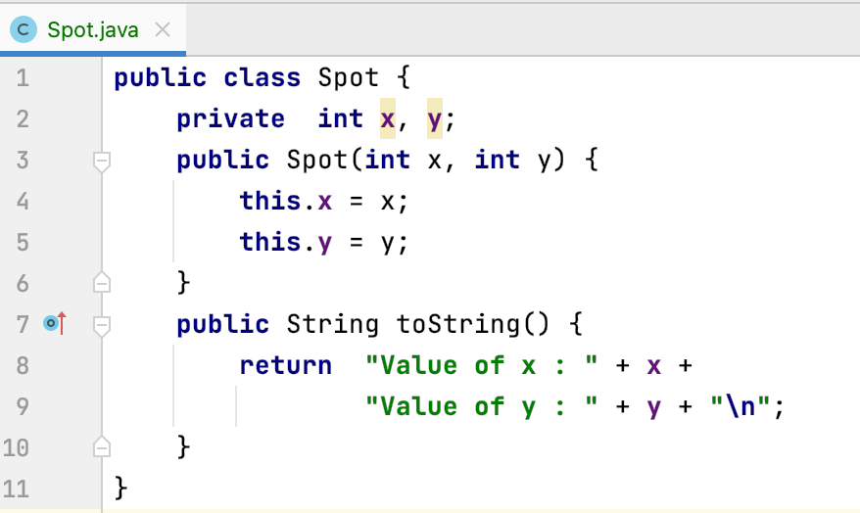
Ex 1. Example of toString() in Spot
Simple Spot Class – Note the toString()

Slide 6
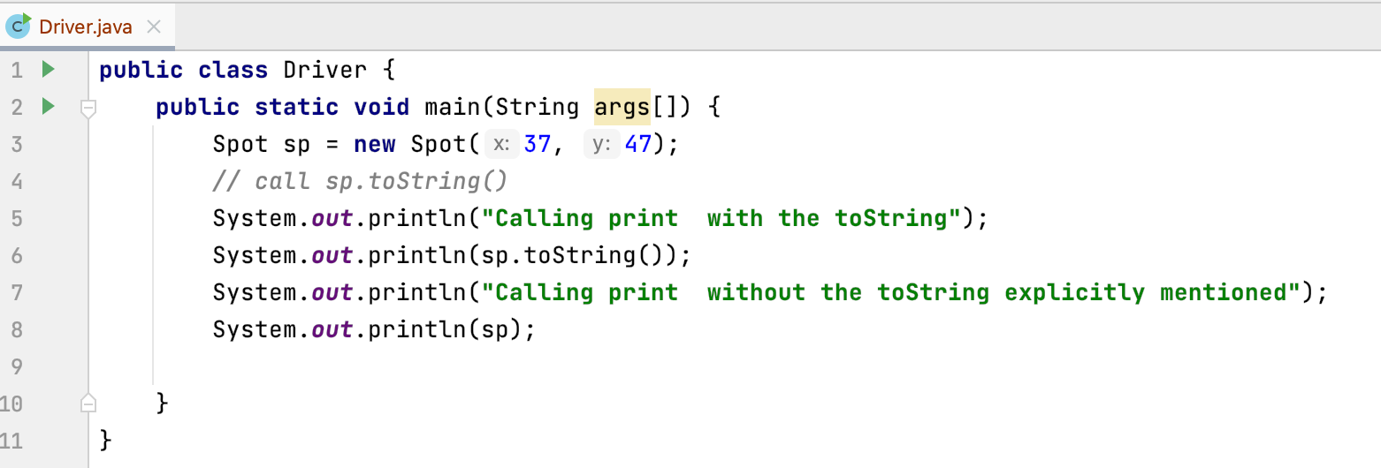
Ex 1. Using toString()
Driver Class using toString()

Slide 7
Ex 2. Example of toString() for a collection of Spots
Simple Spot Class – Note the toString() (no change)

Slide 8
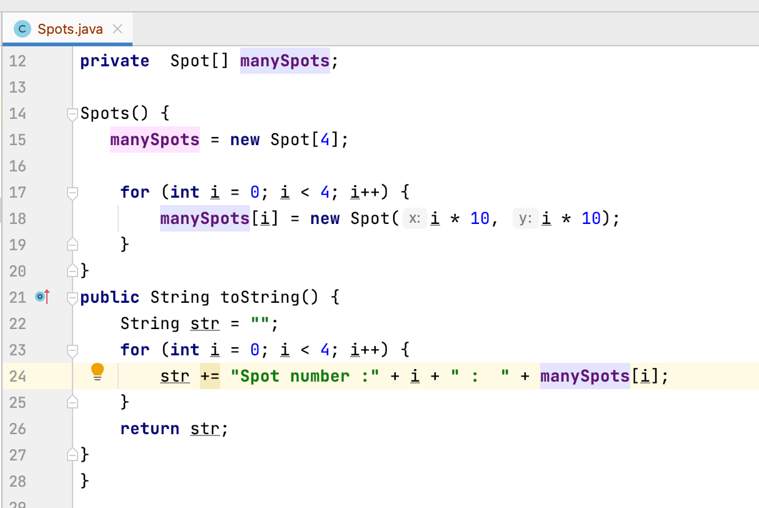
Ex 2. We introduce Spots which contains an array of Spot
Spots Class – Note the toString() – needs a loop)

Slide 9
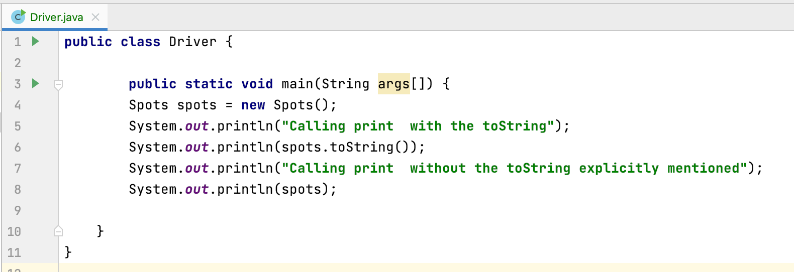
Using toString()
Driver Class using toString() on spots – note similarity

Slide 10

Questions?

Slide 11
References
Reas, C. & Fry, B. (2014) Processing – A Programming Handbook for Visual Designers and Artists, 2nd Edition, MIT Press, London.

