Slide 1

Inheritance
Improving Structure with Inheritance
Produced
by:
Dr. Siobhán Drohan
Mairead Meagher
Siobhan Roche
Department of Computing and Mathematics
http://www.wit.ie/

Slide 2
Introduction to Inheritance in Java
Inheritance is a fundamental feature of object-oriented programming (OOP) that allows a class to inherit properties and behaviours from another class.
It promotes code reusability, extensibility, and organisation by allowing new classes to be built upon existing classes
2

Slide 3
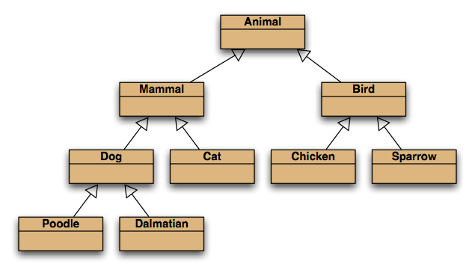
Inheritance hierarchies

Slide 4
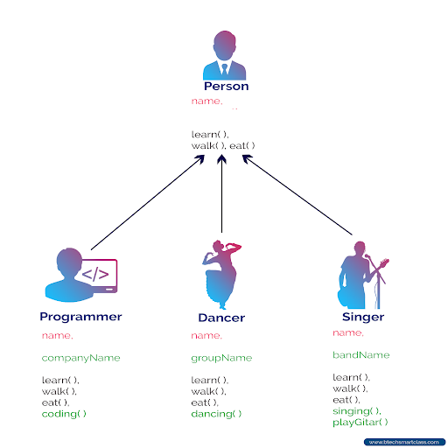
Basic Concept
Parent Class (Superclass/Base Class):
Defines common properties and behaviours shared by multiple classes.
Also referred to as superclass or base class.
Child Class (Subclass/Derived Class):
Inherits properties and behaviours from the parent class.
Can have its own additional properties and behaviours.
Also referred to as subclass or derived class.

Slide 5
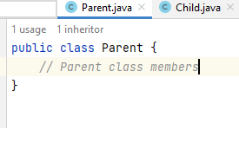
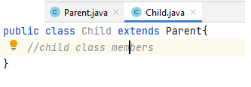
Syntax for Inheritance in Java
extends
Indicates that a class is inheriting from another class

Slide 6
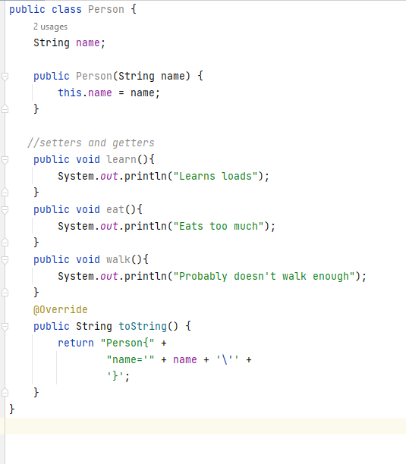
Example - Person

Slide 7
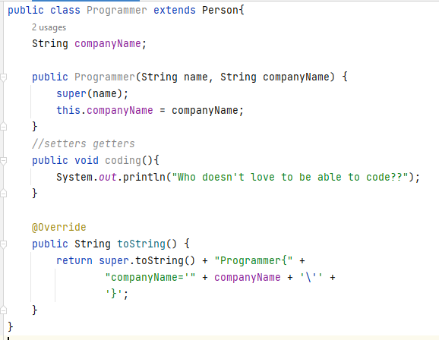
Example - Programmer

Slide 8
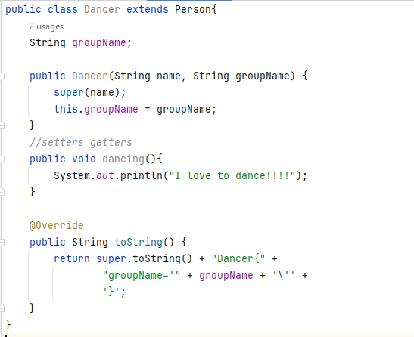
Example - Dancer

Slide 9
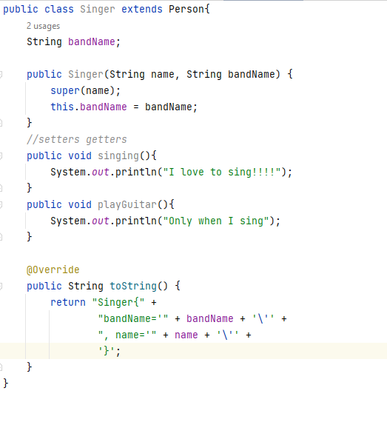
Example - Singer

Slide 10
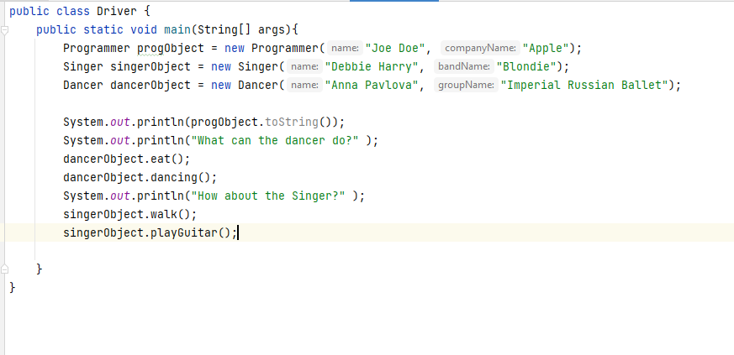
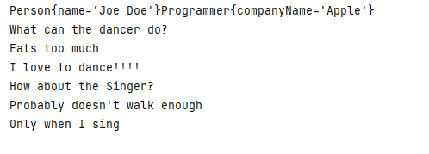
Example - Driver

Slide 11

Any Questions?

