Slide 1


Programming Fundamentals
Inheritance: Improving Structure
Produced
by:
Dr. Siobhán Drohan
Ms. Mairéad Meagher
Ms Siobhan Roche

Slide 2


Agenda
Social Network

Slide 3

Lectures & Labs
This weeks lectures and labs are based on examples in:
Objects First with Java - A Practical Introduction using BlueJ, © David J. Barnes, Michael Kölling

Slide 4
Social Network V3.0 - Recap
A small, prototype SOCIAL NETWORK.
Supports a News Feed with posts.
POSTS:
MessagePost:
multi-line text message.
Operations
e.g., add, display and remove.

Slide 5
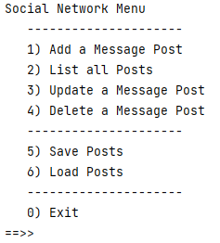
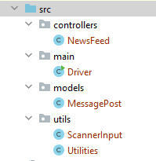
Social Network V3.0 - Recap

Slide 6
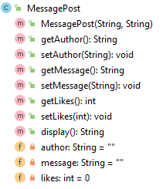
Social Network V3.0 - Recap

Slide 7
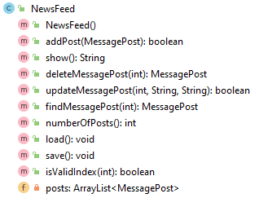
Social Network V3.0 - Recap

Slide 8
Social Network
This is my first post
This is my second post
Text
Posts
This is my third post
This is my fourth post
Notes:
First tweet , Jack Dorsey : Mar 21, 2006
First Insta, July 16th 2010, Mike Krieger, Co-Founder

Slide 9
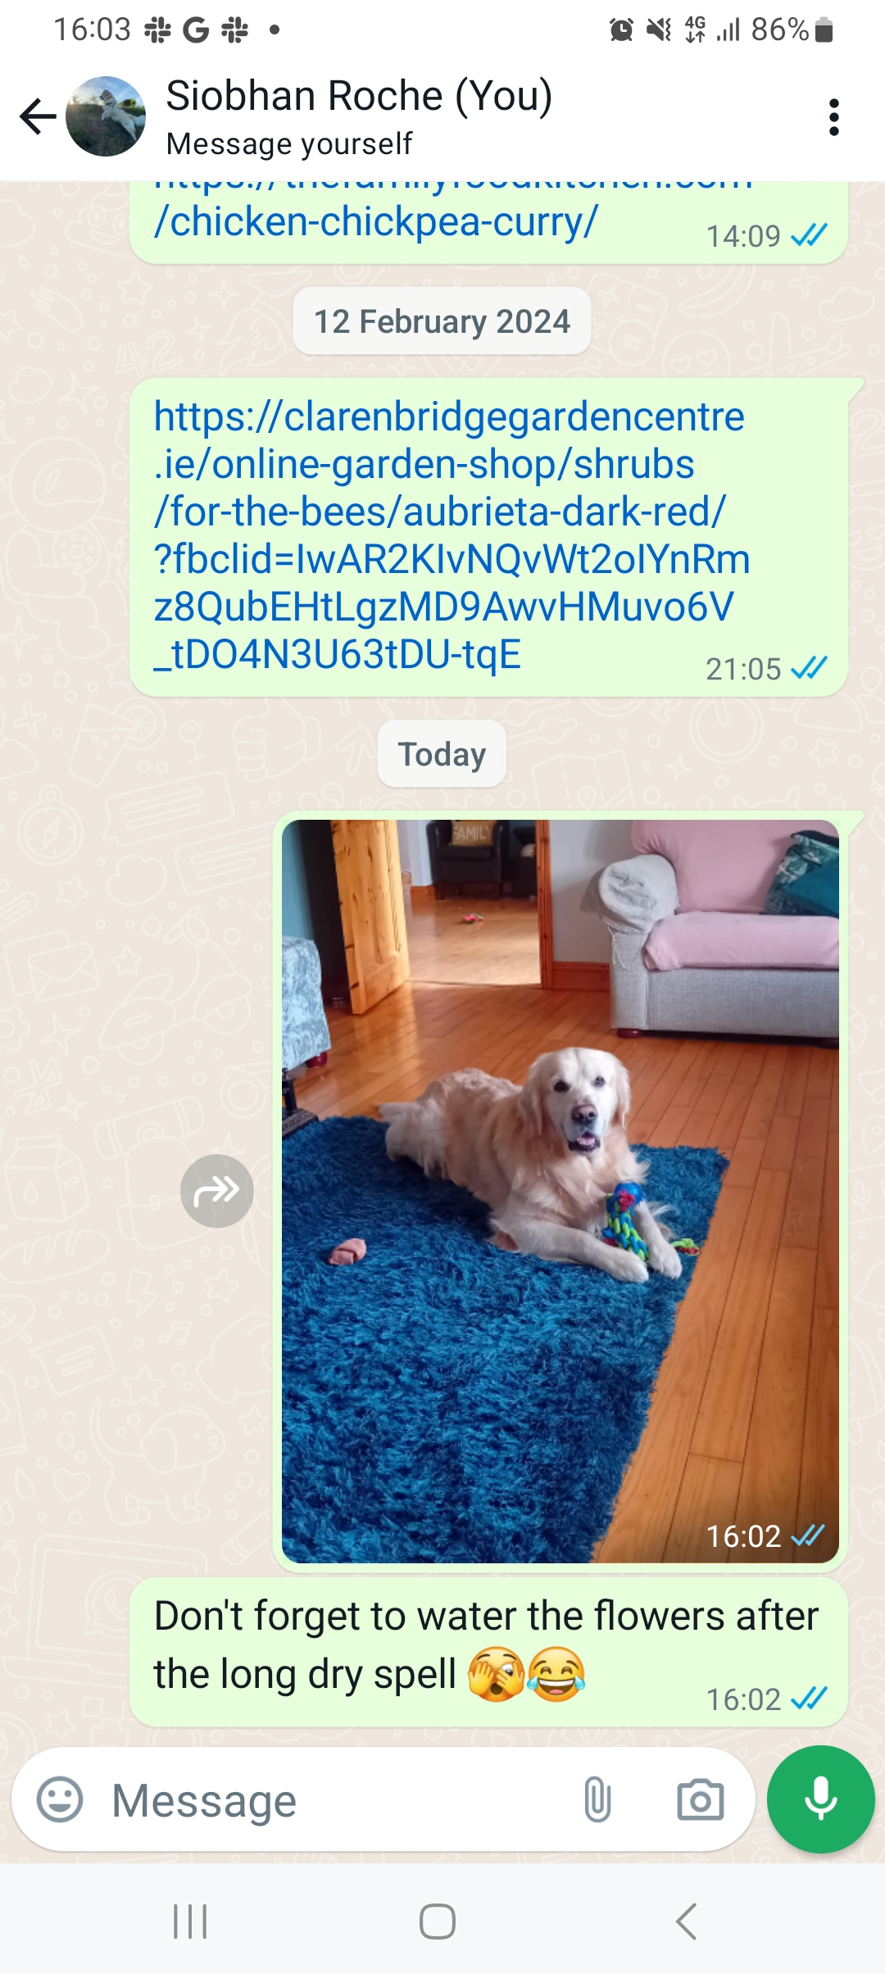
Social Network v4.0 let’s move it on!
A small, prototype SOCIAL NETWORK.
Supports a News Feed with posts.
POSTS:
MessagePost:
multi-line text messages.
PhotoPost:
photo and caption.
Operations
e.g., search, display and remove.
Notes:
API: Application Programmers’ Interface

Slide 10

Social Network
This is my first post
Photo
First post
Text
Posts
This is my third post
This is my fourth post
Notes:
First tweet , Jack Dorsey : Mar 21, 2006
First Insta, July 16th 2010, Mike Krieger, Co-Founder

Slide 11
Social Network V4.0 – Class Diagram
Driver
NewsFeed
MessagePost
This is my first post
PhotoPost
First post
Notes:
class diagram is simple (ArrayList not shown in BlueJ)

Slide 12
Social Network V4.0 – Two Object Types
MessagePost
PhotoPost
author
""
author
""
message
""
caption
""
likes
0
filename
""
First post
likes
0
This is my first post
MessagePost: multi-line text message.
PhotoPost: photo and caption.
Notes:
one object per post; each object stores details for one particular post.

Slide 13
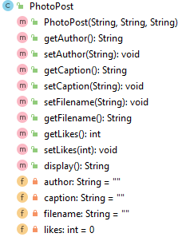
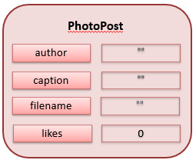
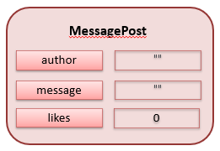
Social Network V4.0 – Class Structure

Slide 14
Social Network V4.0 – Class Structure
author: code duplication

Slide 15
Social Network V4.0 – Class Structure
likes: code duplication

Slide 16
Social Network V4.0 – CRUD on TWO ArrayLists
ArrayList<MessagePost>
NewsFeed
messages
:MessagePost
:MessagePost
:MessagePost
:MessagePost
photos
ArrayList<PhotoPost>
:PhotoPost
:PhotoPost
:PhotoPost
:PhotoPost
Notes:
Newsfeed object will hold two collections: one for MessagePosts, one for PhotoPosts

Slide 17
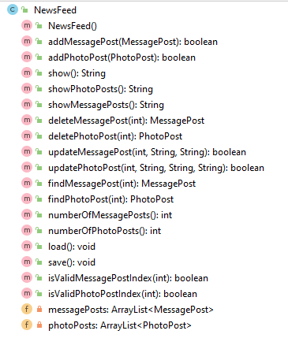
Social Network V3.0 versus V4.0 (NewsFeed)
V4.0
V3.0

Slide 18
Social Network V3.0 versus V4.0 (NewsFeed)
V4.0
V3.0
To handle the two ArrayLists, our NewsFeed methods have grown significantly e.g. delete now has two methods!

Slide 19
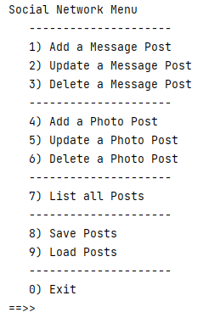
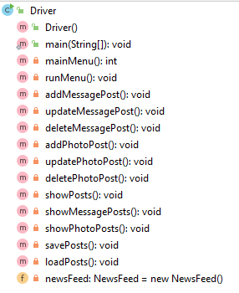
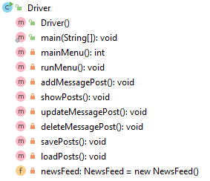
Social Network V3.0 versus V4.0 (Driver)
V4.0
V3.0

Slide 20
Social Network V3.0 versus V4.0 (Driver)
V4.0
V3.0
To handle the two ArrayLists, we have added new Driver methods and new options on the menu

Slide 21
Shop Network V4.0 – NewsFeed – show() method
public String show() { String str = ""; for(MessagePost messagePost : messagePosts) { str += messagePosts.indexOf(messagePost) + ": " + messagePost.display() + "\n"; } for(PhotoPost photoPost : photoPosts) { str += photoPosts.indexOf(photoPost) + ": " + photoPost.display() + "\n"; } if (str.isEmpty()){ return "No Posts"; } else { return str; } }
public class NewsFeed { private ArrayList<MessagePost> messagePosts; private ArrayList<PhotoPost> photoPosts;

Slide 22
Shop Network V4.0 – NewsFeed – show() method
Problem: The posts are not displayed in the order they were added, all the messages are displayed first, followed by the photos.
public String show() { String str = ""; for(MessagePost messagePost : messagePosts) { str += messagePosts.indexOf(messagePost) + ": " + messagePost.display() + "\n"; } for(PhotoPost photoPost : photoPosts) { str += photoPosts.indexOf(photoPost) + ": " + photoPost.display() + "\n"; } if (str.isEmpty()){ return "No Posts"; } else { return str; } }
This is my first post
This is my 2nd post
This is my 3rd post
First Post
public class NewsFeed { private ArrayList<MessagePost> messagePosts; private ArrayList<PhotoPost> photoPosts;
Second Post

Slide 23
Critique of Social Network V4.0
Code duplication:
MessagePost and PhotoPost classes very similar (large parts are identical)
makes maintenance difficult/more work
introduces danger of bugs through incorrect maintenance
Code duplication in NewsFeed and Driver classes as well.
We need a better solution → Inheritance!
Notes:
we note a lot of code duplication.
this is one problem with this solution (there are others)

Slide 24
Now Let’s Introduce Inheritance!

