Slide 1


Dr. Siobhán Drohan (siobhan.drohan@setu.ie),
Mairead Meagher(mairead.Meagher@setu.ie)
Produced by:
Source:
https://www.linkedin.com/learning/learning-github?u=57077417

Slide 2

Version Control
What is git

Slide 3
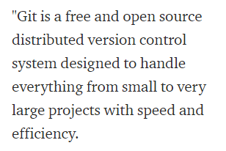
Developed by Linus Torvalds
https://www.linkedin.com/learning/learning-github/what-is-git

Slide 4
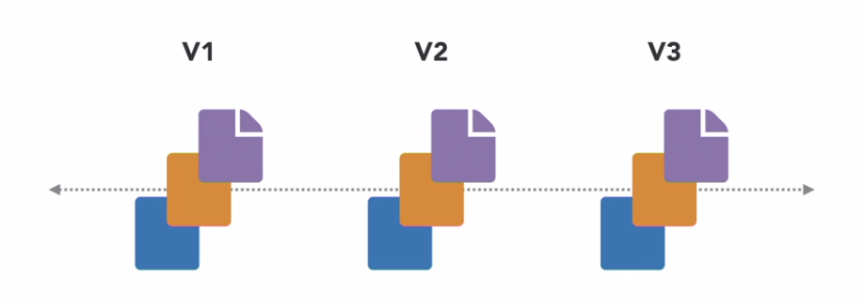
A Version Control System (VCS) is software designed to record changes made to a file or set of files over time.
https://www.linkedin.com/learning/learning-github/what-is-git

Slide 5
A Version Control System (VCS) is software designed to record changes made to a file or set of files over time.
This gives you the ability to revert or recall changes to a file, or set of files after you have made them.
https://www.linkedin.com/learning/learning-github/what-is-git

Slide 6

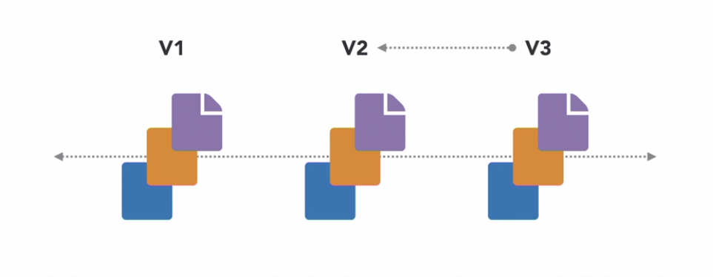
If you want to go back to a version, you can revert one file to a previous version, or a selection of files to their previous versions, or even the entire project back to a specific version in time.
https://www.linkedin.com/learning/learning-github/what-is-git

Slide 7
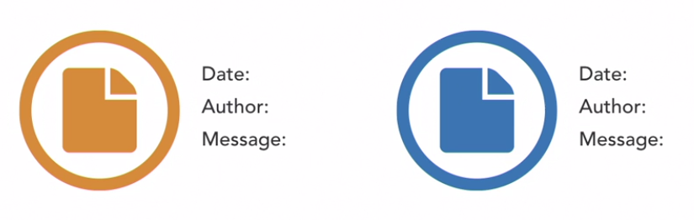
You can see what changes were made between files e.g.:
When the change was introduced
Who introduced the change
What was changed
Why was it changed
https://www.linkedin.com/learning/learning-github/what-is-git

Slide 8

You can version control any type of file on git, not just source code files:
https://www.linkedin.com/learning/learning-github/what-is-git

Slide 9
Basics of git - 1
Git is a the version control system. Git manages all the repo’s history, etc.
When using Git, we have a Git repository (repo) which contains:
Source code and any other files
Files needed to keep the information of the various versions
(these are contained in the hidden .git subdirectory)
The user works away on the local repo.
Usually (but not necessarily), the user will also use a remote server so that
They can backup their work;
They can publish their work;
They can share their work with collaborators. This sharing is the most productive
use of Git but as a starting point, not necessary.

Slide 10
Basics of git - 2
To see a very good intro on git , see here :
https://www.freecodecamp.org/news/learn-the-basics-of-git-in-under-10-minutes-da548267cc91/

Slide 11
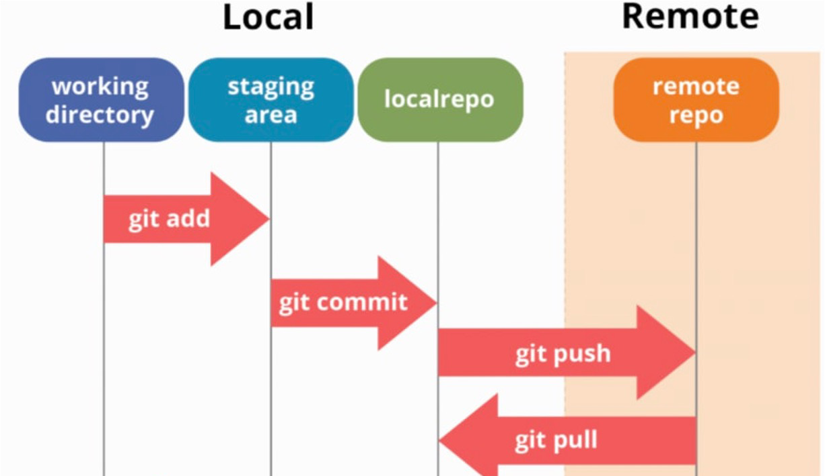
Basics of git - 3
Basic commands

Slide 12

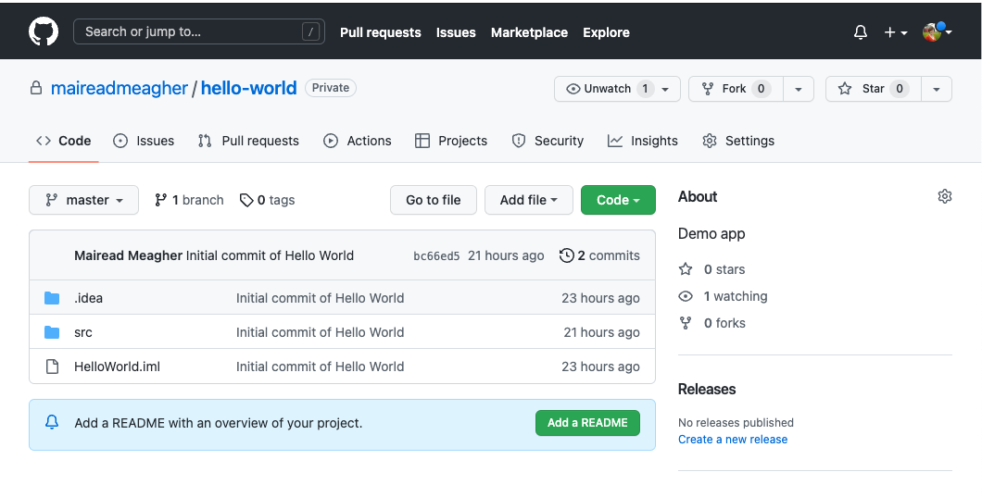

Slide 13
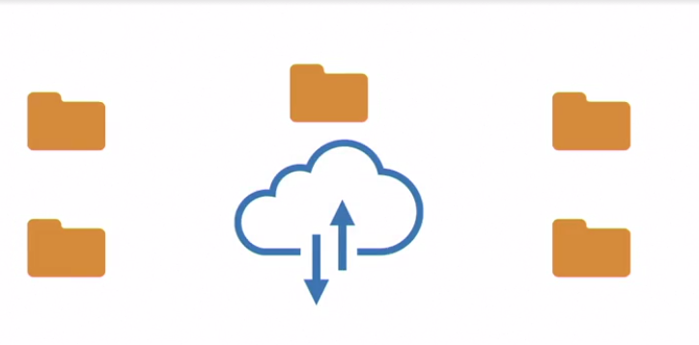

Distributed Version Control allows for collaboration.
Each client fully mirrors the project by pulling down the entire repository.
https://www.linkedin.com/learning/learning-github/what-is-git

Slide 14

Distributed Version Control allows for collaboration.
Each client fully mirrors the project by pulling down the entire repository.
Everyone has a local copy of the entire project history → full back up.
https://www.linkedin.com/learning/learning-github/what-is-git

Slide 15
A tour of a repository
https://github.com/atom/github

Slide 16
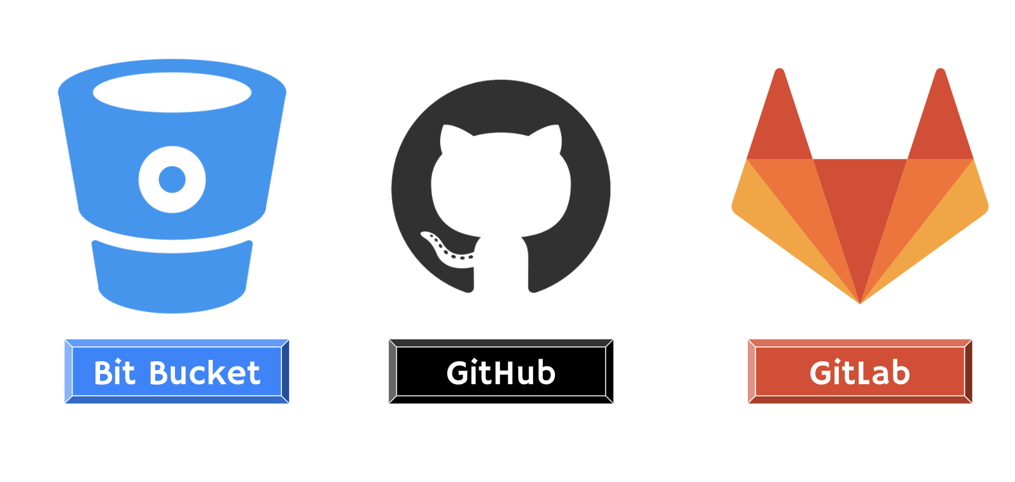
Hosting services for Git repositories
https://medium.com/swlh/what-do-i-need-to-know-about-git-5017bde0b572

Slide 17
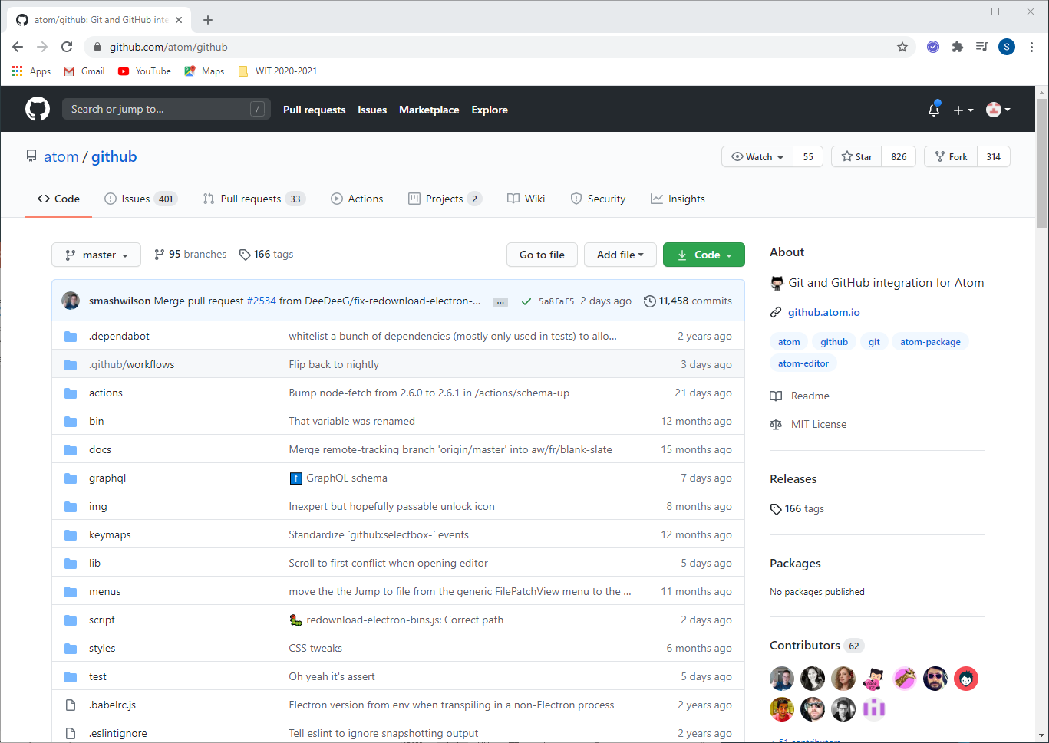
Code View
All files and folders in project.
Can edit file contents via GitHub UI.

Slide 18
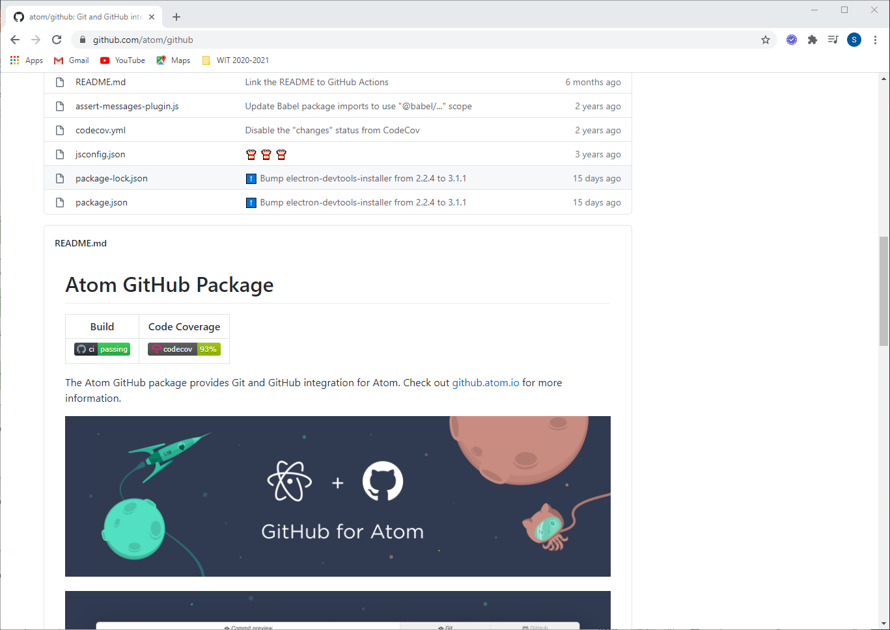
Code View
README.md file is displayed after files and folders

Slide 19
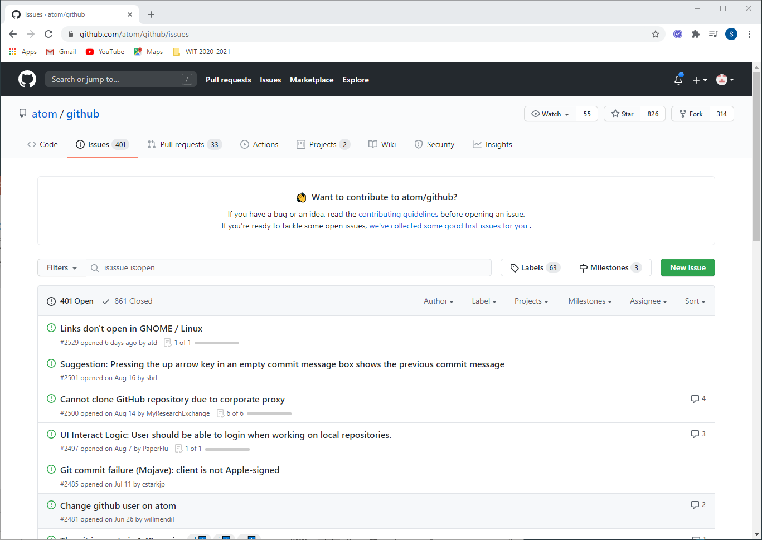
Issues View
Used to track bugs, feature requests, etc.
Can be assigned to specific members/ teams.
No code changes are attached.

Slide 20
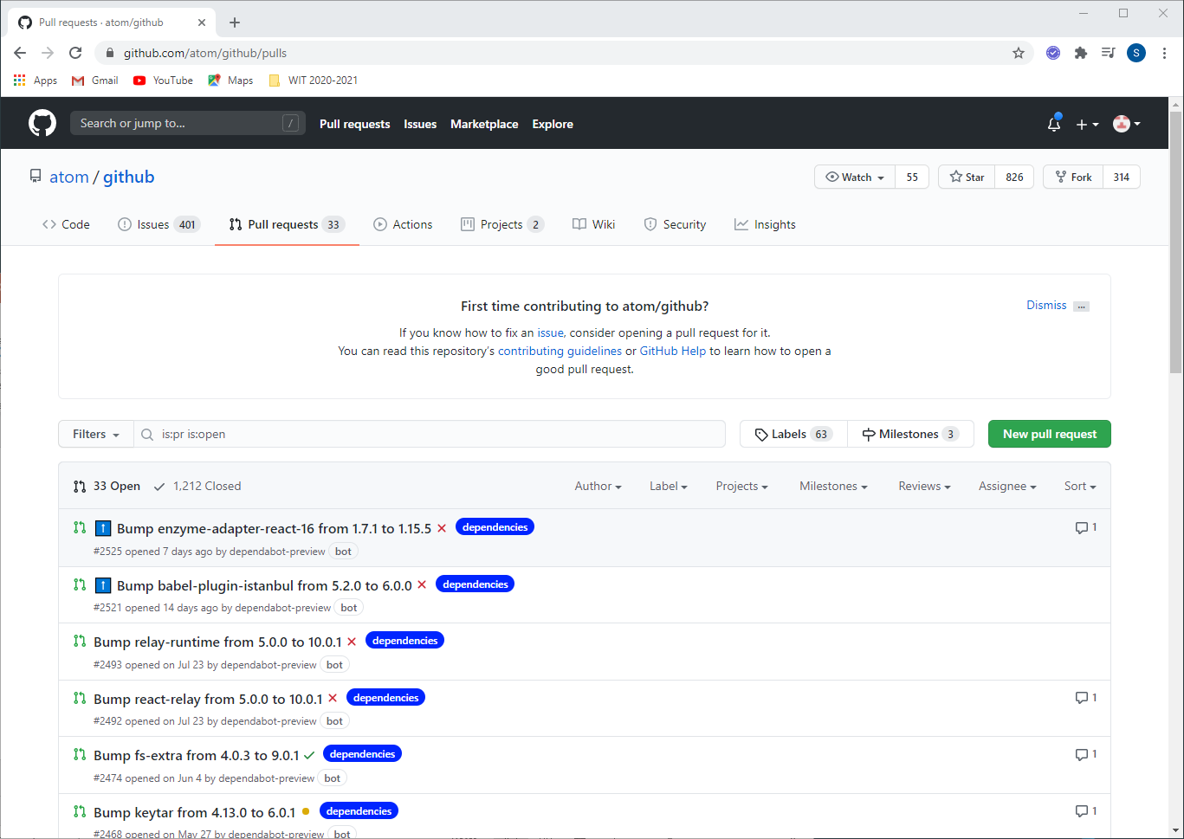
Pull Requests
Represents a change, such as adding, deleting, updating files that the author of the repo wants to make.
It includes code changes.

Slide 21
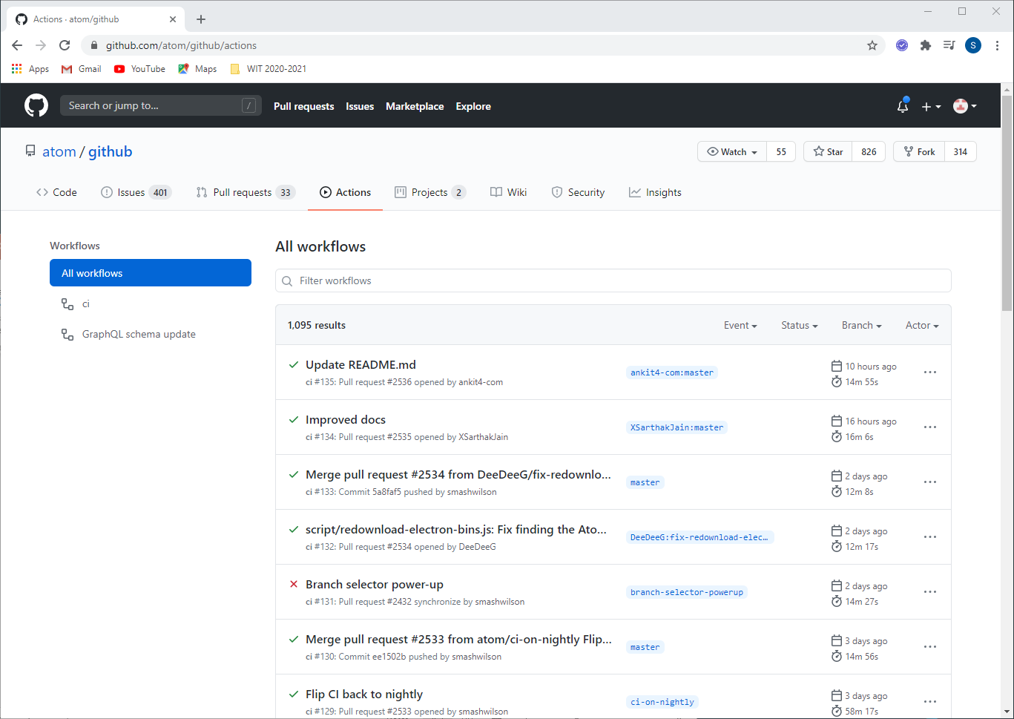
Actions
Allows you to automate your workflows with CI/CD. You can build, test and deploy your code from GitHub.
https://github.com/features/actions

Slide 22
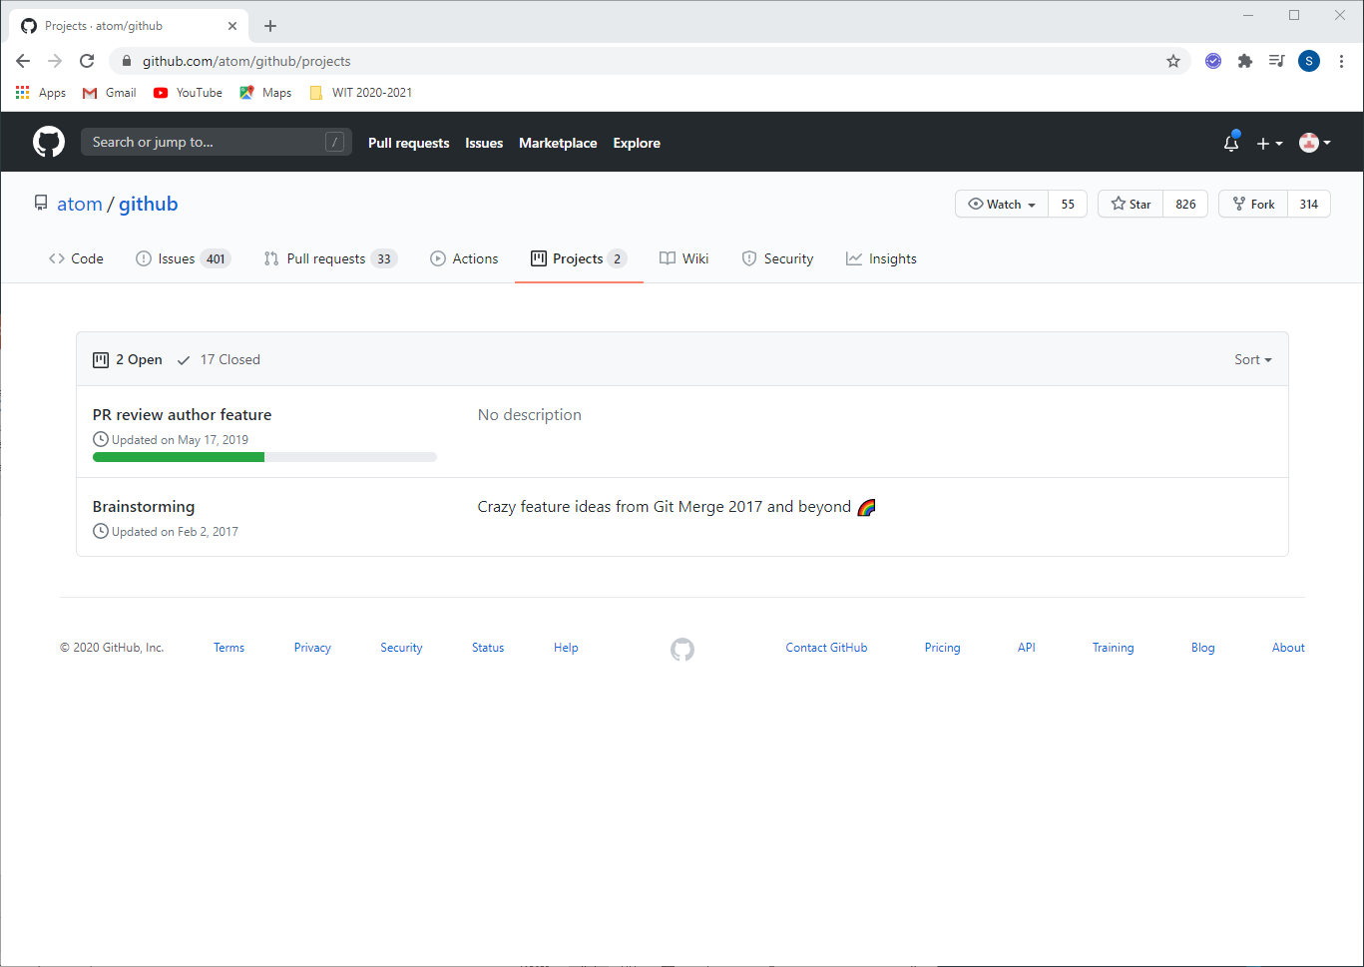
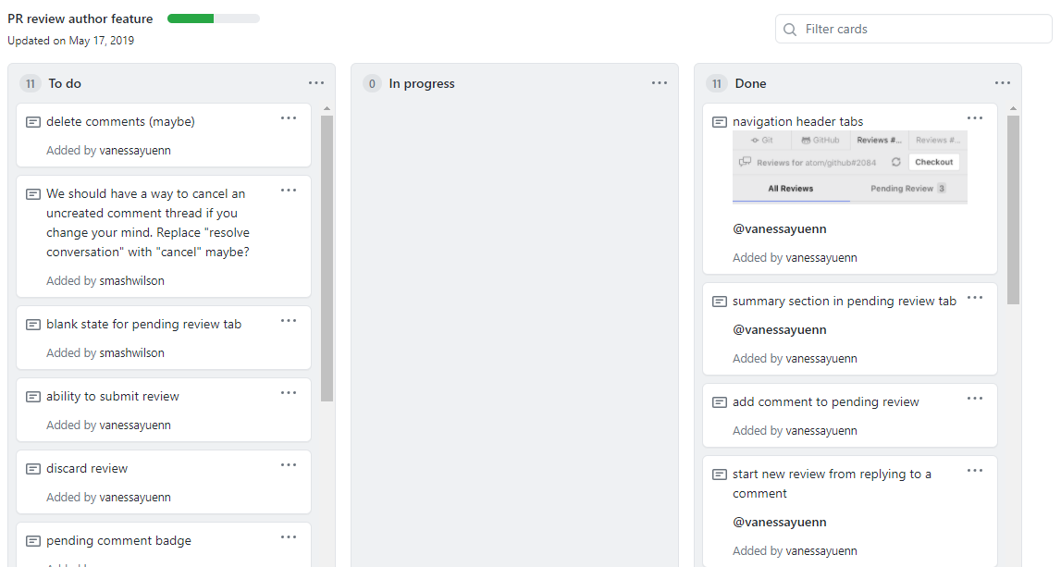
Projects
Allows you to visualise your work with Kanban-style boards.
No code changes here!

Slide 23
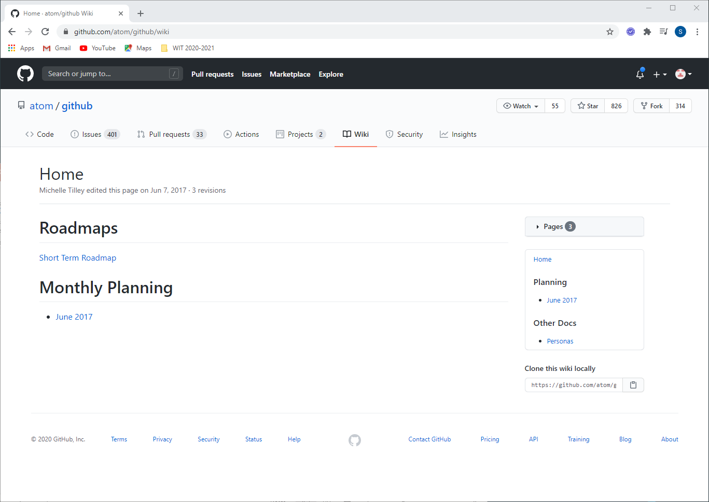
Wiki
Documentation you can add to your project.

Slide 24
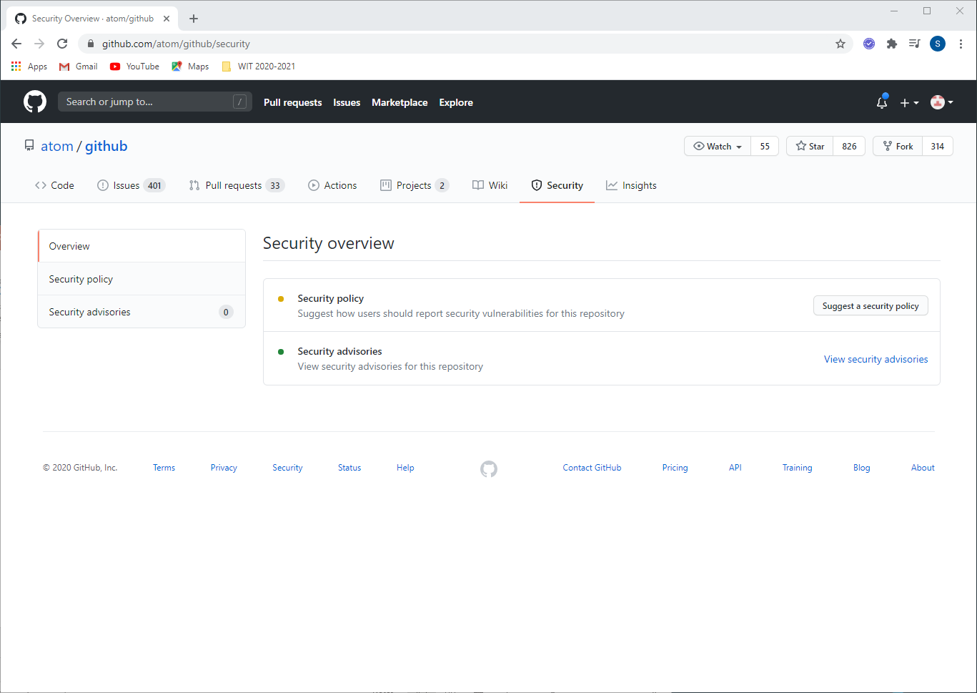
Security
You can give instructions on how to responsibly report a security vulnerability in your project. You can also view any security advisories for your repo.
https://docs.github.com/en/free-pro-team@latest/github/managing-security-vulnerabilities/managing-security-vulnerabilities-in-your-project

Slide 25
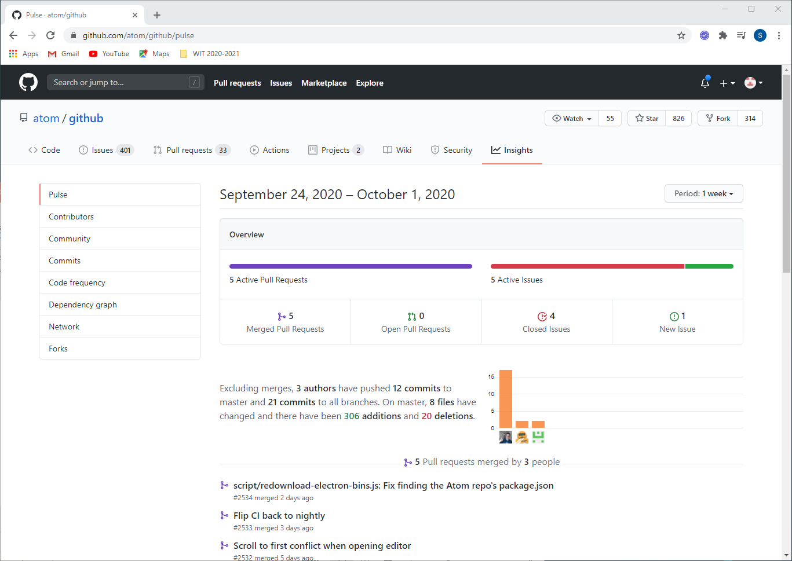
Insights
High level overview of the health / pulse of your repo.

Slide 26
We will see how IntelliJ integrates GitHub into our projects.

Slide 27

Any questions?

