Slide 1

Introducing groups of classes
Arrays Revisited
Produced
by:
Dr. Siobhán Drohan
Ms. Maireád Meagher
Ms. Siobhan Roche
Department of Computing and Mathematics
http://www.setu.ie/

Slide 2
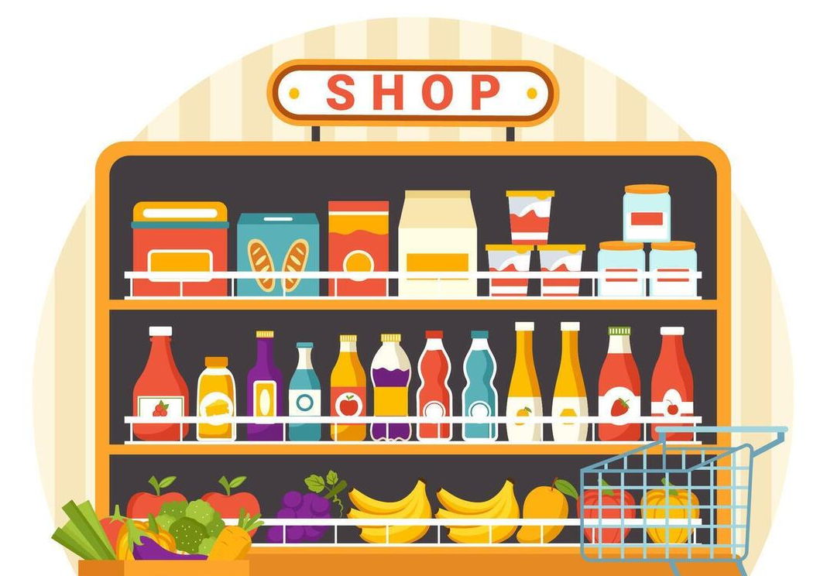
A Shop with one Product isn’t really that great, we need to be able to have multiple products

Slide 3
How about an Array of Products?

Slide 4
An array can store any type of data.
Primitive Types
int numbers[] = new int[10];
byte smallNumbers[] = new byte[4];
char characters[] = new char[26];
Object Types
String[] words = new String[4];
Product products[] = new Product[10];

Slide 5
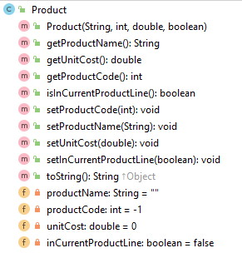
Product Class
Object Type/ Class Name
Methods
i.e. the behaviours of the class
Fields
i.e. the attributes of the class

Slide 6
Structure of a Product primitive array
Product[] products;
products
null

Slide 7
Structure of a Product primitive array
Product[] products;
products
products = new Product[4];
0 | null
1 | null
2 | null
3 | null

Slide 8
Structure of a Product primitive array
Product[] products;
products
productName
“TV”
productCode
123
products = new Product[4];
12.99
unitCost
inCurrentProductLine
true
0 | null
1
2 | null
3 | null
products[1] = new Product(“TV”, 123, 12.99, true);

Slide 9
Example using a Product object array
public String listProducts() {
String listOfProducts = "";
for (int i = 0; i < total; i++) {
listOfProducts += i + ": " + products[i].toString() + "\n";
}
return listOfProducts;
}
}
Returns a String containing all the products stored in the primitive array.

Slide 10
Arrays in Java
Fixed size — must know size in advance
Stored sequentially in memory
Useful for simple, fixed collections of data
Limitations: no automatic resizing, limited built‑in methods

Slide 11
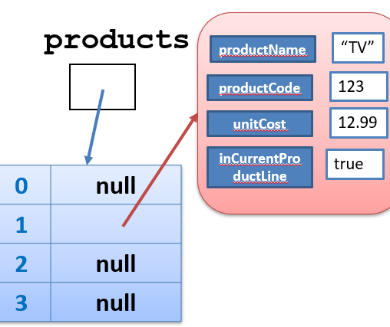
Why Not Always Arrays?
Adding/removing elements is difficult
No built‑in search, sort, or utilities
Errors occur when guessing array size
Collections solve these limitations

Slide 12
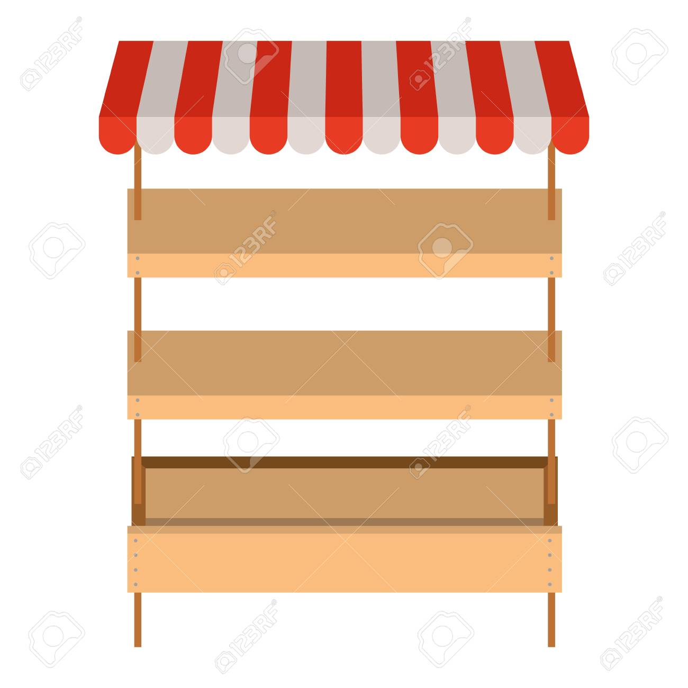
When to Use an ArrayList
When the number of items changes over time
When convenient operations matter
When modelling real-world lists of objects

Slide 13
Shop Program Evolution
Current: Driver → Product
Next: Driver → Store → Product
Store will manage a collection of Products
ArrayList<Product> is ideal because the number of products can grow

Slide 14
Why ArrayList for Store?
Store needs to:
    add products
    remove products
    search products
    list products
ArrayList provides simple, clean methods to support all of this

Slide 15

Questions?

